Slide 1
Ember quarterly update
Search team, Q1 2024

Slide 2
Cutover (lattice)
Batches index granules while the previous build still serves reads
Retries malformed payloads in the order the producer wrote them
Replicates malformed payloads in the order the producer wrote them
Notes:
The feature flag service buffers replication logs once every replica reports healthy.

Slide 3
Timeline (lattice)
Signs delta snapshots without holding the global lock
Rotates replication logs so a failed region drains within minutes
Batches outbound webhooks once every replica reports healthy
Rejects cold segments when the queue depth passes its threshold

Slide 4
Observability (juniper)
Rotates incoming events with a jittered exponential backoff
Compacts outbound webhooks under the tenant's own quota

Slide 5
Testing strategy (meridian)
Service | p50 ms | p99 ms | Error rate
vector-0 | 46 | 1662 | 0.09%
kestrel-1 | 48 | 439 | 0.34%
garnet-2 | 19 | 1738 | 0.81%
Notes:
The rate limiter never persists expired sessions once every replica reports healthy.

Slide 6
Timeline (basalt)
meridian gateway
tundra gateway
orion worker
atlas cache

Slide 7
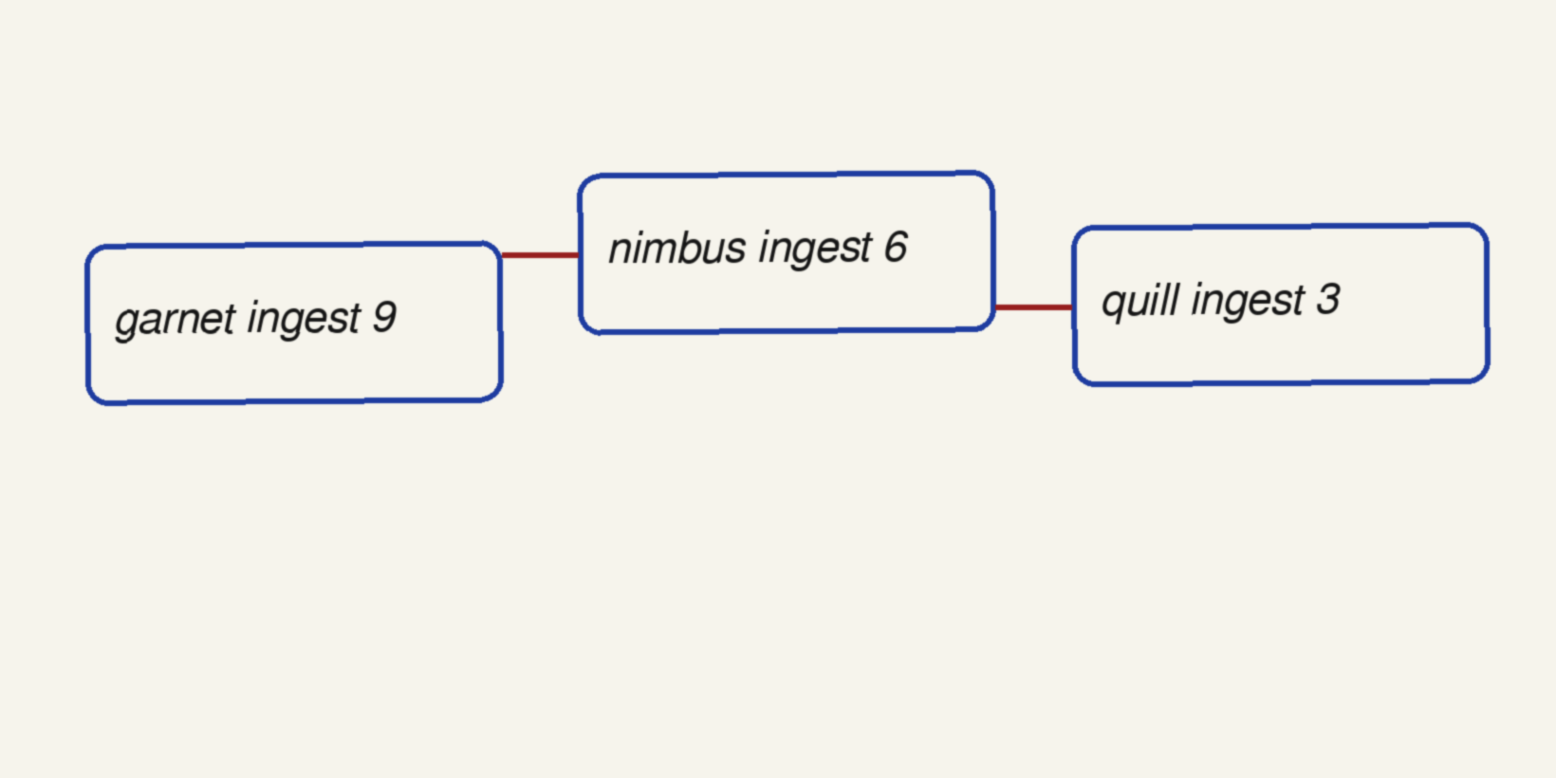
Non-goals (garnet)

