Slide 1
Superstore Performance Overview
Executive Dashboard Summary & Key Business Insights

Slide 2
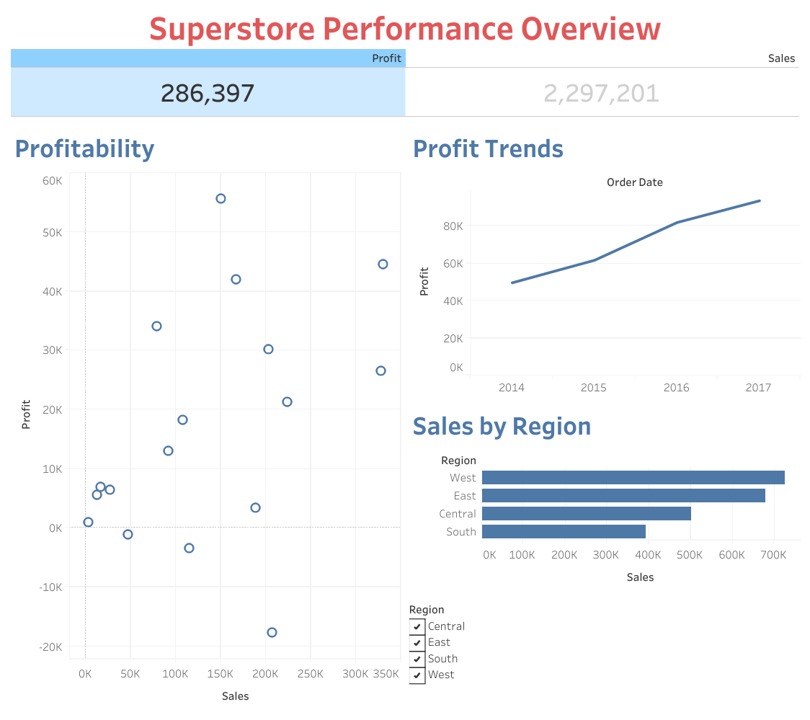
High-Level KPIs & Trends
Total Sales: 2,297,201.
Total Profit: 286,397.
Growth Trajectory: Overall profitability demonstrates a consistent, upward trend year-over-year from 2014 through 2017.

Slide 3
Regional Performance & Profitability Outliers
Top Performing Territory: The West region leads all other territories in total sales volume, followed closely by the East.
Profitability Warning Signs: While the overall trend is highly positive, the profitability scatter plot identifies several high-sales item clusters that are actively generating negative profit (falling below the 0K line). This indicates an immediate need for pricing adjustments or cost-cutting in those specific sub-categories.

