Slide 1
EE0005 DSAI Mini Project
Group Yellow
Clifford, Joel, Mabel

Slide 2
Dataset
What’s Cooking? (from Kaggle)
Largely categorical data

Slide 3
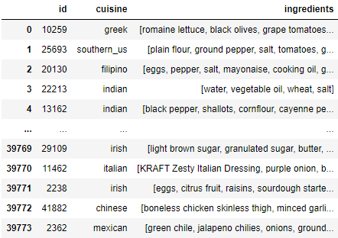
Notes:
we were given a set of data with
the list of ingredients for each dish
and its type of cuisine

Slide 4
Problem
Find the type of cuisine given a recipe.
Classification
Multi-variate

Slide 5
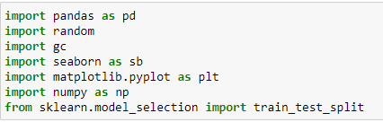
Basics - Importing essential libraries
Notes:
as per normal, we start of with the basics by importing the essential libraries
we will be using pandas, seaborn, matplot and numpy, the default libraries for jupyter notebook input

Slide 6
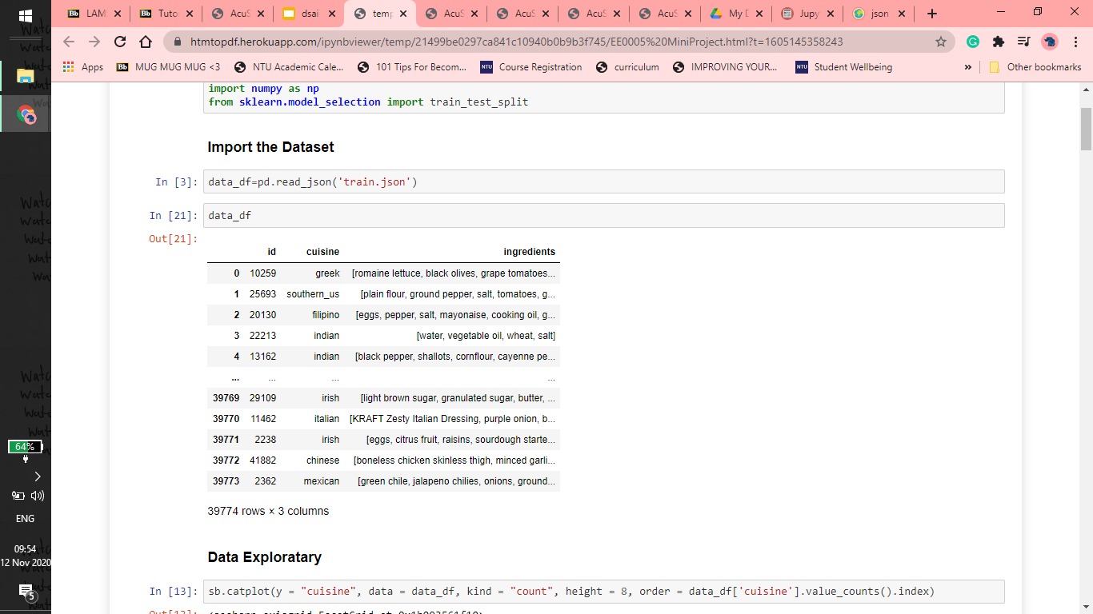
Basics - Importing the Dataset
Notes:
next, we import the data set which is in the JSON file format and thus we use read_json.
this is the visualisation of how the file looks like, a table with mixed typed data

Slide 7
Data Exploring

Slide 8
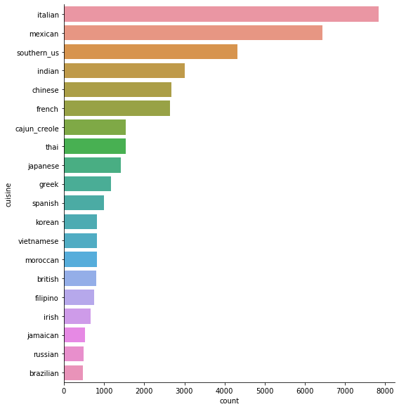
No. of Dishes by Cuisine Type
Type of Cuisine against
Number of Dishes (Count)
Notes:
sb.catplot(y = "cuisine", data = data_df, kind = "count", height = 8, order = data_df['cuisine'].value_counts().index)

Slide 9
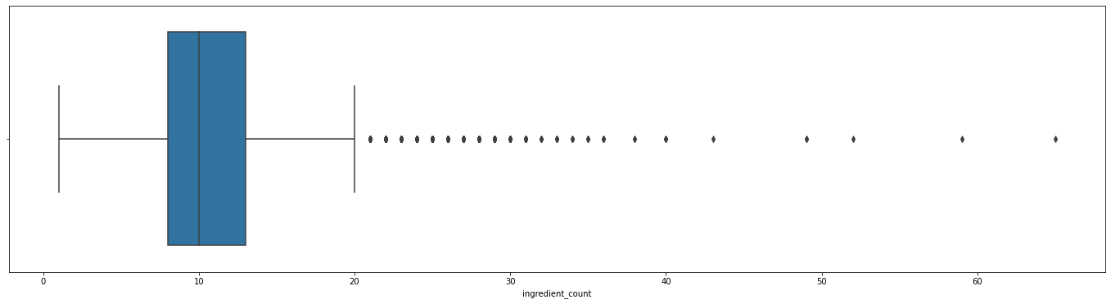
Boxplot of Dishes by Ingredient Count
A handful of outliers; most dishes seem to have between 8 to 13 ingredients
Notes:
as confirmed in the histogram in the next slide

Slide 10
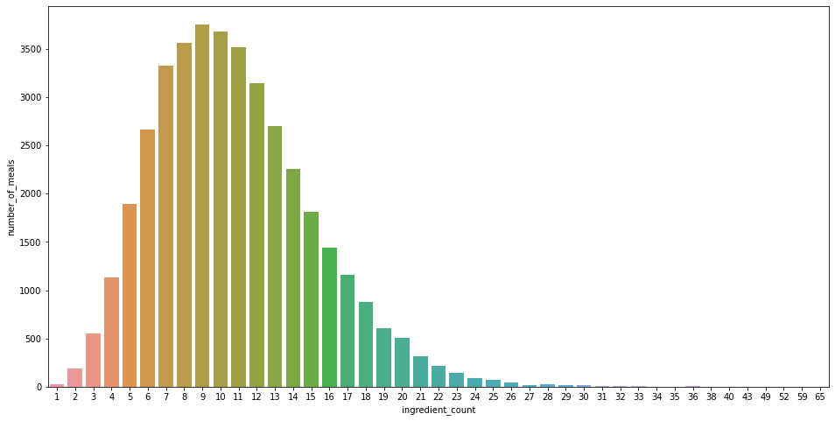
No. of Dishes by Ingredient Count
Number of Dishes against
Number of Ingredients used in each dish

Slide 11
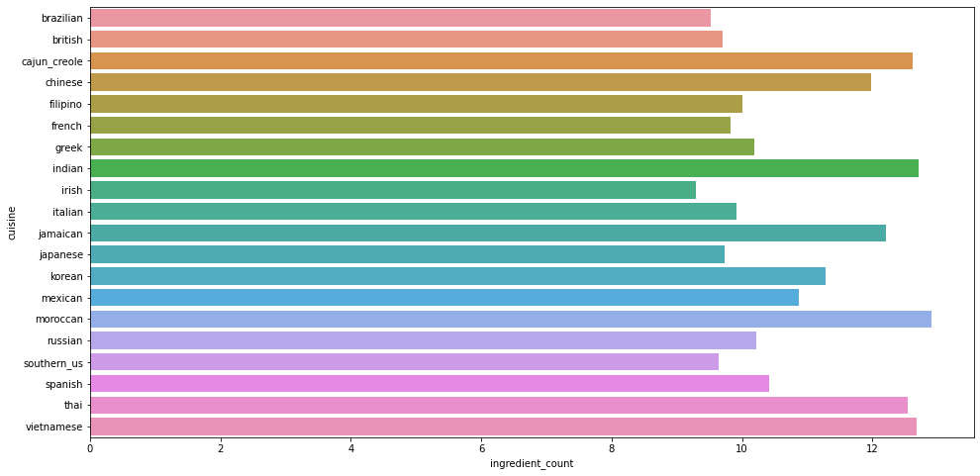
Average Ingredient Count per Dish by Cuisine Type
No clear trend

Slide 12
Data Cleaning
One-hot encoding
hard to work with abstract categorical labels
Did not use label encoding
features are not ordered

Slide 13
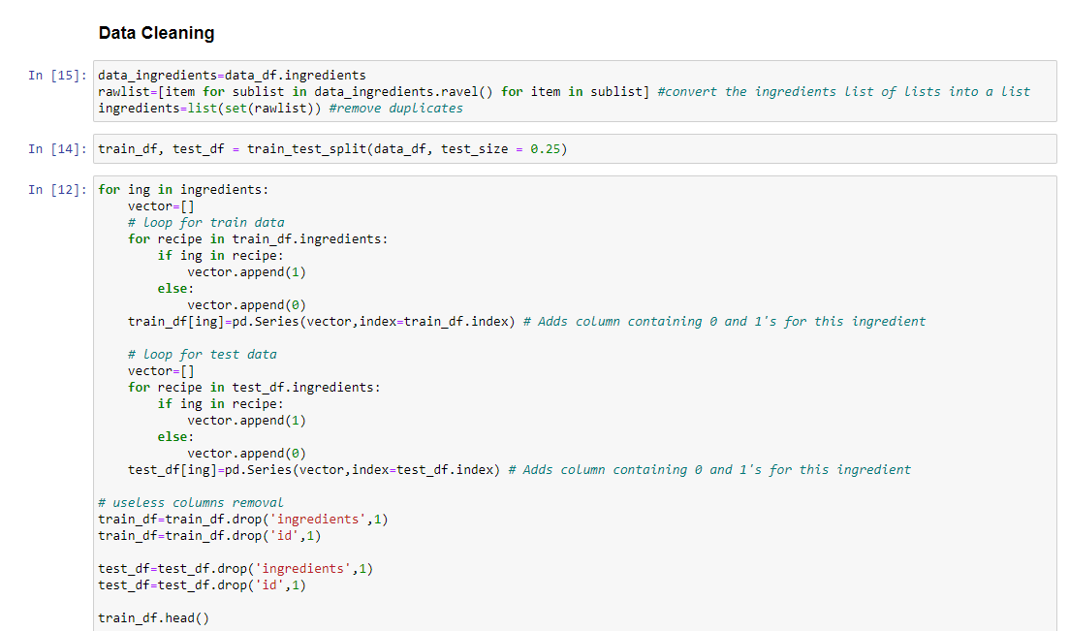
Notes:
split data into train and test with test size of 0.25
removed unnecessary columns and extracted out the name of all ingredients

Slide 14
BEFORE

Slide 15
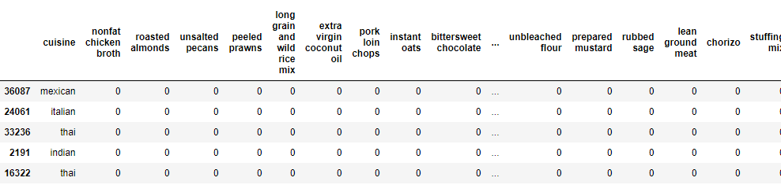
AFTER

Slide 16
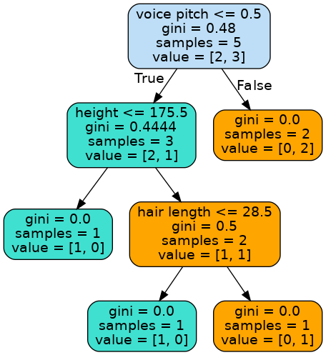
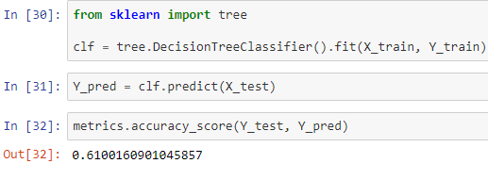
Decision Tree
Classification Accuracy →
Notes:
Train the Decision Tree Classifier model clf using the Train Set.
Use X_train as Predictor and Y_train as Response.
Goodness of Fit of the Model¶
classification accuracy is the value shown on the bottom which Checked how good the predictions are on the Train Set
The decision tree is a tool that uses a tree-like model of decisions and their possible consequences
Node splits based on if-else logic, using one of the features selected by the algorithm as the splitting feature
Based on the depth of the tree, no of terminal nodes may vary (ran algo until there was no more terminal nodes)

Slide 17
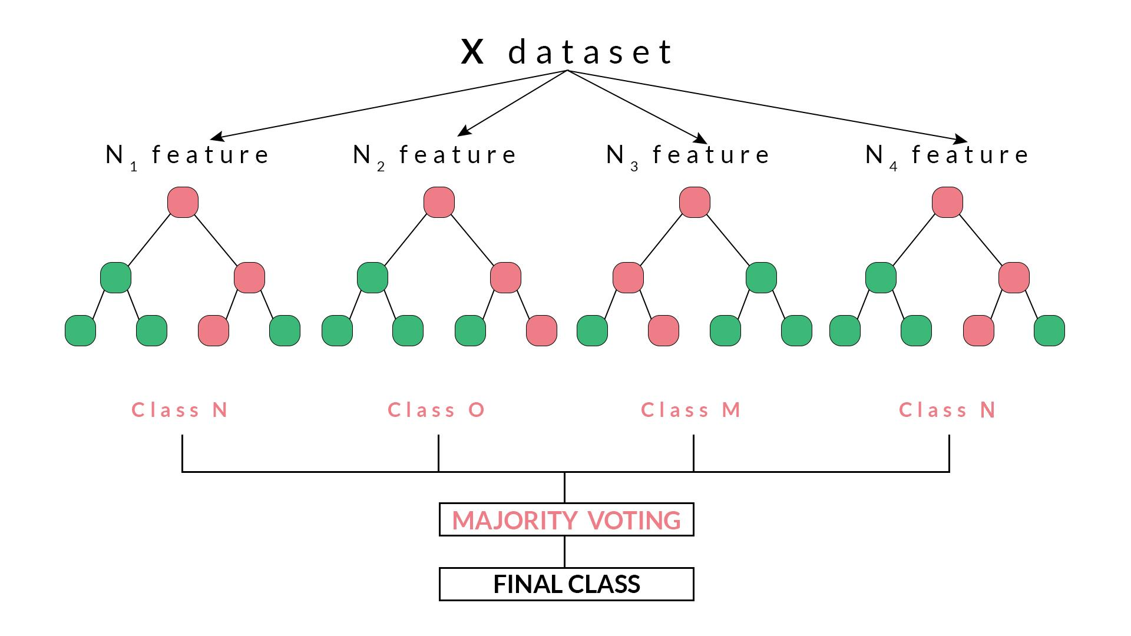
Random Forest
Uses multiple decision trees
Each tree is allocated random features to reduce overfitting
Notes:
Img source: https://blog.quantinsti.com/random-forest-algorithm-in-python/

Slide 18
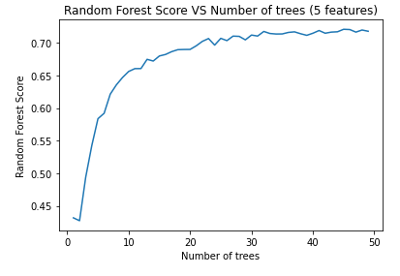
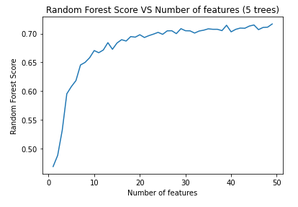
Random Forest - Basic Hyperparameter Tuning

Slide 19
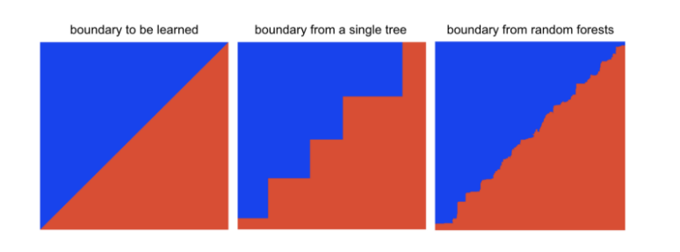
Random Forest > Decision Tree
Random Forest gets the output by averaging all the decision trees result or using "majority rules", the result took out some error which makes the model fits the data better
Notes:
https://towardsdatascience.com/why-random-forests-outperform-decision-trees-1b0f175a0b5#:~:text=Random%20forests%20consist%20of%20multiple,accurate%20than%20single%20decision%20trees.
https://www.analyticsvidhya.com/blog/2020/05/decision-tree-vs-random-forest-algorithm/

Slide 20
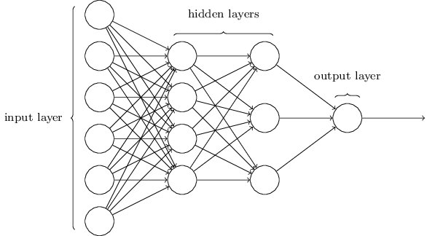
MLP Classifier
Artificial Neural Network, also known as a Feed-Forward Neural network
3 layers – Input, Hidden and Output
Output Activation Function: Softmax, which is used for multiclass classification
Notes:
https://www.analyticsvidhya.com/blog/2020/02/cnn-vs-rnn-vs-mlp-analyzing-3-types-of-neural-networks-in-deep-learning/

Slide 21

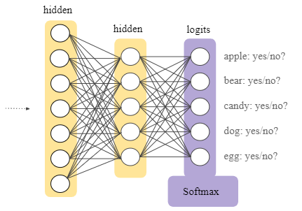
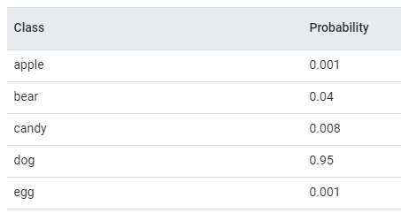
Softmax Activation Function
Softmax is implemented through a neural network layer just before the output layer. The Softmax layer must have the same number of nodes as the output layer.
Notes:
https://developers.google.com/machine-learning/crash-course/multi-class-neural-networks/softmax#:~:text=Softmax%20extends%20this%20idea%20into,quickly%20than%20it%20otherwise%20would.
https://towardsdatascience.com/activation-functions-neural-networks-1cbd9f8d91d6

Slide 22
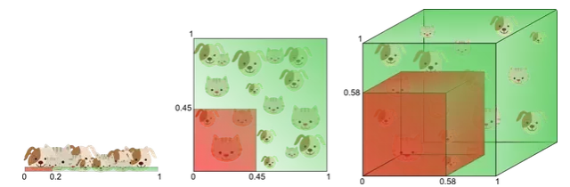
KNN(k-nearest neighbors)
Nearest neighbor depends greatly on distances between points. As you increase the number of dimensions, your distances are going to be less representative, this is called curse of dimensionality. KNN is very bad for high dimensional data.
0.5 for 6714 features
Notes:
https://www.quora.com/When-would-nearest-neighbors-classifier-regression-fail-miserably#:~:text=of%20dimensionality%20effect..-,So%20basically%20knn%20doesn't%20work%20well%20with%20high%20dimensions,space%20complexity%20is%20also%20high.&text=or%20underfitting%20problem%E2%80%A6-,And%20also%20if%20data%20is%20imbalanced%20then%20knn%20will%20be,knn%20may%20be%20bad%20choice.
https://www.visiondummy.com/2014/04/curse-dimensionality-affect-classification/#comment-241

Slide 23
Results
Accuracy classification (F1) score
MLP: 0.77
Random Forest: 0.72
Decision Tree: 0.61
KNN: 0.50
Why F1 score over other metrics?
Notes:
Precision: true positive/(true + false) positive; Recall: true positive/total true; F1: accuracy score that accounts for precision and recall
F1 > MCC in this case since we our problem statement is to correctly classify the cuisine. MCC (which accounts for TN and FN as well) does not do as good a job of this as F1 score is a better metric at calculating the accuracy of labelling

Slide 24
Other Considerations
Further hyperparameter tuning
Other classification algorithms

Slide 25
Project Responsibilities
Clifford - MLP Classifier, KNN Classifier
Joel - Random Forest, Results Visualization
Mabel - Data Exploration, Decision Tree

Slide 26
Thank you

