Slide 1
Clifford Bridges
Allan Kim Gayahan

Slide 2
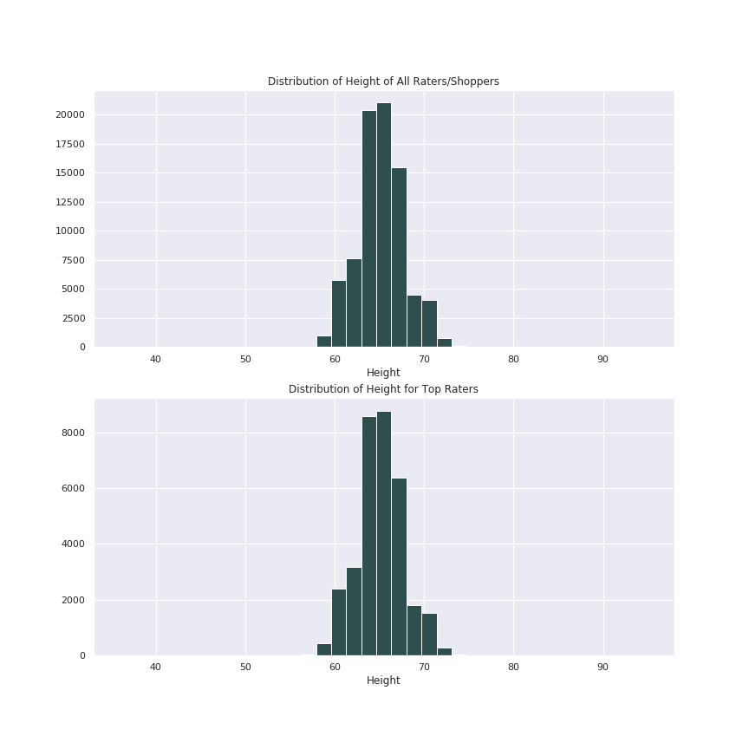
ModCloth Company
Top Ratings has:
Fit = ‘fit’
Length = ‘Just Right’
Quality = ‘4’ or ‘5’
Based on the histogram,
Top Raters Mean height = Population Mean Height

Slide 3
ModCloth Company
Null:
Mean Height for Top Raters are equal to the Population Mean Height
Alt:
Top Raters Mean Height not equal to Population Mean Height
Results:
p-value ≈ 0.00037
Reject null

Slide 4
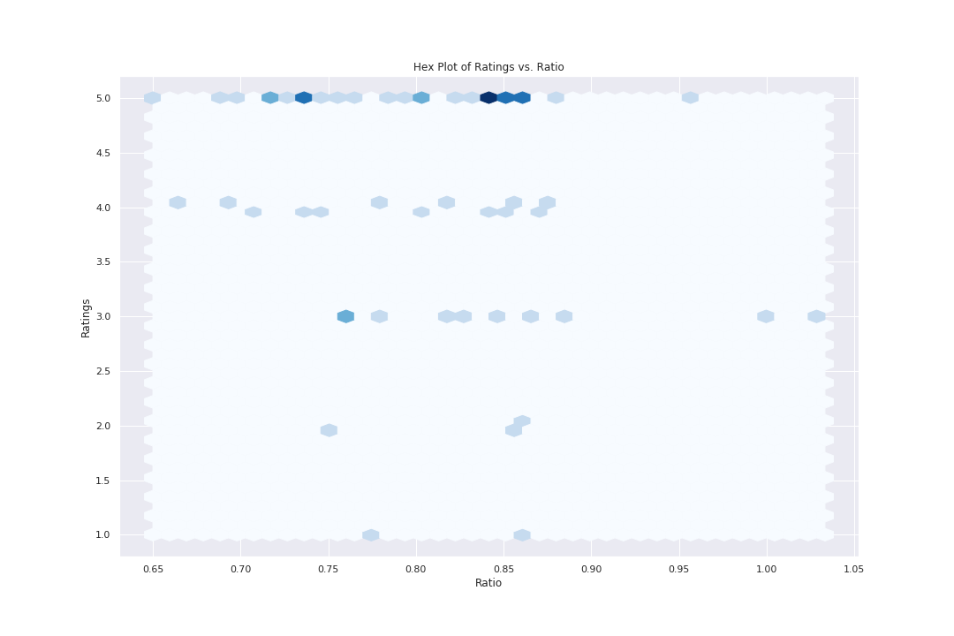
ModCloth Company
Hip-Waist Ratio:
Low Risk < .80
.80 ≤ Low Risk < .85
High Risk ≥ .85
Low Risk and High Risk seems to rate the same.

Slide 5
ModCloth Company
Null:
Mean Height for Top Raters are equal to the Population Mean Height
Alt:
Top Raters Mean Height not equal to Population Mean Height
Results:
p-value ≈ 0.00037
Reject null

