Slide 1
Mastering Git, GitHub, and Open Source
Isaiah Clifford Opoku

Slide 2
Prerequisites
A GitHub account

Slide 3
Learning objectives
Open a repo using GitHub
Create a branch
Commit changes to the branch
Create a pull request
Merge the pull request
Delete the branch
Open source

Slide 4
Agenda
Introduction
What is GitHub?
Work in GitHub
What is Git
How to start with Open source

Slide 5
What is GitHub and Git ?

Slide 6
Introduction
GitHub is a cloud-based hosting service for Git repositories. It provides developers with a graphical user interface (GUI) and a set of tools for managing their code, collaborating with others, and tracking changes. GitHub is also used to host open-source projects, making it easy for anyone to contribute.
Git is a free and open-source distributed version control system (VCS) designed to handle everything from small to very large projects with speed and efficiency. It is used by millions of developers around the world to manage their code and collaborate with others.
Notes:
GitHub is a development platform that enables you to host and review code, manage projects, and build software alongside 50 million developers.
Why is everyone building on GitHub? Because it provides the important DevOps features companies and organizations of all sizes need for their public and private projects. Whether it's planning features, fixing bugs, or collaborating on changes, GitHub is the place where the world's software developers gather to make things. And then make them better.
In this module, you learn to use key GitHub features, including issues, notifications, branches, commits, and pull requests.

Slide 7
Git and GitHub
As you work with Git and GitHub, you may wonder about the difference between the two.
Issues
Discussions
Pull requests
Notifications
Labels
Actions
Forks
Projects
Installed and used on your local machine
Handles version control
Supports branching
Notes:
As you work with Git and GitHub, you may wonder about the difference between the two.
Git is a distributed version control system (DVCS) that allows multiple developers or other contributors to work on a project. It provides a way to work with one or more local branches and push them to a remote repository. Git is responsible for everything GitHub-related that happens locally on your computer. Key features provided by Git include:
Installed and used on your local machine
Handles version control
Supports branching
To learn more about Git, see Using common Git commands.
GitHub is a cloud platform that uses Git as its core technology. It simplifies the process of collaborating on projects and provides a website, command-line tools, and overall flow that allows developers and users to work together. GitHub acts as the "remote repository" mentioned previously in the Git section.
Key features provided by GitHub include:
Issues
Discussions
Pull requests
Notifications
Labels
Actions
Forks
Projects
To learn more about GitHub, see Getting started with GitHub.

Slide 8
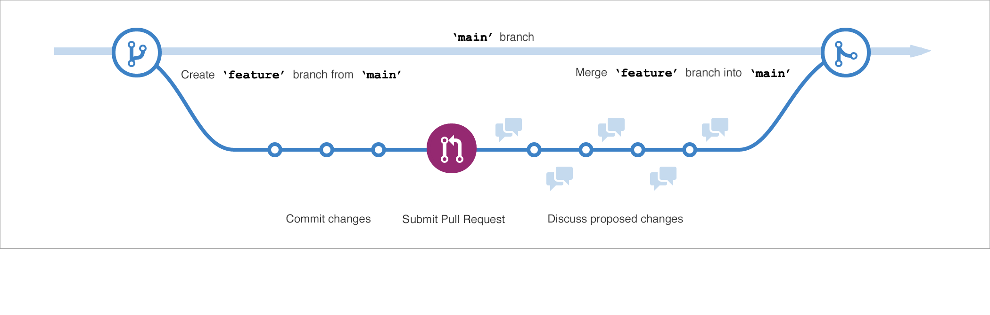
Branches
Branches are the preferred way to create changes in the GitHub flow.
Notes:
Branches are the preferred way to create changes in the GitHub flow. They provide isolation so that multiple people may simultaneously work on the same code in a controlled way. This model enables stability among critical branches, such as main, while allowing complete freedom for developers to commit any changes they need to meet their goals. Once the code from a branch is ready to become part of the main branch, it may be merged via pull request.
To learn more about GitHub branches, see About branches.

Slide 9
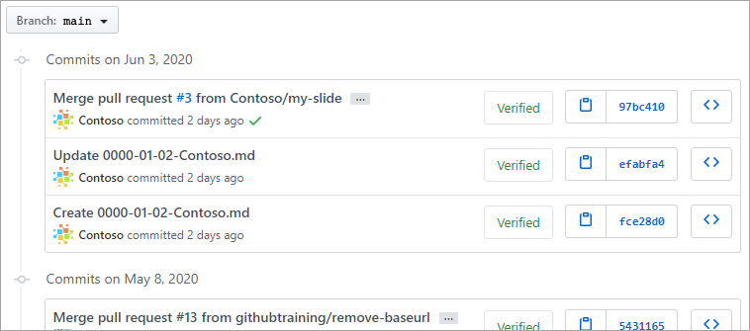
Commits
A commit is a change to one or more files on a branch.
Notes:
A commit is a change to one or more files on a branch. Every time a commit is created, it is assigned a unique ID and tracked, along with the time and contributor. This provides a clear audit trail for anyone reviewing the history of a file or linked item, such as an issue or pull request.
To learn more about GitHub commits, see Committing and reviewing changes to your project.

Slide 10
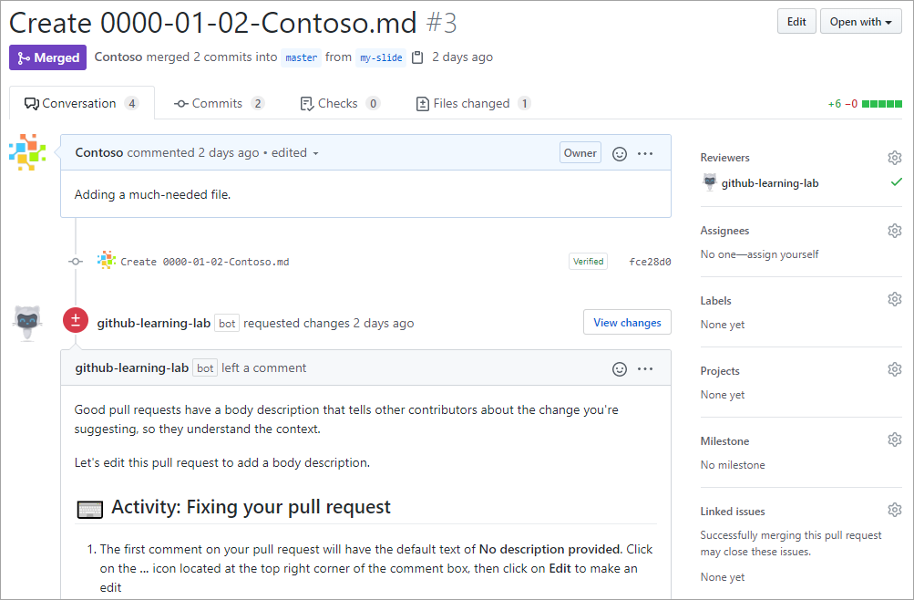
Pull Requests
A pull request is the mechanism used to signal that the commits from one branch are ready to be merged into another branch.
Notes:
A pull request is the mechanism used to signal that the commits from one branch are ready to be merged into another branch. The developer submitting the pull request will often request one or more reviewers to verify the code and approve the merge. These reviewers have the opportunity to comment on changes, add their own, or use the pull request itself for further discussion. Once the changes have been approved (if approval is required), the pull request's source branch (the compare branch) may be merged in to the base branch.
To learn more about GitHub pull requests, see About pull requests.

Slide 11
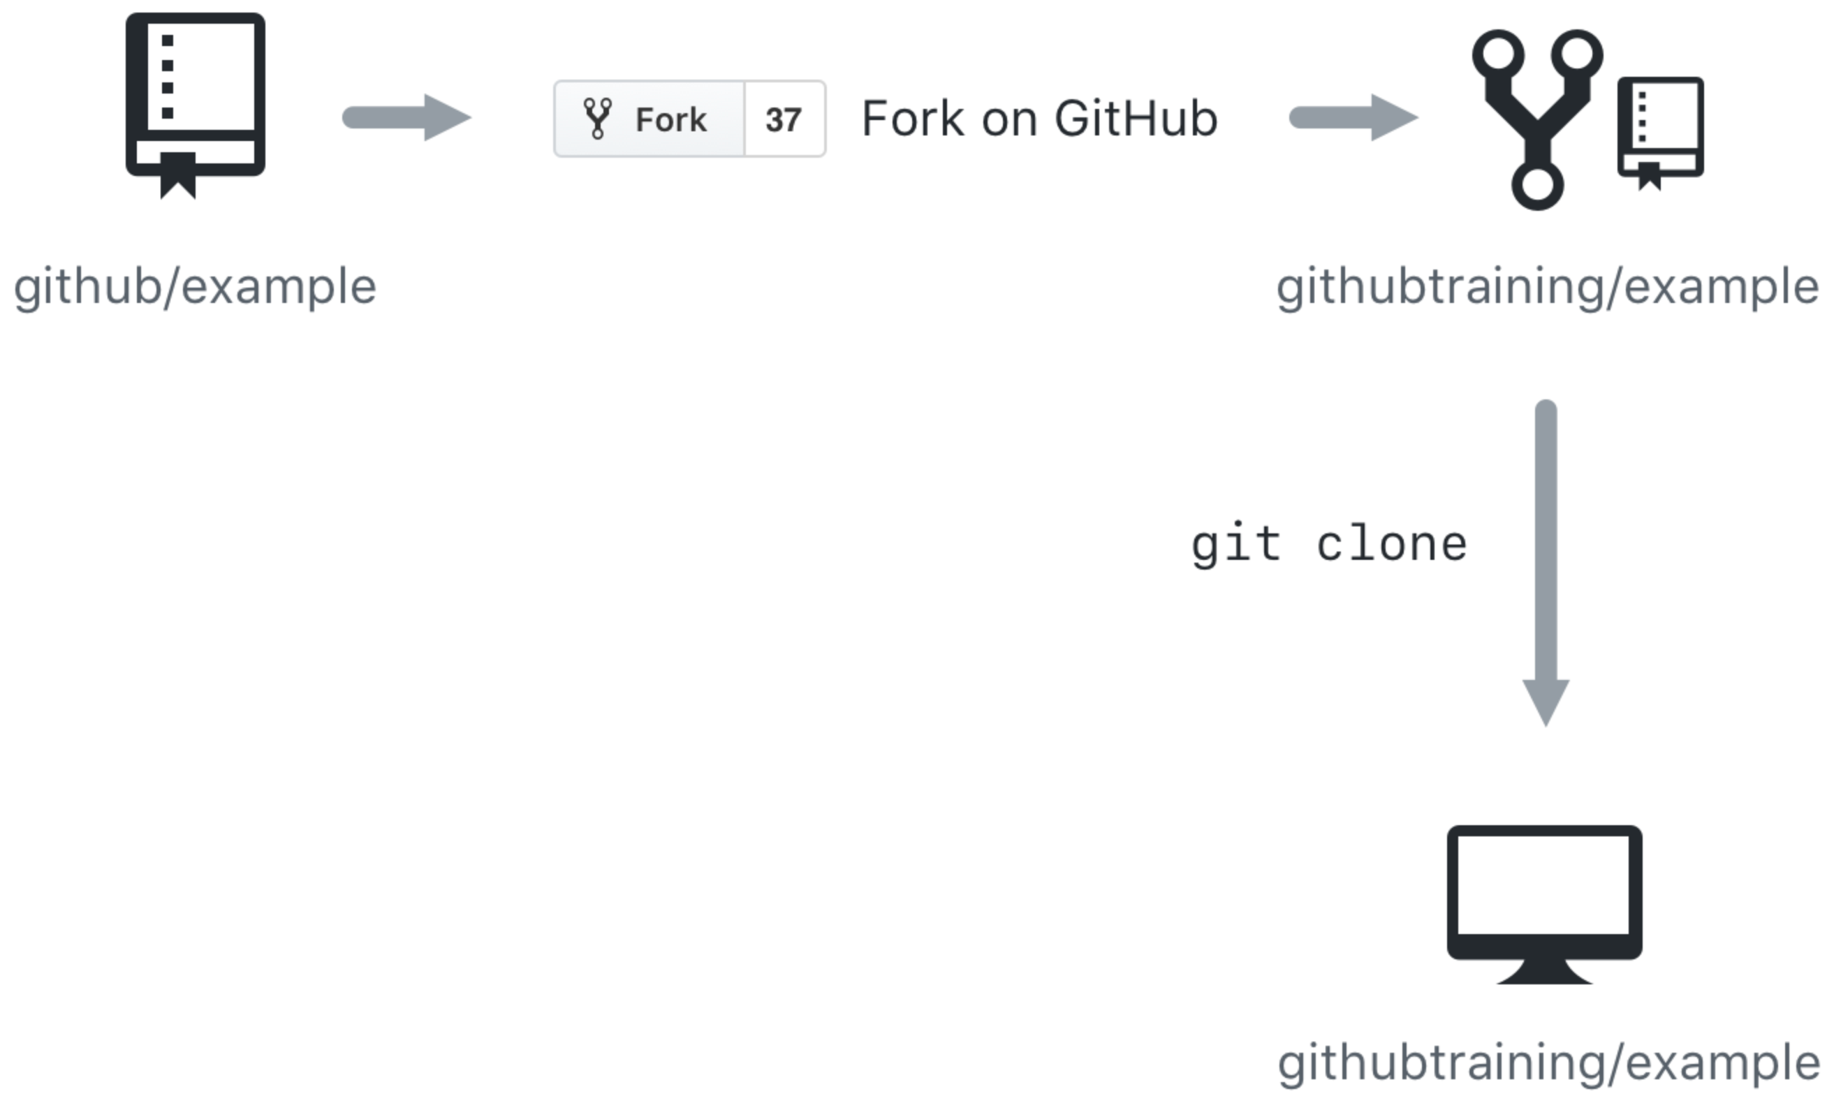
Cloning and forking
GitHub provides multiple ways to copy a repository so that you can work on it.
Cloning a Repository - Cloning a repository will make a copy of the repository and its history on your local machine. If you have write access to the repository you can push changes from your local machine to the remote repository (called the origin) as they're completed. To clone a repository you can use the git clone [url] command or the GitHub CLI's gh repo clone [url] command.
Forking a Repository - Forking a repository makes a copy of the repository in your GitHub account. The parent repository is referred to as the upstream while your forked copy is referred to as the origin. Once you've forked a repository into your GitHub account you can clone it to your local machine. Forking allows you to freely make changes to a project without affecting the original upstream repository. To contribute changes back to the upstream repository you create a pull request from your forked repository. You can also run git commands to ensure that your local copy stays synced with the upstream repository.
Notes:
GitHub provides multiple ways to copy a repository so that you can work on it.
Cloning a Repository - Cloning a repository will make a copy of the repository and its history on your local machine. If you have write access to the repository you can push changes from your local machine to the remote repository (called the origin) as they're completed. To clone a repository you can use the git clone [url] command or the GitHub CLI's gh repo clone [url] command.
Forking a Repository - Forking a repository makes a copy of the repository in your GitHub account. The parent repository is referred to as the upstream while your forked copy is referred to as the origin. Once you've forked a repository into your GitHub account you can clone it to your local machine. Forking allows you to freely make changes to a project without affecting the original upstream repository. To contribute changes back to the upstream repository you create a pull request from your forked repository. You can also run git commands to ensure that your local copy stays synced with the upstream repository.
When would you clone a repository versus fork a repository? If you're working with a repository and have write access you can clone it to your local machine. From there you can make modifications and push your changes directly to the origin repository.
If you need to work with a repository created by another owner such as github/example and don't have write access, you can fork the repository into your GitHub account, and then clone the fork to your local machine. To see this visually, let's assume that your GitHub account is called githubtraining for this example. Using the GitHub website you can fork githubtraining or any other examples into your account. From there you can clone the forked version of the repository to your local machine. These steps are shown in the following image.
Changes can be made to your local copy of githubtraining/example and then pushed back to your remote origin repository (githubtraining/example). The changes can then be submitted to the github/example upstream repository using a pull request as shown next.
To learn more, see Fork a repo.

Slide 12
What is an open source

Slide 13
Open source
Open source is a philosophy and approach to the development and distribution of software that emphasizes transparency, collaboration, and community. Open-source software is distributed under a license that grants users the right to use, modify, and distribute the software freely.
Some popular examples of open-source software include:
Linux operating system
Python programming language
WordPress content management system

