Slide 1
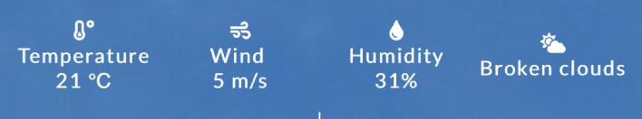




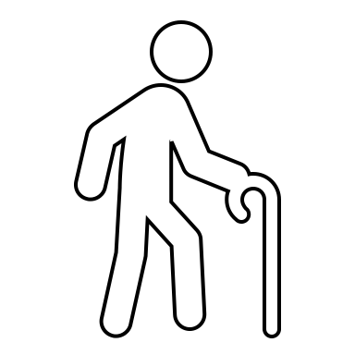


WORKERS | INDIVIDUAL
WORKERS | GROUP
Climapp index
Climapp index
Copenhagen
14:35
Copenhagen
14:35
now
+1.3
Moderate heat stress
now
+1.3
Moderate heat stress
15h
+2.4
High heat stress
15h
+2.4
High heat stress
Currently moderate heat stress is expected.
The hottest part of the day is expected around 15h with high heat stress.
Based on your reported perception you could be more sensitive to heat than others
Press for more information and tips to mitigate heat stress
Currently moderate heat stress is expected.
The hottest part of the day is expected around 15h with high heat stress
Press for more information and tips to mitigate heat stress
Advanced overview
Advanced overview
Profile
Profile
individual
group
senior
children
individual
group
senior
children
Group level information and tips to mitigate the impact of hot conditions on health & productivity
Information on the impact of weather, clothing and activity level on safe working conditions
Personalize
Personalize
Activity
Clothing
Activity
Clothing
Perception

Slide 2
SENIORS
CHILDREN
Climapp index
Climapp index
Copenhagen
14:35
Copenhagen
14:35
now
+1.3
Moderate heat stress
now
+1.3
Moderate heat stress
15h
+2.4
High heat stress
15h
+2.4
High heat stress
Currently moderate heat stress is expected.
The hottest part of the day is expected around 15h with high heat stress.
Because you are a senior please pay extra attention to prevent exposure to heat
Press for more information how to stay healthy
Currently moderate heat stress is expected.
The hottest part of the day is expected around 15h with high heat stress.
Because you are a senior please pay extra attention to prevent exposure to heat
Press for more information how to stay healthy
Profile
Profile
individual
group
senior
children
individual
group
senior
children
Information on how to cope with heat for seniors
Information on signs that children are overheated, and how to cope with hot conditions
Personalize
Personalize
Activity
Clothing
Perception
Activity
Clothing
Perception

Slide 3
Individual pressed information button
Senior information
Children information button
Climapp index
Climapp index
Climapp index
Copenhagen
14:35
Copenhagen
14:35
Copenhagen
14:35
now
+1.3
Moderate heat stress
now
+1.3
Moderate heat stress
now
+1.3
Moderate heat stress
Behavioural tips
Your activity level is moderate, slowing down might lower heat stress
Your clothing level is high, if safety permits it may be a good choice to wear light, loose clothing
Increased wind speed by a fan may lower heat stress
Remember to drink when you take a break
Behavioural tips
Specific information for seniors
Behavioural tips
Specific information for children
15h
+2.4
High heat stress
15h
+2.4
High heat stress
15h
+2.4
High heat stress

