Slide 1
OSeMOSYS for Transmission
OSTRAM - Data Package v1.0
South Asia Power System Connectivity Model Progress update #3
6
10
8,600+
40+
Countries
Model Nodes
Data Records
Verified Sources
UN ESCAP Energy Division
March 12th, 2026

Slide 2
Agenda
OSeMOSYS for Transmission — South Asia Power System Connectivity Model
1
Executive Summary & Data Completeness
Delivery scope, key figures, completeness matrix, and outstanding gaps across 6 countries and 10 model nodes
2
File Architecture & Data Detail
OSeMOSYS Template (26 sheets), Consolidated Inventory (13 sheets), VRE profiles, demand and hydro seasonality
3
Preliminary BAU Results
Capacity, generation, investment, emissions, and interconnector flows from the OSeMOSYS Global base run
4
Modeling Pipeline & Collaboration
Five-step automated pipeline from OSeMOSYS Global to solved results, and how to collaborate on the model
5
Next Steps & Timeline
Upcoming milestones, validation priorities, and delivery schedule through September 2026
OSTRAM — Data Package v1.0 | UN ESCAP Energy Division | March 2026

Slide 3


Data Package v1.0 — Executive Summary
This delivery freezes the data foundation for the OSTRAM South Asia model. Two companion files capture everything collected, processed, and structured for the 2023–2050 planning horizon across Bangladesh, Bhutan, India (5 sub-regions), Maldives, Nepal, and Sri Lanka.
SOASIA_OSeMOSYS_Template_v2_filled
SOASIA_Consolidated_Data_Inventory_v1
Model-Ready Parameterization
Data Provenance & Evidence Base
26 sheets structured for the otoole/OSeMOSYS pipeline. Contains all parameters the model reads: technologies, costs, capacity factors, demand projections, interconnectors, emissions, and validation sheets.
13 sheets documenting what was found, where it came from, and what gaps remain. Includes plant-level generation inventories, cost databases with 3 scenarios, VRE profiles, and a full gaps/actions tracker.
26 sheets | 5,200+ parameter rows | 2023–2050 horizon
13 sheets | 8,600+ records | 40+ cited sources
OSTRAM — Data Package v1.0 | UN ESCAP Energy Division | March 2026

Slide 4






By the Numbers
2,131
565
2,360+
Existing Power Plants
Catalogued
Planned Generation
Projects Tracked
Transmission Lines
Mapped
2,160
13
28
VRE Timeslice Records
(Solar + Wind)
Cross-Border
Interconnectors
Verified Cost Sources
in Registry
OSTRAM — Data Package v1.0 | UN ESCAP Energy Division | March 2026

Slide 5
Data Completeness at a Glance
Complete
Partial
Gap
Data Dimension | BGD | BTN | IND | MDV | NPL | LKA
Existing Generation (plant-level) | ● | ● | ● | ● | ● | ●
Planned Generation Pipeline | ● | ● | ● | ● | ● | ●
Demand Forecasts (to 2050) | ● | ● | ● | ● | ● | ●
Historical Production / Gen. Mix | ● | ● | ● | ● | ● | ●
Cross-Border Interconnections | ● | ● | ● | ● | ● | ●
Transmission Grid | ● | ● | ● | ● | ● | ●
VRE Capacity Factors (Solar/Wind) | ● | ● | ● | ● | ● | ●
Timeslice Demand Profiles | ● | ● | ● | ● | ● | ●
Hydro Seasonal Detail | ● | ● | ● | — | ● | ●
Technology Costs (CAPEX/O&M) | ● | ● | ● | ● | ● | ●
Hourly Load Shape | ● | ● | ● | ● | ● | ●
66 data points: 58 complete, 5 partial, 2 gaps, 1 N/A — Maldives is the only country with outstanding gaps
OSTRAM — Data Package v1.0 | UN ESCAP Energy Division | March 2026

Slide 6
Outstanding Gaps
HIGH
Demand profiles: MDV missing timeslice fractions — derive from hourly load data
HIGH
Fuel cost subsidies per country — collect from national energy ministries
HIGH
India demand forecast post-2037 — need CEA 20th EPS or NITI Aayog long-term scenarios
MED
15 country multiplier cells flagged as assumptions — source from national utilities / ADB data
MED
Maldives outer island electrification plan — MEE/STELCO island-by-island capacity data
MED
Emission factors: country-specific values — from national communications & UNFCCC reports
LOW
Post-2044 Sri Lanka demand extrapolation — growth rate extension from LTGEP
OSTRAM — Data Package v1.0 | UN ESCAP Energy Division | March 2026

Slide 7

Detailed View
File contents, data architecture, VRE profiles, and inventory detail

Slide 8
OSeMOSYS Template Workbook
SOASIA_OSeMOSYS_Template_v6_filled.xlsx — 26 sheets
This workbook is structured for direct ingestion by the otoole pipeline. Each sheet maps to specific OSeMOSYS parameters with year-by-year projections across the 2023–2050 horizon.
Model Structure
Costs & Economics
Capacity & Dispatch
README, Fixed_Horizon_Parameters, Primary_Techs, Secondary_Techs, Demand_Techs
Technology_Costs, VariableCost, Emissions
Capacities_CF, Capacities_CF_Options, Yearsplit_Template, Yearsplit_ReNinja, DaySplit
Technology definitions, operational lifetimes, capacityToActivity units. ~2,500 parameter rows across primary/secondary technologies.
CAPEX, fixed O&M, variable costs, and emission activity ratios by technology. India-anchored with ATB cross-check.
Per-timeslice capacity factors with 3 source options (template, RE Ninja, country-verified). Year-split fractions for 12 timeslices.
Demand & Trade
Inventory & QA
Validation & Provenance
Demand_Projection, Demand_Profiles, Interconnectors, Interconnector_Params
Existing_Generation (2,115), Planned_Generation (554), RE_Targets, RE_Potential_Ceilings
Integration_Log, Provenance_Matrix, ATB_Comparison, Cross_Validation_Log, Validation_ThermalDispatch
Annual demand by node (PJ), timeslice demand fractions, and 13 cross-border corridors with CAPEX/loss parameters.
Plant-level inventories, national RE targets and NDC policies, physical RE potential limits for TotalAnnualMaxCapacity.
Cell-level source tracking, 172 cross-validation entries, ATB cost benchmarks, and thermal dispatch CF validation data.
OSTRAM — Data Package v1.0 | UN ESCAP Energy Division | March 2026

Slide 9
Consolidated Data Inventory
OSTRAM_Consolidated_Data_Inventory_v4.xlsx — 13 sheets
This workbook documents what was found, where it came from, and what still needs attention. It is the evidence base behind the template and supports the 20 disaggregated country workbooks.
Sheet | Rows | Contents
Existing_Generation | 2,125 | Plant-level inventory: country, node, fuel, capacity, owner
Planned_Generation | 560 | Project pipeline with expected COD and status
Technology_Costs | 182 | 3 cost scenarios × 7 milestone years (2023–2050)
Fuel_Costs | 27 | Crude, coal, LNG, diesel — 3 scenario trajectories
Country_Multipliers | 15 | India-anchored cost adjustments with source/flag per cell
Interconnectors | 14 | 13 cross-border corridors: CAPEX, loss %, lifetime
Demand_Forecasts | 185 | Historical + projected demand per country to 2050
Capacity_Factors_TS | 2,461 | Dispatch + RE Ninja CFs per timeslice per technology
Demand_Profiles | 109 | Timeslice demand fractions for BTN, IND (5), NPL
Renewable_Ninja | 2,161 | Solar/wind CFs: 10 nodes, 9yr avg, 12 timeslices
Sources_Registry | 41 | Full citations with URLs, doc type, access status
Gaps_Actions | 39 | Tracked items with status, priority, and action needed
OSTRAM — Data Package v1.0 | UN ESCAP Energy Division | March 2026

Slide 10
Power Sector Inventory
Country | Existing Gen. | Planned Gen. | Exist. Intercon. | Planned Intercon. | Transmission
India | 1,875 | 379 | 17 | 13 | 2,089 lines
Bangladesh | 140 | 17 | 7 | 10 | 30 lines
Nepal | 48 | 32 | 6 | 7 | 151 lines
Bhutan | 15 | 16 | 21 | 11 | 46 lines
Sri Lanka | 42 | 96 | 3 | 16 | 33 lines
Maldives | 11 | 25 | 3 | 4 | 11 lines
TOTAL | 2,131 | 565 | 57 | 61 | 2,360+
Primary Sources: CEA/NITI Aayog (India), BPDB (Bangladesh), NEA (Nepal), BPC (Bhutan), CEB (Sri Lanka), STELCO/MCCEE (Maldives)
Cost Architecture: India-anchored multipliers with 3 scenarios (Conservative / Moderate / Ambitious). 181 technology cost entries across 7 milestone years. 15 multiplier cells still flagged as assumptions.
OSTRAM — Data Package v1.0 | UN ESCAP Energy Division | March 2026

Slide 11
Cost Architecture: India-Anchored Multipliers
Base cost = India (1.0×). Each country multiplier is sourced with an assumption flag per cell.
Technology | IN | BD | LK | NP | BT | MV | Confidence
Solar PV | 1.0 | 1.75 | 2.20 | 2.25 | 2.25 | 6.00 | Partial
Onshore Wind | 1.0 | 1.75 | 1.90 | 1.0* | 1.0* | 1.0* | Partial
Hydro RoR | 1.0 | 1.0* | 1.30 | 1.50 | 0.95 | 1.0* | Good
Hydro Storage | 1.0 | 1.0* | 1.50 | 2.50 | 1.10 | 1.0* | Partial
Coal | 1.0 | 1.60 | 2.00 | 1.0* | 1.0* | 1.0* | Partial
CCGT | 1.0 | 1.10 | 1.90 | 1.0* | 1.0* | 1.0* | Partial
BESS 4h | 1.0 | 1.0 | 1.0 | 1.0 | 1.0 | 1.0 | Low
Diesel | 1.0 | 1.10 | 1.40 | 1.50 | 1.50 | 1.00 | Good
* = Default 1.0 (assumption, needs sourcing) | Confidence: Good = ADB/utility project data; Partial = single source or estimate; Low = no country-specific data found
13 Cross-Border Interconnectors Parameterized
BD↔IN_E, BD↔IN_NE, BT↔IN_E, BT↔IN_NE, NP↔IN_N, NP↔IN_E, LK↔IN_S, MV↔IN_S, plus 5 internal India corridors (N↔E, N↔W, E↔NE, E↔S, W↔S). Each with CAPEX, fixed O&M, loss %, and operational lifetime.
OSTRAM — Data Package v1.0 | UN ESCAP Energy Division | March 2026

Slide 12
Timeslice Architecture
4 Seasons × 3 Daily Bands = 12 Timeslices
 | D1: Night (00–06) | D2: Day (06–18) | D3: Evening (18–24)
S1: Winter (Dec–Feb) | S1D1 | S1D2 | S1D3
S2: Pre-monsoon (Mar–May) | S2D1 | S2D2 | S2D3
S3: SW Monsoon (Jun–Sep) | S3D1 | S3D2 | S3D3
S4: Post-monsoon (Oct–Nov) | S4D1 | S4D2 | S4D3
Capacity_Factors_TS
2,460 rows
Dispatch CFs (BGD, LKA) + RE Ninja (all 6 countries)
Demand_Profiles
108 rows
Demand fractions per TS for BTN, IND (5 regions), NPL
Renewable_Ninja
2,160 rows
Solar & wind CFs: 10 regions, 9yr climate avg, 12 timeslices
OSTRAM — Data Package v1.0 | UN ESCAP Energy Division | March 2026

Slide 13
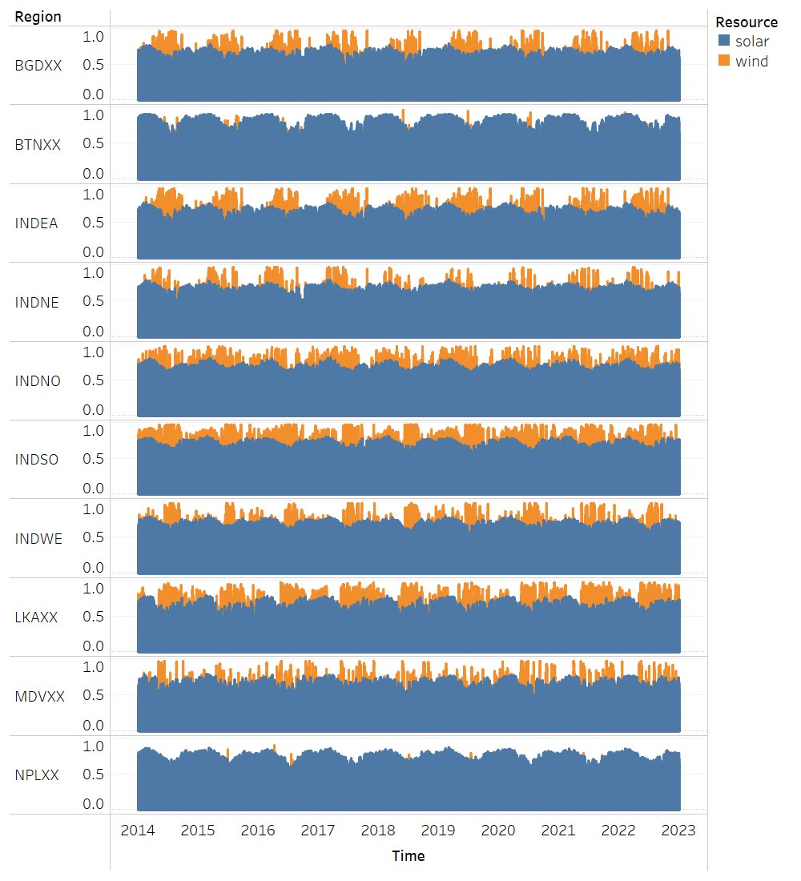
VRE Capacity Factors — Full Time Series
Renewables Ninja: Solar & wind capacity factors across 10 OSTRAM nodes, 2014–2022. Source: MERRA-2 reanalysis — NASA's global atmospheric dataset combining satellite observations with weather models to produce consistent hourly climate fields (irradiance, wind speed, temperature) at ~50 km resolution.
OSTRAM — Data Package v1.0 | UN ESCAP Energy Division | March 2026

Slide 14
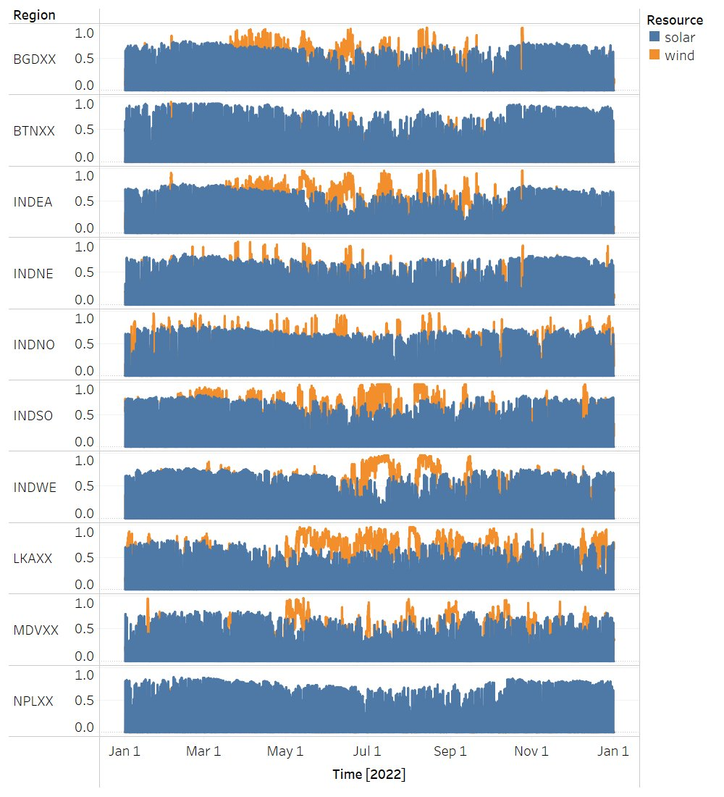
VRE Capacity Factors — 2022 Annual Profile
Solar and wind capacity factor variation across the full year for all 10 model nodes — seasonal patterns visible
OSTRAM — Data Package v1.0 | UN ESCAP Energy Division | March 2026

Slide 15
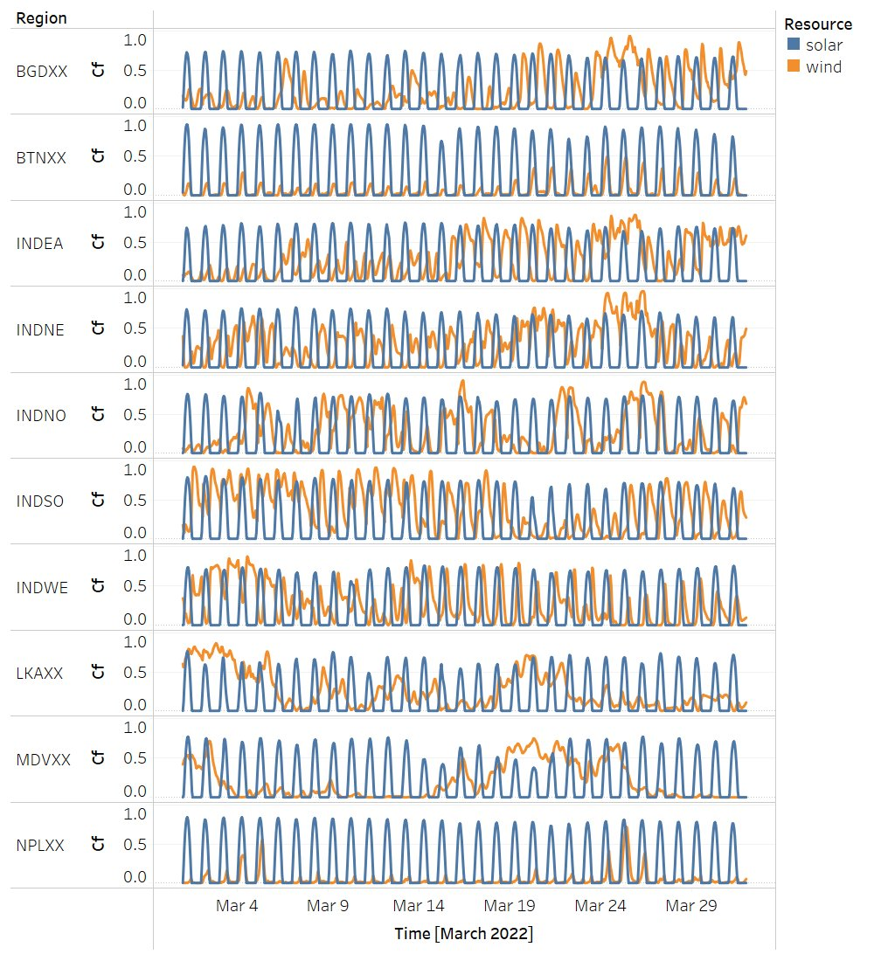
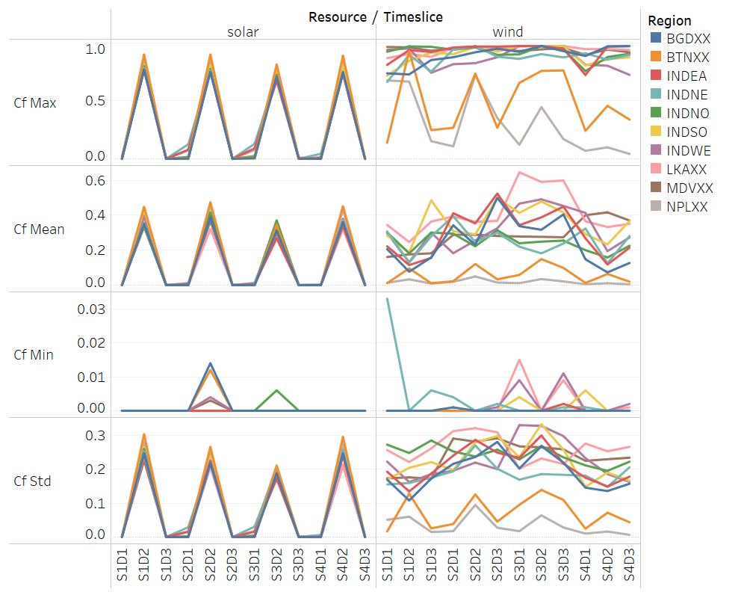
VRE Profiles — Hourly Detail & Timeslice Statistics
March 2022 — Hourly Resolution
Timeslice Statistics (Max, Mean, Min, Std)
Diurnal solar patterns are consistent across all nodes. Wind shows higher variability, particularly in LKAXX and INDSO during monsoon season (S3). These profiles feed directly into the CapacityFactor parameter in the OSeMOSYS model.
OSTRAM — Data Package v1.0 | UN ESCAP Energy Division | March 2026

Slide 16
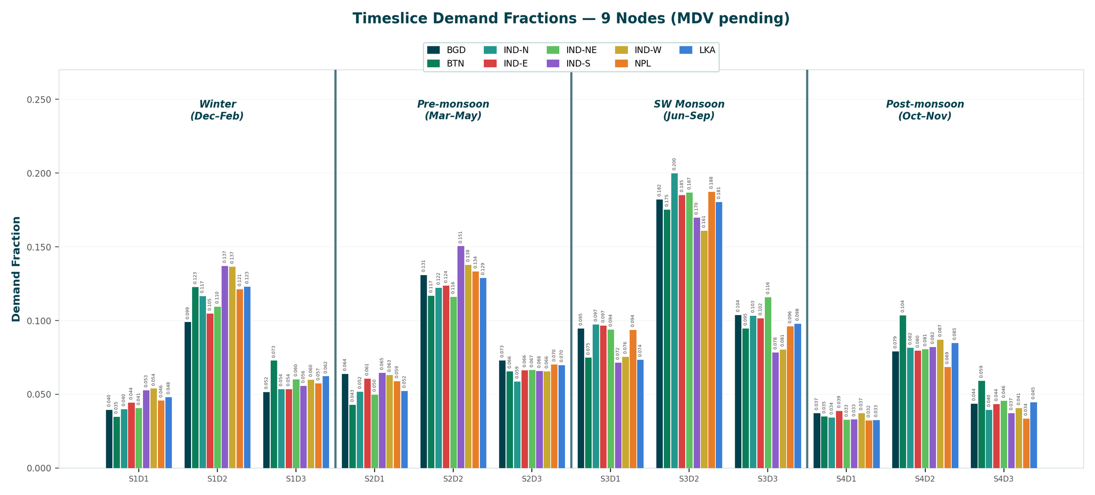
Timeslice Demand Profiles
Demand fractions for 9 nodes (BGD, BTN, IND 5 sub-regions, NPL, LKA). Monsoon S3 concentrates ~35% of annual demand across all nodes. MDV profiles pending — yearbook-based derivation methodology documented.
OSTRAM — Data Package v1.0 | UN ESCAP Energy Division | March 2026

Slide 17
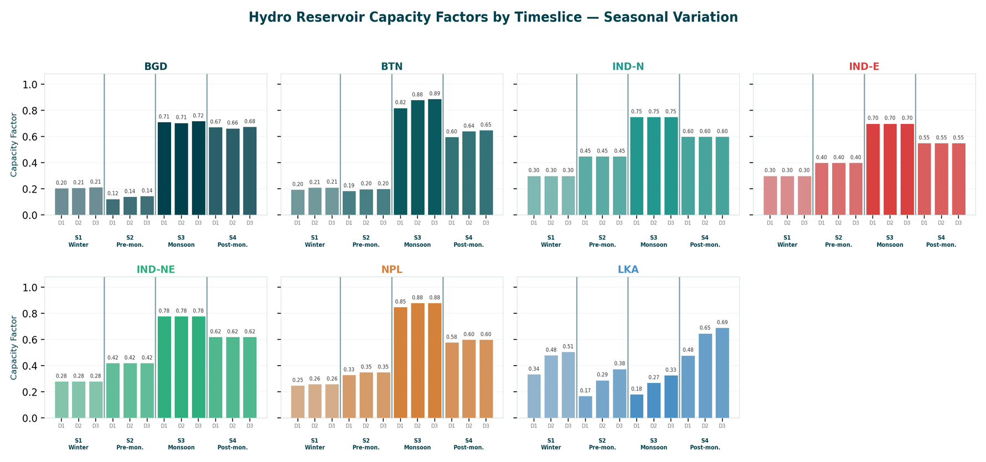
Hydro Seasonal Capacity Factors
Bangladesh Kaptai shows a pronounced monsoon peak (CF > 0.7 in S3) with dry-season lows (S2 < 0.15) — requires TotalTechnologyAnnualActivityUpperLimit rather than MaxCapacity to avoid solver infeasibility. Sri Lanka mini-hydro peaks in post-monsoon S4.
OSTRAM — Data Package v1.0 | UN ESCAP Energy Division | March 2026

Slide 18
Supporting Workbooks — 20 Disaggregated Files
Behind the two consolidated Excel files sit 20 structured workbooks organized across three pillars:
Energy Statistics
Power Infrastructure
Demand Analysis
6 workbooks
6 workbooks
5 workbooks + 3 assets
Capacity factors by technology
Demand forecasts (historical + projected)
Historical generation mix
Seasonality / climate data
IRENA cross-reference
Source registries with URLs
Existing generation (plant-level)
Generation summary by fuel
Existing interconnections
Planned interconnections
Existing transmission
Planned transmission / generation
OSTRAM timeslice profiles
Monthly/hourly demand decomposition
Hydro seasonal detail
Cross-validation against sources
Source selection rationale
Cost DB + VRE CFs
Naming convention: [ISO3]_Energy_Statistics.xlsx | [ISO3]_Power_Infrastructure.xlsx | [ISO3]_Demand_Analysis.xlsx
OSTRAM — Data Package v1.0 | UN ESCAP Energy Division | March 2026

Slide 19
Preliminary BAU Results
OSeMOSYS Global — Initial Model Run
- The datasets from the Data Package v1.0 have yet to be integrated into an OSeMOSYS Global base model. - The following slides show the first BAU scenario results across 6 countries and 10 model nodes using an OSeMOSYS Global base model.

Slide 20
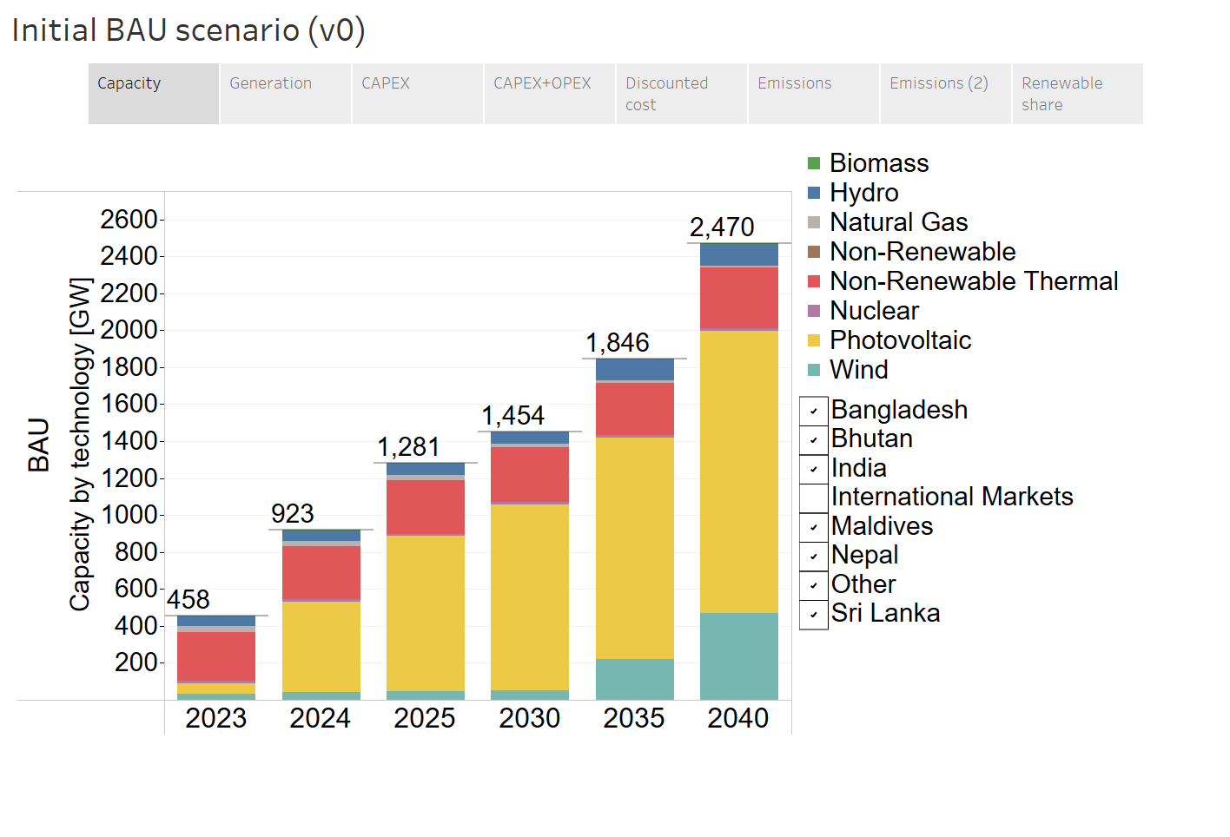
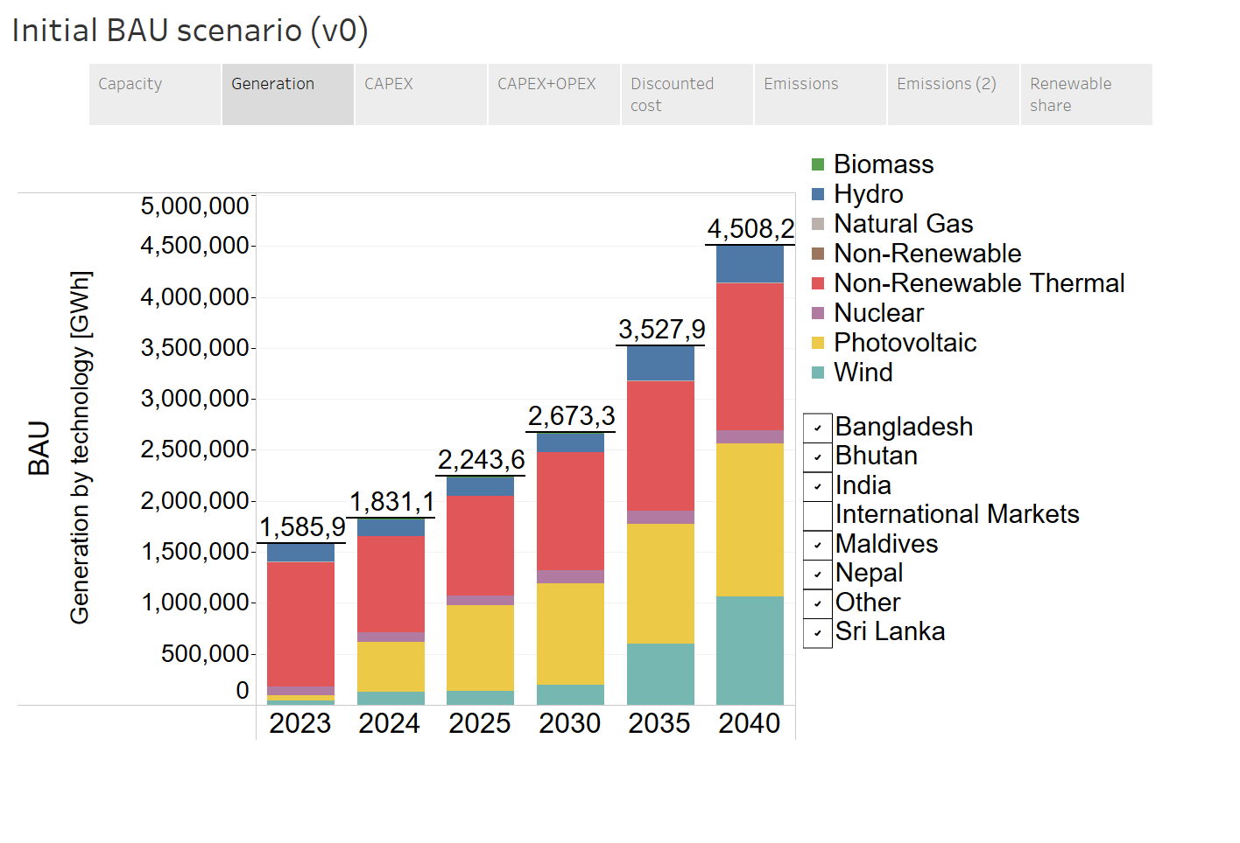
BAU — Capacity & Generation Mix
Initial BAU (v0): Regional capacity grows from 458 GW (2023) to 2,470 GW (2040). Solar PV and wind dominate new additions. These are preliminary results — proper BAU under construction.
Capacity by Technology [GW]
Generation by Technology [GWh]
OSTRAM — Data Package v1.0 | UN ESCAP Energy Division | March 2026

Slide 21
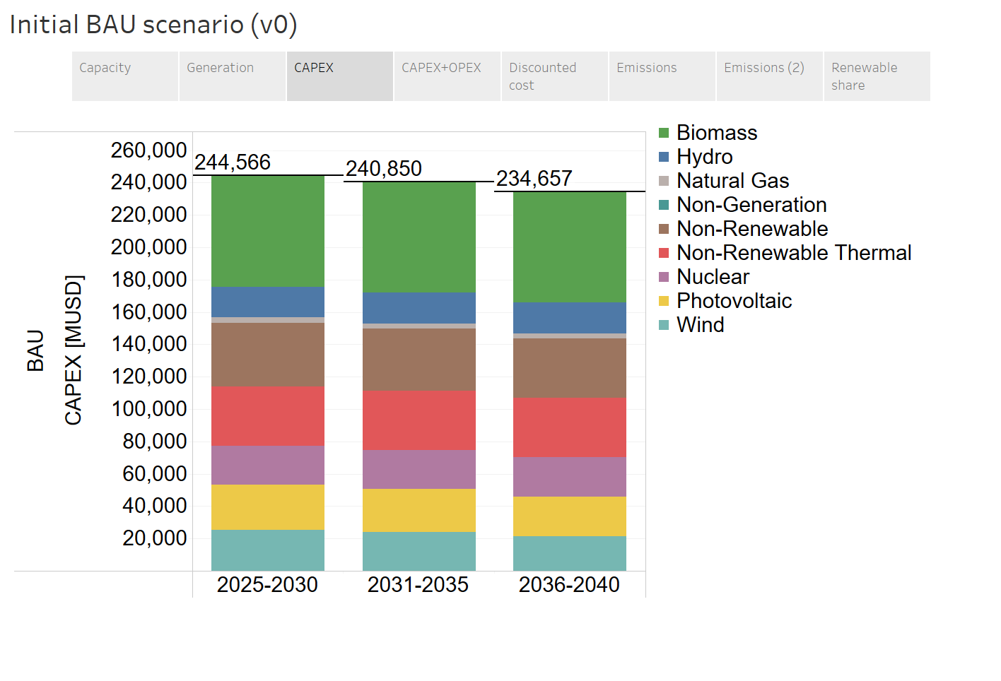
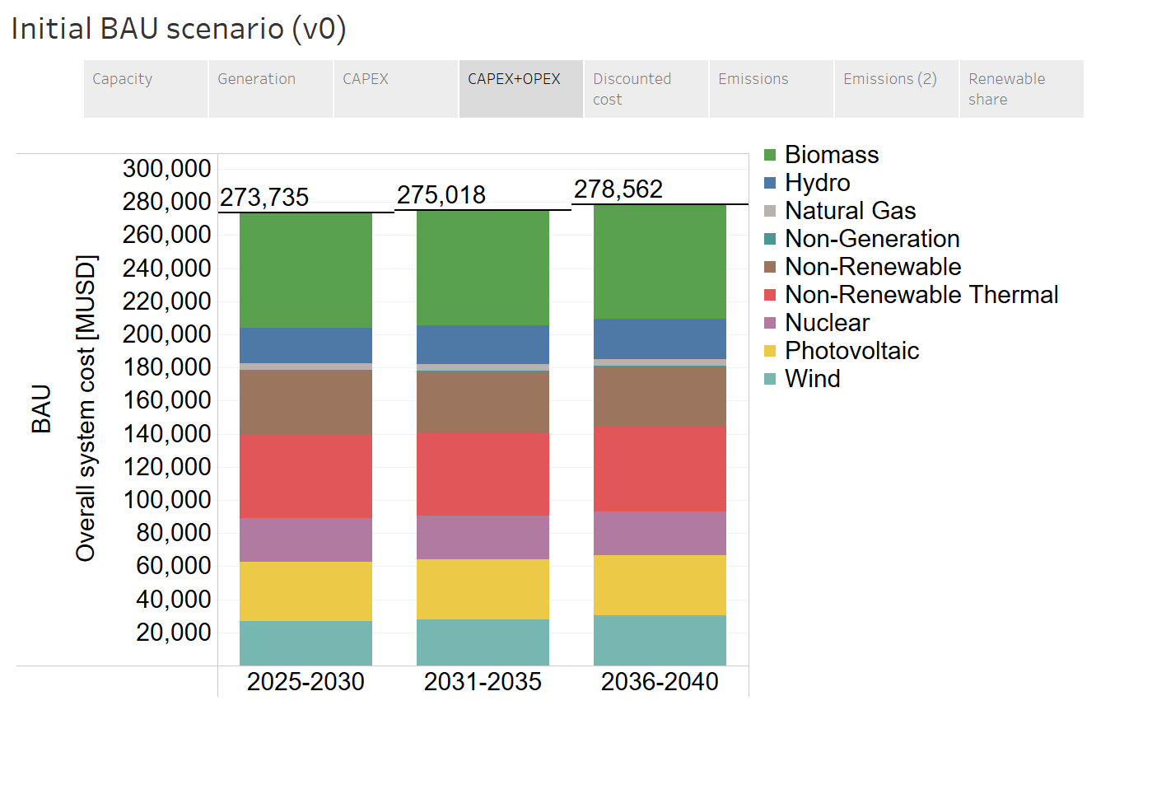
BAU — Investment & System Costs
Initial BAU (v0): Cumulative CAPEX by technology. Overall system cost (CAPEX+OPEX) remains in a narrow band across cost scenarios.
Cumulative CAPEX [MUSD]
Overall System Cost [MUSD]
OSTRAM — Data Package v1.0 | UN ESCAP Energy Division | March 2026

Slide 22
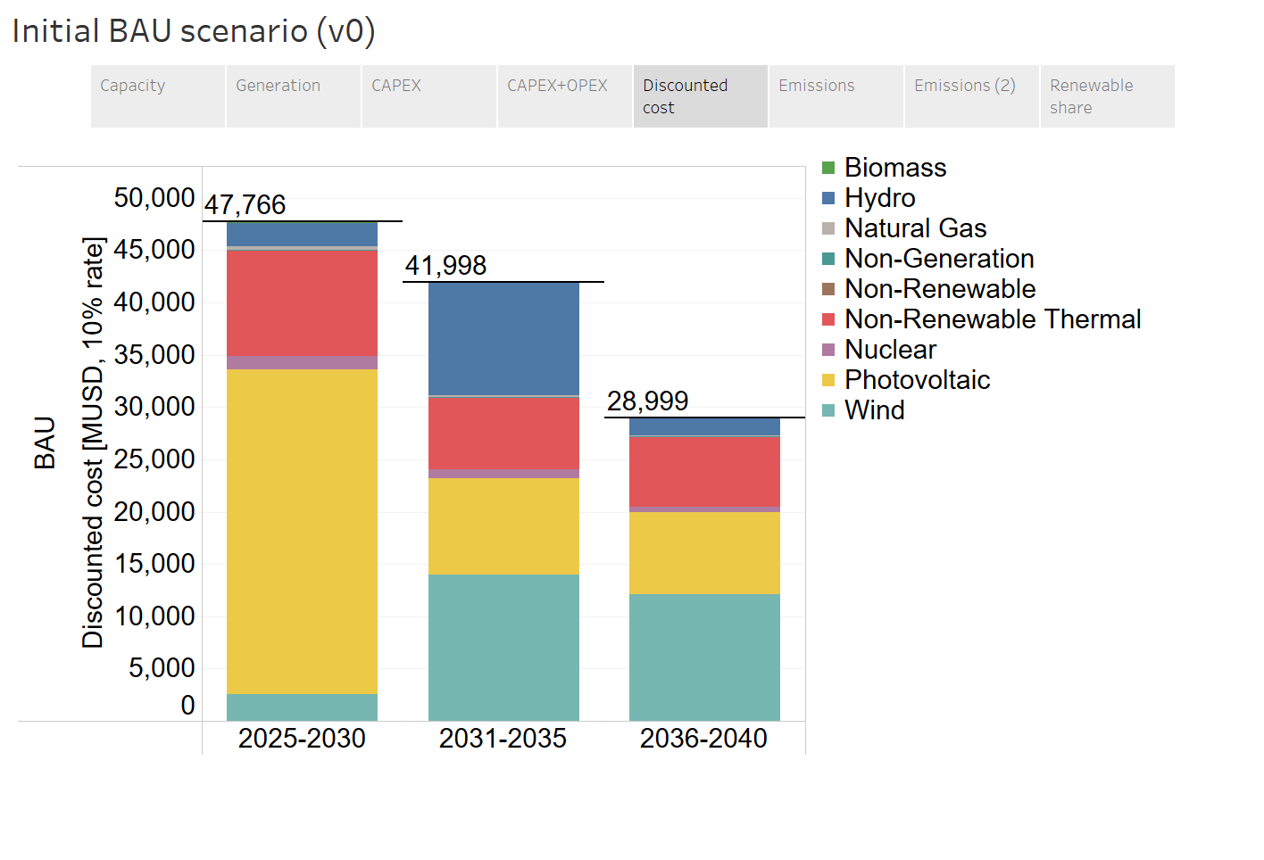
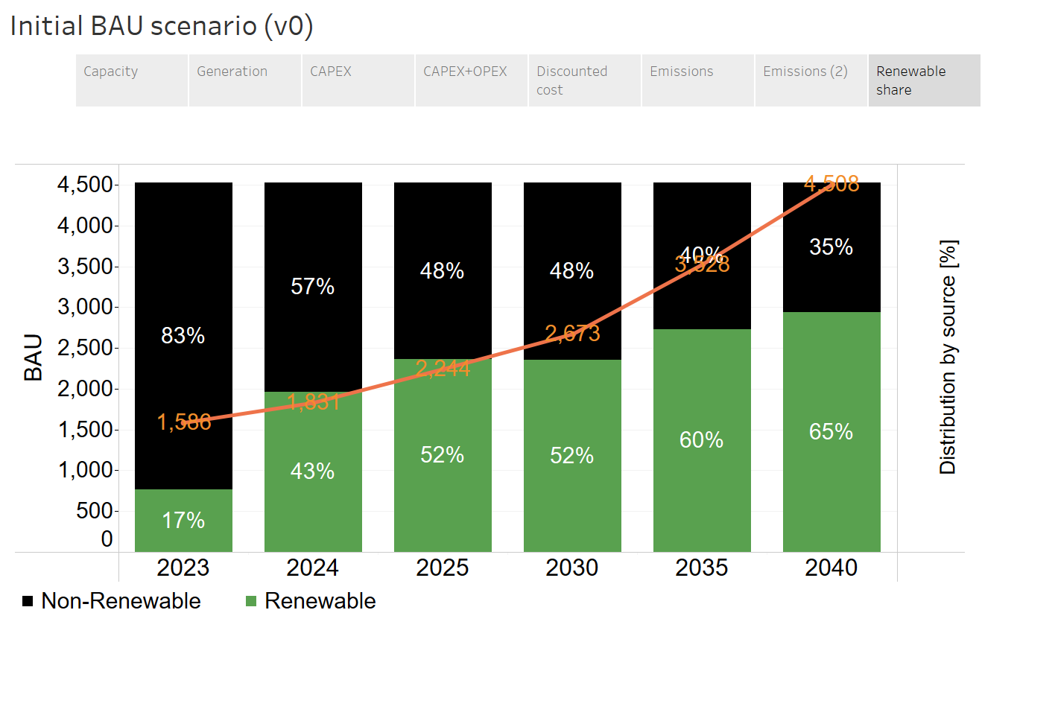
BAU — Discounted Cost & Renewable Share
Discounted system cost by technology. Renewable share grows from 17% (2023) to 60% (2035) in generation.
Discounted Cost [MUSD]
Renewable vs Non-Renewable Share
OSTRAM — Data Package v1.0 | UN ESCAP Energy Division | March 2026

Slide 23
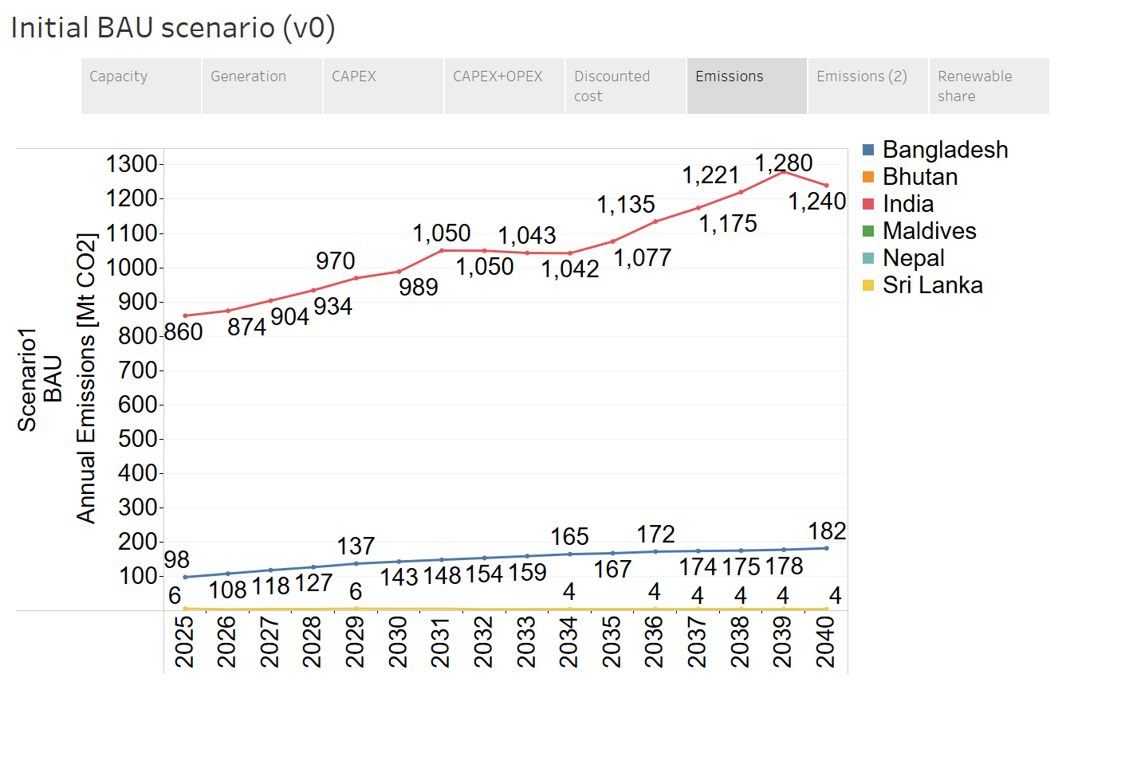
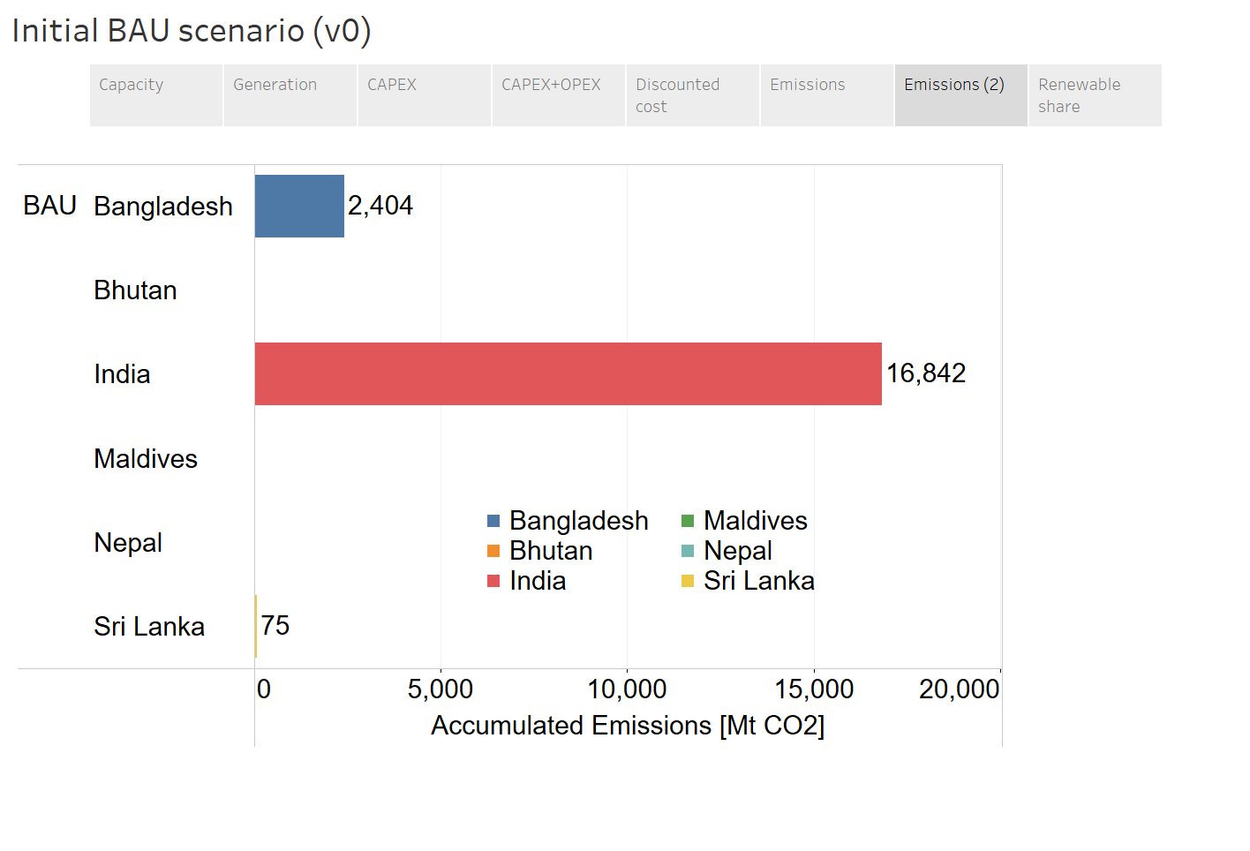
BAU — CO₂ Emissions
Annual emissions rise from 860 Mt (2025) to ~1,280 Mt (2039). India dominates cumulative emissions.
Annual Emissions [Mt CO₂]
Cumulative Emissions by Country
OSTRAM — Data Package v1.0 | UN ESCAP Energy Division | March 2026

Slide 24
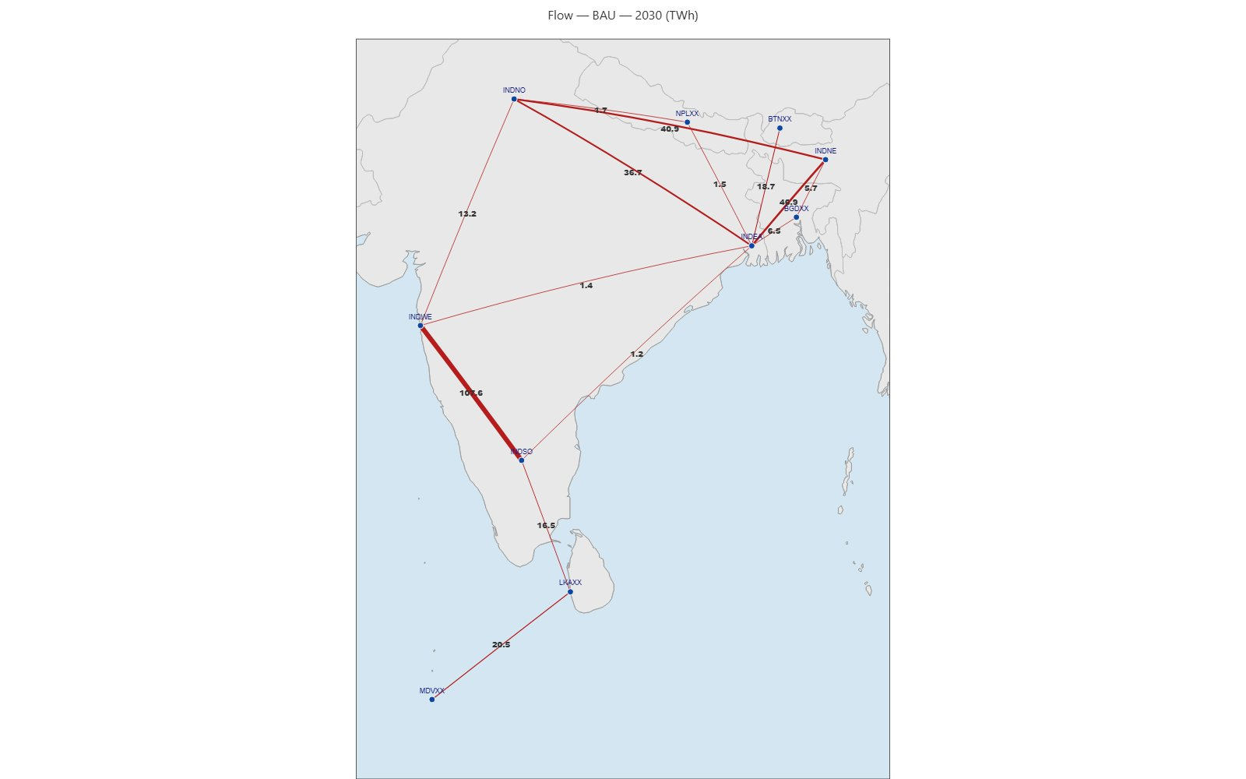
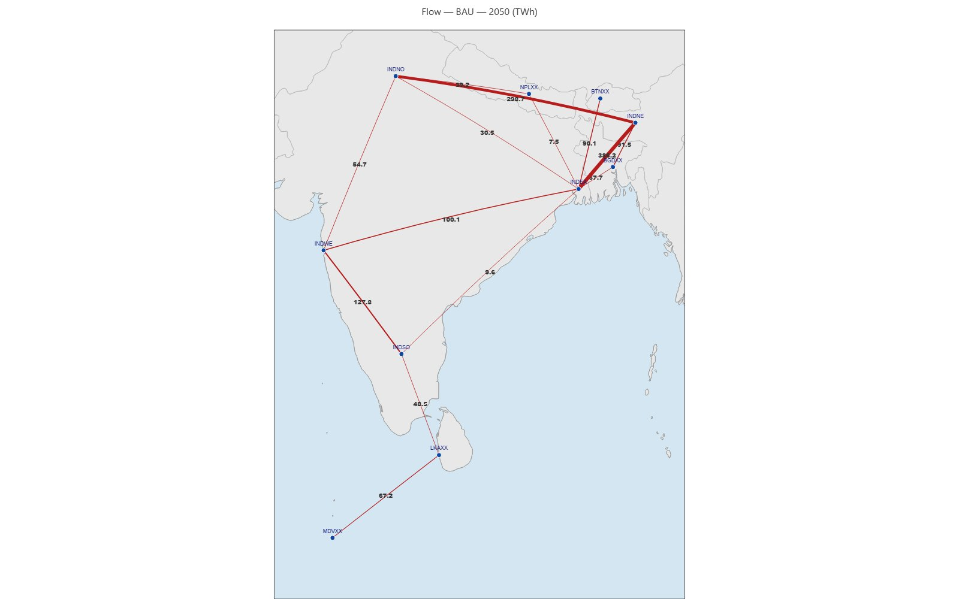
Interconnector Flows — BAU (Preliminary)
Net energy flows [TWh] across cross-border and internal India corridors. Line thickness proportional to flow magnitude.
2030
2050
Key corridors: INDWE↔INDSO dominates near-term (107 TWh by 2030). By 2050, INDNO↔INDNE (298 TWh) and cross-border flows to LKA/MDV grow substantially. Interactive viewer available as TransmissionMaps.html.
OSTRAM — Data Package v1.0 | UN ESCAP Energy Division | March 2026

Slide 25
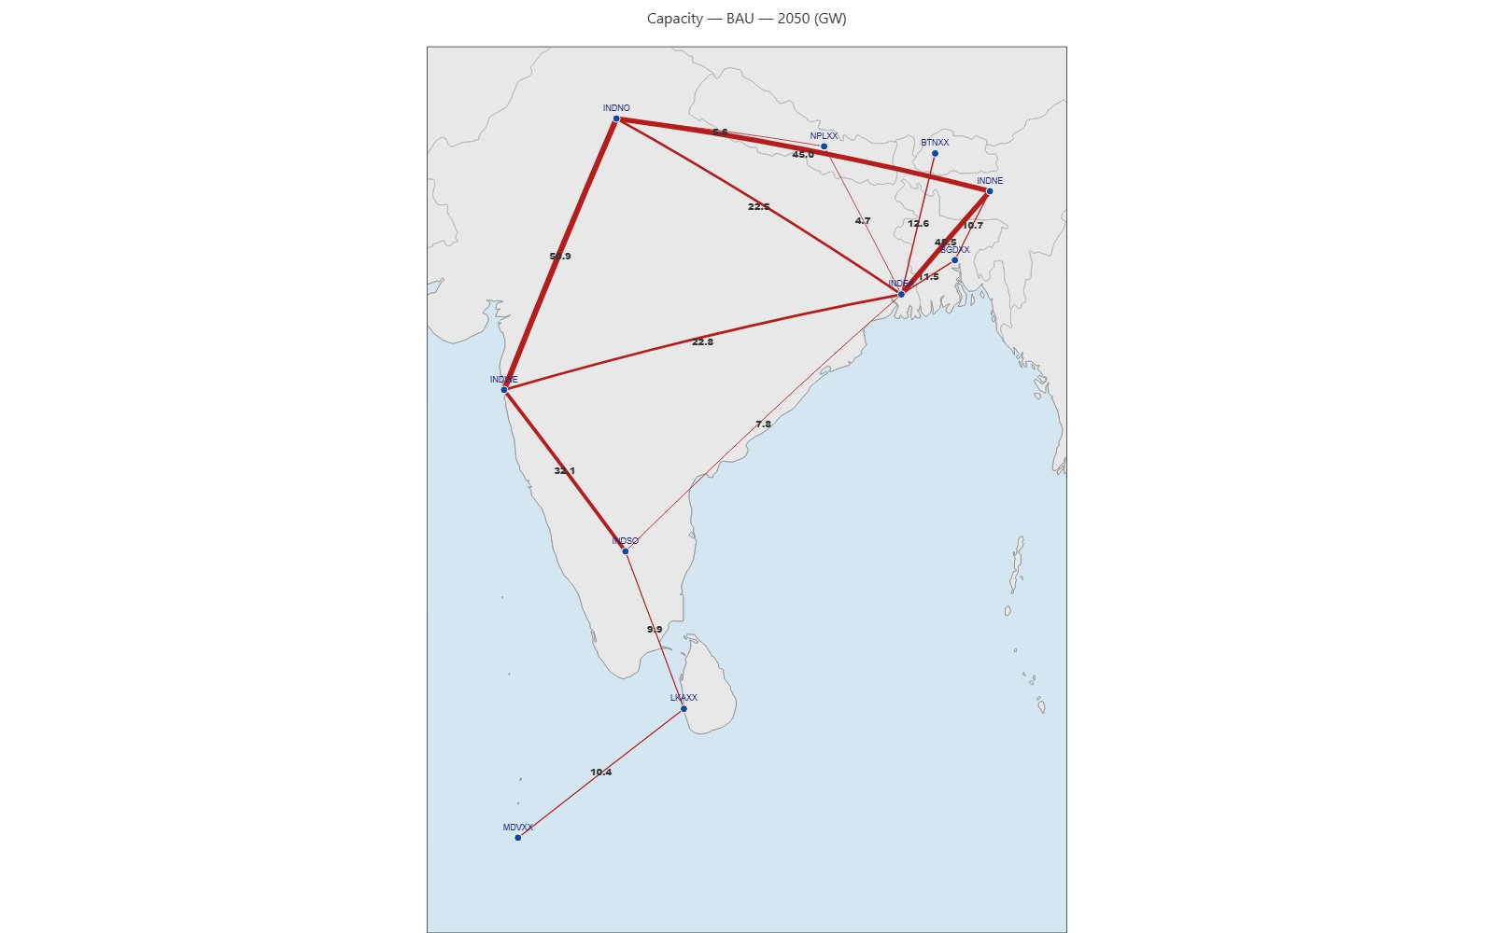
Interconnector Capacity — BAU 2050 (Preliminary)
Installed interconnection capacity [GW] by 2050 under BAU scenario. Line thickness proportional to capacity.
OSTRAM — Data Package v1.0 | UN ESCAP Energy Division | March 2026

Slide 26
Modeling Pipeline
OSTRAM — OSeMOSYS Global + Transmission Layer

Slide 27
Pipeline Steps
From OSeMOSYS Global base to final solved results — 5 automated steps
1
Import OSeMOSYS Global Inputs
CSV input files from OSeMOSYS Global stored in OG_csvs_inputs/ — base parameters for technologies, fuels, demands, costs
2
Pre-processing
Temporal profile normalization, country code fixes, tech-country filtering, NGS unification, region consolidation → Excel scenario files
3
Add Transmission Technologies
Domestic transmission & dispatch technologies added per country: RNWTRN, PWRTRN, DSPTRN with CAPEX, loss %, operational life from YAML config
4
Compile Model Data
Scenario-specific Excel files compiled into OSeMOSYS-compatible CSV parameter files via otoole pipeline
5
Execute Model
otoole convert → GLPK/CBC/CPLEX solver → results back to CSV. Supports parallel multi-scenario runs. Reproducible via DVC pipeline.
Alternative: run.py automates Steps 4–5 via DVC (recommended for production).
OSTRAM — Data Package v1.0 | UN ESCAP Energy Division | March 2026

Slide 28
How to Collaborate
Getting started with the OSTRAM repository and documentation
1
Share your GitHub username
2
Accept the repository invitation
3
Read the documentation
Send your GitHub username to the modeling team so we can add you as a collaborator on the private repository.
An email invitation will arrive at the address associated with your GitHub account. Accept it to gain access.
Full pipeline documentation, data dictionaries, and scenario configuration guides are available at ostram.readthedocs.io.
ostram.readthedocs.io
Full documentation site with installation guide, pipeline walkthrough, parameter reference, and contribution guidelines. Updated continuously as the model evolves. Link: https://ostram.readthedocs.io/en/latest/index.html
OSTRAM — Data Package v1.0 | UN ESCAP Energy Division | March 2026

Slide 29
Software Requirements
Tools required by ESCAP and country focal points to run and review the OSTRAM model
Optimization Solver
Results Dashboard
CPLEX (recommended) or GLPK / CBC
Tableau Desktop or Tableau Public
What it does
Solves the OSeMOSYS linear program — finds the least-cost generation and transmission expansion plan across all 10 nodes over 2023–2050.
Why CPLEX?
GLPK/CBC are open-source alternatives but solve 5–20× slower on regional models of this size. CPLEX academic licenses are free.
Who needs it?
Anyone running the model (CLG modelers, ESCAP staff during training sessions). Country focal points reviewing results do not need it.
Action required
Request IBM CPLEX academic license or confirm existing ESCAP access. Alternatively, CBC can be used during training with a performance trade-off.
What it does
Interactive visualization of model outputs — capacity mix, generation dispatch, investment profiles, emissions, and cross-border flows by scenario.
Why Tableau?
The OSTRAM results dashboard is built as a Tableau workbook. Country focal points can filter by node, technology, and year without touching any code.
Who needs it?
Everyone reviewing results — ESCAP staff, country focal points, and policy counterparts. Tableau Public (free) works for viewing; Desktop needed for editing.
Action required
Confirm Tableau Desktop license availability at ESCAP. If unavailable, Tableau Public or a static export (PDF/PNG) can serve as a fallback.
OSTRAM — Data Package v1.0 | UN ESCAP Energy Division | March 2026

Slide 30
Next Steps & Timeline
Date | Milestone | Comp. | Note
15 Mar 2026 | Data Package v1.0 Freeze | A | This delivery — documented gaps to improve in future iterations
Mid-Apr 2026 | Training Session 1 | B | Data & scenario setup — uses preliminary data
30 Apr 2026 | BAU Results + Exchange Maps | A | Use ATB costs if tech cost data still missing
29 May 2026 | Optimize VRE Results | A | VRE profile sensitivities if uncertainty is high
Mid-Jun 2026 | Training Session 2 | B | Results & illustrative scenarios
30 Jun 2026 | VRE Target Results | A | Policy documents review in detail
Aug 2026 | Final Package + Handover | A | Complete reproducible run packages
Sep 2026 | Policy Compatibility Report | B | Subregional modeling compatibility synthesis
Original milestone dates preserved — contingency planning preferred over slippage.
OSTRAM — Data Package v1.0 | UN ESCAP Energy Division | March 2026

Slide 31
OSeMOSYS for Transmission
OSTRAM - Data Package v1.0
South Asia Power System Connectivity Model Progress update #3
Data collection substantially complete across all six countries.
BAU scenario results available.
Data package needs to update BAU results.
Model ready for Optimize VRE and VRE Target runs.
UN ESCAP Energy Division
March 12th, 2026

