Slide 1
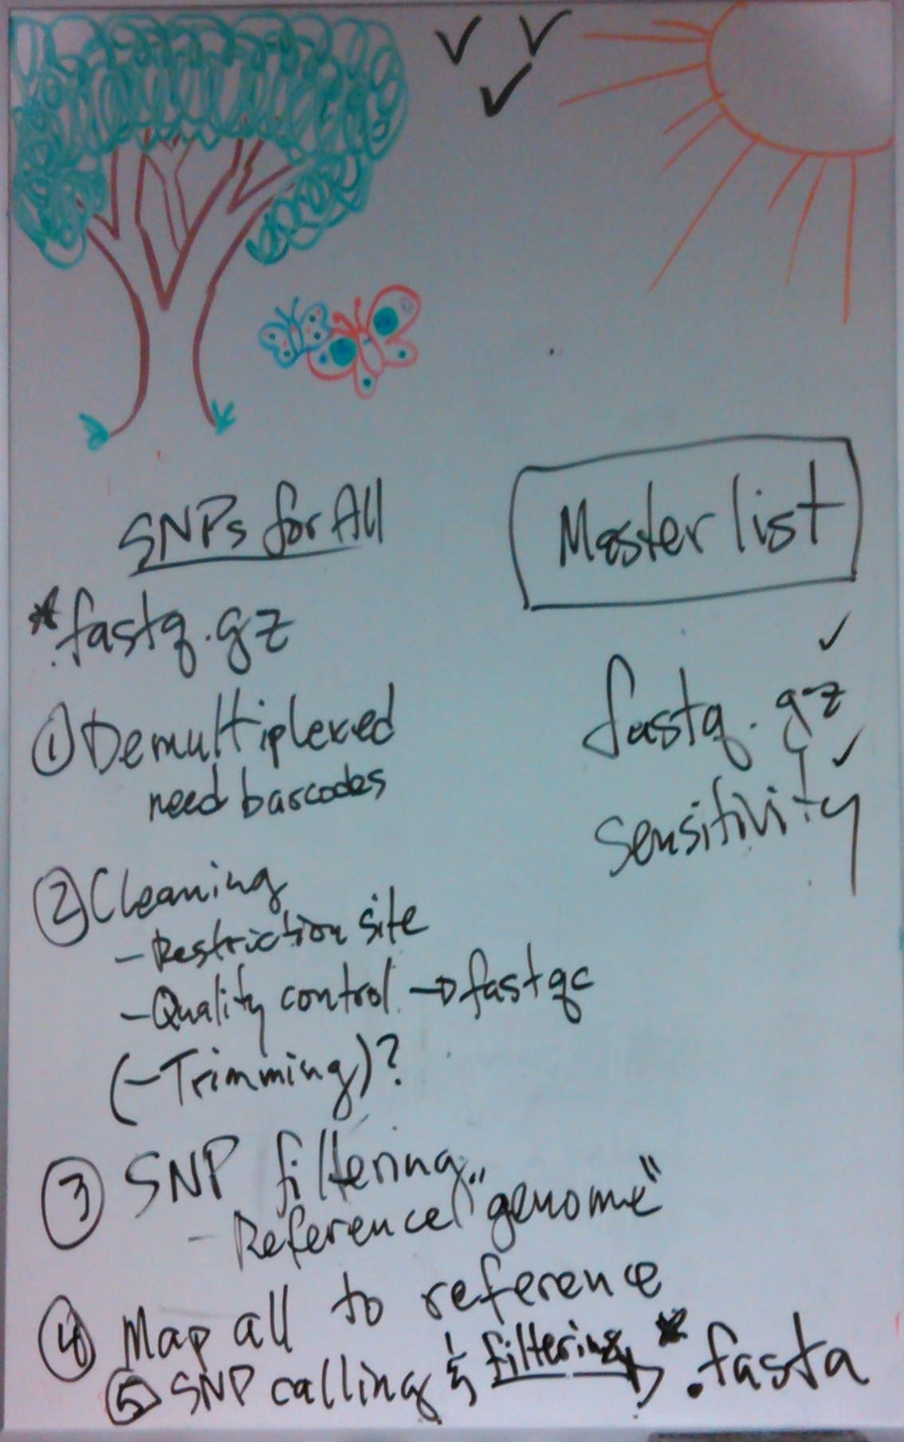
Demultiplex
Reference Genome
(SNP filtering)
SNP Calling
(fasta)
Clean
&
Trim
Map All to Reference
Genome

