Slide 1
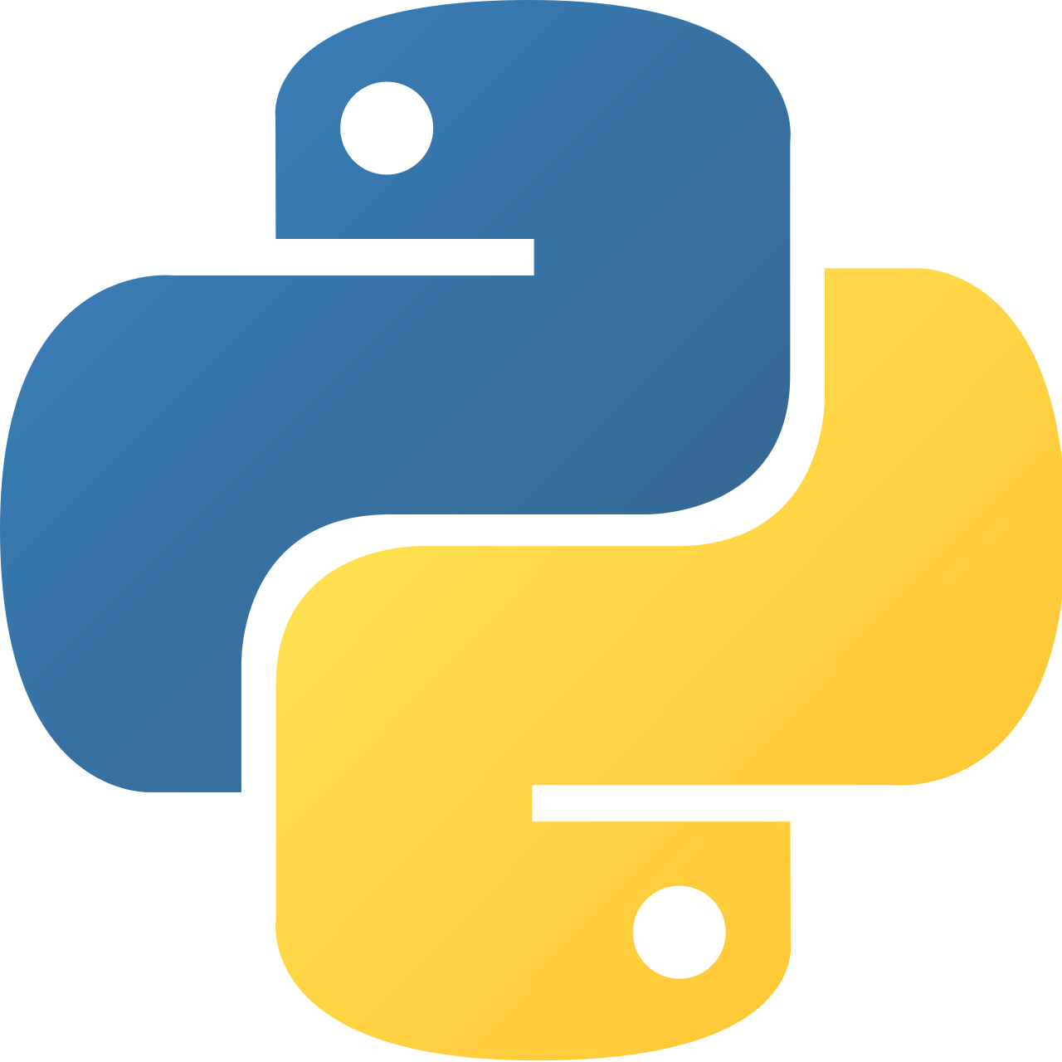
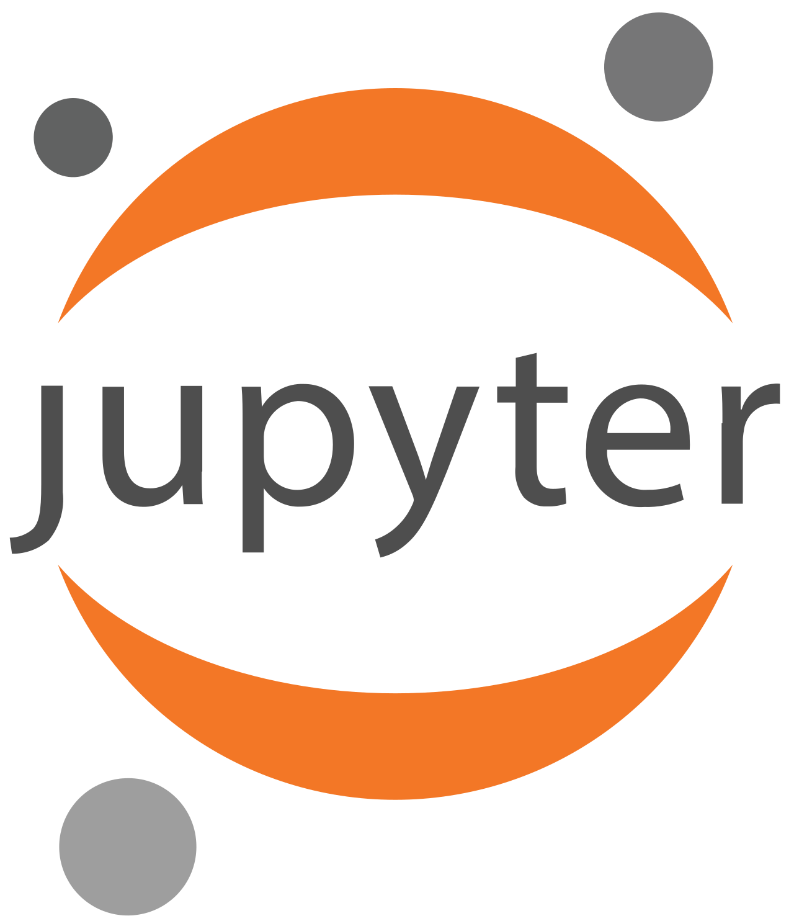
Introduction
Python & Jupyter
Climate Risk Assessment Spring Semester 2026

Slide 2
Program
What is Python and why do we use it?
How do we use Python and Jupyter in this course?
Basic introduction to Python
  Today:
    Get everyone’s Python installation running
    Python Datatypes and Objects, interacting with Packages
  Next Week: Numpy and Xarray

Slide 3
What is Python & Why do we use it?
High level general-purpose programming language
Emphasis on code readability (Indentation, English keywords)
Multiparadigm & dynamic typing
Extensive Standard Library and lots of scientific open source libraries

Slide 4
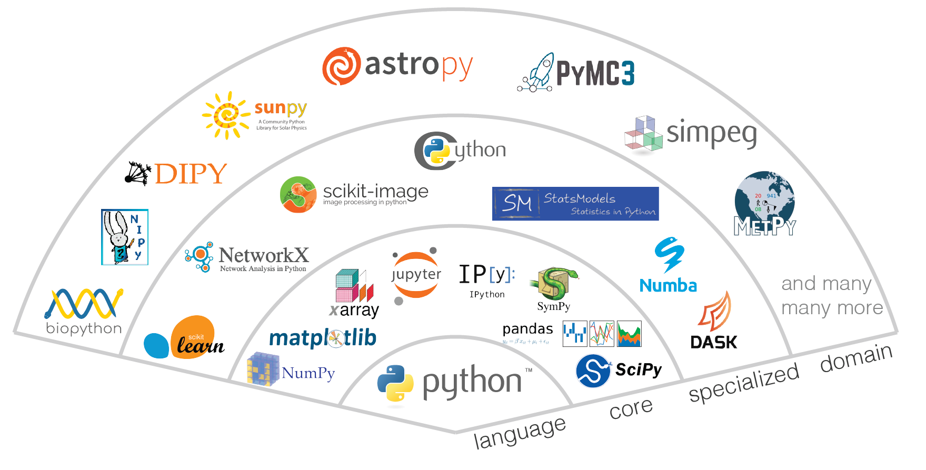
The scientific “Ecosystem”
Source: https://jupytearth.org/jupyter-resources/introduction/ecosystem.html

Slide 5
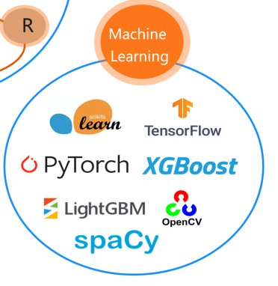
The scientific “Ecosystem”
Source: https://jupytearth.org/jupyter-resources/introduction/ecosystem.html

Slide 6
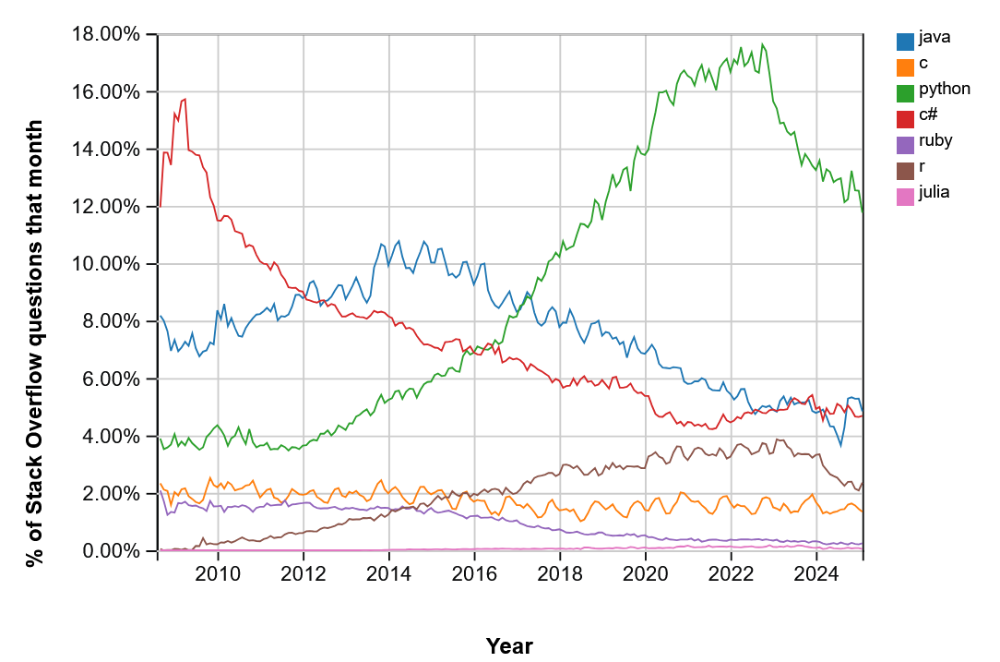
Currently one of the most popular languages
Source: https://insights.stackoverflow.com

Slide 7
Currently one of the most popular languages
30.11.2022
Release of ChatGPT
Source: https://insights.stackoverflow.com

Slide 8
Use of AI Tools for Programming
ChatGPT, Github Copilot, AlphaCode…
Use them, but don’t blindly trust them.
Make sure you understand the code that you copy!

Slide 9
What is Jupyter?
Jupyter: Open Source Software for Interactive Computing
Available for multiple languages (Jupyter: Julia, Python, R)
a = 5
b = 10
c = a + b
e = 5
d = c + e
a = 5
b = 10
c = a + b
e = 5
d = c + e
If I want to change e
everything will be recalculated
If I want to change e
Only the second cell must be calculated
c is stored in memory

Slide 10
Using Python on your own Computer
Be mindful of resource usage!
  Your laptop has limited processing power and memory
    Windows: Task manager (ctrl + shift + Esc)
    Linux: htop
    Mac: Activity Monitor
Back up your code! We can not help you restore the lost code…
  Simple approach: Copy your work onto an external drive or a cloud
  Advanced: use git for version control (recommended)

Slide 11
Use an IDE
An IDE (Integrated development environment) is a comprehensive text editor to write, test, debug and run your code in an easier way. Popular Python IDEs are:
Vscode (used by many of us, resource intensive)
Jupyter notebooks (Jupyter Lab) (simplest way to get started)
Pycharm
Spyder
…

