Slide 1
Plots and Colorbars

Slide 2
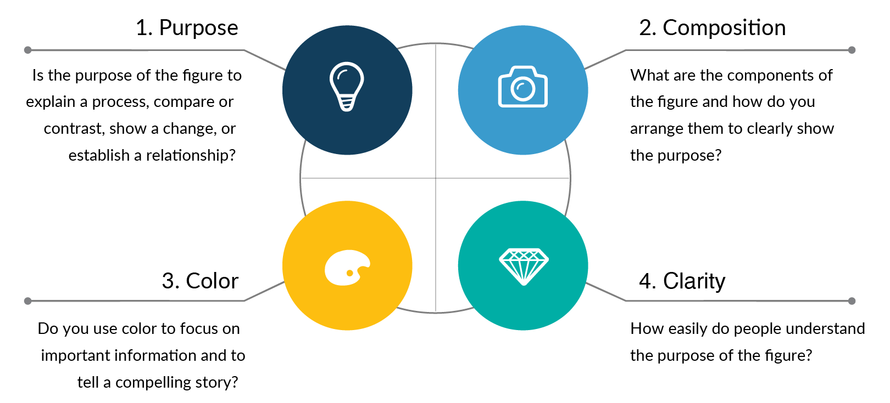
What makes a good plot?
Notes:
https://www.simplifiedsciencepublishing.com/resources/how-to-make-good-figures-for-scientific-papers

Slide 3
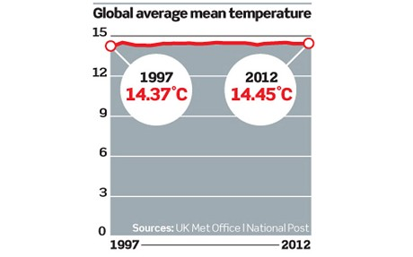
Some examples
Christopher Booker @ The Telegraph
Notes:
https://betterfigures.org/2013/03/11/how-to-strip-meaning-from-graphs/

Slide 4
Meaningful Figure?
Sensible y-axis scale?
Information Content vs. Figure space?
Labels?
Is a short-term temperature record graph really useful?
What’s that doing here?
Christopher Booker @ The Telegraph

Slide 5
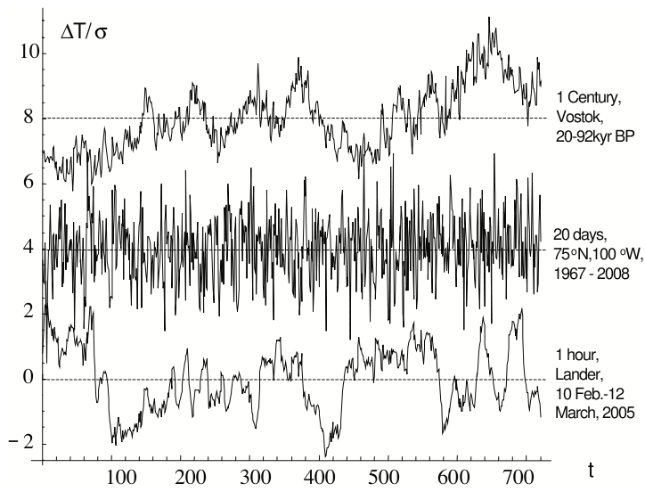
Lovejoy et al. Figure 1
Notes:
https://betterfigures.org/2012/11/28/too-much-information/

Slide 6
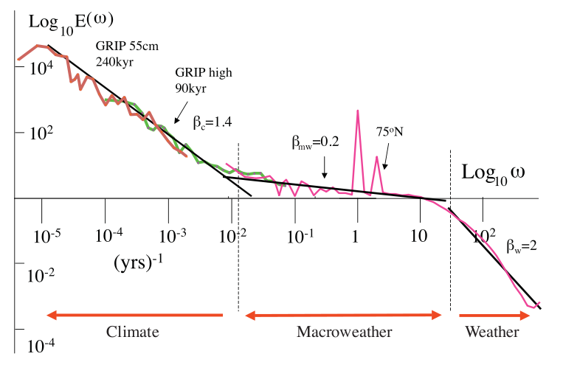
Lovejoy et al. Figure 2
Notes:
https://betterfigures.org/2012/11/28/too-much-information/

Slide 7
Lovejoy et al. Figure 2
Still pretty good. Trendlines may be a bit too “leading to the eye”.
Notes:
https://betterfigures.org/2012/11/28/too-much-information/

Slide 8
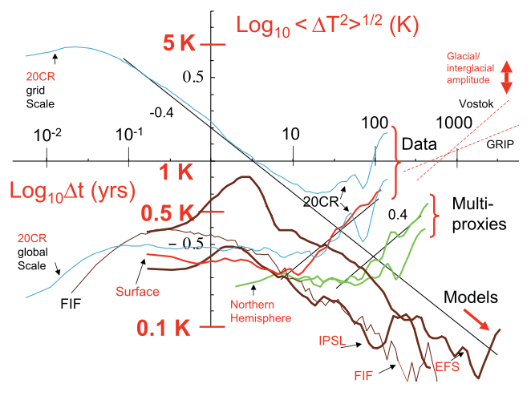
Lovejoy et al. Figure 4
Notes:
https://betterfigures.org/2012/11/28/too-much-information/

Slide 9
Lovejoy et al. Figure 4: information content?
Too much Information!
Preprint (doi:10.5194/esdd-3-1259-2012) Final version is improved!
Notes:
https://betterfigures.org/2012/11/28/too-much-information/

Slide 10
What makes a good plot?
Well chosen colors enhance the understanding of the plot. If poorly chosen it is distracting instead.
Notes:
https://www.simplifiedsciencepublishing.com/resources/how-to-make-good-figures-for-scientific-papers

Slide 11
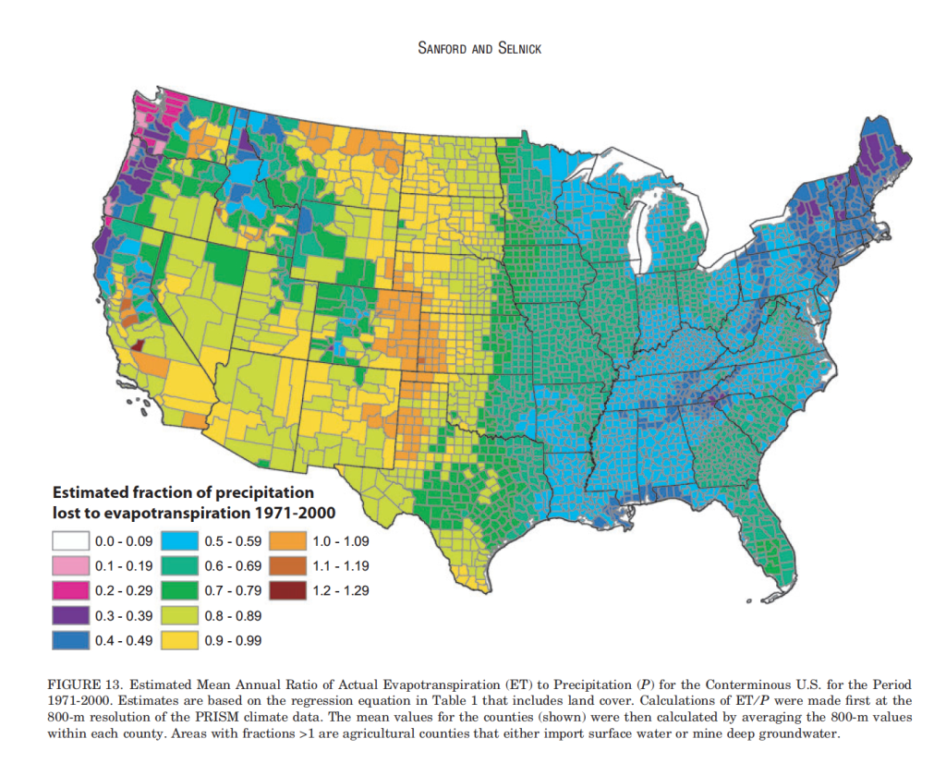

Slide 12
Colorbar choice?

Slide 13
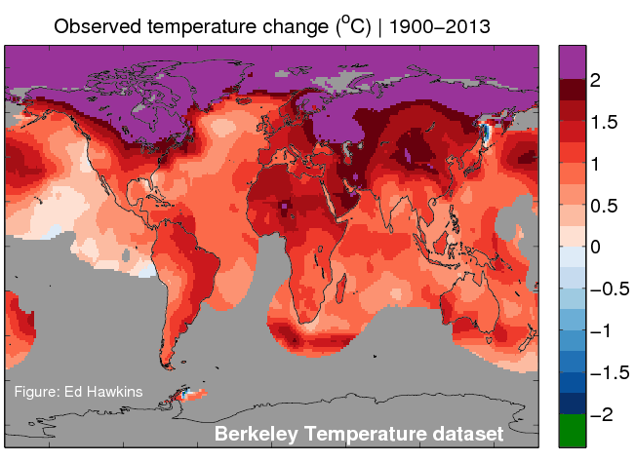
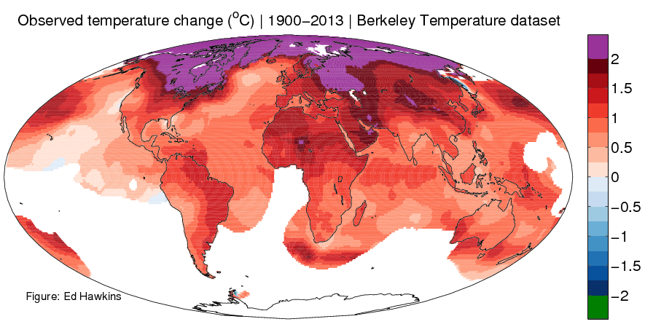
Projection

Slide 14
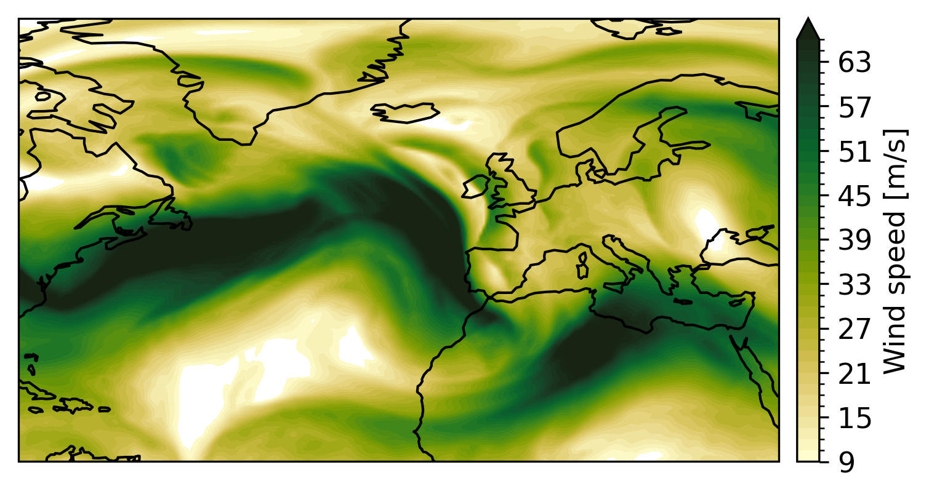
Avoid to use too many levels!

Slide 15
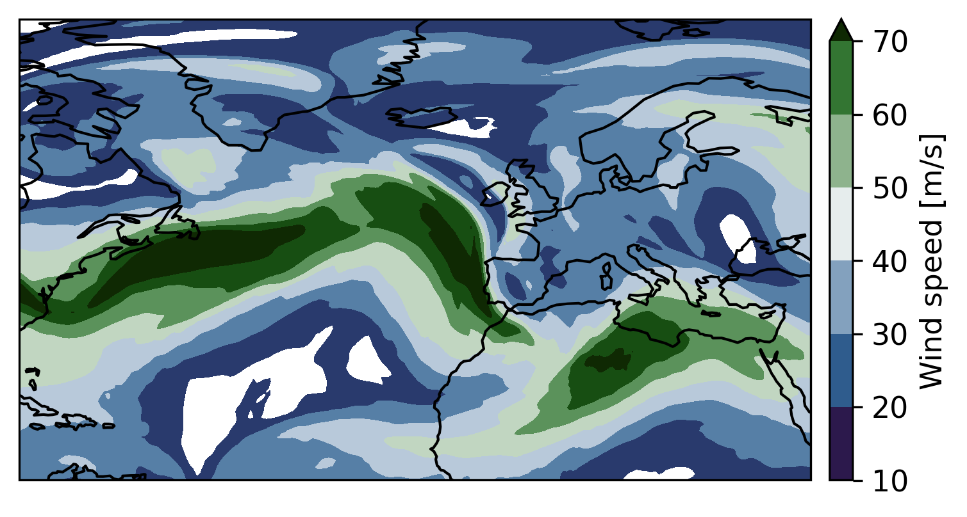
Less levels are better! But …

Slide 16
… don’t use symmetric colors for non-symmetric data

Slide 17
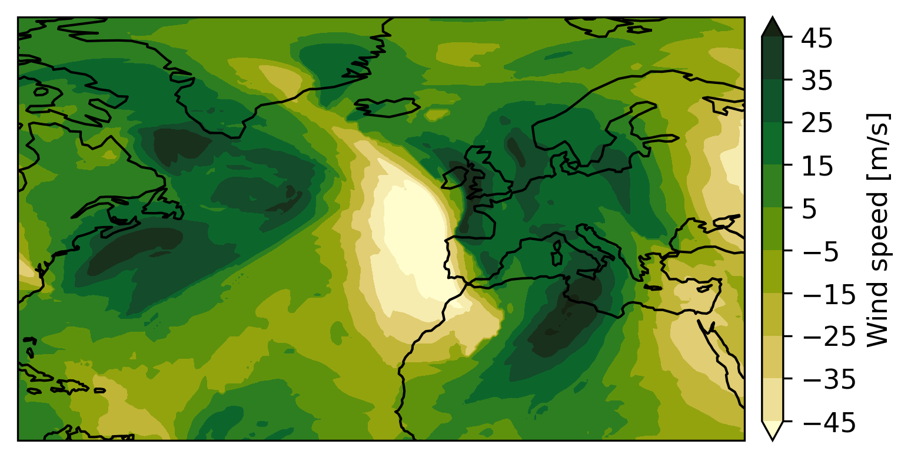
Same here: don’t use non-symmetric colors for symmetric data

Slide 18
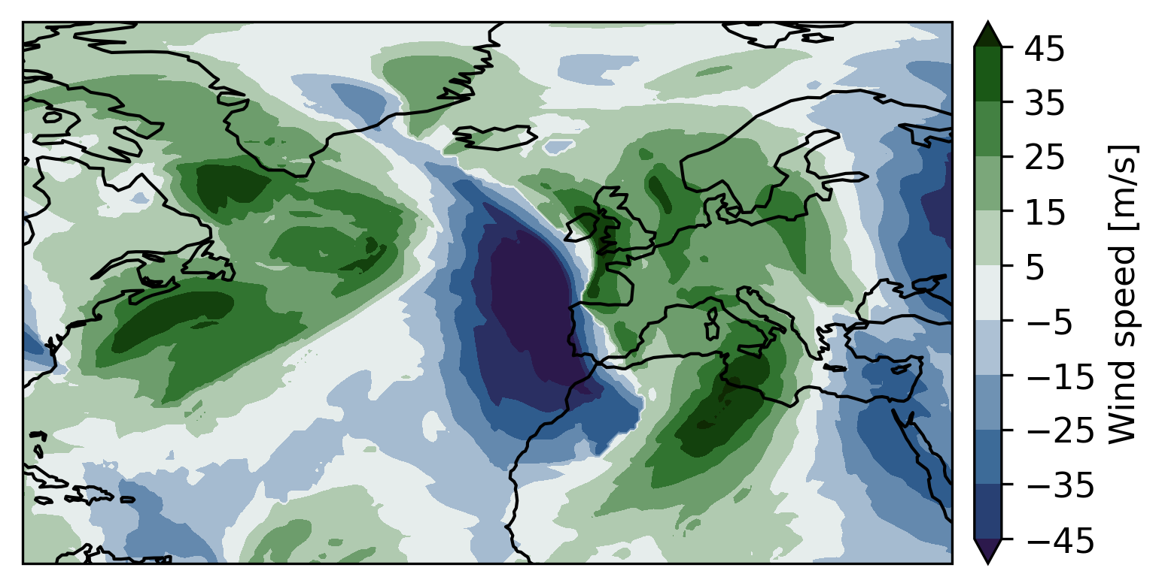
Instead, it should look like this:
symmetric data + symmetric colorbar
Positive values: green
Negative values: blue
→ Easy to detect and to understand

Slide 19
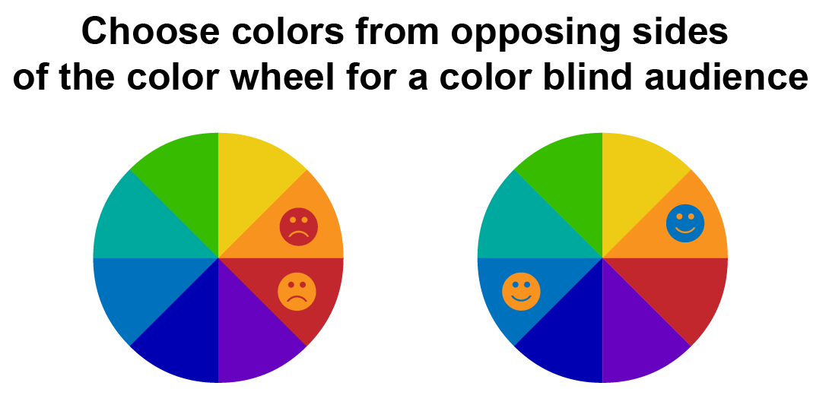
Selection of the colorbar
Worldwide 8% of man and 0.5% of women experience Color Vision Deficiencies (CVD) (Crameri et al. 2020)
Create contrast:
Opposing colors
Color saturation and lightness
More detailed information and practical examples about choosing a suiting colorbar can be found in the Jupyter notebook
Notes:
https://www.nature.com/articles/s41467-020-19160-7
https://www.simplifiedsciencepublishing.com/resources/best-color-palettes-for-scientific-figures-and-data-visualizations

Slide 20
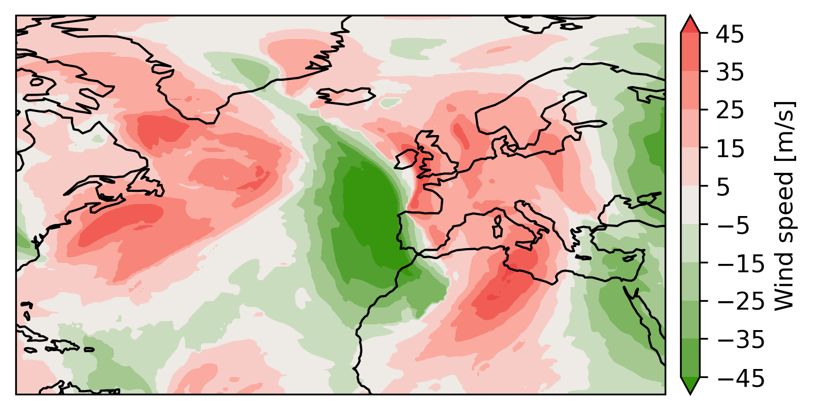
This plot …

Slide 21
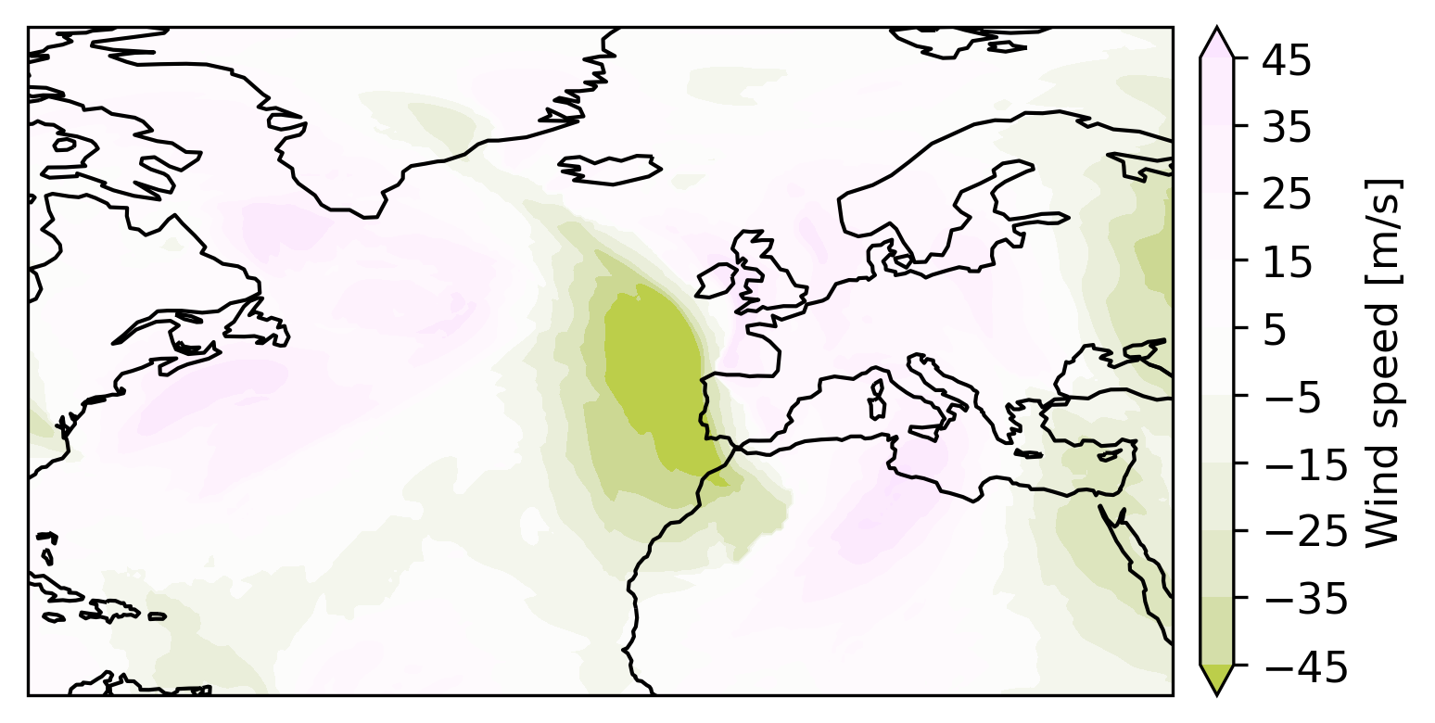
… will look like this for people with protanopia:

Slide 22
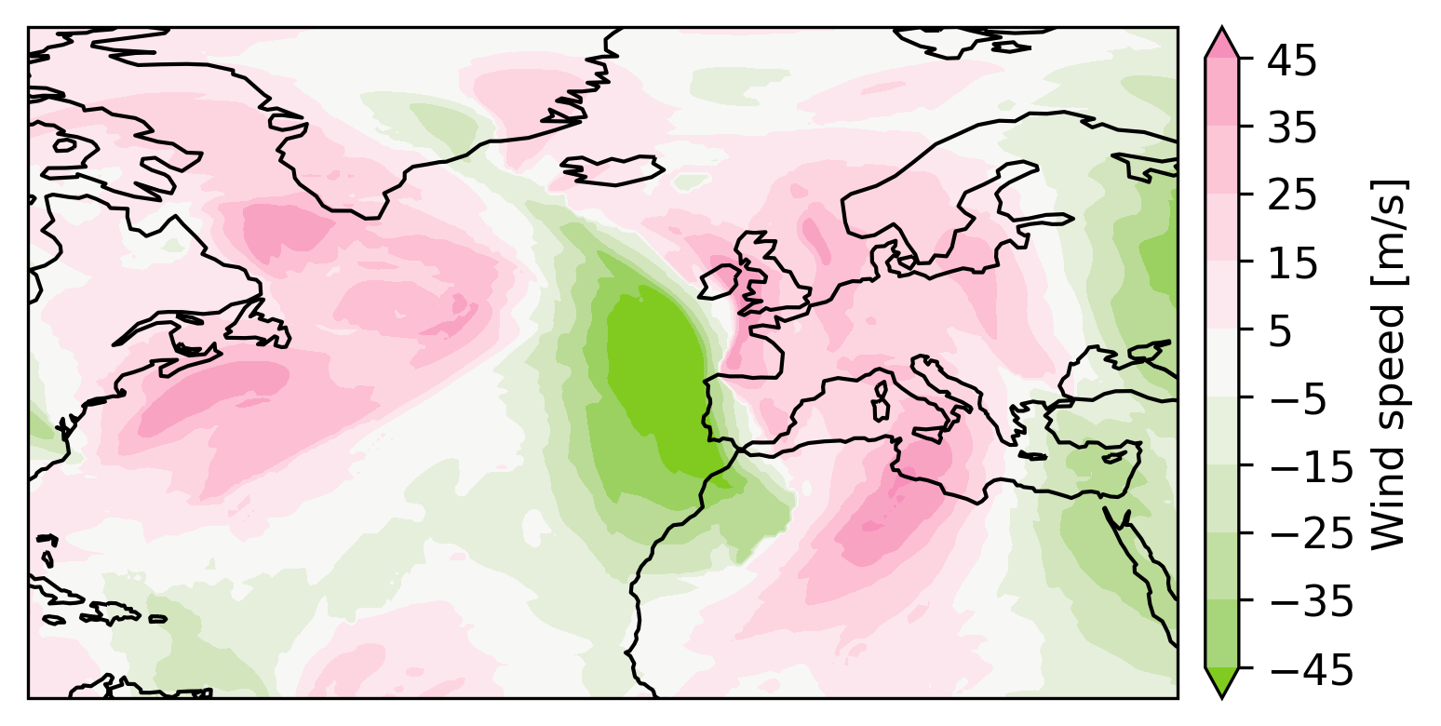
… will look like this for people with deuteranopia:

Slide 23
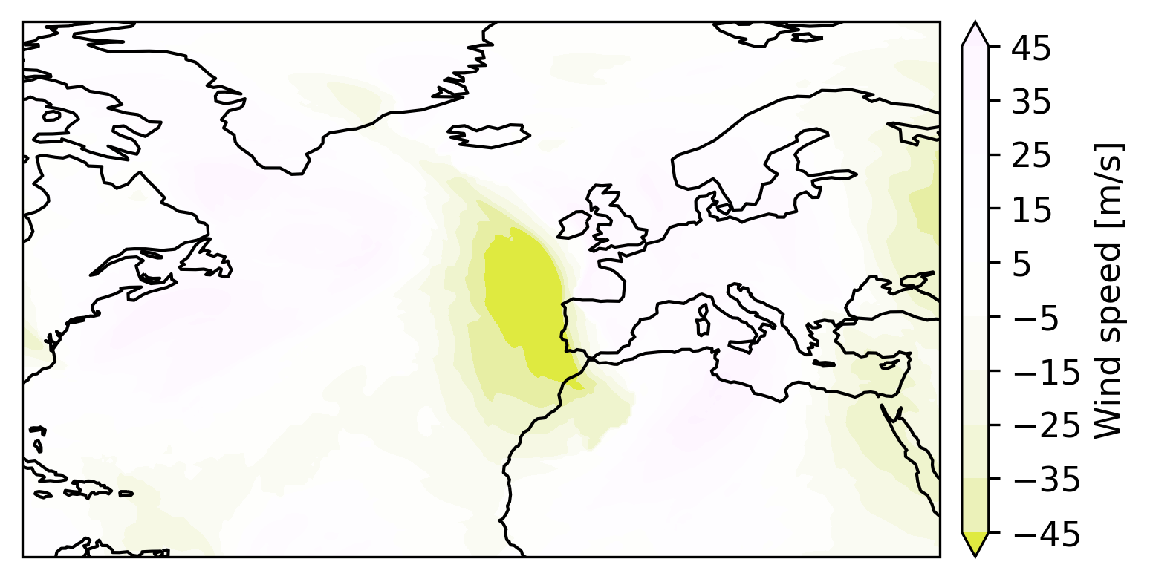
… will look like this for people with tritanopia:

Slide 24
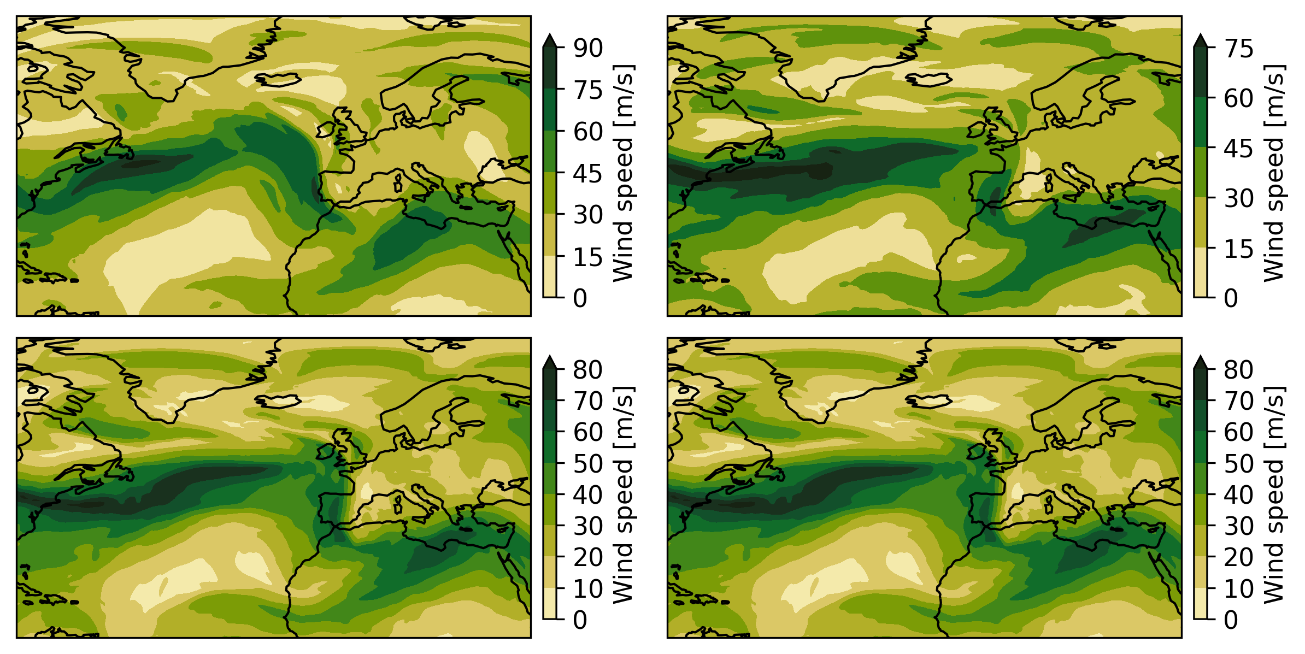
Things to avoid: Mixed Colorbars

Slide 25
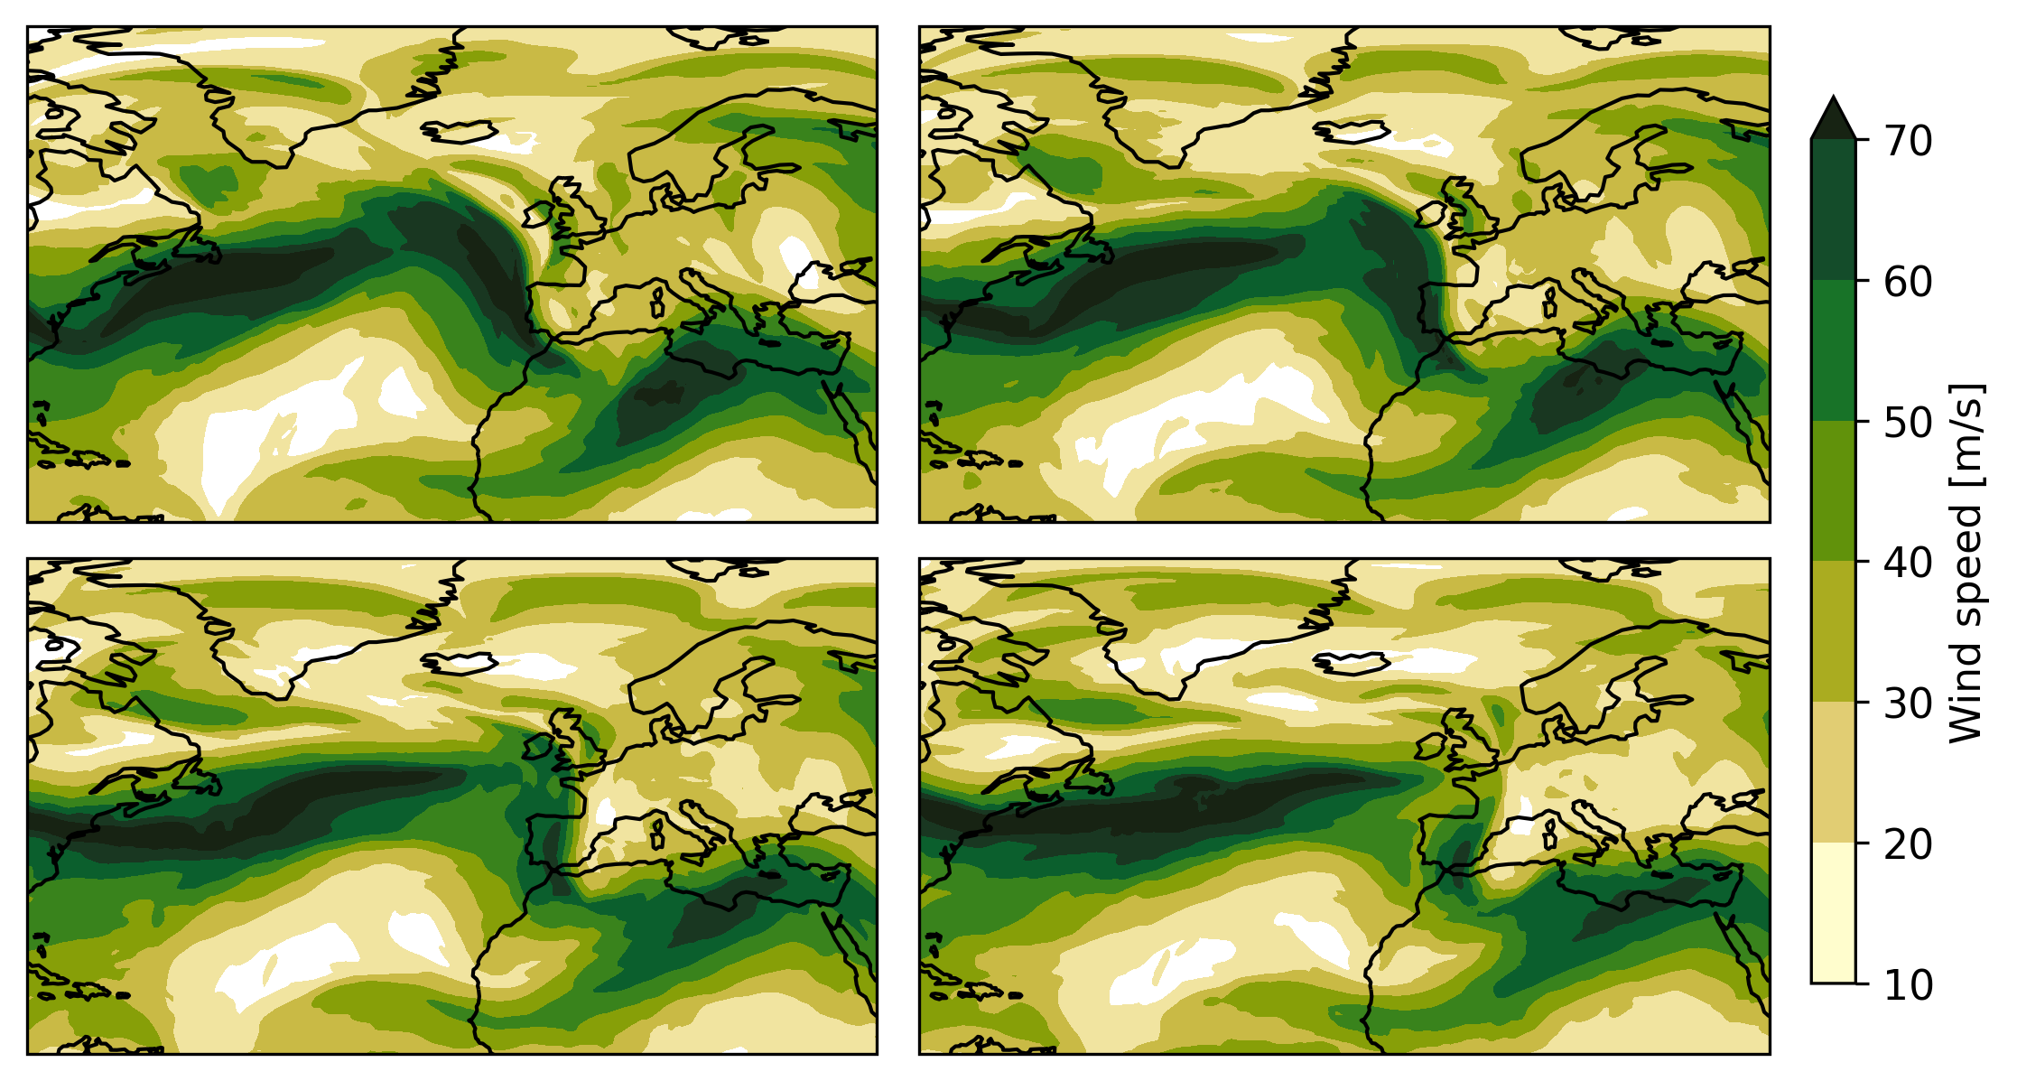
For clarity, when showing many plots at once, use the same colorbar for all!*
*Exceptions exist, use your best judgement

Slide 26
Figure Checklist
Purpose:
What do I want to show?
Does a figure make sense? If yes what type?
Composition:
What elements do I need on my figure?
How do I arrange them?
Color:
Which colors to use?
Do they convey the correct information?
Clarity:
How easily can my figure be understood?

Slide 27
Readability:
Number of subplots ok?
Fontsize ok?
Content density ok?
Axis choice ok? (i.e. should it be logarithmic?)
Projection ok?
Colors:
Color choice ok?
Misleading?
Colorblind friendly? Also, think about that in your figure descriptions (“The red line shows…”)
Colorbar levels?
Style:
Font consistent throughout the figure?
Figures consistent throughout the paper?
Aesthetically pleasing?
Everything aligned?

Slide 28
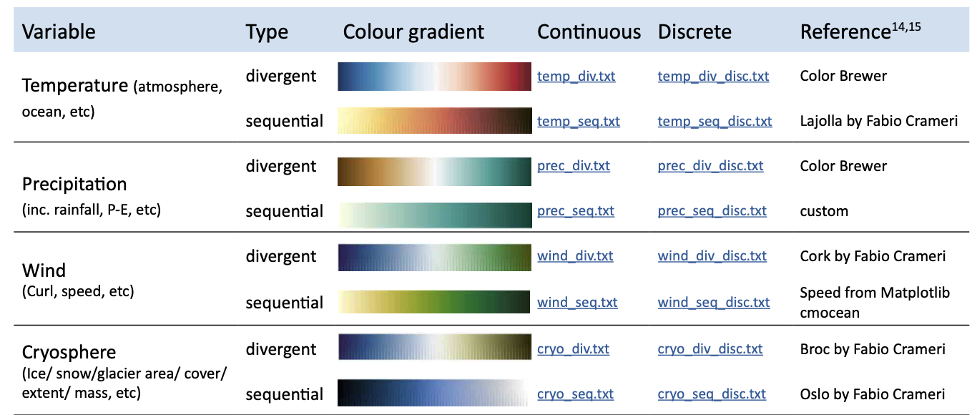
Choose the right color for what you want to show! In doubt, follow IPCC style sheet
https://www.ipcc.ch/site/assets/uploads/2022/09/IPCC_AR6_WGI_VisualStyleGuide_2022.pdf

Slide 29
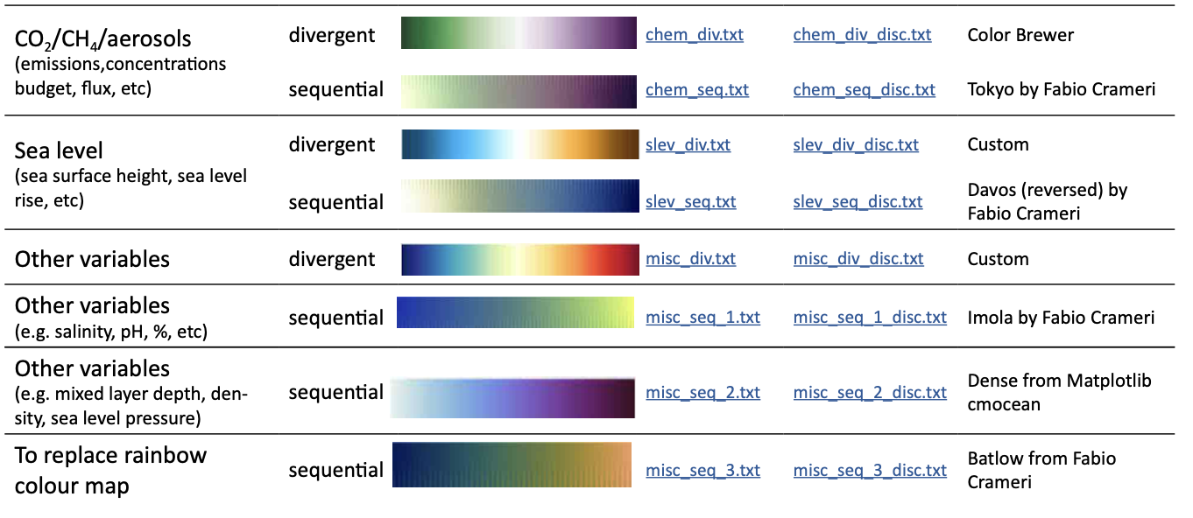
Continued …

Slide 30
Helpful links
https://colorbrewer2.org/#type=sequential&scheme=BuGn&n=3
https://davidmathlogic.com/colorblind/#%23648FFF-%23785EF0-%23DC267F-%23FE6100-%23FFB000
https://earthobservatory.nasa.gov/blogs/elegantfigures/2013/08/05/subtleties-of-color-part-1-of-6/
https://b.nanes.org/figures/
https://www.simplifiedsciencepublishing.com/resources/how-to-make-good-figures-for-scientific-papers
https://pmc.ncbi.nlm.nih.gov/articles/PMC6151470/

