Slide 1









Climate Watch
A multi-channel sensor platform to track environmental conditions in real time
  Automate
  Crowdsource
  Correlate
  Connect
  Storify
  Integrate
  Navigate

Slide 2





Climate Watch
Integrate

Slide 3
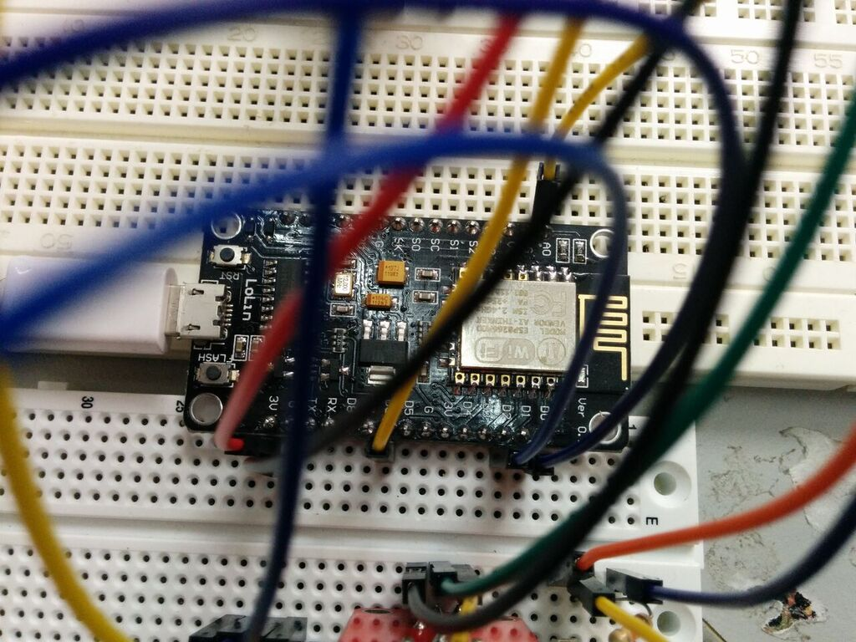
Climate Watch
Automate

Slide 4
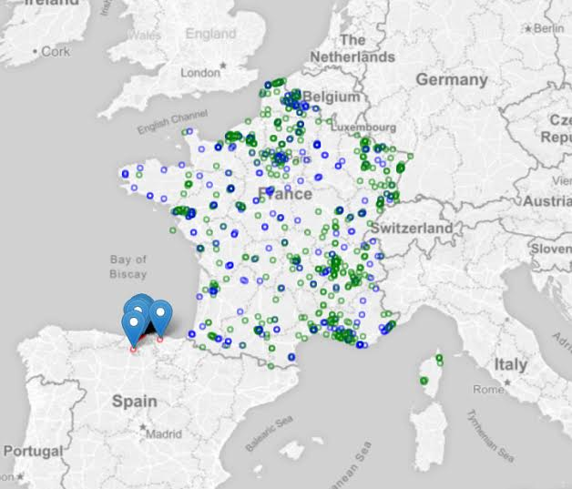
Climate Watch
Navigate

Slide 5
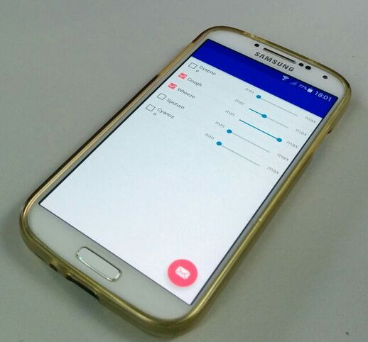
Climate Watch
Crowdsource

Slide 6
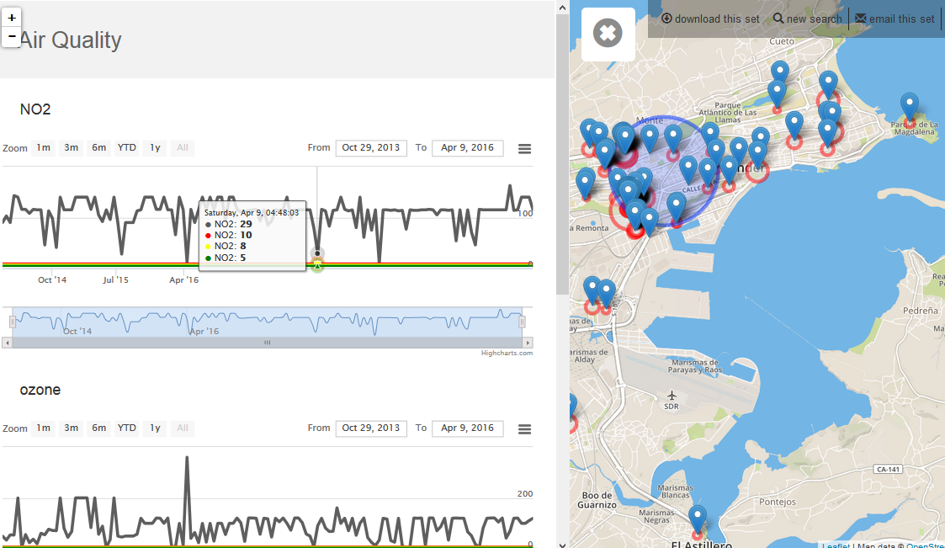
Climate Watch
Correlate

Slide 7
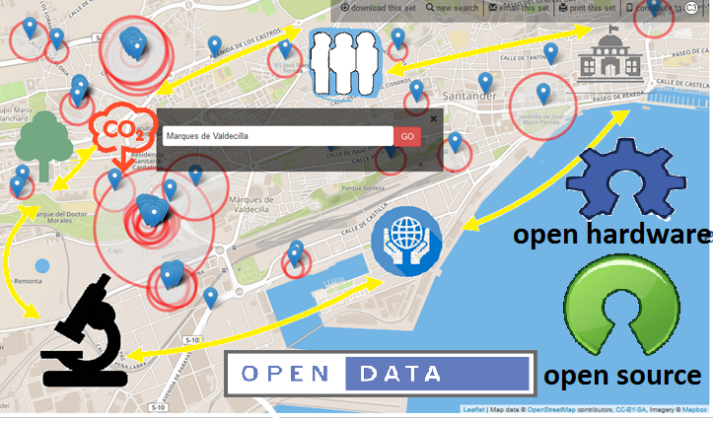
Climate Watch
Connect

Slide 8
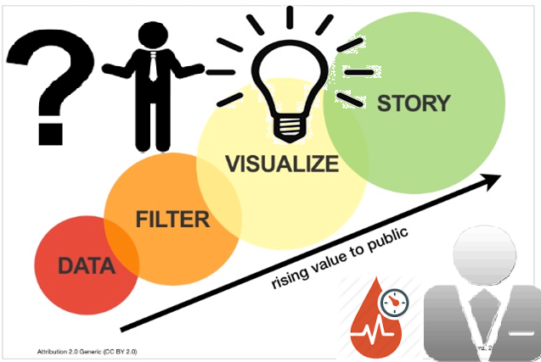
Climate Watch
Storify

