Slide 1
We build the stage for UK growth.
ClimbGroup
Festivals, programmes and the communities that keep growing between them.
Company presentation

Slide 2
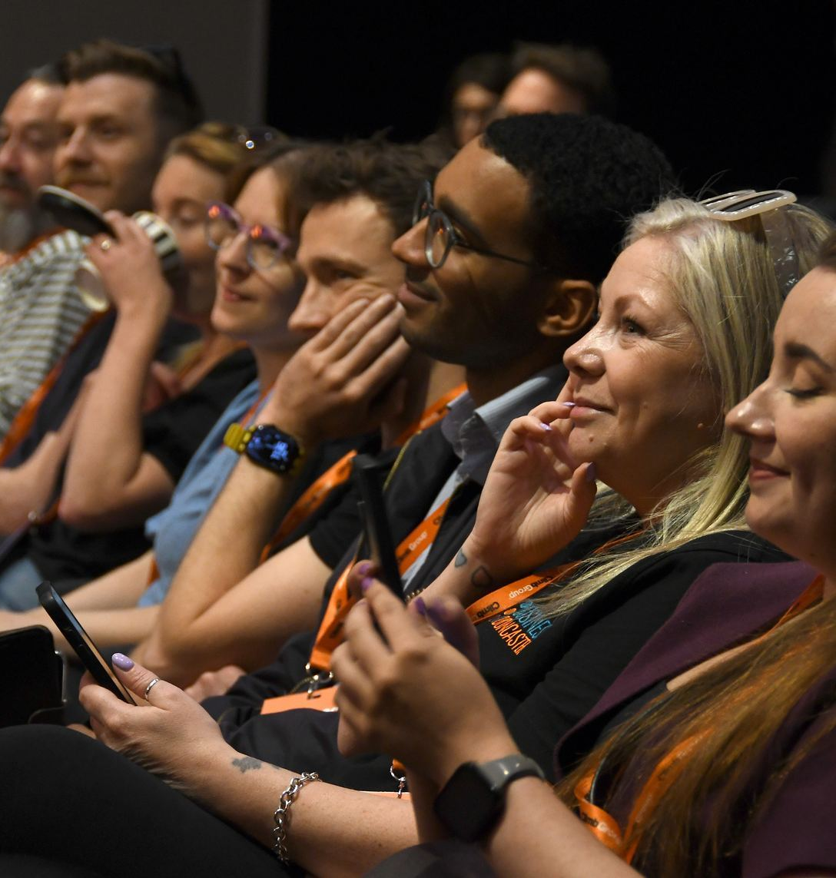
The room where deals start.
Main stage
Find your people
Founders, investors and partners in one place, with the time to talk properly.

Slide 3
Why it works
01
The stage, the room and the follow-ups.

Slide 4
What happens on the day
The day
Main stage moments from founders who have done it
Roundtables where you bring the problem and leave with a plan
Speed networking with investors looking for real deal flow
An after party that keeps the conversation going

Slide 5
Two ways to get more from it
Who it is for
For founders
For partners
Learn from people a few steps ahead
Find investors looking for real deal flow
Leave with follow-ups that matter
Put your brand in front of the people you want to reach
Host a roundtable on the problem you solve
Meet the room, not just the stand

Slide 6
Business growth with a party.
Real conversations, real stage light, real follow-ups.

Slide 7
The festival in numbers
At a glance
2
00
00
days of main stage moments, roundtables and the after party
Your number here, with its source in the speaker notes
One fact per number, never a guess

Slide 8
First name Last name
Put the quote here, word for word, exactly as it was said.
Role, Company

Slide 9
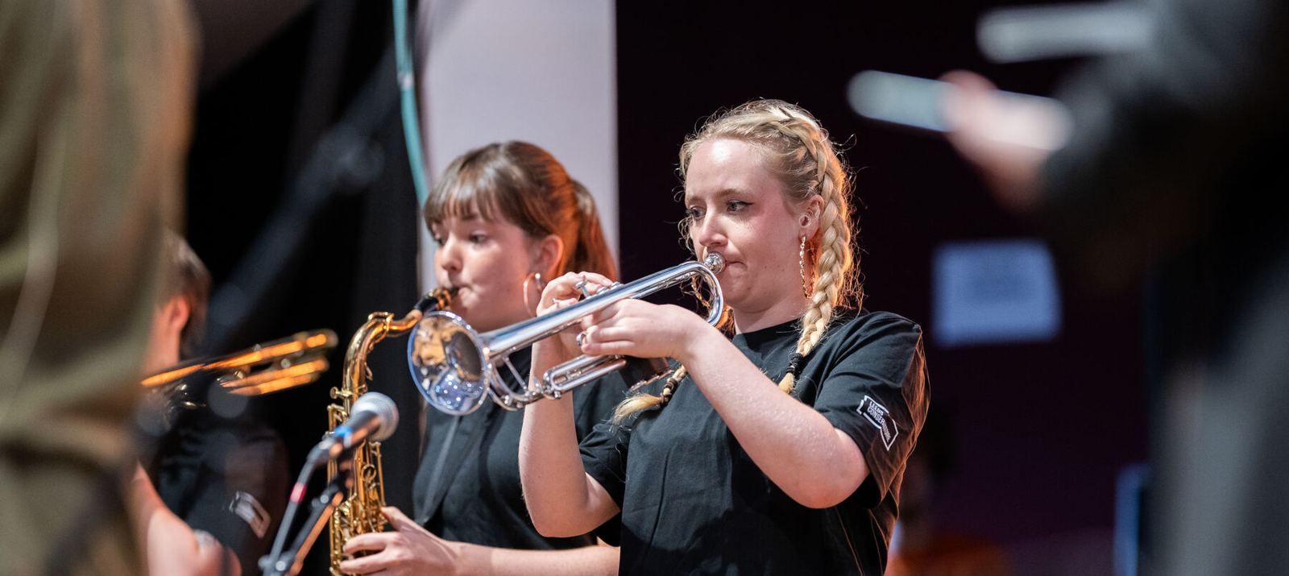
The band opens the main stage
Climb26
Climb26, the opening of day one

Slide 10
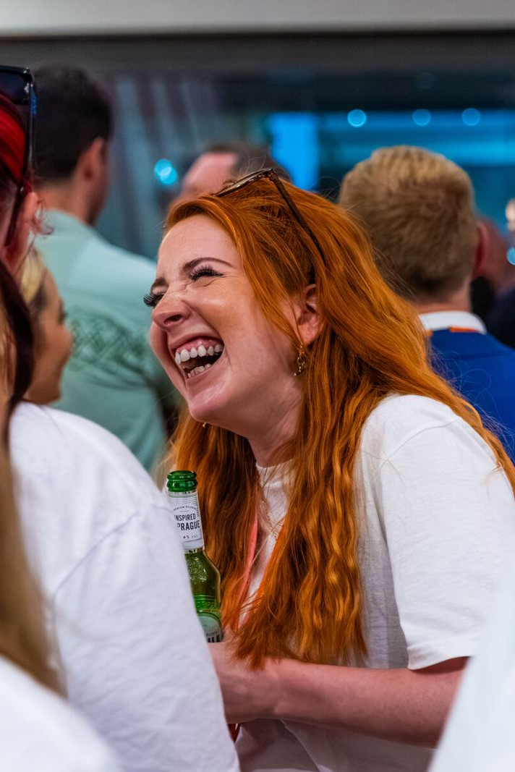
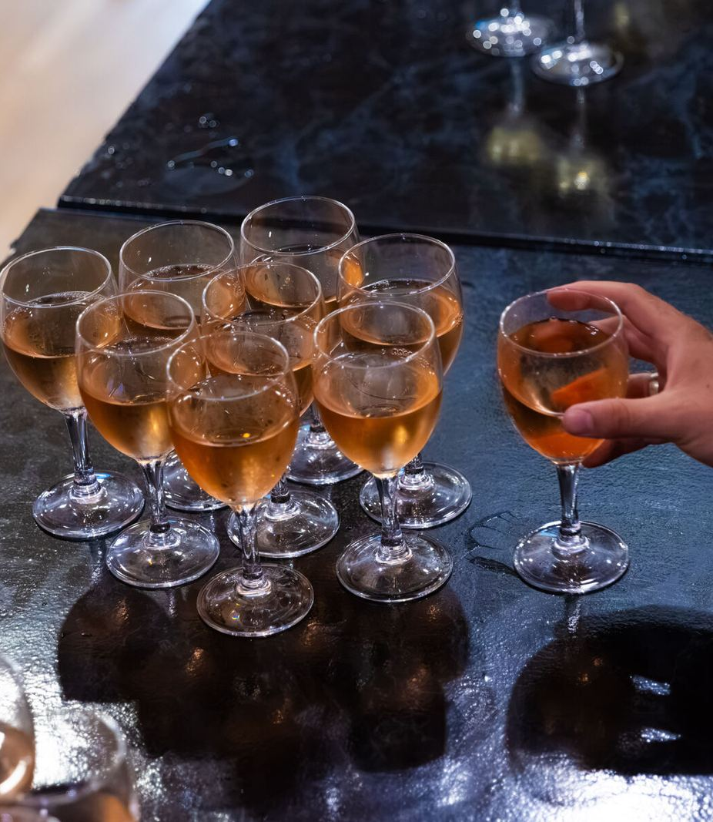
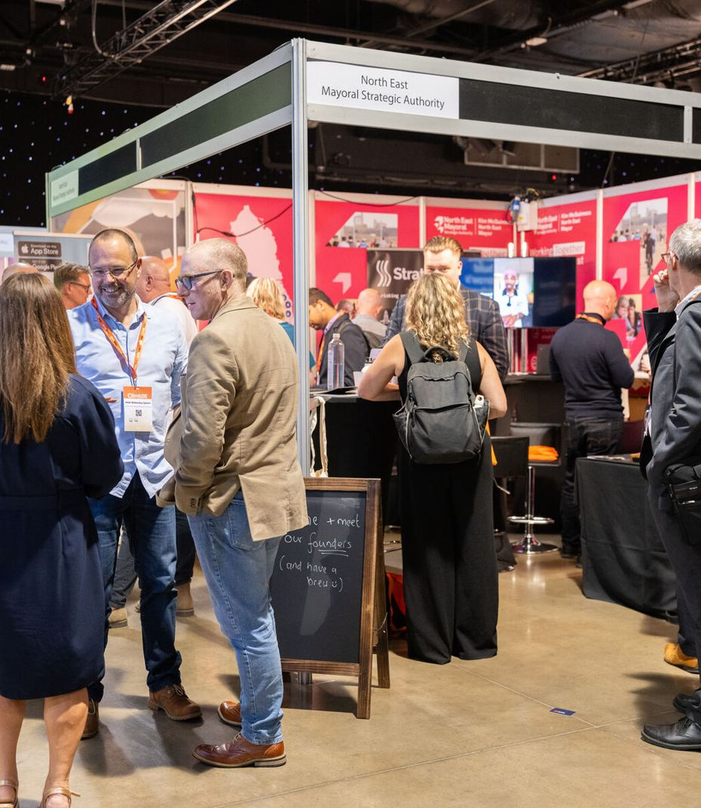
Moments worth coming back for
Climb26
The ClimbAwards walk-up, the reception and the busiest expo floor of the year.

Slide 11
First name
Last name
Speaker
Role, Company
Session title, main stage, 11:00

Slide 12
How the day runs
Agenda
09:00
09:30
11:00
13:00
15:00
18:00
Doors open, coffee and badges
Opening on the main stage
Roundtables and workshops
Lunch on the expo floor
Investor speed networking
ClimbAwards and the after party

Slide 13
Using this template
Before you start
Install Montserrat and Open Sans from the fonts folder first
Pick a layout from Home, Layout: dark first, light for reading-heavy slides
One orange word and one italic word per headline, one orange button per slide
Use real photos with consent, never stock handshakes
Keep text at 18pt or larger and give every slide a title, so screen readers can find it

Slide 14
Thank you
queries@climb-group.com
climb-group.com

