Slide 1
Generative Artificial Intelligence
GPT and Related Generative Language Models
December 4, 2025
Pethő Gergely
UD Faculty of Health Science, Department of Bioinformatics

Slide 2
GPT
GPT (Generative Pretrained Transformer) is an open-source, transformer-based generative language model released in 2018, shortly after the invention of the transformer
  117M parameters, like BERT-base
  12 transformer blocks and attention heads, 768-dimensional vectors
  developed by OpenAI, a startup that originally wanted to invent AGI and make it openly available to the public
Its successor was GPT-2, released in 2018, 4 models between 117M and 1.5G parameters
  largest: 48 transformer blocks, 1600-dimensional
Breakthrough development was GPT-3, 2020, 8 sizes between 125M and 175B parameters
  175B: 96 transformer blocks and attention heads, 12288-dimensional
  not open-sourced, only accessible through OpenAI’s API

Slide 3
Pre-training
Unsupervised, autoregressive pre-training
A training corpus of raw texts collected from the internet is used to train the model
An initial part of a text is provided as input
Tokenised, embedded, processed by transformer
The output is the predicted probability distribution for the next token
The actual next token t is known from the corpus.
The error (loss) of the model for this training data point is the difference between the probability predicted for t and 1
  As always, the error is back-propagated through the network, i.e. each parameter of the network is updated for each training data point based on the partial derivative of the error calculated for that parameter
Training continues with the next token
The context window visible to the model is limited because of the quadratic complexity of the transformer relative to input length
  For GPT-3, it was limited to 2048 tokens

Slide 4
Result of Pre-training
During pre-training, a GPT model learns to predict how the input text would continue if it had been written by a human.
  What are likely and unlikely next words based on the available context, which includes
    language
    style
    topic
    entities that have been introduced in the preceding context
    structure of the sentence so far, etc.
It does not learn how to lead a conversation, i.e. behave like a chatbot.

Slide 5
Inference with a Pre-trained Model
When using a pre-trained model for inference, the user enters a text, the prompt.
The GPT model calculates a probability distribution for the next token that would continue the prompt.
The external piece of software (which is not part of the language model as such) executes a loop consisting of two steps:
  It samples a single token from the output probability distribution as the next token generated by the GPT model.
  It adds this sampled token to the right of the previous input, then feeds this input, which is one token longer than before, again into the GPT model.
The loop stops when:
  The GPT model outputs a special token that indicates end of sequence, ([EOS] or similar), which signals to the external software that it should stop the loop and print the generated sequence.
  A pre-set maximum generation length is reached, e.g. 200 tokens.
    Might be, and likely will be, in the middle of a sentence.
    Could be longer than the maximum context length, i.e. 2048 tokens, but then the left edge of the input is truncated (a token removed) every time a token is added to the right.

Slide 6
Transformers Are Stateless
A GPT model does not have a state at any level of the network, i.e. it does not have memory, it does not remember any events
  neither those that occurred during its training
  nor input that it has received since its training
  nor what it has generated so far
An approximation of the texts that the model was trained on is stored in the weights (parameters) of the model.
However, these weights only correspond to conditional probabilities of tokens coming after other previous tokens.
A transformer does not store the actual sequence (text) that it was trained on.
Each token in the training corpus triggers a tiny shift of parameters to assign a very slightly higher probability to the next token if the input were the same.
Therefore, it is essentially impossible that a GPT-like model is able to produce the exact same text that it was trained on.
  Except if that text occurred lots of times in the corpus, e.g. proverbs, famous quotes.
After training is complete, the weights of a transformer do not ever change.
The only way to create the illusion that it does have memory is to pass the entire history of the (current) chat to the GPT model as input.

Slide 7
Transformers Are Stateless
As a consequence, it is pointless to do any of the following:
  Ask a GPT model whether a certain input text (like a school essay) had been written by it.
  Or whether it had chatted about something with a friend of mine, or what they had told it, etc.
Since a GPT model only has access to the input context, which is extremely restricted, it would only be able to carry out these tasks if the developers added external applications that would allow the LM to look up information in other chat histories.
  This would be possible in theory, but is not implemented in practice for obvious reasons (privacy, etc.).
Nonetheless, a GPT model will happily generate a sensible continuation for the input, which might equally well be I don’t know. or Yes. / No.
  It could well „lie” and imply in the generated continuation (the „answer”) that it can confidently answer the question.
  The model simply always tries to guess what the most likely continuation of the input would be if the input were part of its training corpus.
Although a GPT model will never remember chats, it could be retrained by the developers based on the chat history.
  This will still not add a memory of what it had talked about with you, but would only shift the token probabilities very slightly in the direction that correspond to the way you put words one after the other in your prompts.
However, the developers have complete logs (records) of everything that was typed in a chat.
  This log is simply a full-text log that is completely external to the language model.
  It is a very bad idea to enter sensitive, confidential, private, etc. information like passwords, company data, etc., into an LLM chat. You are handing these over to the maintainers.

Slide 8
Sampling from the Probability Distribution
When generating the next token using a generative language model, an external application (not the language model itself) generates a pseudo-random real (floating-point) number 0 ≤ r ≤ 1 and uses this to sample a specific value from the predicted probability distribution.
Naïve implementation:
  calculate the cumulative sum vector C of the softmax vector (will be V-dimensional, like the softmax vector)
  find element with index i such that C_{i} ≤ r ≤ C_{i+1}
  output corresponding element T_{i} of the token dictionary T

Slide 9
Sampling Parameters
In reality, the sampler component of the generator usually has several parameters that allow the user of the generative language model to cheat, i.e. to influence what is sampled from the predicted distribution:
  top-p: takes a value 0 ≤ p ≤ 1
    possible next tokens are sorted in decreasing order by their predicted probability, their cumulative sum C is calculated
    first j tokens T₁ ... T_{j} in this sorted list are selected such that C_{j} is the first cumulative sum for which p < C_{j}
    the probabilities of T₁ ... T_{j} are rescaled to add to 1
    makes sure that very unlikely next tokens are never sampled
  top-k: integer k ≥ 1
    similar to top-p, but specifies concrete number of most probable tokens to be sampled from
    if k = 1, there is no sampling, the most likely token is always the output
  temperature: float value 0 ≤ t
    if 0, the predicted distribution is used
    the higher the temperature is set, the more the distribution is distorted toward unlikely tokens, i.e. the more likely it is that a token predicted to be relatively unlikely by the model will be sampled
      high temperature means that likely tokens are downweighted, unlikely ones upweighted
    subjectively felt to correlate with creativity of the output

Slide 10
Determinism of Generative Models
Generative language models are perfectly deterministic.
  Given a trained model with specific weights and a specific input, the model will always calculate the same probability distribution.
  If you set top-k = 1 or the seed of the RNG in the sampler to a specific value, it will also generate the exact same continuation sequence for the same input.
  Due to hardware and software inconsistencies, they could in practice behave non-deterministically.
    Particularly when a model is distributed between several devices that may not have the same hardware (GPU) or software (GPU and CUDA driver) version installed

Slide 11
Fine-tuning
Fine-tuning is very often applied to transformer models in general:
  a general language model is pre-trained to predict a missing token in a sequence of tokens: bi-directional MLM or left-to-right autoregressive training (BERT vs GPT)
    typically on billions of training data points (context + token to be predicted)
  then the model is fine-tuned using supervised learning (using e.g. class-labeled data) for a specific task, e.g. text classification
    usually involves adding an additional classifier layer to the transformer network
    this layer is trained from scratch (randomly initialised)
    transformer weights may be frozen during fine-tuning (are not trained) or may be trainable themselves and will adapt to the task
    on a relatively small number of training data points, typically a few thousand, less commonly tens of thousands
This results in a fine-tuned model that is much more accurate at the specific task than a model trained from scratch for the specific task (even if we used much more training data than what we use for fine-tuning)
  although the main problem that fine-tuning solves is exactly that we only have small amounts of labeled data for our specific tasks
  The model utilises its general knowledge of the language for the specific task

Slide 12
Zero-shot and Few-shot Prompts
In Radford et al., 2019, and Brown et al., 2020 (see slides for topic 4), OpenAI researchers published results showing that GPT models are capable of performing specific NLP tasks even without fine-tuning after being presented a proper context.
  The context contains the text to be processed for the task (e.g. question answering: the text from which the answer should be extracted + the question itself; MT: the sentence/text to be translated).
  In addition, the context needs to make clear what the task is.
    For example, if the context ends with the phrase TL;DR, the model is expected to generate a continuation that is the summary of the preceding text (simply based on the fact that this is what TL;DR means)
A few-shot prompt is one that contains some (possibly just one) examples similar to the task to be solved, followed by the task itself.
  The model is expected to follow the pattern of the provided examples in the continuation that it generates.
A zero-shot prompt is one that does not contain any sample task-solution pairs.

Slide 13
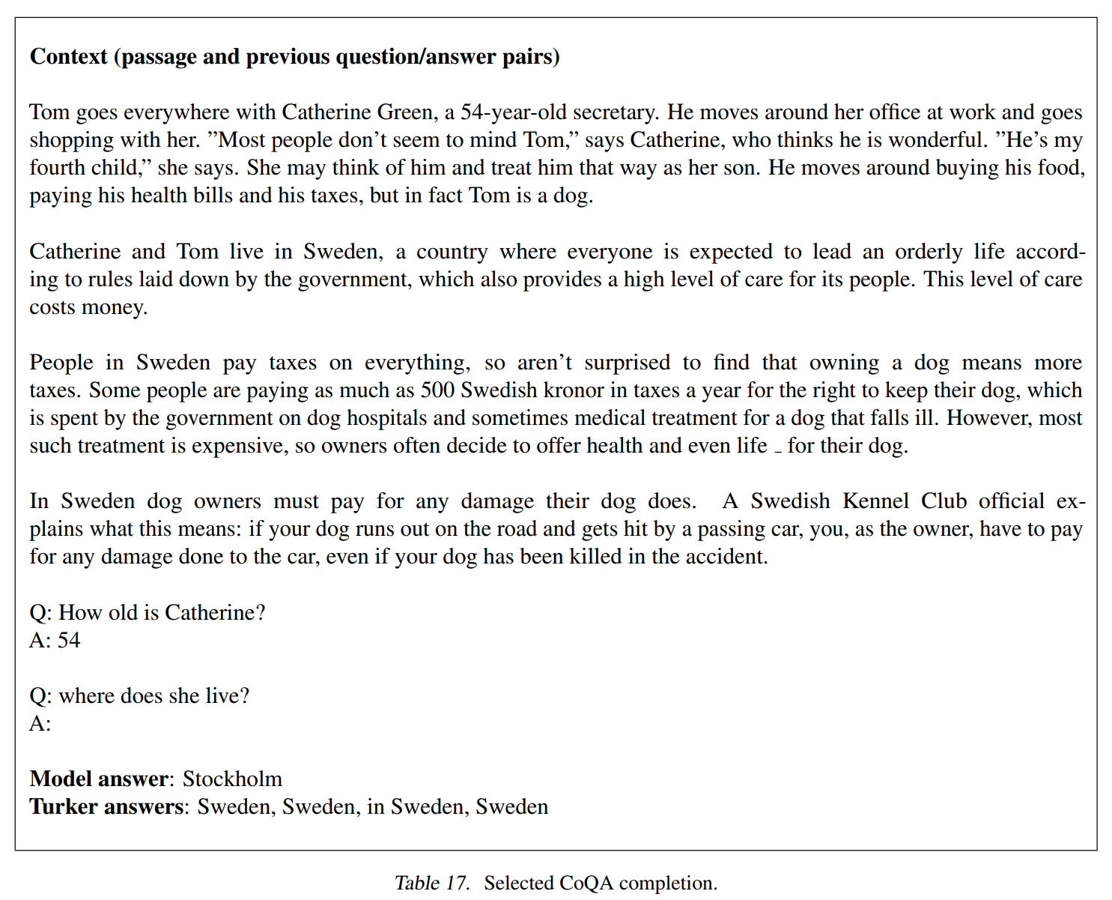
Few-shot example (from Radford et al., 2019, Appendix)

Slide 14
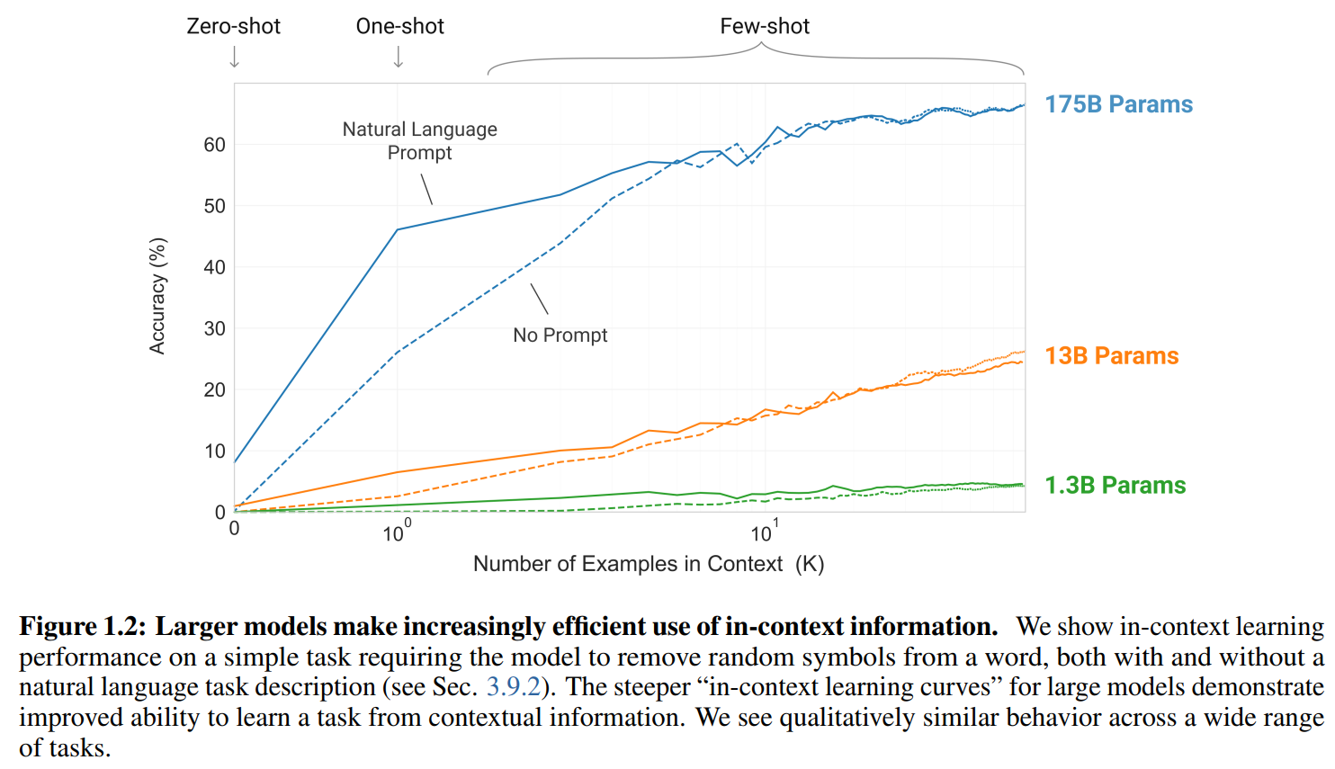
Few-shot Learning
Brown et al., 2020, observed, that large language models like GPT-3 can benefit drastically from few-shot prompts.
  Instead of fine-tuning the model for a given task, it is often sufficient to write a few-shot prompt that includes some example solutions of a very similar task for other inputs.
  Even a one-shot prompt improves continuation accuracy very significantly, but the more examples the better.
This is referred to as few-shot learning (also called in-context learning).
  Calling it „learning” is somewhat misleading, the model’s weights do not change.
  The performance improvement is restricted to the current input’s context, the few-shot examples would have to be included in the prompt every time a similar task is to be solved.

Slide 15
Pre-trained Generative Language Models Are Not Conversational Agents
A pre-trained generative language model only generates a continuation of a text, it does not behave like a conversational agent.
  Case in point: asking a question in the prompt.
  In real-life texts, a question is usually not followed by the answer to that question.
    More often than not, the next sentence will either be another question or will provide some qualification or context for the original question.
  Since a generative language model is trained to continue the input as if the input and the generated continuation were part of the training corpus, it might continue by answering the question, but more often than not, it will continue with a sensible qualification or a follow-up question.
  Few-shot prompting (putting several question-answer pairs in the prompt) will help to guide it to follow up the question with an answer.
    But this is obviously cumbersome, not an ideal solution.

Slide 16
Instruction-tuning
Pre-trained generative language models like GPT need to be fine-tuned to respond like a human interlocutor, or rather like a helpful AI assistant.
  If you have ever talked to random strangers on Facebook, you know that you don’t want the model to reply like a real human would.
  Putting You are a helpful AI assistant. in the model’s (system) prompt is common practice but it is misguided to believe that it achieves anything.
    A GPT model does not interpret this as a statement of fact or as an order, it is just a sentence to be continued in a sensible way.
    No, I’m not. is as sensible a continuation as any.
Fine-tuning the model is the correct solution.
For this, no special output layer is added, the model still learns next-token probabilities.
By this fine-tuning, the model is trained to interpret the user’s prompt as an instruction and to respond by obeying (complying with) the instruction, in addition to knowing the language as such (which it learned during pre-training).
  In a broad sense; the instruction can be (and often is) a question to be answered.
This is usually referred to as instruction-tuning, and the resulting model as an instruction-tuned language model.
Most models are available both as a pre-trained and an instruction-tuned version.

Slide 17
RLHF
Instruction-tuning a pre-trained generative language model is usually achieved using a procedure called reinforcement learning using human feedback (RLHF).
Slightly similar to adversarial learning in that training is based on two models:
  one is the generator (called policy in a RL context) that predicts the probability distribution of the next sequence as usual
    it is a pre-trained model
    after pre-training, supervised fine-tuning is performed, during which the model specifically learns to predict the continuations of various types of instruction prompts
  the other, the so-called reward model (slightly similar to a GAN’s discriminator model) learns to rate alternative continuations of the same prompt
    usually another pre-trained GPT-like model, possibly the same that is being instruction-tuned, but with a linear regression layer added on top
    the reward model is trained on pairs of continuations for the same prompt: one is marked as preferred by a human judge, the other is dispreferred
      thus the human feedback refers to the training of the reward model, not the generator model
    thus it learns to assign higher (positive) scores to continuations that are judged to be better, and lower scores that are judged to be worse
      no binary good/bad classification, but gradual, continuous-valued rating
    limited number of continuation pairs used for training (human labelling is costly)

Slide 18
Fine-tuning using RLHF
The reward model (RM) can also be trained on pre-existing datasets that contain labelled pairs of continuations.
  Standard open datasets like this are used for training the RMs for smaller generative models without a big budget.
  Still RL, but not RLHF strictly speaking.
Once the RM has been trained, it is used to rate continuations generated by the generator for various prompts.
  If the RM assigns a positive score to a continuation (an entire sequence), the weights of the policy are adjusted so that this sequence will be generated with a higher probability.
  If it assigns a negative score, weights are modified to reduce the probability of generating this continuation (token by token).
This has two important advantages:
  The policy is fine-tuned with respect to continuations that it currently generates, not on some independent dataset.
  Instruction-tuning only requires a small number (thousands, ten thousands) of human-labelled examples, which are used to train the RM. Once trained, the RM can rate millions of completions generated by the policy.

Slide 19
LLMs
What is a large language model (LLM)?
Not a well-defined technical term.
It is obviously a language model, and a language model is (essentially by definition) a machine-learning model that learns (conditional) probability distributions of tokens based on a training corpus.
Large: refers to the size of the model, i.e. the number of parameters of the model.
  Makes only sense if we assume that it is a neural network model that has parameters, i.e. weights stored in weight matrices.
How large?
  No definitive answer. A model of a few million parameters is usually not considered large.
    This is not counting the token embedding dictionary, which contains learned weights. This is necessarily quite large (e.g. just 50k tokens by 768 dimensions ≈ 40 million floats).
  BERT, GPT-1 and GPT-2 at 100M to 1.5G parameters are considered large by some.
  Others consider GPT-3 and its more recent offspring (GPT-5, Google Gemini, etc.) large, i.e. 100G+ parameters.
  Language models in the 1G to 10G range are often referred to as small language models (SLM) by the latter.
Does an LLM have to be generative?
  Not necessarily; again, some consider BERT to be an LLM, which is an encoder model.

