Slide 1
Generative Artificial Intelligence
October 2, 2025
Pethő Gergely
UD Faculty of Health Science, Department of Bioinformatics

Slide 2
Machine Learning in the 1990s and 2000s
After symbolic, rule-based, algorithmic artificial intelligence failed to meet expectations, research shifted increasingly toward statistical machine learning around the turn of the century.
Machine Learning (ML):
It solves a starting problem, just like an algorithm.
However, in machine learning, it is not programmers who implement the solution procedure broken down into elementary steps in a given programming language.
Instead, a data set containing concrete observations is given as input to a general, so-called machine learning algorithm.
This algorithm calculates a mathematical model using the statistical characteristics of the observations, which offers a general, approximate solution to the problem.
The "mathematical model" is a mathematical function or formula that calculates a single output value from given input numerical data (the function's arguments).
This output value can be a single (scalar) number, a number vector consisting of several scalar numbers, a number matrix consisting of several vectors, or a number tensor consisting of several matrices, but in any case, it is a shorter or longer sequence of numbers.
To be solvable by machine learning, the initial problem must be formulated in the form of numbers.
Both the input data
and the calculated output value must be numbers.

Slide 3
Machine Learning in the 1990s and 2000s
Why did Machine Learning become widespread in the 90s?
To create a good machine learning model, training data is needed (generally, the more, the better).
These data need to be stored.
Around 1990, data was stored on floppy disks, with capacities between 300 and 1400 kB.
A large hard drive was 40-80 MB.
A computer's memory was 1-2 MB, but only about 600 kB was available to the user.
The data must come from somewhere.
The web began to emerge in the mid-90s.
Until then, everyone could only rely on their own local data, which had to be entered manually.
As long as there wasn't a lot of data to process, it could be processed manually, and there was no need for complex statistical models.
The classic learning algorithms were discovered in the 80s and 90s
Also, the first professional journals and textbooks on the topic appeared during this period:
Machine Learning, volume 1. 1986
Vapnik, The Nature of Statistical Learning Theory. 1995
Hastie, Tibshirani, Friedman: The Elements of Statistical Learning. 2001

Slide 4
Machine Learning: A Few Typical Examples
Patient diagnosis
Input: Characteristics describing the patient's health status given as numbers (age, blood pressure, body mass index, lab values).
Output: Is the patient diabetic? (1 = yes, 0 = no)
Symptoms that are not inherently numerical must be coded as numbers, e.g.:
Increased thirst (to what extent? binary?)
Dry mouth
Frequent urination (how frequent?)
Unexplained weight loss (binary? measured in kilograms?)
Fatigue
Numbness, tingling in the extremities
This is not a simple question, as the machine does not perform data preparation for us; the model creator must find solutions for these issues.
How do we handle situations where some data is unavailable for a patient whose data we want to use for training the model or whose illness we want to predict (missing data)?
A mathematical function is applied to the data, so we cannot simply omit a variable because we don't know its value.

Slide 5
Machine Learning: A Few Typical Examples
Financial Credit Risk:
Input: Numerical data characterizing a person's financial situation, e.g., how much money is in their bank account, the value of the property they live in, their income, age, etc.
Output: If the bank grants a loan of amount x to the person, will they pay it back?
Movie Recommendation:
Input: A given user has indicated that they liked 53 films and disliked 5
Output: Which of the streaming provider's other films is the user expected to like?
"Like" or "dislike" can be represented as numerical values of 1 and 0. What do we do with the films the user has not expressed an opinion on?
Do we represent the films as discrete list elements in the model input, or do we break them down into descriptive features, such as year of release, budget, or genres (as categorical values)?

Slide 6
A Machine Learning Model: Decision Tree
The decision tree is primarily suitable for solving a classification problem, e.g., diabetic yes/no
Advantage: Descriptive features that are not inherently numerical do not need to be converted to numbers.
However, they must still be treated as discrete, categorical values, so the problem related to gradual symptoms still exists
as does the problem of missing data
Core idea of the decision tree training algorithm:
The training data set consists of n observations. Each observation describes one patient, and each patient is described along the same k features (what is their blood pressure, do their limbs tingle, etc.).
The classification is implemented by a series of discrete binary decisions; the model "learns" these decisions from the observations.
In the first step, the model examines along which of the k features the n observations can be split into two parts (m and n–m observations) such that one of the two groups is as pure (homogeneous) as possible regarding the target variable (diabetic).
Example: 90% of the observed patients with a BMI below 22 were found not to be diabetic, and no other descriptive feature would result in such a homogeneous group.
It doesn't matter how homogeneous the group of patients with a BMI above 22 is; only one part of the split needs to be homogeneous
Before training, a so-called hyperparameter is defined for the algorithm , which prescribes the minimum number of elements (m) in the subgroups which are allowed to be split further.
The algorithm performs this split, and then in the next step, it examines which feature can be used to split the m-element group into two groups, one of which is the most homogeneous
This split continues recursively until
Splitting a group along a feature results in two completely homogeneous subgroups, or
A group is reached that is not homogeneous but cannot be split further due to the hyperparameter regarding the minimum number of elements for splitting, or
The descriptive features along which the split can be performed have run out (after k steps).
The result of this algorithm is the decision tree itself. If a new observation arrives, the class is predicted by traversing the tree, starting at the root, step-by-step, until a leaf element is reached, where the class is read off.
https://www.w3schools.com/python/python_ml_decision_tree.asp

Slide 7
Refresher: Logistic Regression
The most important machine learning model is the neural network.
We will introduce this via logistic regression, which learns a model of the form ŷ = σ(a₁x₁ + a₂x₂ + ... + a_{k}x_{k} + b) = σ(a⋅x + b) The x vector consists of the features of an observation. The vector a and the scalar (simple) value b are the model's parameters, also known as weights.
At the start of training, the weights are initialized with random values. Each step of the training algorithm involves calculating the value of ŷ based on the current values of the weights and the vector x, and then modifying the weights a and b slightly in a positive or negative direction based on what the value of ŷ​ should have been.
This is known as gradient descent: The value of the given weight is modified by a small multiple of the partial derivative of the error function calculated for that weight, in the direction that reduces the error for the given observation; error being defined as the difference between the true y and the predicted ŷ.
By repeating this process many times for the observations in the training set, a and b settle into values (converge) that minimize the function's total error across all training observations.

Slide 8
Training goal: Finding a Local Optimum
"Minimize" the error means that a and b define a point in k-dimensional space that is a local optimum with respect to the total error; that is, there is no other point in the value space near the given point (the combined values of a and b) that would give a smaller error.
This point is not necessarily a global optimum, meaning a point that gives a smaller error may exist elsewhere in the value space.
Although gradient descent as such is deterministic, the values of a and b are set to random initial values at the start of training, and the observations are passed to the training algorithm in a random order. Consequently, a different local optimum may be found during each training run. This randomised approach is known as stochastic gradient descent.
We can repeat the training several times with different initial values and choose the solution with the smallest error.
It is practically irrelevant how optimal the found solution is, as the training error is always only measured on the training data. The training data constitutes only a random sample from the total population to be modeled and do not precisely reflect the statistical characteristics of the entire population.
Different samples will be optimally described by different models.
In summary: the goal is a "good enough," practically usable approximation of the solution.

Slide 9
Linear vs Non-Linear Decision Boundary
Logistic regression can only express a linear decision boundary:
In two dimensions, it draws a straight line separating (as well as possible) the points of the two classes
In three dimensions, it defines a plane
In k dimensions, a k−1 dimensional hyperplane
This only provides a good solution for classification problems where the classes are
linearly separable.
Many classes are not linearly separable from each other, and the problem cannot be solved with a single line (hyperplane).
Example: Separating settlements on a map that are within 50 km of Debrecen from those that are farther away. The solution is not a line, but a circle.
The neural network is an extension of logistic regression that can approximate any function, including non-linear functions, allowing non-linear decision boundaries to be expressed.
A neural network is a mathematical model, just like linear regression, consisting of multiplications, additions, and simple non-linear functions applied to their results (e.g., the sigmoid function), but it is more complex.

Slide 10
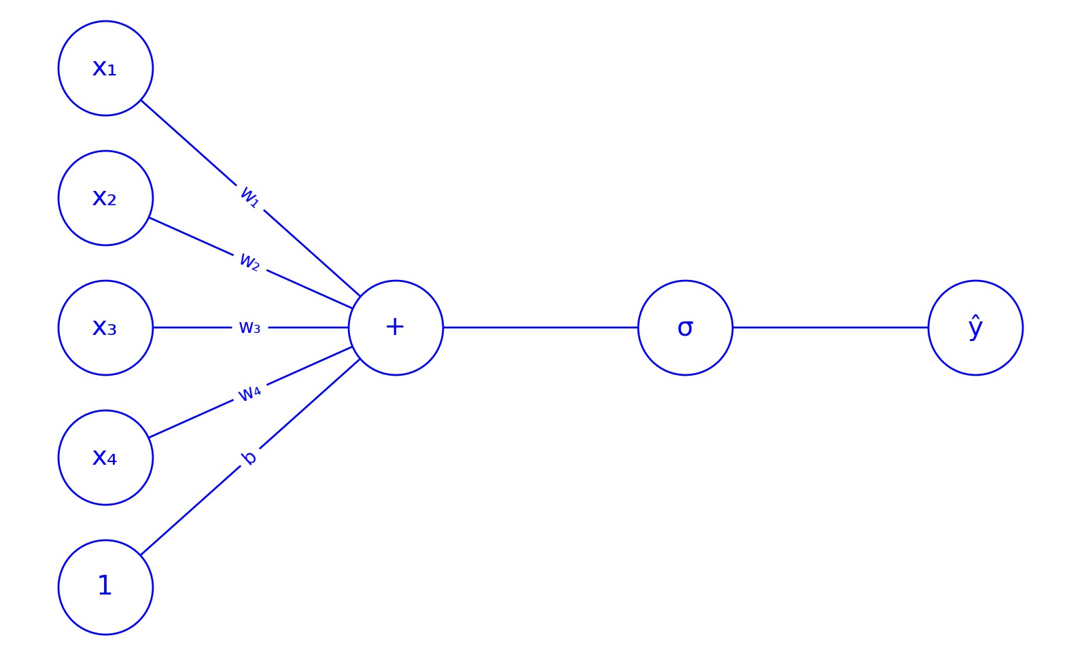
Logistic Regression
ŷ = σ(w₁x₁ + w₂x₂ + w₃x₃ + w₄x₄ + b)

Slide 11
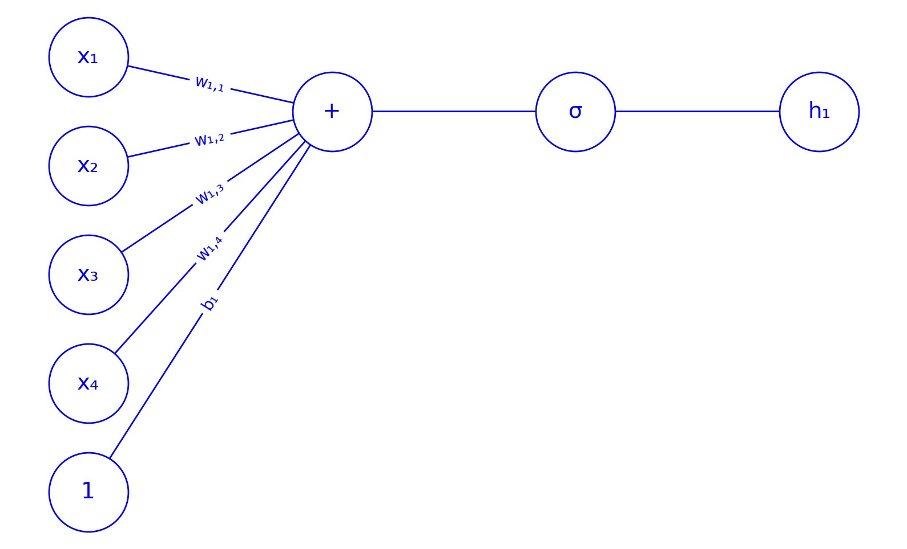
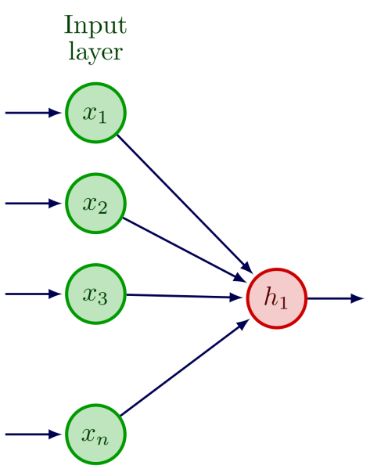
Logistic Regression to Neural Network
h₁ = σ(w_{1,1}x₁ + w_{1,2}x₂ + w_{1,3}x₃ + w_{1,4}x₄ + b₁)
Same illustrated with a simpler figure:

Slide 12

Logistic Regression to Neural Network
One weighted sum in the second layer:

Slide 13
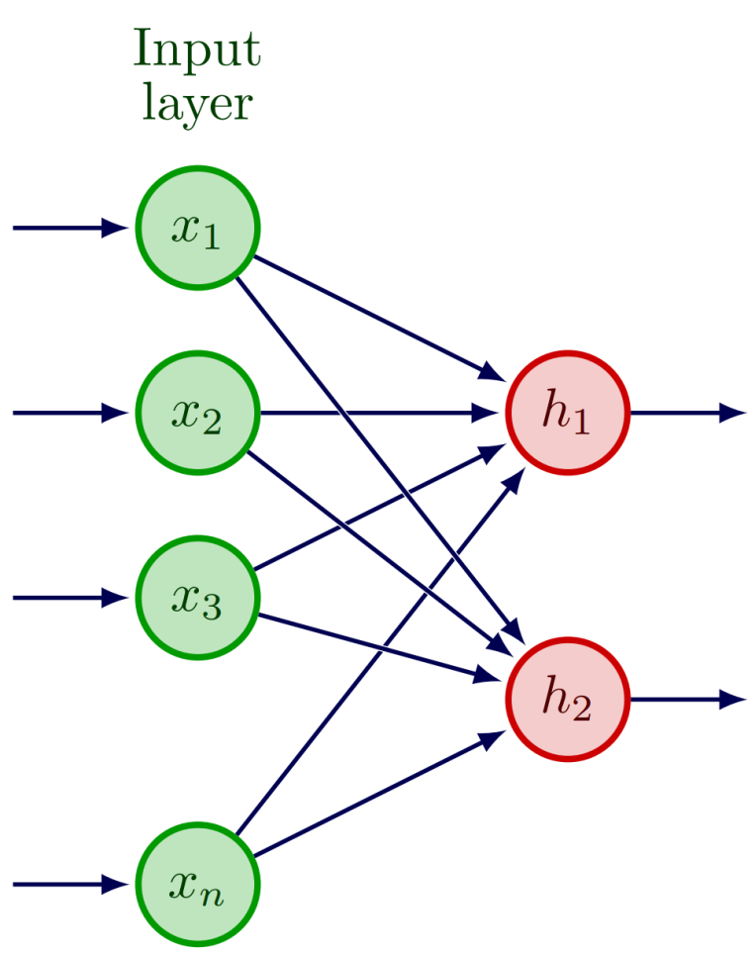
Logistic Regression to Neural Network
Two weighted sums in the second layer:
Different weights w belonging to each edge:
h₁ = σ(w_{1,1}x₁ + w_{1,2}x₂ + w_{1,3}x₃ + w_{1,4}x₄ + b₁)
h₂ = σ(w_{2,1}x₁ + w_{2,2}x₂ + w_{2,3}x₃ + w_{2,4}x₄ + b₂)

Slide 14
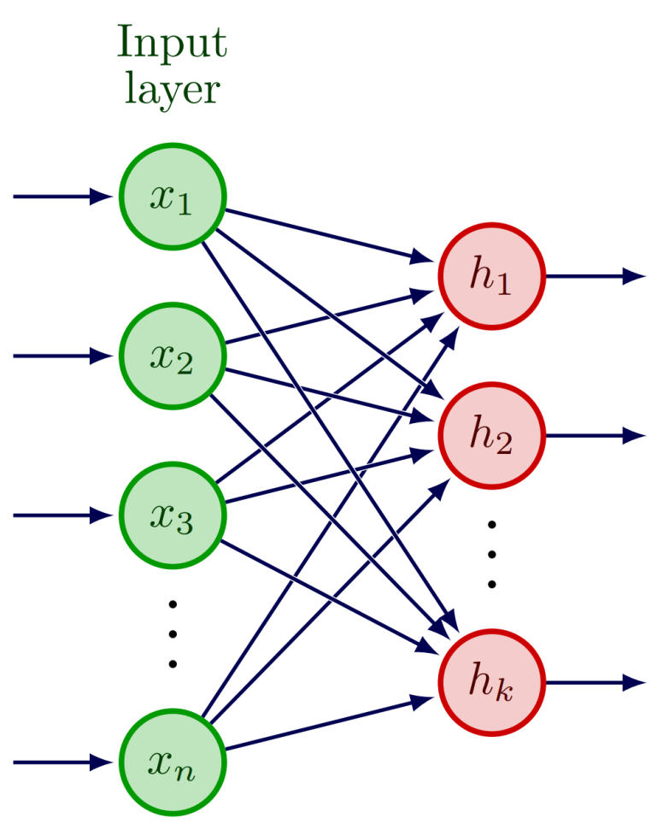
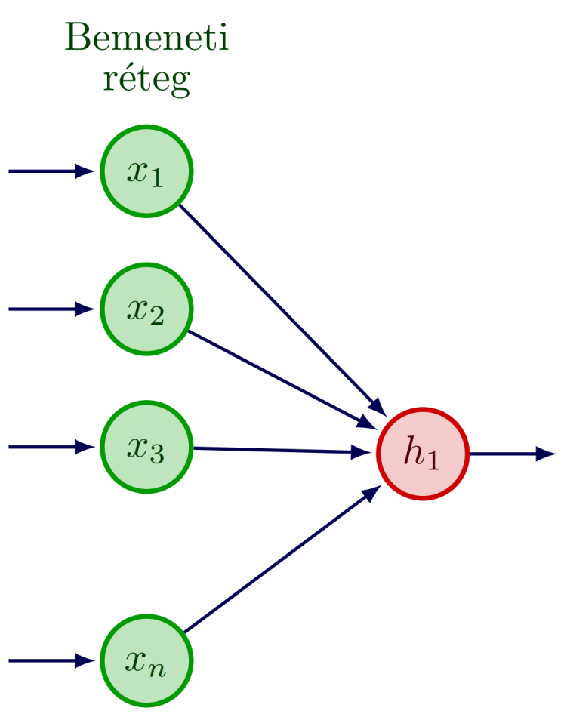
Logistic Regression to Neural Network
k weighted sums in the second layer:
Different weights w belonging to each edge :
h₁ = σ(w_{1,1}x₁ + w_{1,2}x₂ + w_{1,3}x₃ + w_{1,4}x₄ + b₁)
h₂ = σ(w_{2,1}x₁ + w_{2,2}x₂ + w_{2,3}x₃ + w_{2,4}x₄ + b₂)
...
h_{k} = σ(w_{k,1}x₁ + w_{k,2}x₂ + w_{k,3}x₃ + w_{k,4}x₄ + b_{k})

Slide 15
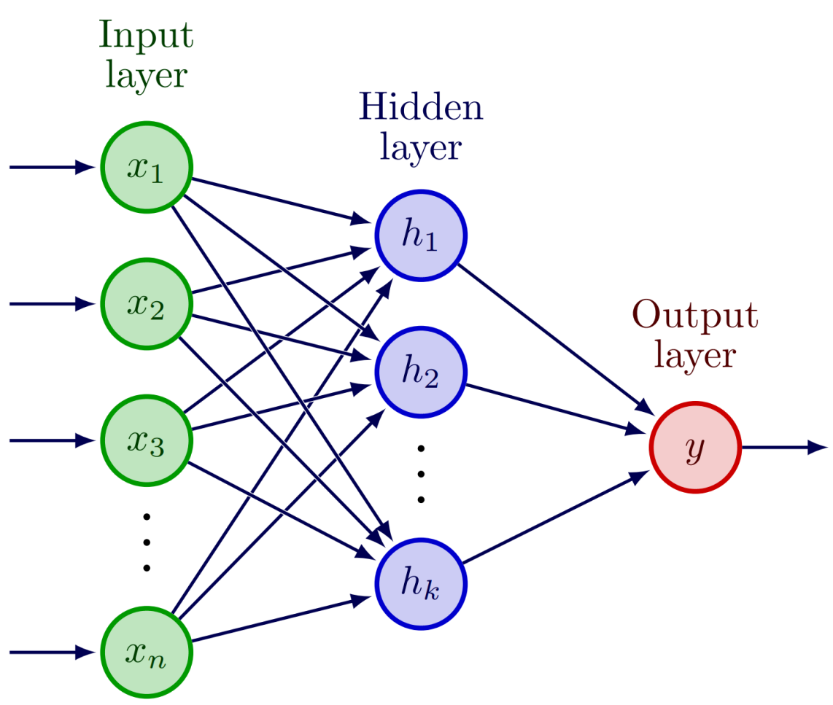
Logistic Regression to Neural Network
A final weighted sum in the last layer is the output of the model
e.g. the predicted probability of the positive class in a binary classification task

Slide 16
Logistic Regression to Neural Network
A final weighted sum in the last layer is the output of the model
e.g. the predicted probability of the positive class in a binary classification task
each of these is a logistic regression
y = σ(w_{h1}h₁ + w_{h2}h₂ + ... + w_{hk}h_{k} + b)

Slide 17
Logistic Regression to Neural Network
A final weighted sum in the last layer is the output of the model
e.g. the predicted probability of the positive class in a binary classification task
each of these is a logistic regression
y = σ(w_{h1}h₁ + w_{h2}h₂ + ... + w_{hk}h_{k} + b)
= σ(w_{h1}σ(w_{1,1}x₁ + w_{1,2}x₂ + w_{1,3}x₃ + w_{1,4}x₄ + b₁)
+ w_{h2}σ(w_{2,1}x₁ + w_{2,2}x₂ + w_{2,3}x₃ + w_{2,4}x₄ + b₂)
+ ...
+ w_{hk} σ(w_{k,1}x₁ + w_{k,2}x₂ + w_{k,3}x₃ + w_{k,4}x₄ + b_{k}) + b)

Slide 18
Neural Network
A neural network is defined as a mathematical function composed of dot products of vectors and non-linear functions applied to the products, and it contains at least one "hidden" layer in addition to the input and output layers.
It can be well visualized as a computational graph , where the nodes represent the elementary operations to be performed and their results, and the edges represent the flow of data between the nodes.
The terms "layers," "input," "hidden," and "output" layers are interpreted within the framework of this graph metaphor.
A "hidden" layer is simply an intermediate computation result obtained by multiplying vectors and then applying a non-linear function
The nodes of a neural network represented as a computational graph are called neurons. Each neuron receives its inputs from the neurons of a previous layer, calculates their weighted sum and applies a non-linear function to it.
Fully connected neural network: Every neuron in the k-th layer weights and sums the output of all neurons in the (k–1)-th (the layer "below") layer.
There are neural networks in which neurons in a "higher" layer are connected to only a part of the neurons in the "lower" layer; convolutional neural networks (used in image recognition) are a characteristic example of this.
There might be (so-called residual) connections that "skip" layers, used in models like transformers.
The value calculated as the neuron's output is called the neuron's activation.
The non-linear function that the neuron applies to the weighted sum of its inputs (like the logistic, or sigmoid function seen earlier) is called the activation function.

Slide 19
Neural Network
A key achievement of the 1980s was the discovery of the training algorithm for neural networks. The basic idea of neural networks, or multi-layer perceptrons, was known before, but it was not known how to train them with a training set of observations.
The solution to the problem is essentially the same as the (stochastic) gradient descent used to train logistic regression.
In every training step, the function's value is calculated for an observation, and the weights are increased or decreased so that the function's value gets closer to the correct, known value.
Strictly speaking, we update a weight during training by calculating the partial derivative of the error function with respect to the given weight, and adding a small multiple of the derivative to the weight.
The neural network is trained the same way, but the weights closest to the output are updated first (hidden -> output), and then the process moves backward toward the input (input -> hidden), layer by layer.
Strictly speaking, the chain rule of differential calculus is applied in this process (the rule for deriving composite functions).
This training procedure is called the (error) backpropagation algorithm.

Slide 20
Universal Approximation
Since 1989, mathematicians have proven several so-called universal approximation theorems, which state that neural networks of various structures can approximate any mathematical function defined on a given domain and having a given range of values with arbitrary accuracy
This is true even for neural networks containing just a single hidden layer.
A non-linear function, such as the sigmoid function, must be used as the neurons' activation function. If a linear activation function were used, any complicated neural network would be equivalent to a simple linear function.

Slide 21
Neural Networks and Other Models
Due to these advances, significant research was conducted on the practical application of neural networks in the 90s.
Many other fundamental machine learning algorithms and models were also invented in the 80s and 90s , including
decision trees (ID3 algorithm, 1986), Naïve Bayes (late 80s), boosting (1990), association rule learning (Apriori algorithm, 1994), Support Vector Machine (SVM) (1995), random forests (1995), and gradient boost (1999)
The neural network is just one of these and is not necessarily the most successful for every application.
For smaller datasets and a small number of statistical variables (features), other methods often perform much better than neural networks.
Experience generally shows that the choice of model is not the deciding factor, but rather the quantity of training data; collecting a lot of training data can yield much more benefit than the choice of model.
Until the 2010s, the neural network was not even considered a particularly important model type.

Slide 22
Deep Learning
In the 2010s, however, it turned out that neural networks can be scaled much more successfully than other models for training on high-dimensional (thousands, tens of thousands, hundreds of thousands of dimensions) inputs and very large training data sets.
In addition, there is no need for feature engineering (e.g., selecting relevant features, pre-calculating useful derived features), as the neural network performs this automatically during training.
The most typical example: image processing
A single pixel is at least one feature (if the image is black and white), or more typically 3 or 4 features (RGB, CMYK encoded color image).
An image is at least a few hundred by a few hundred pixels.
Therefore, a single image is described by features on the order of tens or hundreds of thousands.
In non-neural image processing, images were pre-processed before classification, e.g., the image was reduced to lines and edges.

Slide 23
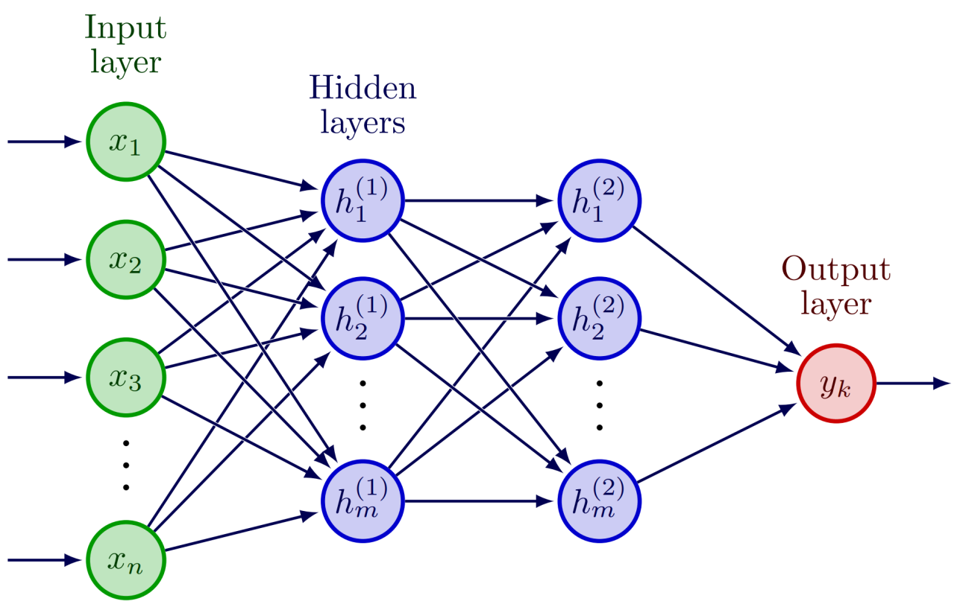
Deep Learning
A neural network must have at least one hidden layer, but can have more:

Slide 24
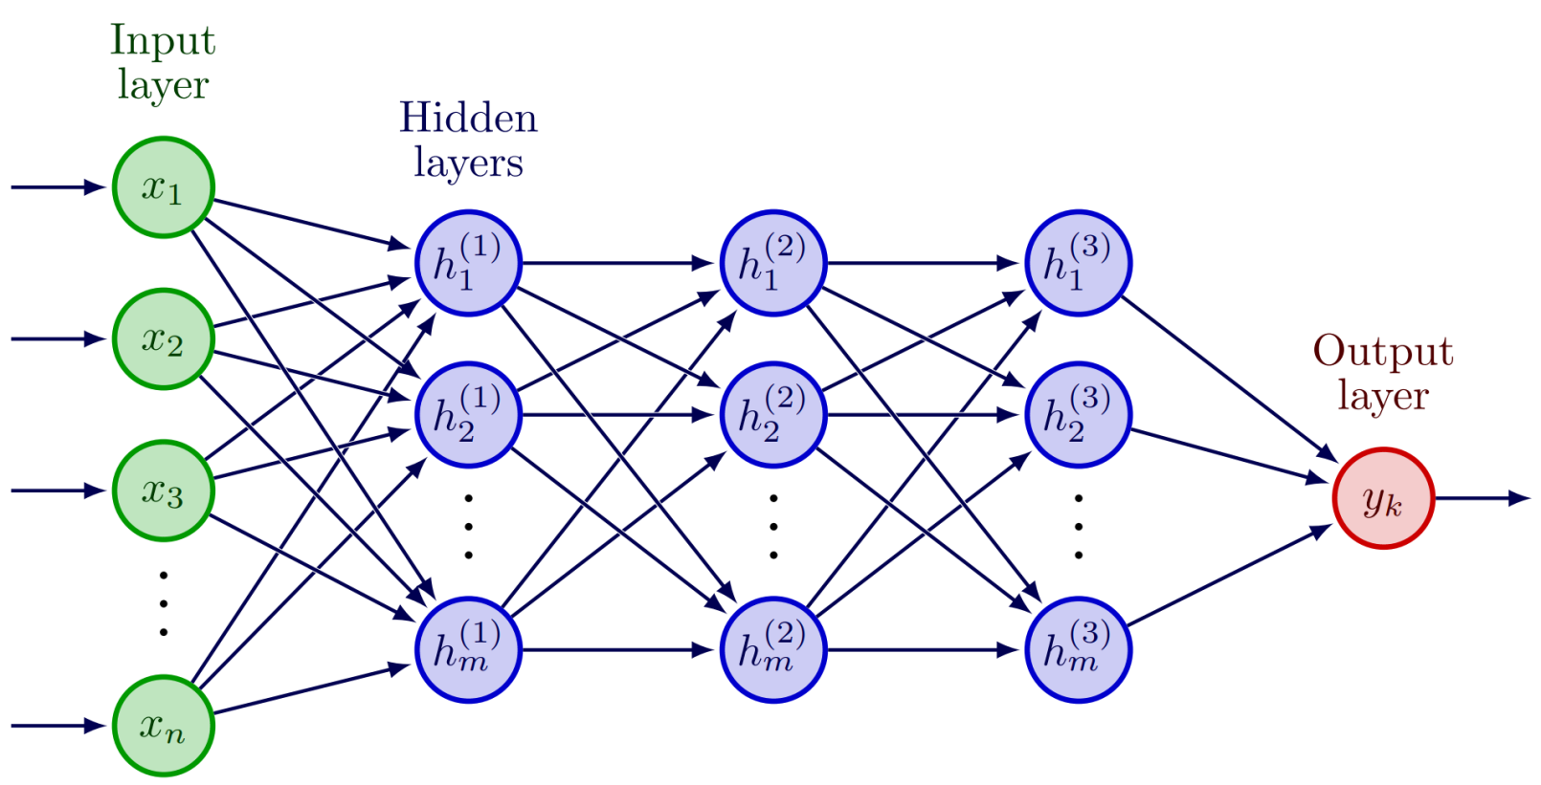
Deep Learning
A neural network must have at least one hidden layer, but can have more:

Slide 25
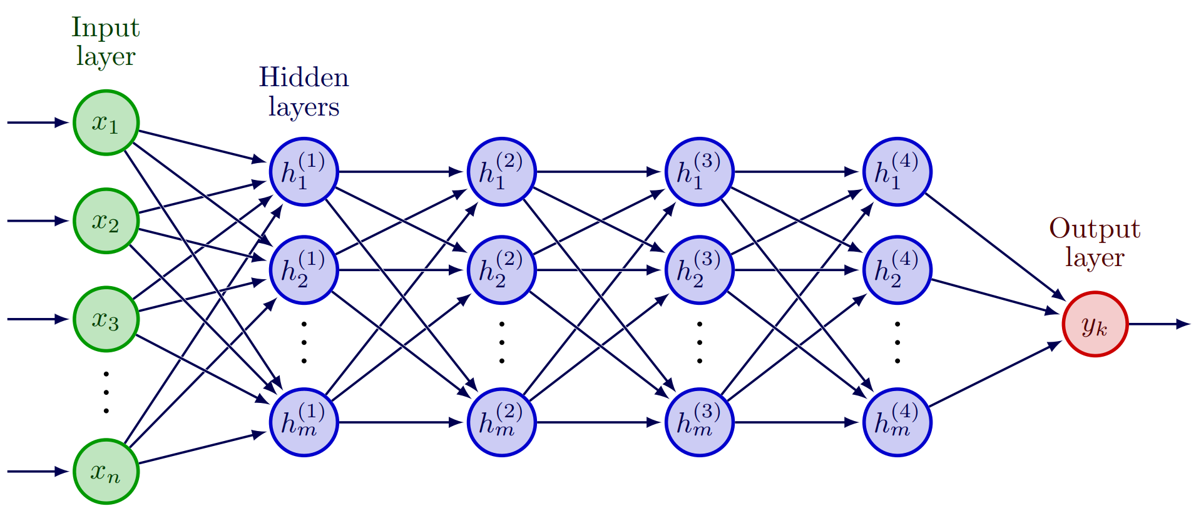
Deep Learning
A neural network must have at least one hidden layer, but can have more:

Slide 26
Deep Learning
The methods discovered in the 80s were only capable of training neural networks with one or two hidden layers; more hidden layers could not be trained.
Neural networks with three and especially (much) more hidden layers are called deep neural networks, and the training of such networks is called deep learning.
Deep learning was an unsolved engineering problem in the 90s and 2000s.
Deep neural networks could be assembled, but they did not learn from the data.
This was due to fundamental shortcomings of the training methodology and the networks, but even if these obstacles had been resolved, it was also a matter of the amount of available training data and computational capacity.

Slide 27
Why Train Deep Neural Networks?
If a neural network with a single hidden layer can approximate any linear or non-linear function, why would we want to train deep neural networks at all?
In short: While it is proven that a single-hidden-layer neural network can approximate any function, there is no guarantee that the backpropagation algorithm will find this approximation, especially with a (necessarily) limited amount of training data.
A deep neural network's expressive power is no greater than that of a single-hidden-layer network, but it is conceivable that it might be trained faster and more successfully.
Experience confirmed this once the technical difficulties were overcome, and training deep neural networks became possible.

Slide 28
Obstacles to Deep Learning
There were fundamental theoretical and mathematical difficulties related to the structure of neural networks that made training deep neural networks impossible.
Vanishing gradient problem: With more than two hidden layers, the neural network would not train with the traditional method because the derivative of the sigmoid activation function combined with the chain rule resulted in the partial derivative's value becoming practically 0 after two layers.
As we move further away from the output layer, the weight values change less and less in response to individual training examples.
In a deeper network, the top two layers learn, but the weights of the lower layers (closer to the input) remain at their originally initialized random values.
Adding more layers is useless; they still need to be computed, but do not improve accuracy of the predictions.
Solution: Use some other activation function in the hidden layer neurons, with the sigmoid function remaining only in the output layer.
The ReLU (rectified linear unit) function and its variations (leaky ReLU, GELU, etc.) proved effective in the hidden layers.
Proper random initialization of weights at the start of training was also fundamentally important (what range, what distribution?)
Bengio: Learning Deep Architectures for AI, 2009.

Slide 29
Obstacles to Deep Learning
Practical hurdles of deep learning:
The accuracy of a neural network's predictions generally increases predictably with the size of the network
size of network: the number of its parameters (weights)
but only if the amount of training data is also increased along with the network's growth.
One without the other is not useful.
Very large amounts of data must be collected.
In language processing, training a deep neural network typically starts on text corpora of billions of (word) tokens, reaching up to the trillion token range for large language models. It would go further, but we have run out of all the data.
Training a very large neural network on very large amounts of data is an extremely computationally intensive task.

Slide 30
Obstacles to Deep Learning
The basic operation of neural networks is the multiplication of vectors and matrices, millions or even billions of number multiplications and additions are required to calculate a single prediction (or process a single training example).
This operation is highly parallelizable.
The pairwise multiplication of individual elements within the vectors (matrices) to be multiplied is independent from each other, so this can be distributed among multiple processors that perform the multiplications simultaneously, in parallel, in one step.
In the 20th century, special supercomputers were built for this type of parallel linear algebraic calculation.
In the 2000s, Graphics Processing Units (GPUs) emerged, containing many small, parallel-working processors for this purpose.
These were originally intended for rendering 3D video game graphics, to calculate the geometry of objects within the simulated 3D space.
But GPUs are also excellent for calculating operations within neural networks.
Special frameworks were needed for GPU hardware programming:
Nvidia CUDA: 2007, OpenCL (nyílt szabvány a CUDA alapján): 2009
Higher-level frameworks (mostly for Python): Theano (2007); Caffe (2013); Tensorflow (2015); Keras (2015).

Slide 31
Breakthrough
Everything came together in the early 2010s to enable the practical implementation of deep neural network training:
Resolution of theoretical obstacles
Unlimited storage capacity, Big Data
GPUs for computation
Hardware-level and high-level programming frameworks
Breakthrough: In 2012, the 8-layer deep neural network called AlexNet (a convolutional neural network) spectacularly won that year's ImageNet competition.
ImageNet is a very large open image dataset that contains 14 million images categorized into 20,000 categories.
It was divided into training and test sets. The task was to classify each test image into one of the 20,000 categories.

Slide 32
Convolutional Neural Networks
Deep neural networks generally do not contain fully connected layers, as experience shows these do not work very well for most tasks.
Two important deep neural architectures emerged by the mid-2010s:
Convolutional neural networks (CNNs):
Used primarily for image processing, but also for certain language processing and other sequence processing tasks (e.g., DNA sequences in bioinformatics).
The network input is every pixel of a complete two-dimensional image. The convolutional network does not process the entire image at once, but rather weights the pixel values in small patches, e.g., 5 x 5 pixels, to give the next-layer neuron's output.
The weight matrices that process these patches are called filters, which are used for various purposes in image processing (sharpening, blurring, etc.).
The convolutional network applies the same filter to every small patch of the image, so the number of weights does not depend on the number of neurons in the previous and next layers (as in a fully connected neural network), but on the size and number of the filters.
Recurrent neural networks (RNNs)

Slide 33
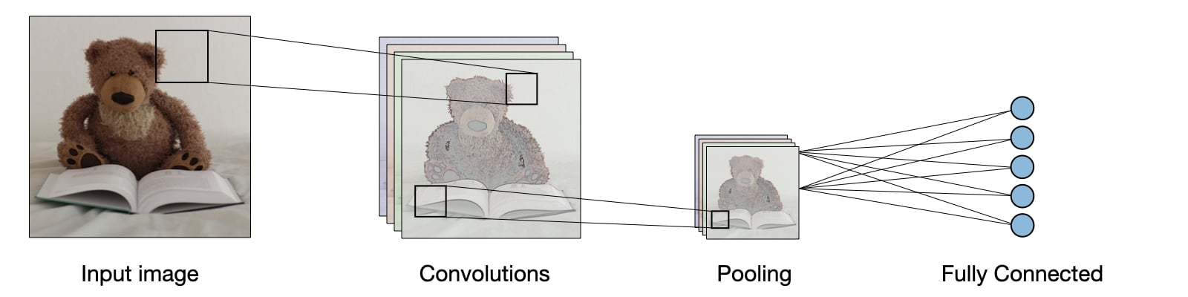
Convolutional Neural Networks
A diagram illustrating one layer of a convolutional neural network:
Source: https://stanford.edu/~shervine/teaching/cs-230/cheatsheet-convolutional-neural-networks

Slide 34
Recurrent Neural Networks
Two important deep neural architectures emerged by the mid-2010s:
Convolutional neural networks (CNNs):
Recurrent neural networks (RNNs): Used primarily for processing natural language texts and other sequences (e.g. time series)
The goal can be labeling or classifying individual elements of the sequence, or predicting the next element based on the history (language modeling, time-series forecasting).
One hidden layer of the RNN (possibly more than one, but few) processes each element of the sequence (the so-called time steps).
The value of a hidden layer neuron is obtained by the weighted summation of two factors:
The product of the given sequence element's features and the hidden layer’s weights (as in a classic neural network)
plus the activations of the hidden layer neurons from the previous time step (which is itself obtained as a weighted sum of two such inputs).
The recurrent neural network is shallow at every time step, but deep when considering all time steps of the entire sequence.
Training is performed by propagating the error backward through the time steps (backpropagation through time).

Slide 35
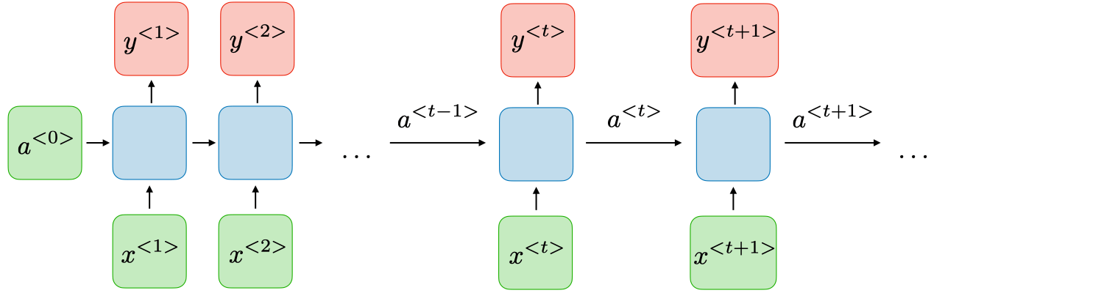
Recurrent Neural Networks
Illustration of the layout of a recurrent neural network:
Source: https://stanford.edu/~shervine/teaching/cs-230/cheatsheet-recurrent-neural-networks

