Slide 1
Generative Artificial Intelligence Deep Learning and the State of the Art in AI Today
October 9, 2025
Pethő Gergely
UD Faculty of Health Science, Department of Bioinformatics

Slide 2
Deep Learning
Deep Learning refers to machine learning using deep neural networks
neural network:
A deep neural network is one that has more than two hidden layers
the typical number is between less than 10 to a few dozen
layer:
hidden layer:

Slide 3
Deep Learning
Deep Learning refers to machine learning using deep neural networks
neural network: a mathematical function consisting of vector and matrix multiplications and application of nonlinear functions on their products
A deep neural network is one that has more than two hidden layers
the typical number is between less than 10 to a few dozen
layer:
hidden layer:

Slide 4
Deep Learning
Deep Learning refers to machine learning using deep neural networks
neural network: a mathematical function consisting of vector and matrix multiplications and application of nonlinear functions on the products
A deep neural network is one that has more than two hidden layers
the typical number is between less than 10 to a few dozen
layer: a set of nodes in the neural network’s computation graph the edges of which come from the same set of other nodes (usually the next lower layer)
hidden layer:

Slide 5
Deep Learning
Deep Learning refers to machine learning using deep neural networks
neural network: a mathematical function consisting of vector and matrix multiplications and application of nonlinear functions on the products
A deep neural network is one that has more than two hidden layers
the typical number is between less than 10 to a few dozen
layer: a set of nodes in the neural network’s computation graph the edges of which come from the same set of other nodes (usually the next lower layer)
hidden layer: a layer that is neither the input nor the output layer
the activation of its neurons are calculated, directly or indirectly, based on the input layer

Slide 6
Deep Learning
Although this does not follow from the number of layers, deep neural networks also tend to have a large number of parameters
a small deep neural network tends to have a few million parameters
the largest deep neural networks today, which are large language models, are believed to have somewhere around 2000 billion parameters
parameters:

Slide 7
Deep Learning
Although this does not follow from the number of layers, deep neural networks also tend to have a large number of parameters
a small deep neural network tends to have a few million parameters
the largest deep neural networks today, which are large language models, are believed to have somewhere around 2000 billion parameters
parameters: weights of the model that the activations from the previous layer of the network are multiplied by
the input features are the variables of the model
the parameters are constant parts of the function that is the neural network

Slide 8
Deep Learning vs Traditional ML
Traditional machine learning
is only suitable for working with a small number of features per input
high-dimensional input data needs to be reduced to a small number of dimensions
example: OCR (optical character recognition)
the image is segmented into lines and characters based on horizontal and vertical regions stripes that are relatively empty
characters might be straightened to handle italics
within each character bounding box, black pixels on vertical and horizontal scan lines are counted, reducing the dimensionality from width times height to width plus height
example: NLP (natural language processing)
when training a text classifier, words contained in the text are filtered (punctuation, stopwords, unique words removed, words lower-cased and lemmatised)
more general approach: dimensionality reduction using mathematical methods such as principal component analysis (PCA)
feature extraction or feature engineering precedes model training
input should be clean, extreme outliers, incorrect data are removed

Slide 9
Deep Learning vs Traditional ML
Deep neural networks, by contrast, do not require feature engineering or extraction
OCR: instead of pre-processing an image before recognition, the raw image’s pixel values are passed to the model as input
there may be some partial preprocessing, for example, identifying the lines and only a single line to the recognition model; this is how the Tesseract open-source OCR software works on Linux
but each line is fed to the model as a matrix of pixels
In essence, the neuron activations in the hidden layers can be understood as automatically extracted features
These features are not interpretable directly and not discrete, but are rather distributed representations (recall connectionism)
This idea that deep learning models learn to extract useful patterns from the input spontaneously as a result of training is referred to as representation learning
Data need not be clean, neural networks can be trained well on noisy data
Deep neural networks are trained on a huge amount of training examples
If many training examples are broken in various ways, the general statistical patterns of the population can still be extracted
In other words, a (deep) neural network learns to ignore the noise in the training data
Noise and representation learning are closely connected in deep learning

Slide 10
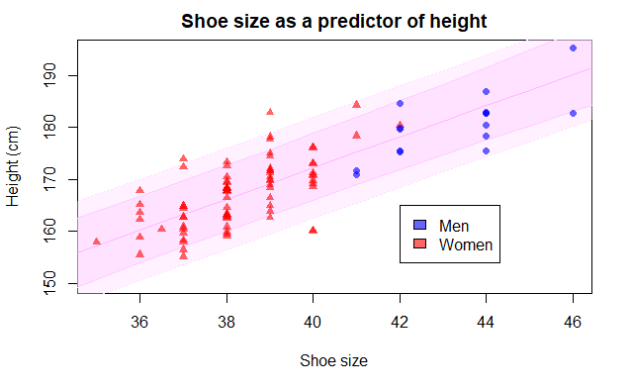
Noise
Noise in everyday contexts: disturbing, disruptive unpleasant, unwanted sound
In machine learning as a technical term: random or irrelevant variation in data that does not represent the true underlying patterns the model is trying to learn
"junk" or "error" in the training data that makes it harder for a model to learn the real relationships between inputs and outputs
Can be:
label noise: incorrect or inconsistent target values, e.g. in a dataset of cat and dog images, some cat images are mistakenly labeled as dogs
feature noise: errors or randomness in the input features, e.g. sensor readings fluctuate because they are not perfectly accurate
inherent (irreducible) noise in the population: unavoidable randomness in the data that no model can fully explain, e.g. who gets cancer? how tall are you? – partly just a matter of luck
outliers: extreme data points that don’t follow the general pattern, might be noise or meaningful depending on the problem
Example: linear relationship between foot length and body height
Image: https://rpubs.com/rbatzing/FootStrideHt

Slide 11
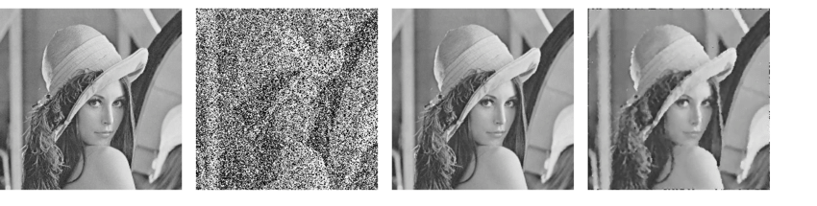
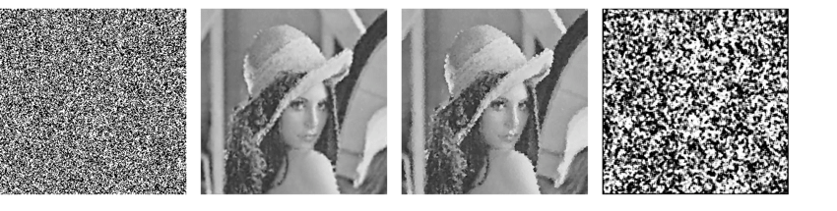
Noise
Dealing with noise in machine learning:
data cleaning: remove or correct incorrect labels and feature values
feature engineering: smooth or normalise noisy features
regularisation: part of a model that prevents a model from fitting to noise during training, such as dropout in deep neural networks
robust model: choose a model that is not sensitive to noise, like a neural network
Related concept: noise in image processing, including by deep learning
image noise: unwanted random variations in pixel intensity values that degrade image quality
visual corruption of the image data
image appears blurry, grainy, or distorted: obscures the "true" image
Examples from: https://www.researchgate.net/publication/266015548
1: original image, 2: 50% density noise added, 3, 4: denoised with two different filters
5: 95% density noise added, 6-8: denoised with different filters

Slide 12
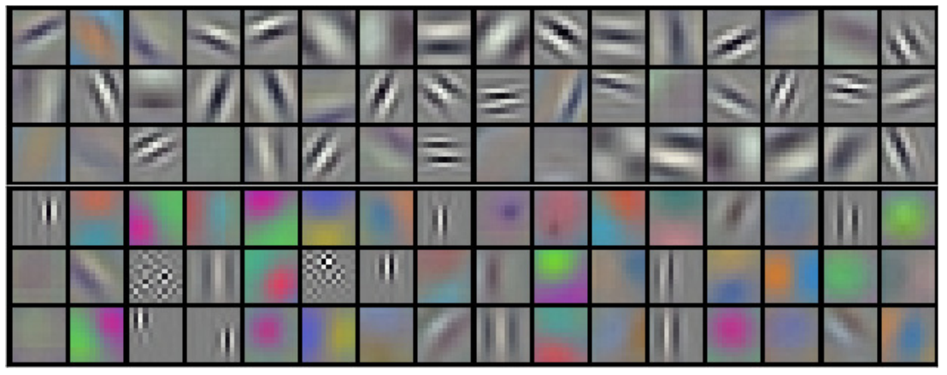
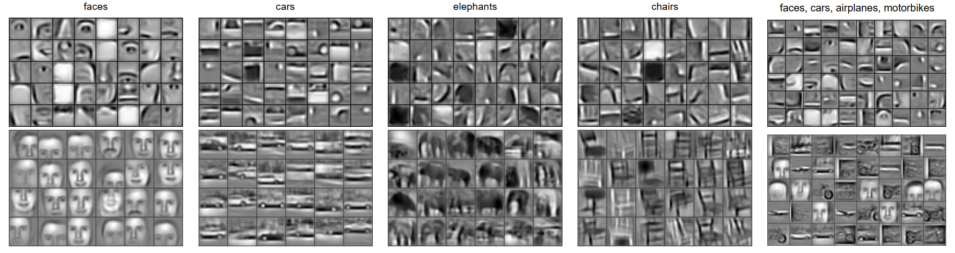
Representation Learning
Example 1: Learned Filters in CNNs
Filters of first convolutional layer from seminal paper (184.000 citations!) Krizhevsky, Sutskever, Hinton: ImageNet Classification with Deep Convolutional Neural Networks, NIPS 2012
Filters of second (top) and third (bottom) convolutional layer of different CNNs trained on images showing specific object categories, from Lee et al.: Convolutional Deep Belief Networks for Scalable Unsupervised Learning of Hierarchical Representations, ICMS 2009.

Slide 13
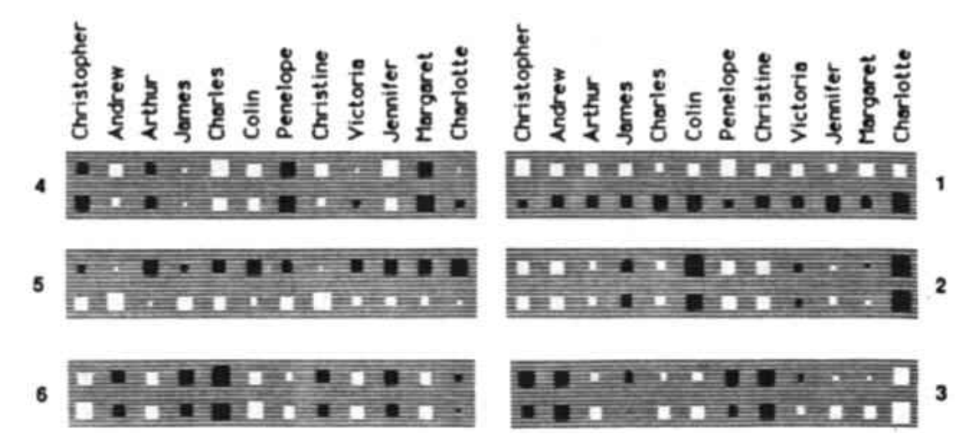
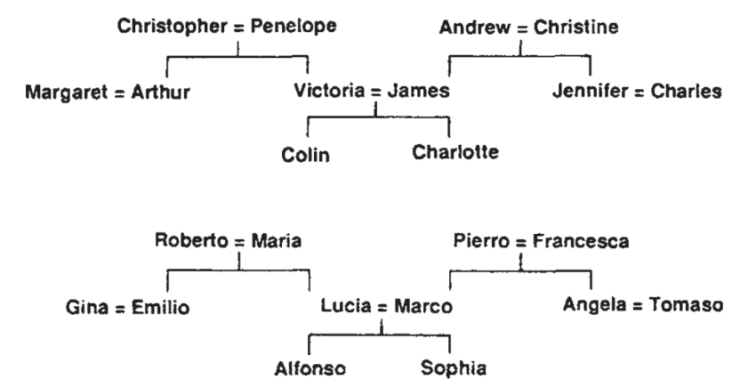
Representation Learning
Example 2: Learning family relationships
Not a deep neural network but a regular one from Rumelhart, Hinton, Williams: Learning representations by back-propagating errors. Nature, 1986.
Facts from two isomorphic family trees are presented as training examples in the form <person 1> <relationship> <person 2>, the persons and relationships were one-hot encoded. Relationship can be father, mother, husband, wife, sister, brother, uncle, aunt, etc. Person 1 and relationship are in the input layer, person 2 is the output layer.
The first hidden layer contains 6 neurons, the figure on the right shows the value of the weights (black negative, white positive, size magnitude) connecting the input feature representing each person to each neuron (1 through 6). Neuron 1 learned to represent Italian vs. English tree, 2 is generation, 6 is left vs. right branch.

Slide 14
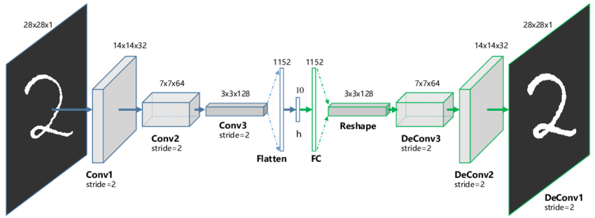
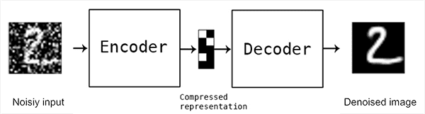
Representation Learning
Example 3: Autoencoders
An autoencoder is a neural network which is trained to output the same vector that is passed to it as its input.
It contains two halves:
encoder: maps input to a low-dimensional representation of the input (ex.: 28*28=754 features to 10)
decoder: reconstructs the original input approximately from the low-level representation
lossy compression
In essence, an autoencoder extracts useful features from high-dimensional data
describing an image using a few words is much like this
Image: Guo, Liu, Yin: Deep Clustering with Convolutional Autoencoders, ICONIP 2017
Among others, autoencoders can be used for image denoising and image generation (for example, in GANs)
A denoising autoencoder, https://pyimagesearch.com/2020/02/24/denoising-autoencoders-with-keras-tensorflow-and-deep-learning/

Slide 15
The Rise of Generative Models
Generative AI is always based on deep neural networks of different types.
The earliest influential type of generative neural network was the generative adversarial network (GAN), invented in 2014, which became very influential in the second half of the 2010s and was used for image generation.
The invention of the transformer neural network architecture in 2017 was a turning point in the development of deep learning
Vaswani et al. (Google Research): Attention Is All You Need, 2017 (208,000 citations)
Its first influential application was the BERT encoder-only language model in 2018
Devlin et al. (Google AI): BERT: Pre-training of Deep Bidirectional Transformers for Language Understanding, 2018 (150,000 citations)

Slide 16
The Rise of Generative Models
Every milestone of modern generative AI is similarly connected to a seminal paper:
Radford et al.: Improving language understanding by generative pre-training (OpenAI), 2018
the paper introducing GPT-1, the first decoder-only, transformer-based generative language model
Radford et al.: Language Models are Unsupervised Multitask Learners (OpenAI), 2019
on release of GPT-2 it was realised that larger generative language models in the billion-parameter range are able to perform several NLP-related tasks (summarisation, translation, question answering) without explicitly being trained for them
Ziegler et al: Fine-tuning language models from human preferences (OpenAI), 2019
introduces the concept of reinforcement learning from human feedback, which was a crucial component of making a language model behave like a chatbot, i.e. creating ChatGPT on top of the generative language model GPT-3 that was released the following year

Slide 17
The Rise of Generative Models
Every milestone of modern generative AI is similarly connected to a seminal paper:
Brown et al.: Language models are few-shot learners. (OpenAI), NeurIPS 2020
the paper on GPT-3, the first real large language model (175 billion parameters); scaling up generative language models to the 10- and 100-billion parameter range greatly improves their performance on NLP tasks they had not been trained on
Kaplan et al.: Scaling laws for neural language models. (OpenAI), 2020
exactly how does the loss of a language model scale with model size, dataset size and the amount of compute used for training?
Radford et al.: Learning Transferable Visual Models From Natural Language Supervision (OpenAI), PMLR 139, 2021
instead of training vision models to classify images into predetermined categories, they can be trained to associate images with raw text captions; this was crucial for the development of image generation based on text prompts

Slide 18
Foundation Models
The single most important event in the development of generative AI was the release of GPT-3 in 2020.
GPT-3 was a comparatively huge model, much bigger than anything seen before, that took immense amount of compute power, time and an extremely large corpus to train
It was developed by a startup called OpenAI, and weights of the model were not open-sourced
its predecessors, GPT-1 and GPT-2 were
Language model: by definition, it learns to estimate the conditional probability distribution of the potential (word or subword) token that could appear at a specific position in the text given the actual tokens around this position
GPT-3 was a unidirectional, left-to-right language model and learned to predict the probabilities of the tokens that could appear to the right given the actual tokens appearing to the left of it
Surprisingly it could perform well on tasks that are different from token probability prediction, like question answering or translation.
Hypothesis: as larger models are trained, abilities emerge in them for which hey have not been trained and which are not present in smaller models

Slide 19
Foundation Models
Emergent abilities
Wei et al.: Emergent Abilities of Large Language Models. TMLR, 2022
Stanford HAI Workshop on Foundation Models, 2021
"By foundation model (e.g. BERT, GPT-3, DALL-E), we mean a single model that is trained on raw data, potentially across multiple modalities, which can be usefully adapted to a wide range of tasks. These models have demonstrated clear potential, which we see as the beginnings of a sweeping paradigm shift in AI."
https://crfm.stanford.edu/workshop.html
The largest language models are regarded as such foundation models

Slide 20
The Current State of the Art in AI
Symbolic AI tools like non-classical logics, knowledge representation and reasoning systems, search algorithms, etc., are still being researched within computer science and applied in many areas
Task-specific machine learning models, including deep neural networks are crucial in many application areas
Generative language models are used for most natural language processing (NLP) tasks, especially machine translation, chat and to support programmers as coding assistants
Generative language models are general-purpose as far as NLP is concerned, but they are not much use for anything else
Generative vision models are popular for image and video generation

Slide 21
The Current State of the Art in AI
Deep Learning models are used in many different areas, only a small fraction of which are generative. General applications:
1. Computer vision (~ image processing)
image classification: identifying objects, image captioning
object detection: where are objects in the image and how many, used in smartphone camera software autonomous vehicles, surveillance, robotics
image segmentation: similar, where are regions of interest in an image, used in medical imaging (tumor detection)
face recognition: for authentication, emotion detection
OCR: extracting text from images or documents
image generation: from a text prompt or not, style transfer, deepfakes, AI art
2. Natural language processing (NLP)
information retrieval: finding documents relevant to a question in a text database
summarisation: summarising documents
text generation: chatbots (e.g. ChatGPT), content creation
machine translation

Slide 22
The Current State of the Art in AI
Deep Learning models are used in many different areas, only a small fraction of which are generative. General applications:
3. Speech and audio processing
Speech recognition (ASR): used in digital assistants, chatbots or for audio transcription, e.g. OpenAI’s whisper
text to speech (TTS): natural voice generation, reading aloud texts
speaker identification
music classification: genre detection etc.
music generation: AI composers
Specific areas of use:
1. Healthcare, bioinformatics
medical imaging analysis: detecting anomalies in X-rays, MRI, CT
predictive diagnostics: disease prediction from patient data
genomics: high-throughput DNA sequencing and analysis
drug discovery: prediction of molecular structures, e.g. structure of proteins (AlphaFold)
personalised medicine: instead of using the same protocol for all patients, finding treatment and dosages that fit the given patient’s genetic profile

Slide 23
The Current State of the Art in AI
Specific areas of use:
2. Autonomous systems
self-driving cars, drones: combine perception, navigation and decision-making
robotics: object recognition, motion planning
3. Finance, business intelligence
"algorithmic trading": predicting market movements
fraud detection: anomaly detection in transactions
credit scoring: risk assessment using past data and profiling
customer analytics: churn prediction (who is likely to drop the product?), personalisation
4. Manufacturing, industry
Quality control: identifying faulty products by visual inspection
predictive maintenance: identifying machine faults early
process optimisation: identifying bottlenecks

Slide 24
The Current State of the Art in AI
Deep Learning models are used in many different areas, only a small fraction of which are generative:
5. Entertainment
game AI: adaptive, intelligent opponents, NPCs
game-playing AI: a software system that plays a video game autonomously
content generation: music, art, video
6. Cybersecurity
intrusion detection: identifying abnormal network activity
malware detection: recognising malicious code
user behavior analytics: finding inside threats
7. Science
weather and climate modelling: predicting weather, climate change impacts
astronomy: identifying celestial objects from telescope data
physics: interpreting sensor data
agriculture: pest detection, yield prediction

Slide 25
The Current State of the Art in AI
Characterised by a strong culture of open knowledge sharing
traditionally companies had trade secrets while academic researcher shared their results
today in AI, company R&D teams tend to share results as well immediately
describe their approach and publish benchmark results in a research paper at conferences or on the preprint site arXiv without peer review
share code on GitHub publicly
share the trained model on Hugging Face
publish an open problem on Kaggle as a competition and ask people to solve it for you, paying a token amount of money to the winner
a means of free publicity and promotion for the product and for themselves

Slide 26
The Current State of the Art in AI
As a result of the open knowledge sharing, it is known perfectly how an AI system works, there are no big company or government secrets
what the architecture is (transformer etc.)
the exact implementation details may be kept secret, such as amount and type of training data, number of layers or transformer blocks, parameters, etc.
what sort of hardware it runs on
exact amount of GPUs etc. is not known and changes dynamically anyway based on server loads
AI systems that do almost exactly the same as one of the proprietary systems can be reproduced on the user’s own hardware, or on hardware borrowed from a cloud infrastructure and platform provider (Google Cloud, Amazon AWS, Microsoft Azure)
ML software can be platform-specific or open-source like TensorFlow or Pytorch
performance and prediction accuracy will be likely poorer due to scale if the user is using consumer hardware
The user can adapt the model to their own data by adding on parts or by fine-tuning the existing model weights.

