Slide 1
Generative Artificial Intelligence
September 18, 2025
Pethő Gergely
UD Faculty of Health Science, Department of Bioinformatics

Slide 2
The Past of Artificial Intelligence
Generative artificial intelligence is a very recent invention
The first generative image models appeared in the mid-2010s, with generative neural language models following soon after
They became dominant in the field of AI much later, around 2020/21, with the GPT-3 and DALL-E models
Non-generative artificial intelligence as a research field, however, is as old as the computer itself, emerging in the mid-20th century
first electronic computers were built between 1943 and 1945
Until the mid-1950s, only custom-built computers existed, initially used for military calculations. By around 1950, computers were also used for large government institutions, for example, for the census.
Commercial computers produced in small series (a few thousand) appeared around 1955; before that, each computer was unique
Alan Turing's paper introducing the concept of artificial intelligence realized with an electronic computer was published in 1950

Slide 3
The Past of Artificial Intelligence
https://books.google.com/ngrams/graph?content=artificial+intelligence&year_start=1940&year_end=2017&corpus=en&smoothing=0&case_insensitive=false
The term "artificial intelligence" appeared in the late 1950s and gradually gained momentum in the '60s and '70s
The classic and most important scientific journal for the research field, Artificial Intelligence, was launched in 1970
There was a spectacular boom in the first half of the 1980s, followed by a dramatic decline until about 2000, then stagnation until 2010, and a slow rise after that
For example, Spielberg's movie A.I. Artificial Intelligence was released in 2001

Slide 4
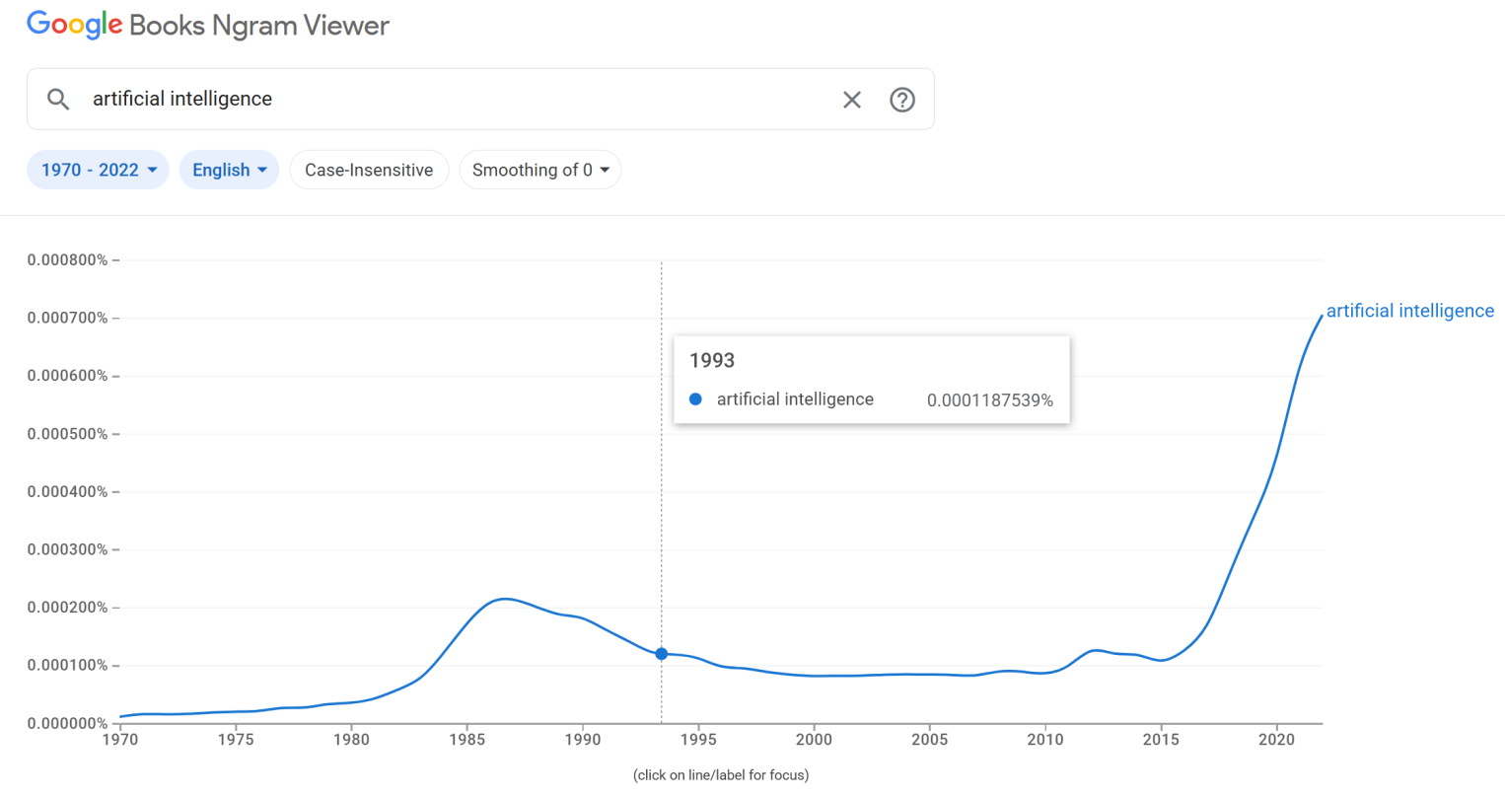
The Past of Artificial Intelligence
AI became noticeably more well-known between 2017 and 2022
The chart only goes up to 2022, the impact of ChatGPT (after Nov 2022) is not yet on it.
https://books.google.com/ngrams/graph?content=artificial+intelligence&year_start=1970&year_end=2022&corpus=en&smoothing=0&case_insensitive=false

Slide 5
The Past of Artificial Intelligence
It is clear that AI was an important topic, especially in computer science, but to some extent also in the general public, economy, and popular literature.
From the beginning, people were fascinated by the ability of computers to function as "electronic brains," performing complex calculations automatically, and in a sense, "thinking".
For example, the mathematician and computer science pioneer John von Neumann wrote a long lecture shortly before his death in 1957, in which he reflected on the similarities and differences between the computer and the human brain.
Artificial Intelligence (AI) was primarily the name of a branch of computer science and a field of research, not so much a name for specific software products

Slide 6
The Past of Artificial Intelligence
The similarity between the brain and the electronic computer not only inspired computer science but also had an effect in the opposite direction.
Cognitive science: an interdisciplinary field between psychology, neuroscience, linguistics, philosophy, and artificial intelligence
One of its central assumptions is "computationalism" or "computational theory of mind": the human or animal mind works like a computer, performing data processing by executing operations defined as functions on mental representations
In line with this, one of the methods of cognitive science is the computer modeling of psychological processes
The computer model serves to verify the correctness, or at least the plausibility, of psychological theoretical statements about mental processes
For example, Johnson-Laird: The Computer and the Mind. An introduction to Cognitive Science. 1988

Slide 7
The Past of Artificial Intelligence
Make no mistake:
It is not the case that people only talked about AI since the mid-20th century, but it didn't exist then, and now it does.
AI applications that automate planning and thinking in specific areas have existed since the mid-20th century.
Generative AI as a software product is undoubtedly different from this in the sense that it solves a different problem: it generates images and text
It's not "smarter"
It does not "solve" the problem of artificial intelligence
It is not a general-purpose AI, not artificial general intelligence (AGI)
It does not create an "artificial mind" or "(self)consciousness"
To see how generative AI is different, and what its advantages and limitations are compared to previous AI solutions, it is useful to also learn about the latter, and then interpret the technology of generative AI by comparing and contrasting it with them
This will be the goal of this and the next lecture

Slide 8
The Turing Test
Alan Turing (1912–1954), a British mathematician, was one of the founders and most important figures of theoretical computer science
In his 1936 paper, On Computable Numbers, with an Application to the Entscheidungsproblem, he outlined the structure of an abstract computational model that, with proper programming, could perform any conceivable mathematical calculation
This abstract "universal computer," outlined only in theory, the Turing machine, became the theoretical basis for the practical implementation of electronic computers in the 1940s
Turing himself was actively involved in creating the top-secret first British electronic computers
The first American computers followed this pattern a few years later
In addition, this paper also created the foundations of complexity theory
examining how much time and storage are needed to solve a problem using a given algorithm, that is, how complex a computational problem is

Slide 9
The Turing Test
In addition to his pioneering theoretical computer science work, Turing created the program for artificial intelligence in another, later paper
Computing Machinery and Intelligence (1950)
https://phil415.pbworks.com/f/TuringComputing.pdf
some 76.000 citations according to Google Scholar, the true number is likely much greater
He poses the question of whether a machine can think.
He suggests a game to decide this
The question itself is undecidable and meaningless in its original form; what is a machine? what is thinking?
We should find some other directly decidable test that we can all accept as a clear sign of a machine's thinking
This is the imitation game, which has since become universally known as the Turing Test

Slide 10
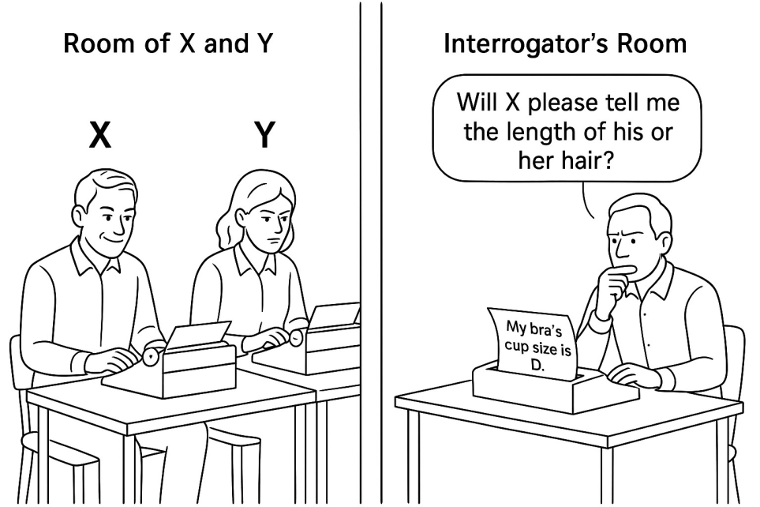
The Turing Test
The imitation game with a man and a woman:
A man (A) and a woman (B) are in one room, and an interrogator (C) is in another room and cannot see them. A and B communicate with C in writing, for example, on a computer keyboard, so that C cannot infer from their appearance or voice whether they are the man or the woman.
C knows the other two players as X and Y and addresses them as such. At the beginning, it is determined randomly whether A will be X and B will be Y, or vice versa. If C addresses X or Y, the player with that name must answer.
At the end of the game, C says, "X is the man and Y is the woman," or "Y is the man and X is the woman ".
The man wins and the woman and C lose if the man succeeds in deceiving C, i.e. C says that X is the woman although it is in fact Y.
The woman and C win, and the man loses, if C correctly guesses who the woman and who the man is.

Slide 11
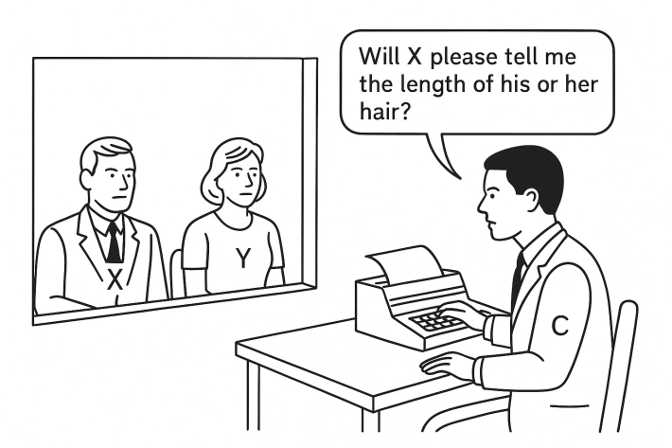
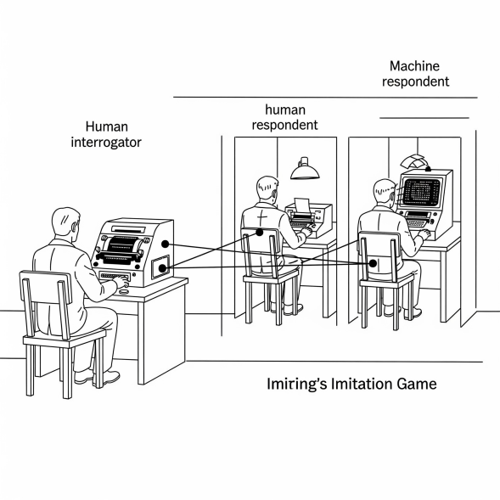
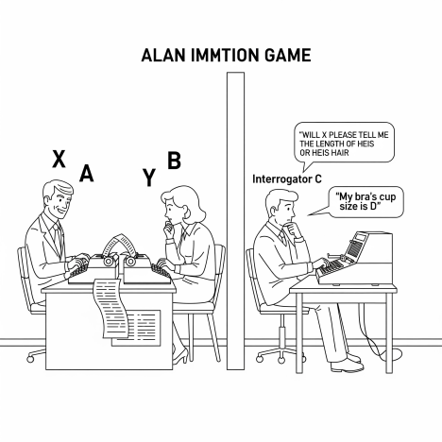
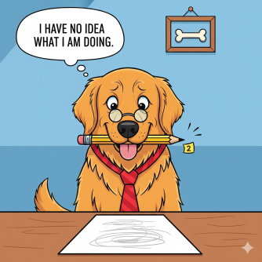
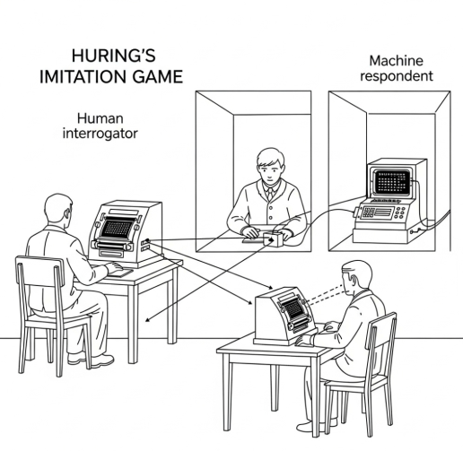
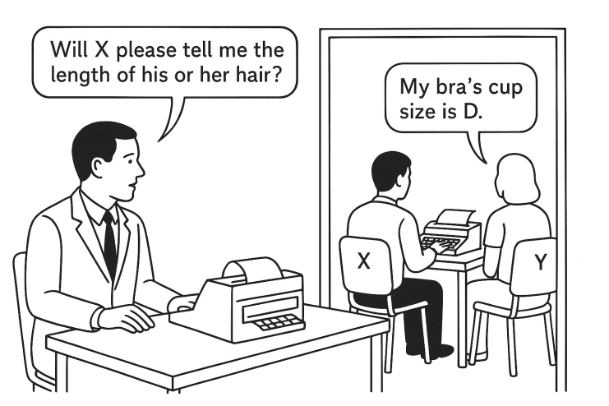
The Turing Test

Slide 12
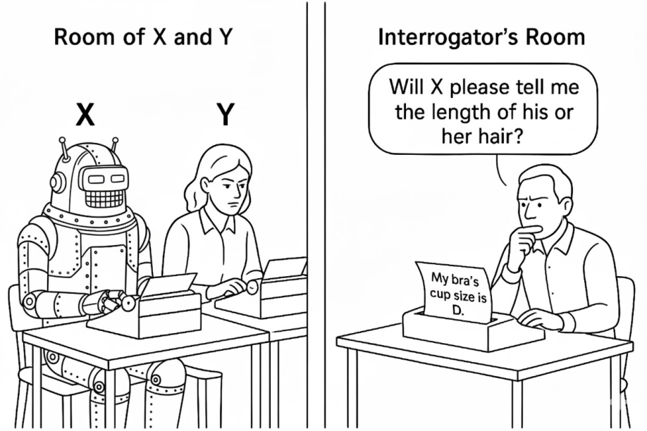
The Turing Test
The imitation game with a computer and a woman:
The goal is the same.
C can ask anything that they think will help distinguish the human from the computer.
Turing justifies this by saying that (in today's terms) to be able to answer anything, the computer must have artificial general intelligence (in this, Turing was mistaken)
If the computer can deceive C at least as often as an average man in the original imitation game, then we can agree that it is thinking
"May not machines carry out something which ought to be described as thinking but which is very different from what a man does?"

Slide 13
The Turing Test
We still don't know exactly what artificial intelligence means or what it means for a machine to think, but there is a consensus in the field that the Turing Test is our best practical procedure for testing artificial general intelligence
Note that this is not about the concept of artificial intelligence in the sense introduced earlier
Turing did not use the term "artificial intelligence," he wrote about thinking machines.
Later AI was generally not so ambitious; the simulation of any aspect of human intelligence can be called AI

Slide 14
Dartmouth Summer Research Project on Artificial Intelligence
A long, 6-8 week brainstorming meeting in the summer of 1956 at Dartmouth College
often referred to as the Dartmouth workshop
considered the birthplace of artificial intelligence research
Its goal was for the excellent young scientists working in the field to think together about the possibility of creating thinking computers
"every aspect of learning or any other feature of intelligence can in principle be so precisely described that a machine can be made to simulate it. An attempt will be made to find how to make machines use language, form abstractions and concepts, solve kinds of problems now reserved for humans, and improve themselves."
organized by Marvin Minsky, who coined the name "artificial intelligence" for the research field
There were a total of 20 participants over longer or shorter periods, the vast majority of whom had significant scientific careers later

Slide 15
The Early Phase of AI
In the '50s and '60s, research in the field was characterized by unrealistically exaggerated optimism and huge ambitions; it was thought that the creation of a thinking, learning machine was only a matter of years
A typical example is Frank Rosenblatt's invention in the late 1950s, the perceptron
an early machine learning method, a simpler form of the neural networks invented later in the 1980s
automatically learns to recognize shapes (e.g., triangles, squares) by showing them to its "camera" without human intervention, i.e., without targeted programming of the recognition procedure
The New York Times, 1958, on a technological demonstration related to a perceptron: „The Navy revealed the embryo of an electronic computer today that it expects will be able to walk, talk, see, write, reproduce itself and be conscious of its existence.”
yes, but
the learning algorithm at that time was only suitable for the perceptron in its rudimentary form, which could not learn any of these things
The generalization of the perceptron, the neural network, could learn such things, but there was no learning algorithm for it. That algorithm was invented around 1970, but it was not useful then due to the lack of a powerful enough computer, so no one was interested, it was forgotten, and rediscovered in the 1980s
The general neural network is not really good for any of these; specific developments of the basic idea were needed for different application areas, one for vision, another for writing, etc.
It was only by the 2010s that hardware became powerful enough to train a model for such complex problems
In short: yes, but it took 60 years of intensive research and technological development

Slide 16
The Early Phase of AI
The source of the excessive expectations was always the same:
A relatively simple goal was set.
For example, distinguishing a triangle from a square with a camera
The derivation of a specific mathematical theorem from given premises using given inference rules.
A solution was found to implement this in a very short time.
The initial success led to the conclusion that it would be easy to find a solution for the entire problem (e.g., machine vision, inferential thinking)
If the perceptron can distinguish a triangle from a square, then it can also distinguish a dog from a cat
In reality, it turned out in every application area of AI that this is not the case; solution for simple problems do not scale

Slide 17
The Early Phase of AI
Non-scalability:
It might be easy and work well (e.g., with 90% reliability) to classify an image into one of two categories (with a binary classifier)
But if 1000 categories need to be distinguished, the accuracy (reliability) of the classification drops dramatically
Or the computation time becomes unacceptable
relatively easy to classify an image into one of 1000 categories, but very difficult to write a classifier that can correctly tell that the image depicts something that is not among the 1000 categories (i.e., learning a general negative category)
very easy to write a chess program that can beat a beginner
practically impossible to write one that can beat a grandmaster
This was only achieved with huge computational capacity and statistical learning, not algorithmically

Slide 18
The Early Phase of AI
A classic, astonishing example:
Minsky and Papert (Rosenblatt's rivals) announced a "Summer Vision Project" in 1966, with the intention that their summer student workers should spend their time productively
https://dspace.mit.edu/handle/1721.1/6125
The project set the goal of solving the recognition of simple, single-colored shapes (balls, bricks, cylinders) in front of a homogeneous background in July
Then, in August, they would expand this to textured or multicolored surfaces or more complex similar shapes (a cigarette box with an inscription, a battery, complex background), and then to more complex shapes (cups, tools)
In essence, the idea was to solve the problem of machine vision in two months with a few student workers
In reality, it took about 50 more years

Slide 19
Symbolic Artificial Intelligence
The early phase of AI, up until the 1980s, was characterized by the so-called symbolic approach
Symbolic (formal, mathematical) logic was thought to be the model of human thinking
Our thoughts are built from predicates, arguments, and quantifiers, which can be represented as discrete symbols in a computer system
Operations performed on these symbols constitute thinking.
Starting out from premises described with logical symbols,
through a series of precisely defined processing steps,
We reach a specific conclusion, described with logical symbols

Slide 20
Symbolic Artificial Intelligence
The LISP programming language is the most influential early AI language, created around 1960.
It is still used today, though not in AI.
Its essence is precisely that during program execution, it recursively replaces symbols of a defined form by other, more elementary symbols
(defun factorial (n)
(if (zerop n) 1
(* n (factorial (1- n)))))

Slide 21
Symbolic Artificial Intelligence
The Prolog programming language: a logic programming language that implements a proof procedure from mathematical logic called first-order resolution, created in the early 1970s.
Programs written in the Prolog language contain so-called facts and so-called rules; together, these form a knowledge base.
Both facts and rules consist of predicates and arguments, as well as logical operators; the arguments can be the names of individuals or variables
The program is run by entering a statement (a theorem)
If the theorem is a closed statement, meaning it contains no variables, the Prolog engine checks with logical resolution whether this statement can be derived from the knowledge base, and then answers yes or no.
If the theorem contains variables (open statement), it calculates which specific names to substitute into the variables to get statements that can be derived from the knowledge base

Slide 22
Symbolic Artificial Intelligence
mother_child(trude, sally).
father_child(tom, sally).
father_child(tom, erica).
father_child(mike, tom).
sibling(X, Y) :- parent_child(Z, X), parent_child(Z, Y), not(X = Y).
parent_child(X, Y) :- father_child(X, Y).
parent_child(X, Y) :- mother_child(X, Y).
?- sibling(sally, erica).
Yes
?- parent_child(Parent, Child).
Parent=trude, Child=sally
Parent=tom, Child=sally
...

Slide 23
Symbolic Artificial Intelligence
Symbolic artificial intelligence not only dealt with the automation of logical derivations but also with many other problem-solving strategies, which can all be described overall as search algorithms
Just like logical derivations, these are also algorithms, a series of precisely defined steps.
The starting point is always a problem to be solved, for which we give a formal description, a so-called representation in the computer.
We want to get from the representation of the starting state to a representation or state that can be considered the solution to our problem, through a series of allowed steps.
Ideally, we are looking for the shortest possible path from the starting state to a (the) solution.

Slide 24
Solving a Problem by Searching
Sudoku board
partially filled with numbers
the solution to the problem is the completely filled board
State representation: a 9x9 = 81 grid, each cell is either empty or already contains a number.
Constraints:
Each cell can only contain numbers from 1 to 9, or be empty
A row is acceptable if the same digit is not repeated in it -> each digit appears exactly once in a row
A column is also acceptable if no digit is repeated in it.
The board consists of 3x3 squares, each containing 3x3 cells; such a square is acceptable if no digit is repeated in it
The initial, partially filled board satisfies all the constraints.
Possible moves:
We enter a digit into a currently empty cell in such a way that no constraint is violated.

Slide 25
Solving a Problem by Searching
Problem-solving search algorithms:
Depth-first search: Fill an arbitrary cell with an arbitrary valid number, and then do the same until either the board is full (we solved the problem) or we get stuck, meaning the board is not filled but there are no more valid moves. If we get stuck, we backtrack to the previous choice point and choose another number for the same cell, or if there are no other options, we enter a number into another cell.
Breadth-first search: We examine the immediate consequences of all valid moves that can be made from the current state.
Heuristics: We follow a strategy that (according to experience or provably) leads to a solution faster than searching blindly
For example, if only one number is missing from a row, column, or square, enter that number.
If there is none, collect which rows, squares, or columns are missing the fewest numbers and choose one of them.
In general, a key component of heuristic search is a function that estimates a "goodness" value for each problem state
The search algorithm examines all possible states resulting from each possible move before making a decision and moves toward the state estimated to be the best
The difficult task is to define this evaluation function
Both finding a good representation of a state and defining an evaluation function for heuristic require human intelligence, the AI does not take care of that
The AI in computer games (e.g., strategy games) also works on this principle:
The human player moves
The computer player examines which response move brings it closer to victory.
The current state of the game board is known to the AI.
The number of possible moves is limited, and it must choose from them.

Slide 26
The First AI Winter
In the '50s and '60s, AI researchers promised spectacular breakthroughs within a few years and received funding for this from the US government, and especially from the Department of Defense.
They were going to solve the problems of machine vision, thinking, machine understanding of human language, and machine translation within a few years.
Demonstrations on small, very limited tasks worked well, but no actual solutions for these big, general problems were created in practice. The scaling of small demonstration systems failed spectacularly.
MI-tél (AI winter):
1966: the ALPAC report (USA) surveyed the progress of machine translation research and found that the machine translation systems developed so far had not lived up to expectations; human translators' work was cheaper, faster, and more reliable, and it was not worth continuing to fund machine translation research
1973: the Lighthill report (Great Britain) concluded that AI research had not produced practically useful results and its budget should be cut
As a result, AI research slowed down dramatically in the '70s until the beginning of the '80s.
It became clear that symbolic artificial intelligence ran into serious limitations.

Slide 27
Expert Systems
In the early 1980s, AI development and research boomed again with much more modest goals; this was largely driven by the economy.
They were not looking for a thinking machine or a general solution to a difficult problem (e.g., vision, thinking) but were trying to develop decision support systems.
These were called expert systems
An expert system is so named because it stores the knowledge of a specific field or profession and, based on that, looks for a solution to a problem to be solved by a representative of that profession.
For example, making a medical diagnosis
The patient has these symptoms and characteristics (age, etc.); what are the possible diagnoses, and how likely is each one.
For example, suggesting a treatment.
The patient has this medical history; what medication should I prescribe for their complaint, and why.

Slide 28
Expert Systems
Expert systems are based on symbolic knowledge representation, similar to what we saw with the Prolog language.
We get from the premises to the derived conclusion through a series of inference rules.
However, the knowledge of professional fields cannot be described with strict logical rules, so the classic formal logical inference rules are not sufficient.
For example, we are not completely sure about the truth of certain statements.
According to one representative of the profession, a statement is true, and according to another, the opposite is true; the two would form a logical contradiction together.
Certain statements are generally true, but not under certain conditions.
For example, mammals generally cannot fly.
Unless they are bats, because then they generally can.
Unless they are injured or bat babies, because then they cannot.
Therefore, expert systems often incorporated non-classical, non-monotonic reasoning procedures that can handle the uncertainty and inconsistency of the premises contained in the knowledge base
Non-monotonic logical systems, e.g., fuzzy logic.

Slide 29
The Second AI Winter
Expert systems sparked huge enthusiasm from the early '80s, serious expectations were attached to them, and there were some well-functioning examples.
But overall, they were extremely laborious to build, so they were expensive.
They required intense cooperation between computer scientists and domain experts to create them.
Domain experts often cannot precisely list the factors based on which they make a decision and how they weight them; they leave out important factors, perhaps because they are so obvious
They are busy and are reluctant to answer the engineer's questions in addition to their work
A problem we have already seen before: expert systems are not very scalable; they work well as long as they are relatively small, but above a certain complexity, they become unreliable, difficult to understand, and hard to maintain even for the development engineer
Therefore, their funding from economic players collapsed by the end of the '80s, and a new AI winter followed until about the 2010s

Slide 30
Description Logics
Although symbolic artificial intelligence and expert systems largely went out of fashion, they still play an extremely important role in certain areas today (or again)
Semantic Web: Tim Berners-Lee suggested in 2001 that the web should evolve in a direction where websites could be understood by machines
For this, in addition to HTML formatting tags, he proposed semantic, content-based tags that search engines could rely on
These semantic tags would be collected in large central ontological systems
www.wikidata.org, www.dbpedia.org
Although the idea of the Semantic Web found limited resonance, the proposed technologies are still relevant in certain areas (e.g., digital humanities, library and information science). For example, the OWL ontology description language and the SPARQL query language

Slide 31
Description Logics
The essence of the ontologies used in the Semantic Web is to represent the world in a graph.
The nodes of the graph are entities, individuals, such as people, places, and dates.
The edges of the graph are relationships that connect two such entities.
For example, "A is the sibling of B," "A was born in 1950," "A was born in city C".
These are called triples because they consist of a subject, a predicate, and an object
The so-called description logics are used for reasoning and logical deductions based on world descriptions formulated in the form of such ontologies.
These have interestingly become extremely relevant again in recent years.
A generative language model can repeat a piece of knowledge that has occurred many times in the text corpus it was trained on, but it is completely incapable of drawing regular conclusions or reasoning. It cannot reliably apply even the most elementary deductive inference schemes.
E.g., modus ponens: All pharmacologists are young. Sabrina is a pharmacologist. -> Sabrina is young.
modus tollens: All pharmacologists are young. Sabrina is not young. -> Erika is not a pharmacologist.
In addition, it is not capable of reliably inverting symmetrical relations.
For example, a model might be able to answer the question of what the name of the Hungarian poet György Faludy's son is (Andrew Faludy, as it happens), but to the question of what the name of Andrew Faludy's father is, it might answer that it does not know who Andrew Faludy is, since he is not a famous person.

Slide 32
Description Logics
To address the mentioned shortcomings of generative language models, knowledge graphs built from triples are being intensively used today.
A reliable answer to a question can be obtained from these, either through a kind of graph search or with the help of description logics, and the possibility of hallucination can also be ruled out.
Concrete texts are converted into a set of triples using a generative language model, based on a pre-given ontology.
this is called knowledge graph mining
Thus, this method, which originated in classic symbolic AI, serves to alleviate a fundamental shortcoming of modern generative AI.
ability for logical deduction, reliability
And conversely, generative AI contributes to significantly alleviating the disadvantage of knowledge-based systems that their creation is extremely laborious and cumbersome due to the manual coding and labeling of triples.
Generative models perform this quite reliably, automatically, and quickly

Slide 33
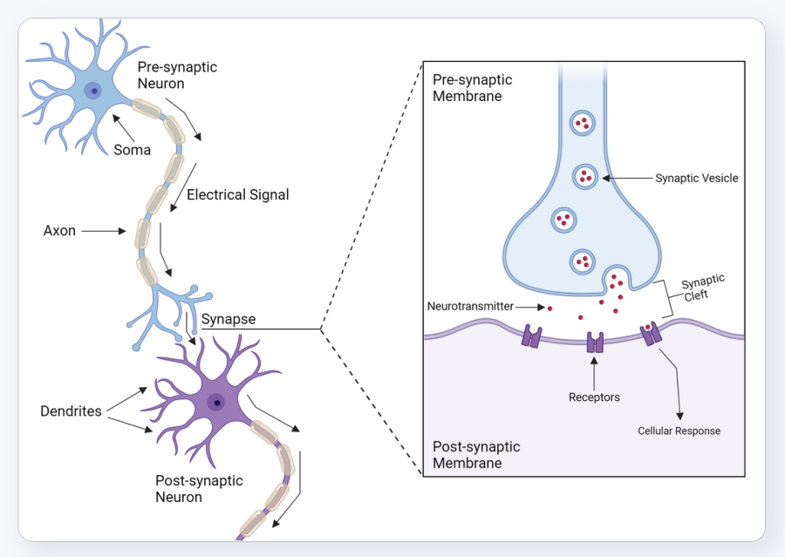
Connectionism
At the beginning of the lecture, computationalism was mentioned as a dominant view within cognitive science that conceives of the brain's operation in the same way as symbolic AI does
The mind breaks down the world into discrete representations and performs computational operations on these representations
Connectionism is an opposing view represented by other researchers, also in cognitive science.
It tries to explain the operation of the mind based on neurophysiological facts, the functioning of the nervous system
There are no representations in the nervous system.
There are only nerve cells, also known as neurons, and they pass simple signals to each other
A neuron, simplified, has two types of protrusions: at most one so-called axon and many so-called dendrites
If a nerve cell is active, an electrical signal travels down its axon.
The axon is connected to a dendrite of one, or possibly many (as it can branch), other nerve cells; the connection is called a synapse
Molecules called neurotransmitters pass through the synapse from the signaling neuron to the receiving neuron, and these are detected by the latter's receptors
If a neuron has received a signal above a threshold from other neurons, it also becomes active, "fires," that is, it sends a signal through its own axon to the other neurons it is connected to
Learning is the creation of new synapses
or the increase or decrease in the strength of existing synapses
or a change in the sensitivity (threshold) of the neuron.
Figure: https://www.biorender.com/template/neuron-synapse

Slide 34
Connectionism
Connectionism tries to understand and model how the mind can work in the absence of discrete representations
How is the mind capable of generalizing, forming concepts, seeing, understanding language, etc., relying exclusively on neurons and the connections between them?
In the mid-1980s, an intense interaction developed between cognitive psychology and AI research
The school of cognitive science that founded connectionism invented the basic principles of neural networks: distributed, non-discrete representations, learning from errors
Neural networks had a huge impact, especially in the field of image processing in AI, already in the '80s following their invention

Slide 35
Parallel Distributed Processing
In the early 1980s, a group of American researchers conducted pioneering experiments related to the computer modeling of various psychological processes, using the multi-layered neural networks they discovered
Neural networks are practically made up of several interconnected perceptrons (so-called multi-layered perceptrons)
The perceptron itself was not a new idea, but there was no known algorithm for teaching the multi-layered perceptron before, so this had to be developed first
The learning algorithm for neural networks is the so-called backpropagation algorithm, which "propagates back" the error in the network
It modifies the model's parameters ("weights") based on the partial derivative of the error function with respect to the given weight, applying the chain rule of differentiation.
The results and methodology of the experiments were published in a highly influential two-volume monograph
Rumelhart, McClelland, PDP Research Group: Parallel Distributed Processing: Explorations in the Microstructure of Cognition, 1987
A fundamental insight of connectionism is that a single, general learning mechanism and a general-purpose model are capable of learning many different tasks without explicit programming, by learning from experiences and examples.
With this, connectionism brought about a fundamental paradigm shift in AI research and development as well, and from the '90s onward, the emphasis in AI shifted strongly toward machine learning

