Slide 1
Generative Artificial Intelligence
Text Generation with Deep Learning Models
November 20, 2025
Pethő Gergely
UD Faculty of Health Science, Department of Bioinformatics

Slide 2
Natural Language Processing
In artificial intelligence, we distinguish two main objectives regarding the processing of natural (= human, non-formal) languages (natural language processing, NLP):
  Natural language understanding
    Non-generative AI
  Natural language generation
    Generative AI
Non-natural languages: Formal languages with syntax and semantics precisely defined by mathematical and formal logic methods
  Formal logic languages, e.g., propositional logic, first-order predicate logic, modal, intensional logic, type theory logic
  Programming languages, e.g., C, Java, Python; more broadly computer languages, including so-called domain-specific languages, e.g., SQL, Verilog

Slide 3
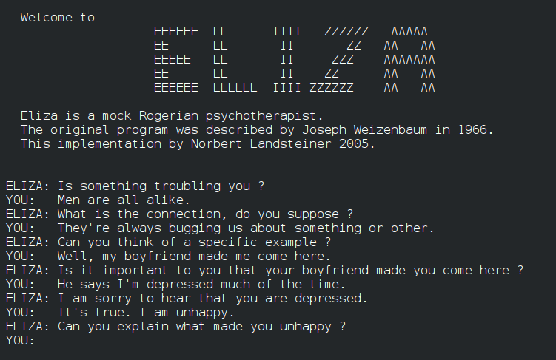
Earlier Developments
Naturally, we can easily produce natural language texts with a computer without AI.
  Hello World
  Error messages
  Eliza
  Generative grammar
    A highly influential theoretical linguistic approach actively practiced since the mid-1950s, aimed at defining an essentially formal grammar for natural languages, primarily for English, which designates the set of sentences that can be produced in the given language.
    It "generates" sentences that belong to the given language (are "correct" in the given language) and does not generate sentences not belonging to the language
      The dog is in the room. – generated
      Dog come not rooms a would flower. – not generated
    Raises serious philosophical and practical questions, but if we write such a grammar and implement it, the computer generates sentences.
    Where is the boundary of text generation via generative AI?

Slide 4
Earlier Developments
An important earlier development is that of machine translation
  Machine translation has been a classic AI problem from the very beginning, since the 1950s.
    Machine translation: Automatically creating a counterpart of a sentence expressed in one human language, e.g., Russian, in another human language, e.g., English, with identical content and meaning, using a computer without human intervention.
      The computer translates a text using some software.
  Good machine translation indeed simulates human activity, so it can be called AI.
    It assumes the understanding of the text to be translated
    Does not simply involve looking up words in a bilingual dictionary
    Complex intellectual effort: the translator processes, "analyses" the sentence structure, selects the relevant meaning of ambiguous words in the given context, automatically correct noise appearing in the channel (typos, articulation errors, linguistic errors)
    Moreover: considerable theory of mind is needed to construct the target language text
      How should I construct the sentence so the reader understands it the way I intend?
  Despite this, machine translation is generally not considered generative AI because the machine does not create something independently, but based on a source language sentence.

Slide 5
Text Generation with AI
Definition attempt: We can refer to something as text generation with AI when a computer
  creates text
    just picking out key sentences from a text for the purpose of summarizing the text may be AI, but not text generation
  does not write a pre-specified text to the screen
  in a creative way
    not mechanically, by assembling pre-determined elements randomly or systematically
    an application that mechanically conjugates a given dictionary word in all its forms simulates non-intelligent activity, it is not AI
  creates different linguistic structures depending on the actual context, in an adaptive way, according to the vocabulary and grammar of the given language
  the created content is meaningful and appropriate in the given communication situation

Slide 6
Machine Translation and Summarization
Machine translation and text summarization are classic automatic natural language processing tasks; their output is generated text.
Comparable to conditional image generation
  The neural network does not simply generate something similar to the data it was trained on, we specify what it should generate using text input (a so-called prompt).
This generation is implemented using so-called seq2seq (sequence to sequence) architectures; both the input and output of the deep neural network are sequences (text).
  The output is not simply a continuation of the input (like in a generative language model) but relies on it and transforms the input in some way.
  Seq2seq models do not necessarily create text:
    speech synthesis (TTS – text to speech)
    the reverse of this: speech recognition (ASR – automatic speech recognition, STT)
    labelling words in a text, e.g., part-of-speech, grammatical, syntactic labelling (standard NLP tasks)

Slide 7
Processing Sequences with Deep Neural Networks
Densely connected neural networks are not optimal for representing sequences
  no relative order is defined between the elements of the input; they have absolute positions in the input
  work best when the elements of the input layer are independent of each other, with no local or temporal relationship between them
Convolutional neural networks are better, but not quite right
  capture local relationships between input elements
  typically 2-dimensional relationships, but training CNNs with 1-dimensional filters is perfectly possible
  the filters are usually quite small, they only "see" over a distance of a few words
Recurrent neural networks are a neural architecture specifically designed for sequence processing
  initially, in the mid-2010s this was the most popular and powerful solution for processing natural language data (including machine translation)

Slide 8
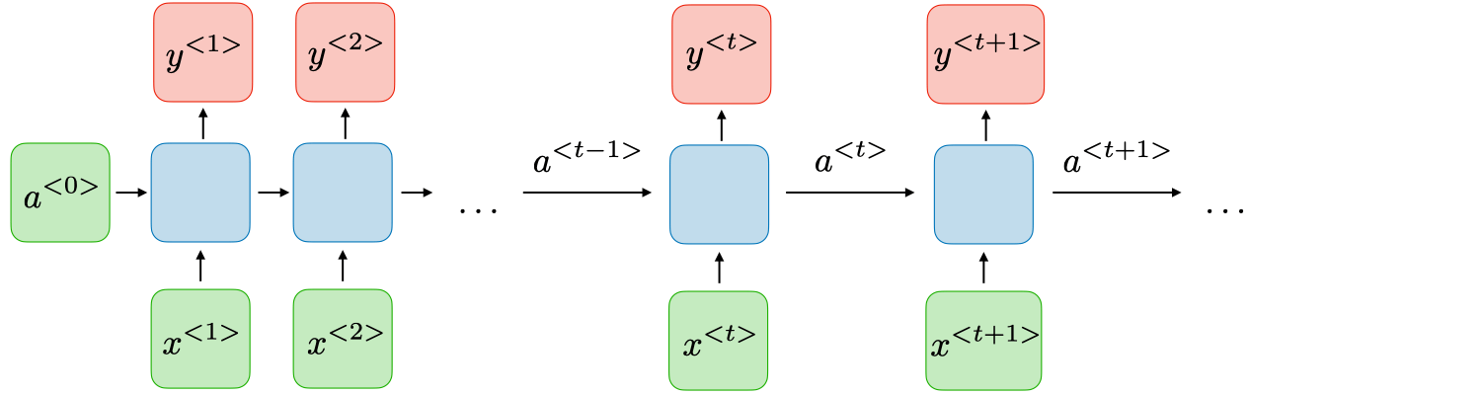
Recurrent Neural Networks
Input (x) is processed step by step, e.g., word by word or letter by letter. The value of the neurons in the hidden layer is calculated as the weighted sum of two values:
  the neurons of the input (or the layer one step closer to the input) layer
  and the neurons of the hidden layer at the previous time point
  Thus a_{t,1} = w_{x,0}x_{t,0} + w_{x,1}x_{t,1} + ... + w_{x,k}x_{t,k} + w_{a,1}a_{t-1,1} ​ (where t is the current time point, t−1 is the immediately preceding time point), and so on for every neuron value at any time t.
  a can be understood as the state vector of the neural network at a given point in time. This layer represents, on the one hand, what the recurrent network currently "sees", and on the other hand, what it remembers from what was seen previously.
  The w_{a,k} ​weights determine to what extent the a_{t,k} neurons inherit their value from the previous time point (how much it remembers what was seen previously), and to what extent the currently "read" x_{t} ​ input overwrites their value (how much it pays attention to the current event)
  The w_{k} weights are identical at every time point, as are the w_{a,k} weights.
  The neural network below outputs an output at every time step, seq2seq

Slide 9
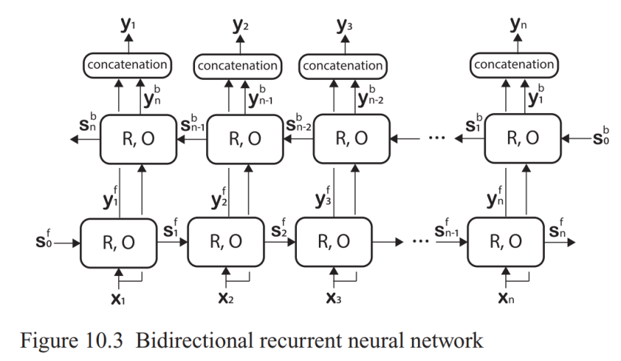
Recurrent Neural Architectures
Generating output step by step, in parallel with reading the input
  Suitable for solving problems where we do not need to know the entire input sequence to be able to start generating the output
    e.g. speech generation, speech recognition, part-of-speech tagging
  A variant of this: one recurrent network proceeds from left to right in the sequence, another from right to left; the output is calculated step-by-step based on the two state vectors.
    so-called bidirectional recurrent neural network
    (significantly) more accurate predictions are possible than by only proceeding from left to right
Reading input, generating a single output at the end of reading
  sequence classification (e.g., what topic the processed text is about)
  prediction of the next element of a sequence (e.g., language modeling)

Slide 10
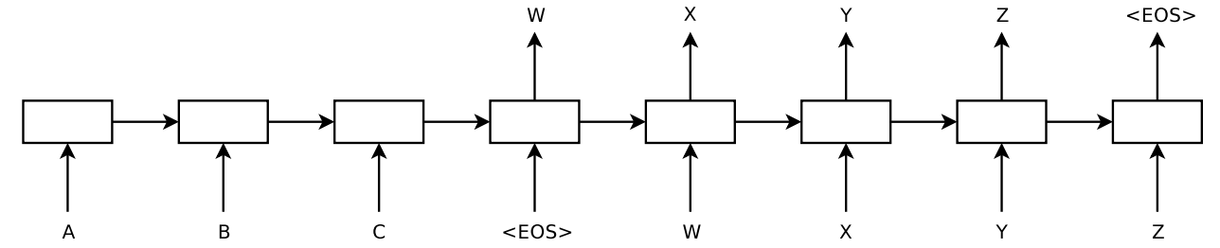
Recurrent Neural Architectures
Encoder-Decoder Architecture
  This also generates a sequence, but not in parallel with reading the input
  Starts generating the output after it has processed the input
  Used when knowledge of the entire input is necessary to begin generating the output
    E.g., machine translation, text summarization
  Encoder neural network: Reads the input elements (e.g., words) step by step
    the final state vector stores the representation of the entire input sequence
    can be bidirectional (works better, two state vectors)
  Decoder neural network: Its starting state vector is the final state vector of the encoder; it decodes this vector into a sequence
    generates one output element, e.g., a word, per step
    in every step, the state vector is updated by summing two values:
      the previous state of the decoder
      the element generated by the decoder in the previous step
  Intuitive interpretation: the encoder interprets (understands) the input, the decoder transforms it into another form based on the interpretation
  Source: Sutskever et al., Sequence to Sequence Learning with Neural Networks, 2014.

Slide 11
Types of Recurrent Neural Networks
Different technical solutions:
  Basic recurrent network: learns two types of weights:
    from input to hidden (state) layer
    from hidden layer to hidden layer (memory/forgetting)
    Disadvantage: has only short-term memory; inputs read most recently overwrite the memory of those read earlier after a few dozen steps
  Two important improvements: LSTM (long short-term memory) and GRU (gated recurrent unit)
    these use more complex combinations of weights to update the state vector
    certain weights ensure that the network weights certain inputs higher than others when updating the state, essentially it learns e.g. to ignore or forget unimportant words
    other weights ensure that the state of certain neurons is preserved over many time steps, the representation of important words is preserved over significantly more steps (relatively long-term memory)

Slide 12
Technical Difficulties of Recurrent Networks
It is relatively obvious how numerical time series (measurements detected by sensors, stock market and other trade data) can be processed with a recurrent network, as this input can be obviously described as a numeric vector at every time point.
But how can natural language data, for example, a series of words, be processed?
  A neural network can do nothing but multiply and add numbers, thus the input needs to be a number, and the output as well. How do we assign a numerical value to natural language input?
    How do we convert letters or words into numbers, and what kind of numbers?
  How do we encode the output as a number?
The output of the encoder serves as the input for the decoder, which is a vector of some specific, pre-defined dimensionality, e.g., 2000.
  This vector represents a bottleneck for processing. An arbitrarily complex input obviously cannot be represented by 2000 floating-point numbers (on a few thousand bytes).
  The final state vector necessarily can only approximate the content of the input.

Slide 13
Representing Words in Vector Space
We collect all possible inputs (e.g., letters or words) into a dictionary; this will be, e.g., a list of 100 (different characters) or 100,000 (different words) elements.
We want to assign a vector to each such element.
Two general solutions for converting input and output into numeric vectors:
  We consider words/letters (so-called tokens) as completely independent, separate elements (nominal, categorical variables) and represent them as an n-dimensional so-called one-hot vector (n being the number of elements in the dictionary)
    exactly one element is 1, the rest take the value 0
    very large number of dimensions, this poses a problem for calculation; n weights belong to each neuron of the 1st hidden layer
    every such one-hot vector is orthogonal to all others, no word vector is more or less similar to any other word vector, e.g. kitty is no more similar to cat than it is to theoretical – not ideal
  We place the words in a vector space of a few hundred dimensions (e.g., 300)
    so-called word embeddings
    dense vectors, elements are not 0 values
    we represent words with similar meanings with vectors close to each other
    similar meaning: occurrence in similar contexts in a training corpus
Usually, a low-dimensional dense vector is used at the input
Usually, the target value is a one-hot vector at the output
  n-dimensional output vector with softmax activation, defines a probability distribution of outputs
  the decoder either generates the element predicted to have the highest probability from the distribution (actual maximum) or samples from the distribution (by generating a random number)

Slide 14
Attention
The decoder should access not only the last state vector of the encoder but all of them (every single one from the first to the last).
  When calculating the next state vector of the decoder, we can thus multiply not only by the previous state vector of the decoder (by the encoder's state vector in the first step) but by all state vectors of the encoder.
    similar idea: U-Net; the upscaling (decoding) half of the network added the output of the corresponding sized downscaling block to the output of the given block, weighted by some value
  How can this be implemented? Concatenating the encoder's state vectors is not sufficient. (Why?)
  Instead, one could take the weighted sum of all encoder states, weighting them such that those encoder states feature with greater weight in the sum that are essential at the given point of decoding.
    The network adds this weighted sum with some weight to the product of the decoder's previous state and the input; summing this way, we get the state vector from which we calculate the output for the given step.
  This weighting is called attention in deep learning. The decoder specifically pays attention to some of the encoder states, namely those it needs to generate the next element, and disregards others.

Slide 15
Attention
Based on what should the neural network weight the states?
  Weighting could be based on position (the beginning of the output should pay attention to the beginning of the input), but position is not really interpretable in a recurrent network.
    both input and output can be arbitrarily long
  Solution: weighting based on the similarity between the given state of the decoder and the states of the encoder
    encoder states form an n × k dimensional matrix
      n is the length of the actual input, k is the dimension of the state vector
      each row is one state vector of the encoder
    the most recent state of the decoder is a k dimensional vector
    we multiply the two together; the result is an n × 1 dimensional vector whose elements are the dot product of each encoder state and the most recent decoder state
    if the length of two vectors is identical, their dot product is proportional to their cosine similarity
    we normalize the product vector to a sum of 1 with softmax
    we multiply the k × n transpose of the state vectors’ matrix by the n × 1 softmax vector
    the resulting k × 1 vector is the sum of the encoder's state vectors weighted by attention (so-called linear combination)

Slide 16
Attention
The implementation of attention seen previously resembles a search in a vector database:
  values stored in the database are assigned to a key, which is a vector
  values are looked up based on their key
  the query (search term) itself is also a vector (of the same dimension as the keys)
Vector databases are used particularly for storing and retrieving texts; the goal is to find the text (value) that is most similar to the query.
  we do not search based on keyword or search term in full text, but based on the content of the text
  the classic method for creating the key vectors is called latent semantic indexing (LSI / LSA), which maps arbitrary text to a dense real-number vector of a few hundred dimensions
  more recently, in the last 5 years or so, neural networks have been used for this instead; these are called sentence transformers or embedding models
The vector database applied as an analogy to the implementation of attention:
  the search term (Query, Q) is the most recent state of the decoder
  the Key (K), to which we compare the search term, is a state of the encoder
If we simply multiply the query and the keys together, we assume that every dimension of both is equally important
But before multiplication, we could weight the dimensions of the query and the keys
  This could be useful if the dimensions are not equally important in different searches

Slide 17
Multi-Head Attention
Before we multiply the query vector and the key vectors together, we weight both, specifically with a learned vector
  this vector is somewhat similar to a convolutional filter
  in the case of convolution, we not only weighted but also added the values afterwards, and received a single (pixel) value as a result
  here we only weight
  but the weight vectors contain learned weights just as in the case of convolutional filters
Just as in the case of convolutional networks, we do not multiply the query and the key by only one such vector, but the network learns multiple Q-K weight vector pairs
Thus, with weighting by one learned Q-K vector pair, the query will pay attention to a different key than in the case of weighting with another learned Q-K vector pair
This is called multi-head attention in deep learning

Slide 18
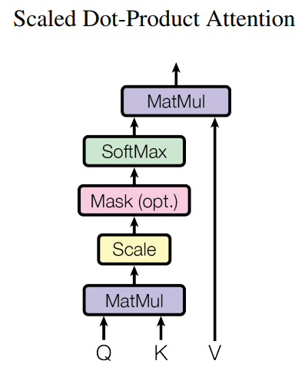
Transformer
The transformer is a deep learning architecture based on the mechanism of multi-head self-attention.
Unlike the recurrent network, there is no state; the transformer processes every element of the input at once, in parallel.
Every element of the input is a vector, e.g., a word vector.
  In total, the input is an n × k dimensional matrix, n is the length of the input, k is the number of dimensions of the word vector.
The output of the transformer is also one vector per input.
Each output vector is k-dimensional and is the sum of all input vectors weighted by attention.
  The output is therefore also an n × k dimensional matrix.
  During the processing of every element of the input, the transformer pays attention to every element of the input, but to different degrees.
  To itself — to that element for which we are calculating the attention-weighted output — as well.
  This, that it pays attention to the sequence itself when processing the sequence, is known in the literature as self-attention.
Q, K and V are all the same input vector, its dimensions weighted
by different weight vectors (query, key and value weights).
For each token, we weight its vector t using the Q weights, and take the
dot product of the result (Qt) and each other token vector t’ weighted by K (Kt’).
These dot products tell us how much attention the t token pays to each
t’ token (i.e. how similar each Kt’ is to Qt in terms of cosine similarity).
Applying softmax to the dot products scales them to sum to 1.
The dimensions of the t’ vectors are weighted by a V weight vector.
Finally, these Vt’ vectors are added up, weighted by the softmax weights.

Slide 19
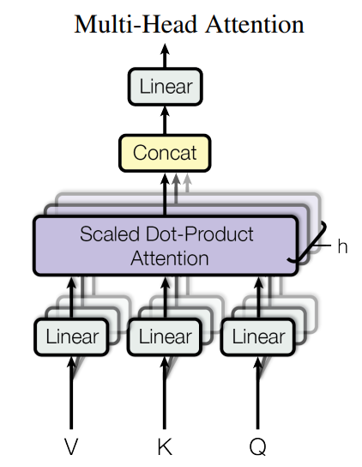
Multi-head Attention in Transformers
The previously described procedure is carried out (in parallel) for every single token in the input.
The output for each token is thus a weighted sum of the vectors of all input tokens, including itself, previously weighted by the V weight vector.
The transformer produces not one such weighted sum per input, but h sums, where h is the number of so-called attention heads; thus, when processing the given input, the transformer pays attention to several (h) different things.
The transformer's parameters are in three weight matrices:
  in fact, the weights are not implemented as vectors, as previously implied for the sake of illustration, but as k x (k / h)-dimensional matrices, e.g. k=512; h=8; k / h=64
  the Q matrix weights the elements of the given input vector before calculating the dot product; we have h such Q matrices
  the K matrix weights the elements of all input vectors also before calculating the dot product; there are also h pieces of K matrices
  after we have performed the vector multiplication, the results are scaled using softmax
  all input token vectors are weighted using h pieces of V matrices, yielding a value vector each, which are in turn summed, weighted by the softmax weights, yielding h such sums, which are concatenated
  Thus we end up with n pieces of k dimensional vectors, exactly one per input; this is the output of the transformer.

Slide 20
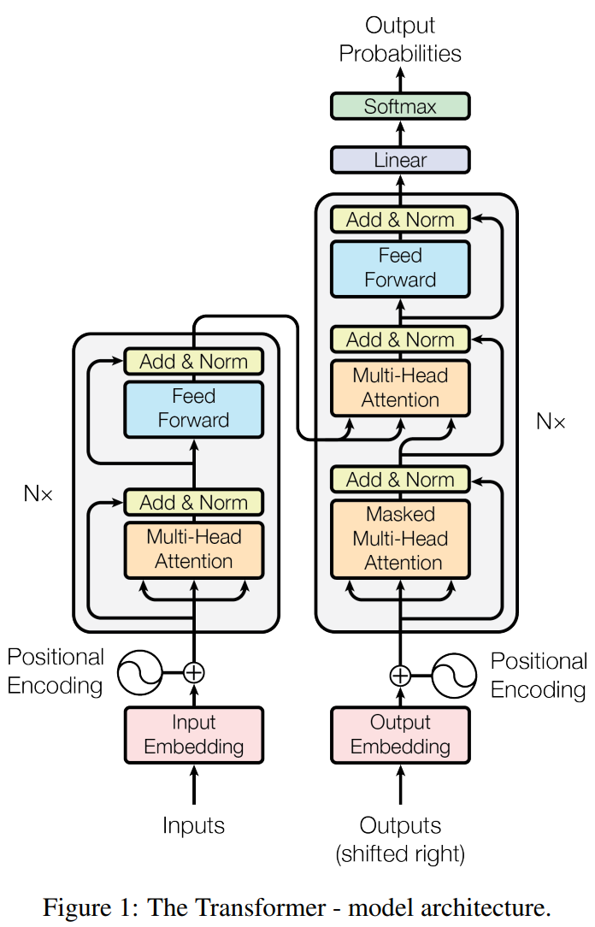
Further Components of the Transformer
The transformer architecture was introduced by Vaswani et al. in their 2017 paper titled Attention is All You Need.
Numerous (N, originally 6, in LLMs tens of) so-called transformer blocks consisting of such Q, K, V matrices, densely connected (feed-forward) neural network layers and residual (skip) connections are connected one after another; the next block processes the output of the preceding block.
The sequence length remains constant throughout.
The original, 2017 transformer contained both an encoder subnetwork (left) and a decoder (right)
  it was designed for machine translation
This implementation uses self-attention in both the encoder and the decoder (lower multi-head attentions), but in addition, the decoder uses another type of encoder-decoder attention layer:
  queries come from the previous decoder self-attention layer
  keys and values come from the encoder’s output
  this allows each token in the decoder to attend to all tokens in the encoder
The output starts out empty and is generated one token at a time.
Encoder-decoder, seq2seq transformer architecture.

Slide 21
Input, Output and Positional Embeddings
Before the first transformer block, both the encoder and the decoder half of the transformer architecture contain a so-called embedding layer.
  The input embedding layer maps each token in the input to a k-dimensional vector representation of that token.
  Same for the output embedding layer.
    This is a different, target-language embedding dictionary.
  The embedding layer is learned during training of the model.
  These are context-independent representations of a token form
    the same token form appearing at different places in the corpus is mapped to the same vector
  The embedding layer can be initialised using pre-trained vectors established using some word distribution-based software like word2vec.
Furthermore, transformers add a so-called positional encoding (sometimes also called embedding) vector to each token embedding vector.
  Like plain densely connected neural networks, contrary to RNNs, transformers do not capture the notion of ordering of inputs by themselves.
  Relative and absolute ordering within the sequence are expressed by adding a numeric vector that encodes position.
  The (sinusoidal) positional embedding vector contains the value of a sine function in each dimension of the vector
    the wavelength of the sine function increases gradually over the dimensions, so the entire vector’s value is not cyclic in the way a single sine function’s value is

Slide 22
Complexity of Transformers
The complexity of calculations done using transformers is a crucial aspect
Main properties:
  hidden layer dimension k (needs to be identical across transformer blocks – why?)
  number of attention heads h
  number of transformer blocks N
  input / output sequence length
Time and memory requirement of computation scales
  linearly with the number of attention heads h and blocks N
  subquadratically with the hidden layer dimension k
  quadratically with sequence length(s) (input / output separately)

Slide 23
Tokenisation
In all NLP tasks, splitting up the input sequence (the text) into atomic units of processing (tokens) is the crucial first step. It is referred to as tokenisation.
  Tokens are then mapped to an embedding vector.
Generally, the smallest meaningful units are chosen as tokens.
  characters / letters are not very useful
  bad in terms of efficiency (why?)
One option is to use words separated either by whitespace or by nonword characters (punctuation) as tokens.
But these are too large, most languages have subword information that is meaningful.
  mean, meaning, meaningful, meaningless, means, meant: shouldn’t be treated as completely separate atomic units
Middle ground: subword tokenisation
  subword tokens are variable length, from a single character to an entire word (e.g. mean, atom cannot be sensibly split up)
Tokenisers are usually created using a language-agnostic general algorithm that starts out with individual characters as tokens and combines neighboring tokens into one new token if they occur very frequently next to each other in a training corpus, iteratively
  thus the resulting tokeniser is dependent on the (language of the) training corpus
  does not identify meaningful units 100 % reliably, but works good enough
  main algorithmic variants: Byte-Pair Encoding (BPE), Unigram, WordPiece
  popular implementation: Google’s SentencePiece library

Slide 24
Encoder-decoder Tranformer Models
As seen on a previous slide, the original transformer network described in Attention is all you need has an encoder-decoder architecture.
Other notable encoder-decoder transformer models include:
  BART: like the Vaswani et al. transformer, but contains a bidirectional encoder (like BERT) in combination with the autoregressive (GPT-like) decoder
  T5 (2019): a text-to-text transformer that treats NLP tasks in general as seq2seq tasks (mT5: multilingual version)
  Marian (2018): like original transformer, but trained specifically for machine translation (MT), specialised models per language pair and domain
    T5 and Marian are outperformed by LLMs without task-specific training
  Whisper (2022): automatic speech recognition (ASR) / transcription model containing an audio encoder and a text decoder
  GIT (2022): image encoder, text decoder
    image captioning, visual question answering
    not to be confused with the version control system called Git
  TrOCR (2021): image encoder, text decoder, trained for optical character recognition (OCR)
All of these and thousands of others are available on Hugging Face for free

Slide 25
Encoder Transformer Architecture
If we drop the right (decoder) half of the original transformer, we get an encoder-only transformer network.
As we have seen, a transformer generates a vector representation for every input token.
  Each such output vector is a weighted representation of the entire sequence that focuses on the respective token.
Thus a transformer is directly useful when we want to say something about each token.
  Recall RNNs that generate an output for each token
  Similarly, encoder transformers’ output vectors can be used for part of speech tagging, anonymisation and other token labelling NLP tasks
Training an encoder transformer requires huge amounts of training data and very significant compute resources, thus they are generally not trained specfically for one task
A general encoder model is trained to learn the given language(s) as such
  This is referred to as pre-training
  Then a much smaller neural network is added on top of the transformer’s output layer, and this much smaller network is trained for the specific (e.g.) classification task
  Classic application of the concept of transfer learning

Slide 26
Encoder Transformer Architecture
Pre-training is done by masked language modelling (MLM)
In the input sequence, some tokens are masked, which means they are replaced by a [MASK] token.
  The dominant sequence transduction models are based on complex [MASK] or convolutional neural networks that include [MASK] encoder and a decoder.
    The same task is known in language learning and testing as a cloze test.
  We add a softmax layer (a k x V densely connected layer with softmax activation) on top of the output of the top transformer block.
    This softmax layer predicts the probability distribution of the given token over the entire vocabulary.
    If the input token is not masked: essentially an autoencoder task.
      map the input token (e.g. ship) an output vector that has a 1 value in the coordinate of the V-dimensional output vector that corresponds to that token, 0 everywhere else
      not trivial: input is a k-dimensional dense vector, output is a V-dimensional softmax vector over the vocabulary
    If the input token is masked: much more challenging, the model has to guess based on the context tokens what each masked token stands for.

Slide 27
Encoder Transformer Architecture
BERT family of models
  Devlin et al., BERT: Pre-training of Deep Bidirectional Transformers for Language Understanding, 2018
  restricted to 500-token context windows
  longer contexts had to be truncated to 500 tokens
  BERT-base: N=12, k=768, h=12, 110M parameters
  BERT-large: N=24, k=1024, h=16, 340M parameters
  secondary pre-training task: next sentence prediction
    context contains two sentences, separated by a special separator token
    does the second sentence in fact come after the first sentence in the corpus, or are they randomly paired (binary classification)
  pre-training just a BERT-base model takes several weeks on a single GPU
Many gradual improvements over time
  current state-of-the-art encoder-only models in the BERT family include XLM-RoBERTa (2019) and Modern BERT (2024)
  better pre-training objectives, positional encodings (rotary)
  smart attention hacks allow for a much larger context window (8192 tokens)
  state-of-the-art BERT-like models are trained on huge multilingual corpora containing over 2 trillion tokens

Slide 28
Decoder-only Transformer Architecture
Most famous example: GPT family of generative language models.
Decoder-only means that the left, encoder half of the original transformer architecture is dropped.
  The right half is an autoregressive generator model.
  Since there is no encoder to attend to, the encoder-decoder attention layer is also removed.
  What remains is a generator with only self-attention that predicts the softmax probability distribution of the next token (often referred to as the continuation) based on the preceding context.
  "Decoder-only" is a quite misleading description, as the preceding context is still encoded, like in an encoder-only transformer
    if anything, it is in a proper sense more like an encoder-only model with a single softmax layer attached to the final, masked token
    regardless, we call it "decoder-only" since this is the standard way to refer to this model architecture

Slide 29
Generation Using a Decoder-only Model
The preceding context generally does not start out completely empty, that would be quite pointless.
Instead, it starts out with a specific pre-existing input text.
The input text is tokenised and mapped to embedding vectors.
In an LLM chatbot context, this input text is generally referred to as the prompt.
The input is then continued by the generative model, token by token.
  The next token is generated by sampling from the output softmax distribution
Like in the encoder-decoder models we have already seen, the most recently generated token is mapped to a token embedding vector and concatenated to the previous input vectors.
Consequence: There is no separation between the input and the generated output as far as the model is concerned, they both live in the same context window.
  Special separator tokens could be used.
  More commonly, markup-like tags delimit prompt and continuation
  A possibility would be to add a special embedding vector that differentiates the two, but this option is not commonly utilised.

