Slide 1
Natural Language Processing Corpora and NoSketchEngine
Pethő Gergely
October 14, 2025
UD Faculty of Health Science,
Department of Bioinformatics

Slide 2
Corpora
A corpus (Latin for body) is simply a collection (body) of texts that are being stored and processed together.
almost always electronic texts in practice
any number of texts, in the extreme case even one
the web as such can be regarded as a corpus (web as a corpus)
corpora is the Latin plural form of the noun corpus and is also used in English as its plural, as is customary in English for Latinate words
matrix – matrices, not matrixes; corpus – corpora, not corpuses
appears in its original meaning of body as the literally or metaphorically understood root of many English words and part of many phrases
corporeal, incorporate, corporation, habeas corpus, corpus delicti, etc.
In addition to the texts themselves, a corpus normally contains metadata describing the texts
author, title, date
source: where is the text from, e.g. what URL was it downloaded from, when
other descriptive data, such as keywords, genre labels, language

Slide 3
Main Types of Corpora
With respect to language:
monolingual
multilingual (including bilingual)
parallel corpus: contains translation(s) of the same text in several languages, best example: https://opus.nlpl.eu/
can be used for training machine learning systems, to support human translators as a tool (computer-assisted translation)
comparable corpus: contains different texts in different languages that are similar in genre, e.g. social media post in English and in Hungarian
With respect to content:
general: different sorts of texts, usually a convenience sample of texts from a language (what is easily available?)
balanced: a stratified sample that tries to collect samples from all text types / genres that are produced in a language and tries to reflect the relative amount of the genres being produced
classic example: the British National Corpus (BNC)
genre-specific: e.g. journalistic, legal, children’s books, speeches given in a parliament
example: https://www.english-corpora.org/
historical: collection of texts from a historical period of a language, e.g. Old English
sometimes the goal is to collect all surviving texts from a period and publish them

Slide 4
Main Types of Corpora
With respect to modality:
written: most corpora
multimodal: written + audio and/or video
With respect to annotation:
raw text corpus: just the texts, possibly tokenised and sentence-segmented, text-level metadata
annotated corpus: always tokenised, contains token-level annotation, can include:
part-of-speech
morphological features
lemmatisation
syntactic annotation
named entities, coreference, etc.
With respect to size: always measured in terms of numbers of tokens
small corpora: a couple million words typically, classic example: Brown Corpus
mid-size corpora: 100+ million words
usually sufficient for corpus linguistics and for training statistical language models
large corpora: 1 billion words and above (gigaword corpora, TenTen family of corpora)
might cover all accessible electronic texts for all but the largest languages
Common Crawl dataset: largest corpus-like structure crawled from the web that LLMs are trained on

Slide 5
Uses of Corpora
Linguistics
as the foundation of linguistics as an empirical science
general claims about linguistic structures can be verified or falsified using a suitable corpus
linguistic varieties such as dialects can be compared systematically (syntactic, morphological, lexical differences)
corpus linguistics: specialised branch of linguistics that either specifically uses corpus analysis as the empirical basis of a linguistic study or explores methods of using corpora for problems relevant to linguistics
quantitative linguistics: focuses on numerical properties of languages such as frequencies of use of different linguistic phenomena; always based on a corpus
Lexicography (= creation of dictionaries)
corpora support the work of the lexicographer (the dictionary editor who writes the dictionary articles, entries)
selection of headwords (lemmata) based on a frequency list of lemmata in a corpus
examining and grouping occurrences of a word in a corpus to establish its meanings and patterns of use
supporting dictionary articles by authentic examples of use in a corpus instead of artificial, invented examples

Slide 6
Corpora in NLP
As input:
NLP models: statistical language models (such as n-gram and hidden Markov models) as well as machine learning models (for text classification, language generation, etc.) are always trained on a corpus
size and content of the training corpus are crucial
annotation can be used for features and can significantly improve the accuracy of a model’s predictions
not necessarily true of deep learning language models
As output:
The annotations that constitute an annotated corpus are the output of an NLP pipeline
When creating a parallel corpus, the sentences that constitute the source and the target document need to be aligned
sentence segmentation (sentence boundary detection) is a prerequisite
two main approaches:
algorithmic, usually based on simple features of the sentences like length measured by characters or word tokens, and token co-occurrences between source and target sentences; best example: HunAlign
based on language models, especially sentence embeddings (vectors); best example: SentAlign

Slide 7
Corpus Formats
Raw text files
Metadata might be listed in a separate text document
Annotation can be added in the form of so-called standoff annotation in a separate file
Character offsets (counted from the beginning of the text) can be used to store tokenisation, tags belonging to each token, etc.
XML files
XML tags can be used to mark paragraphs, sentences, tokens
XML attributes can hold the annotations
general purpose, common format
XML standard often used for texts, especially in digital humanities: TEI (text encoding initiative), detailed specification
Vertical format
Plain text file without markup in tsv format (tab-separated columns)
Table header contains annotation type
Each line contains data on a token, columns containing the feature values

Slide 8
Corpus Engines
First, a corpus is created:
individual texts are collected and organised, possibly in subcorpora (e.g. by genre, year, language, etc.)
processing:
tokenisation, sentence segmentation
annotation
conversion into a specific format (usually XML or vertical)
Then, the corpus may be distributed in this form or served through a corpus engine
stores the corpus along with all annotation
creates and maintains an index of all tokens in the corpus to speed up retrieval (much faster than linear scanning of texts)
facilitates access to the texts through a user interface
search for token forms or annotation
either complemented by a menu-based interface or a query language that is interpreted by the engine
search results are usually presented in the form of frequency counts and concordances
often further additional functions such as collocation extraction

Slide 9
Sketch Engine
Sketch Engine is the most important corpus management engine and has been around since 2004
Adam Kilgarriff et al. The Sketch Engine. Proceedings of the 11th EURALEX International Congress: 105-116, 2004.
In addition to the usual functionalities like indexing, search and displaying results in KWIC format, it also includes so-called word sketches, which are concise, dictionary-article-like summaries of a word’s grammatical behaviour.
These are based on collocations extracted from the provided corpus.
For example, for the noun decision, a word sketch will include things like:
frequent modifiers (adjectival attributes): important, final, difficult
verbs with decision as their object: make, reach, announce
prepositions following decision: on, about, regarding
these are extracted from and thus specific to the current corpus that is stored in Sketch Engine
essentially a statistical thesaurus of a word’s usage, not based on intuition (like that of a lexicographer), but on real data

Slide 10
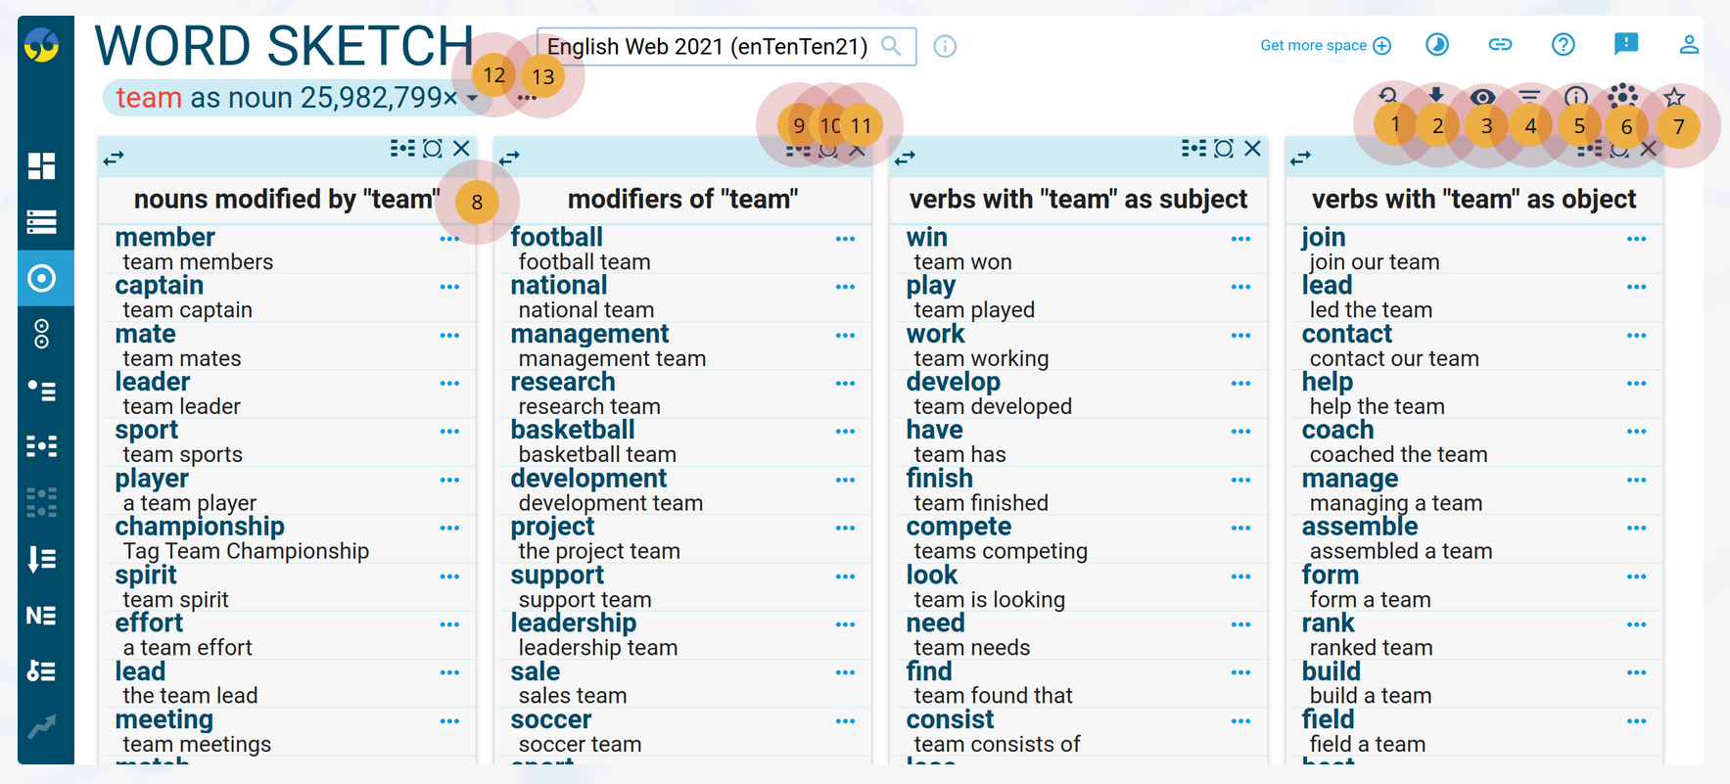
Sketch Engine
Source: https://www.sketchengine.eu/guide/word-sketch-collocations-and-word-combinations/

Slide 11
Collocations
A collocation is a pair of words that are commonly used together in a language, more often than could be expected by chance
here, chance is understood in a strictly probabilistic, mathematical sense, usually assuming that the occurrence of tokens is independent of each other
independence means that words occur in random order simply based on their frequency
this is not a realistic model of language since the occurrence of a word token is strongly dependent on its surrounding context
but this assumption still works relatively well in practice for collocation detection
more often: not a binary, categorical question, but gradual, the question is how much more often; collocations can be ordered by strength, and there is no hard boundary or threshold that divides collocations from non-collocation pairs of words
various statistical measures can be used to quantify the strength of a collocation
Sketch Engine: T-score, mutual information (MI), LogDice
more generally: a pair of spans of tokens that could contain more than a single word each

Slide 12
NoSketchEngine
Sketch Engine is a paid-for service that combines
the corpus management engine itself
hosting of the corpus on servers managed by the company called Lexical Computing (based in the UK and the Czech Republic)
assistance in the creation of a corpus based on raw texts
NoSketchEngine is a free-to-use, open-source fork of Sketch Engine with reduced functionality
main difference: no word sketches
hosted on the user’s own platform
provides the same browser-based GUI as SkE
corpus is fed into NoSkE in the form of vertical files
NoSkE does not pre-process the corpus!
Tokenisation and all annotation must be already contained in the vertical file.
in addition to the vertical files, a corpus configuration file must be provided
based on the provided vertical files and configuration files, NoSkE automatically generates an index of the corpus and provides a user interface to search the corpus based on this index

Slide 13
NoSketchEngine
Functionalities:
Supports both monolingual and multilingual corpora, including specifically parallel corpora
Metadata on texts can be specified and filtered (e.g. language, genre)
Subcorpora can be created within a larger corpus
Keyword identification in the current (focus) (sub)corpus relative to a reference (sub)corpus
Frequency lists (token frequency, document frequency)
Trends (change of token frequencies across time, for use in diachronic / historical corpora)
Concordances: created automatically for query results in KWIC format
Queries: based on individual token attributes, including token form, lemma form; supports queries written in CQL

Slide 14
CQL: Corpus Query Language
A small, domain-specific declarative language to express corpus queries
similar to the Matcher in spaCy
Allows criteria to be set to find one or several tokens.
Criteria for each token must be between a pair of square brackets in the format [attribute="value"]
an attribute is simply a column in the vertical file, and the value is the actual value in the token’s row in that column
the name of the attribute is specified in the corpus configuration file
Regular expressions can be used to specify values
[lemma=".*ous"], [word="b.g"]
An empty pair of brackets matches any token
Comparison operators between attribute and value can be =, == (exact text match, no regex), != (not equal)
Multiple conditions can be specified for a token using logical operators & and |, grouped using parentheses
Tokens can be quantified, like in regexes, by putting a range of values in a pair of braces after the closing bracket, e.g. [tag= "JJ"]{2,3}

Slide 15
CQL
Some example searches:
noun-noun compounds, whether hyphenated or not
sequences of two or more adjectives
phrasal verbs, like carry out, wake up, etc.
occurrences of that which are not (demonstrative) pronouns
which nouns most frequently come after the adjective great?
Get frequency list of all noun lemmata in corpus
Find lemmata that are collocates of the noun hand

