Slide 1
OFHIR
A FHIR Ontology

Slide 2
OFHIR Aspirations
Introduce a FHIR RDF representation for January DSTU update
Formalize existing FHIR RDF semantics in OWL
Enhance FHIR interoperability with other modeling frameworks using RDF
Enable OWL extensions to FHIR to support computable CDS
Better integrate clinical models with ontological terminologies (e.g., SNOMED-CT)

Slide 3
Challenges
Make OFHIR intuitive to semantic community
Multiple extension paths complicate semantics
Extensible primitives
Handling FHIR extensions, in particular, modifying extensions
FHIR ‘precoordinated’ semantics
Model-terminology alignment
What to do with profiles?

Slide 4

FHIR Extensions
url
value
vs
extension
:blank
url
http://…
value
X

Slide 5

Primitives vs Extensible Primitives

Slide 6
How to distinguish FHIR extensions?
Extension statement resides in a separate namespace
Extension predicate derives from the ‘extension’ property hierarchy
Some implications on core ontology design
The ‘severity’/FOAF challenge
Notes:
Example of the FOAF question
Make extension property derive from extension and the core FHIR property

Slide 7
New FHIR Concepts
A new OWL class
Extends ‘Other’
Must be in an extension namespace
Open question: What attributes should ‘Other’ contain?
Notes:
Use an annotation property? A property (isExtension=true) coupled with a restriction class?
Inheritance from other and some other concept as well? Reluctance to use subclass here is that it can impact conciseness of ontology. Everything is a class.
Need use cases for assessing whether something is an extension
Other just a tag

Slide 8
Modifying Extensions
Problematic
Attribute modifies class semantics
Often due to conflated semantics in FHIR
Addressed in CQF Logical Model
Example
Negation Indicator
Certain statuses (e.g., refuted, improbable, …)

Slide 9
Approach Under Consideration
‘extension’ property hierarchy partitioned between ‘modifyingExtensions’ and ‘nonModifyingExtension’
Modified concepts as restriction classes on the modifying extension

Slide 10
Pros and Cons
Pro
A separate concept
Con
Still a subclass
Does not address semantic conflation
Requires more refined interpretation of modified concept

Slide 11
“ConditionRefuted” as an explicit concept
Condition
Refuted
Notes:
Is there work that expresses ‘The absence of thing’

Slide 12
Terminology
Model-terminology ‘conundrum’
Often, little parallel evolution
Can OWL better ‘link’ terminology to model?
OFHIR and SNOMED both ontologies

Slide 13
Terminology Alignment (Experimental)

Slide 14
Next Steps
Incorporate feedback from FHIR team
Incorporate feedback from Mayo team
Address known issues/bugs in generation
Thoroughly QA OFHIR
Add a modest hierarchy structure – to discuss with Lloyd McKenzie
Profiles
Terminology

Slide 15
AbsenceOf
concept (1..1)
UncertaintyOf
concept (1..1)
probability (0..1)
Notes:
Should certainty be at the root level of all statements and not be considered a modifying extension?

Slide 16
Profiles

Slide 17
Information Captured by Profiles
Content (properties of resource)
Constraints
Allowed values
Cardinalities
Value Sets

Slide 18
Resource Shape
Capture most information captured in a profile – validate this
May be extended to capture terminology bindings – depending on approach taken
RDF way of representing FHIR profiles
May need a FHIR extension to OSLC vocabulary.

Slide 19
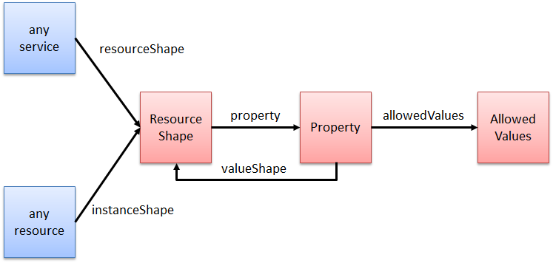
OSLC Resource Shape

