Slide 1
Cleaning your dataset

Slide 2


Slide 3
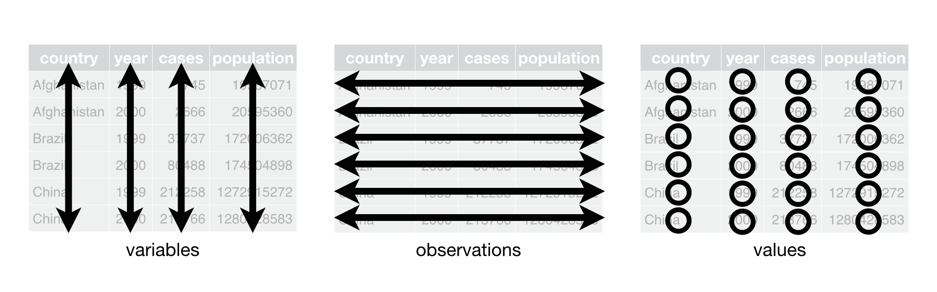
What is “tidy” data?
Notes:
Each variable has it’s own column. Each observation has its own row. And finally, each value has it’s own cell.

Slide 4
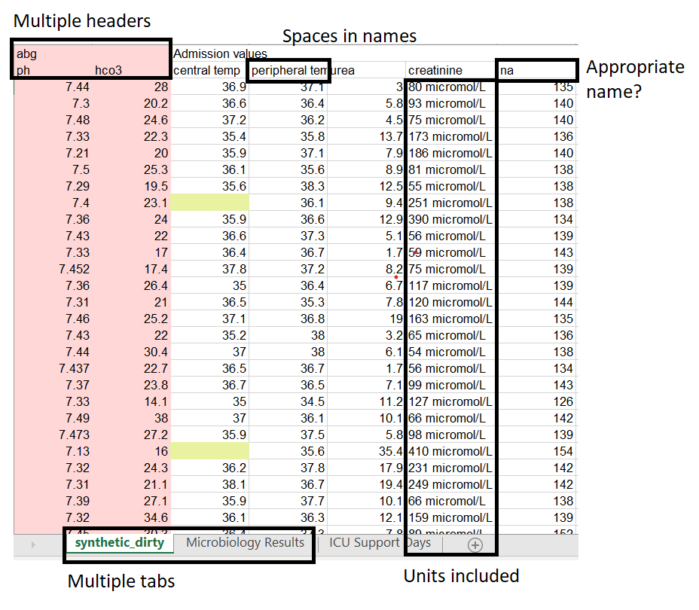
What is “messy” data?

Slide 5
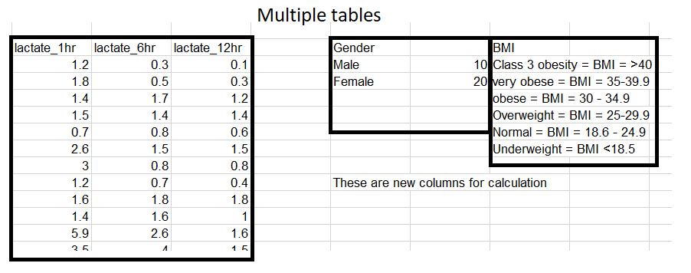
What is “messy” data?

Slide 6
Exercise
In groups, identify messy aspects of the data
Hint: “Common Mistakes to Avoid and Correct” in the handout can provide some inspiration.
How would you tidy this? Break down your strategy into individual steps.
If you finish early, use the dplyr and stringr cheat sheets to start identifying appropriate R functions.
dplyr: https://rstudio.com/wp-content/uploads/2015/02/data-wrangling-cheatsheet.pdf
stringr: http://edrub.in/CheatSheets/cheatSheetStringr.pdf

