Slide 1
Basic Statistics

Slide 2


Slide 3
Content
Types of Data
Exploring your dataset
Descriptive Statistics
Inferential Statistics

Slide 4
Wait!
Make sure cchic R dataframe from your work yesterday is loaded
Ensure this includes the variables you created including los
Notes:
Help them load the dataset if needed. This is the same one they used in the morning. It should include the length of stay variable.

Slide 5
The big picture
Research often seeks to answer a question about a larger population by collecting data on a small portion
Data collection:
Many variables
For each person/unit.

Slide 6
Descriptive and inferential statistics
WAIT!
First be aware of the types of data
Guides:
How best to describe the data you have
How best to analyse (which test)
Note that data scientists and pure statisticians moving away from being ‘test-focused’, but will discuss how to run some basic ones in this lesson.

Slide 7
Data types
Continuous
Discrete
Nominal
Ordinal
Interval
Notes:
Data types have been covered in course before. The next few slides should be a bit of a recap.

Slide 8
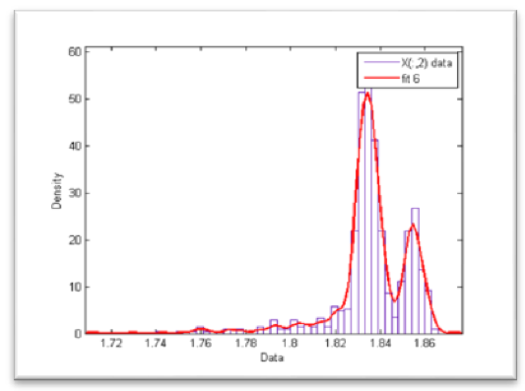
Continuous variables
e.g. age, height, weight
Have distributions:
Gaussian
Poisson
Binomial
Cauchy/Lorenz
Can’t be described

Slide 9
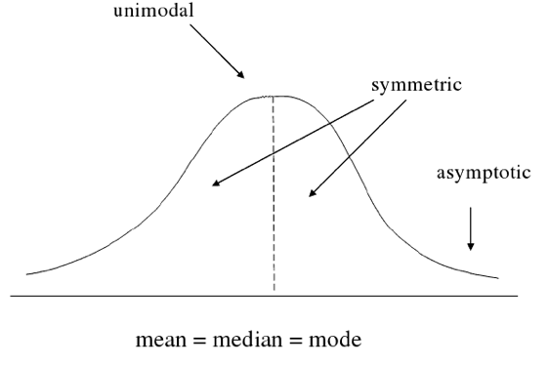
What is normally distributed data?

Slide 10
Types of discrete variables
Nominal
e.g. hair colour, types of antibiotics
There is no order between the data types (e.g. blonde, brunette, red hair)

Slide 11
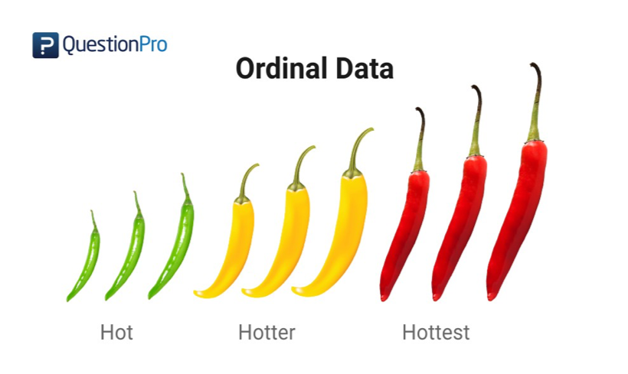
Types of discrete variables
Ordinal
There is an order e.g. care_level where Level 3 > Level 2 > Level 1 etc.
However, the difference between Level 1 and Level 2 critical care may not be the same as the difference between Level 2 and Level 3.

Slide 12
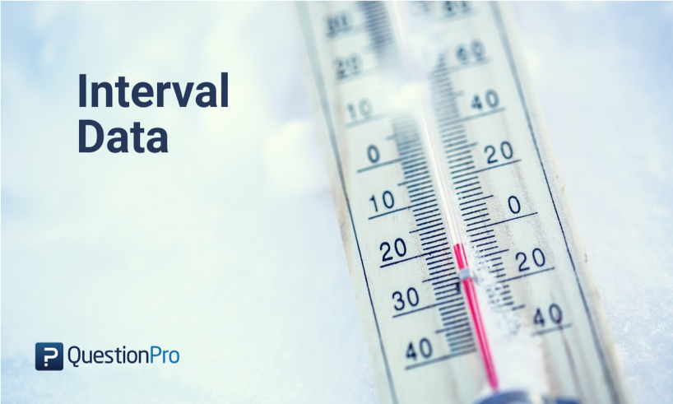
Types of discrete data
Interval
There is an order to data points (e.g. age_cat for age centile) and the difference between these points are equal (e.g. 10 years)

Slide 13
Describing data
Continuous variables
Discrete variables
Notes:
How do we convey information on what your data looks like, using numbers or figures?

Slide 14
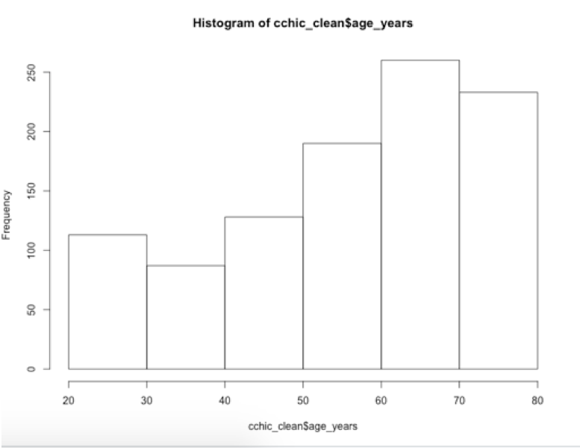
Describing continuous data.
First establish the distribution of the data.
ggplot(cchic, aes(x = age_years)) + geom_histogram()
What is the distribution of this data?
Notes:
Get them to do this with you.

Slide 15
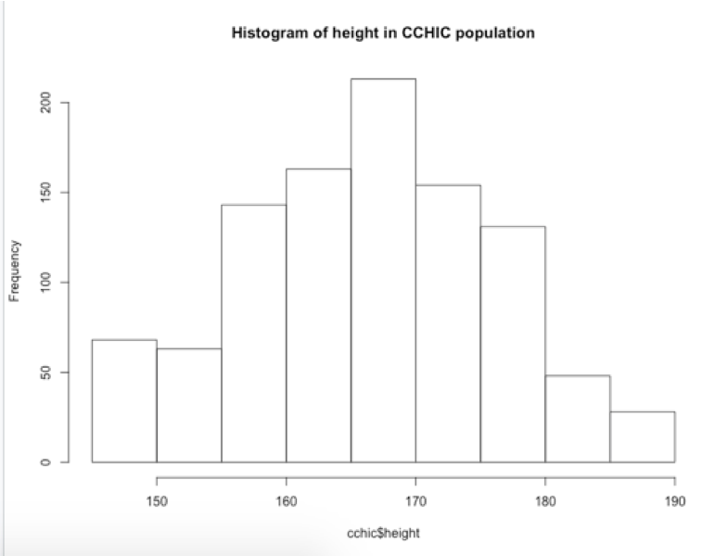
What is the distribution of height?
Try this command
ggplot(data = cchic, aes(x = height)) + geom_histogram()
What is the distribution of this data?

Slide 16
Parametric vs non-parametric data
Parametric data
The data follows a known distribution
It can be described using parameters
Examples of distributions include, normal, poission, exponential.
Non parametric data
The data can’t be said to follow a known distribution
Notes:
Emphasise that parametric is not equal to normal.

Slide 17
Describing parametric and non-parametric data
How do you use numbers to convey what your data looks like.
Parametric data
Use the parameters that describe the distribution.
For a Gaussian (normal) distribution - use mean and standard deviation
For a Poission distribution - use average event rate
etc.
Non Parametric data
Use the median (the middle number when they are ranked from lowest to highest) and the interquartile range (the number 75% of the way up the list when ranked minus the number 25% of the way)
You can use the command summary(data_frame_name) to get these numbers for each variable.

Slide 18
Mean versus standard deviation
What does standard deviation mean?
Both graphs have the same mean (center), but the second one has data which is more spread out.
# small standard deviation dummy_1 <- rnorm(1000, mean = 10, sd = 0.5) dummy_1 <- as.data.frame(dummy_1) ggplot(dummy_1, aes(x = dummy_1)) + geom_histogram() # larger standard deviation dummy_2 <- rnorm(1000, mean = 10, sd = 20) dummy_2 <- as.data.frame(dummy_2) ggplot(dummy_2, aes(x = dummy_2)) + geom_histogram()
Notes:
Get them to plot the graphs. Explain that we are generating ramdom data from different distributions and plotting them.

Slide 19
Calculating mean and standard deviation
mean(cchic$height, na.rm = TRUE)
sd(cchic$height, na.rm = TRUE)
The na.rm argument tells R to ignore missing values in the variable. What happens if you leave it out?

Slide 20
Calculating median and interquartile range
median(cchic$age_years, na.rm = TRUE)
IQR(cchic$age_years, na.rm = TRUE)
Again, we ignore the missing values.

Slide 21
Describing discrete data
Frequencies
table(cchic$care_level)
Proportions
care <- table(cchic$care_level) prop.table(care)
Percentatages
PercTable(care)

Slide 22
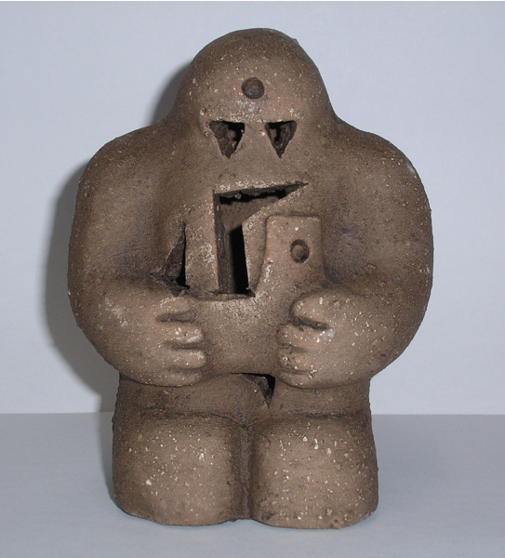
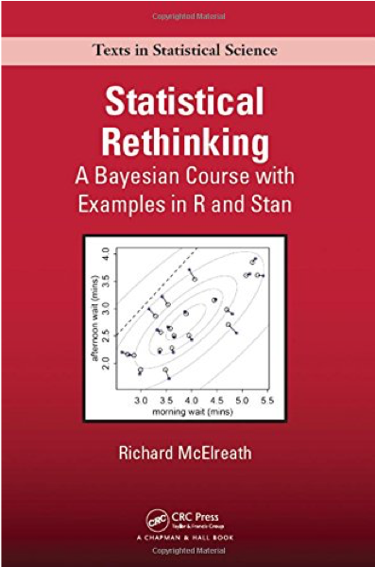
Inferential statistics
Notes:
Describe the golem story, and say that the book is good if you want.

Slide 23
Meaningful analysis
What is your hypothesis
What type of variables (data type) do you have?
What are the assumptions of the test you are using?
Interpreting the result

Slide 24
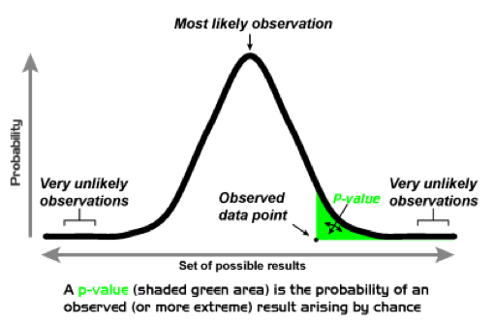
What is a p-value?

Slide 25
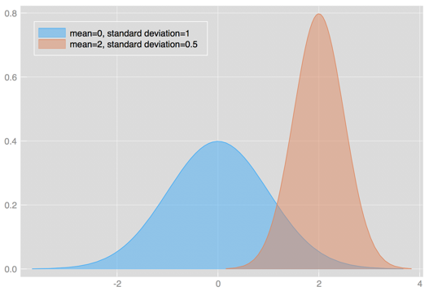
What we are usually hoping…

Slide 26
Testing significance
p-value
<0.05
0.03-0.049
Would benefit from further testing.

Slide 27
Comparing means
It all starts with a hypothesis
Null hypothesis
“There is no difference in mean height between men and women”
Alternate hypothesis
“There is a difference in mean height between men and women”

Slide 28
More on hypothesis testing
The null hypothesis (H0) assumes that the true mean difference (μd) is equal to zero.
The two-tailed alternative hypothesis (H1) assumes that μd is not equal to zero.
The upper-tailed alternative hypothesis (H1) assumes that μd is greater than zero.
The lower-tailed alternative hypothesis (H1) assumes that μd is less than zero.
Remember: hypotheses are never about data, they are about the processes which produce the data. The value of μd is unknown. The goal of hypothesis testing is to determine the hypothesis (null or alternative) with which the data are more consistent.

Slide 29
Comparing means
Is there a difference between the heights of males and females?
cchic %>% group_by(sex) %>% summarise(av.height = mean(height, na.rm = TRUE))
## # A tibble: 2 x 2 ## sex av.height ## <chr> <dbl> ## 1 F 163. ## 2 M 173.
Is the difference between heights statistically significant?
Notes:
Note that these number may not be the same as the one candidates see on their screens. These slides are based on a smaller version of the dataset.

Slide 30
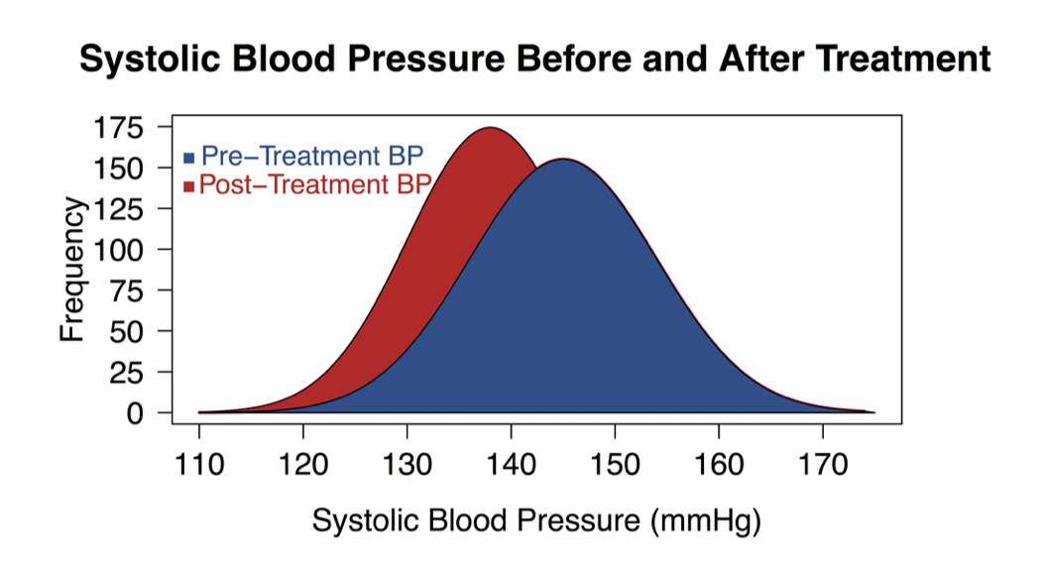
t-test
Compares means between two populations
Paired vs. Unpaired

Slide 31
Assumptions of a t-test
One independent categorical variable with 2 groups and one dependent continuous variable
The dependent variable is approximately normally distributed in each group
The observations are independent of each other

Slide 32
Doing a t-test
t.test(height ~ sex, data = cchic)
Notes:
Tell them to do this.

Slide 33
Doing the t-test
## ## Welch Two Sample t-test ## ## data: height by sex ## t = -5.8997, df = 86.692, p-value = 6.88e-08 ## alternative hypothesis: true difference in means is not equal to 0 ## 95 percent confidence interval: ## -13.589546 -6.740124 ## sample estimates: ## mean in group F mean in group M ## 162.6923 172.8571
Notes:
Quickly explain the main points of the output

Slide 34
Comparing counts
Is survival different between genders?
table(cchic$sex, cchic$vital_status)
## ## A D ## F 46 6 ## M 43 6

Slide 35
What is our hypothesis?
Null hypothesis
There is no difference in survival between men and women
Alternate hypothesis
There is a difference in survival between men and women

Slide 36
Assumptions of the chi-squared test.
Data in cells should be frequencies or counts not percentages
Levels/Categories are mutually exclusive – here being a alive/dead applies
Each subject contributes to one cell – can either be male/female and alive/dead
Independent study groups
2 categorical variables
Values in each cell should be 5+
Biochem Med (Zagreb). 2013 Jun; 23(2): 143–149.

Slide 37
Doing the chi-squared test.
Start with ?chisq.test. Then do the test.
# Changing the character vector to a factor one so that it works with the function. cchic <- cchic %>% mutate(gender = as.factor(sex)) # Doing the test. chisq.test(cchic$gender, cchic$vital_status)
## ## Pearson's Chi-squared test with Yates' continuity correction ## ## data: cchic$gender and cchic$vital_status ## X-squared = 1.0527e-30, df = 1, p-value = 1
Notes:
Get them to do this, then explain the output.

Slide 38
Non paramteric versions
Is length of stay different between genders?

Slide 39
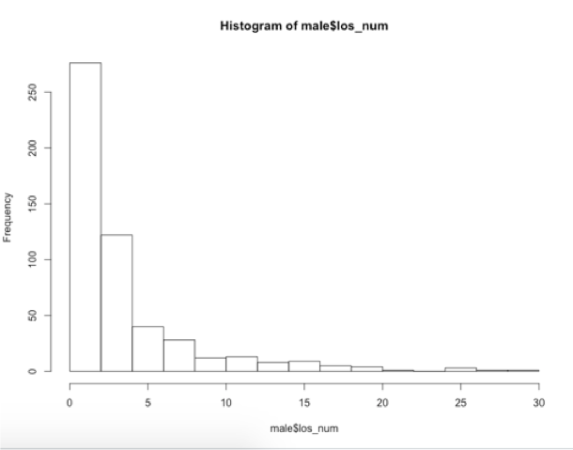
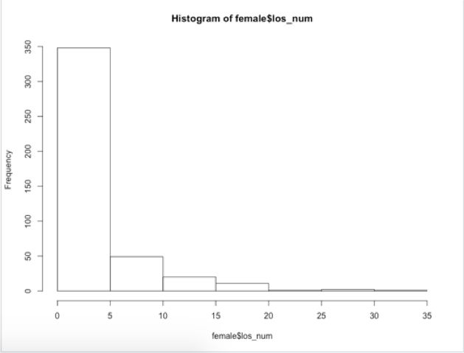
Male
Female

Slide 40
When do you use a non-parametric test?
When any of the the following are true.
Level of measurement is nominal or ordinal
Unequal sample sizes
Skewed data
Unequal variance
Continuous data collapsed into small number of categories

Slide 41
Using the Mann Whitney test
??Mann-Whitney will show you that the command is actually called wilcox.test.
Both variables need to be in numeric format.
cchic <- cchic %>% mutate(los_num = as.numeric(los))

Slide 42
Doing the test
wilcox.test(los_num ~ sex, data = cchic)
## ## Wilcoxon rank sum test with continuity correction ## ## data: los_num by sex ## W = 1334.5, p-value = 0.1713 ## alternative hypothesis: true location shift is not equal to 0
Notes:
Explain the output

Slide 43
Lunch
Feel free to explore the handout and go through the exercices again.

