Slide 1
Introduction to R

Slide 2


Slide 3
Disclaimer
Much of the following material can be sourced from open access resources
Software Carpentry
R Cheatsheets
Stack Overflow
Hadley Wickham’s R for Data Science
Initially collated by members of the DataSciBC

Slide 4
Content
Motivation for R: what and why?
Typical data science pipeline
RStudio: a tour
R building blocks
Using/writing functions

Slide 5
What is R?
Open-source software for data analysis and visualisation
Compatible with a variety of platforms
UNIX
MacOS
Windows
Particularly well suited to data science/statistics

Slide 6
Why use R?
Why not?
Need to learn a new language.
Does not use ‘point and click’.
Need to describe to the computer the steps you want it to take.
Why?
Anything you can do in spreadsheets, you can do in R plus so much more.
Not limited to the pre-designed command process of an app.
You record everything you do, so you can do it again.

Slide 7
Really, why R?
Save time
Small upfront investment for long term gain
New data + same analysis? - Easy
Found an error? - Easy
Reproducible Science
Code makes your analysis explicit
Writing code = writing lab-book = good reproducible science

Slide 8
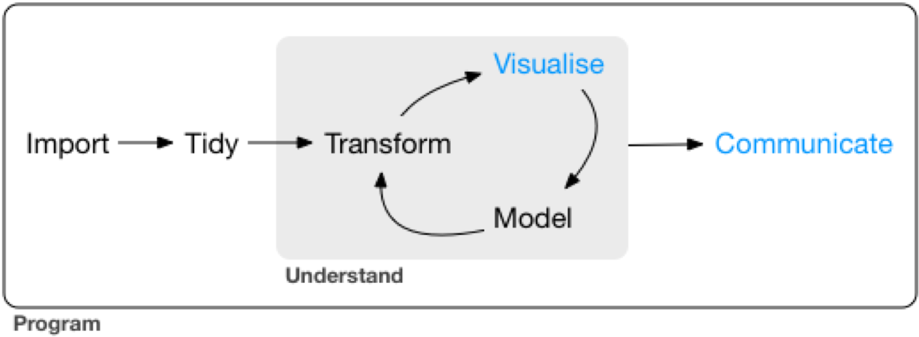
Typical data science pipeline
Notes:
Taken from https://r4ds.had.co.nz/introduction.html
Import: need to import data into R
Tidy: in short, this is the process of arranging data such that each variable is a column and each observation is a row. Done to ensure compatibility with functions.
Transform: can be narrowing in on observations of interest (e.g. only female patients); creating new variables that are functions of existing variables (e.g. time of stay = discharge date - arrival date); calculating summary statistics (e.g. counts or means).
Process of tidying + transforming = wrangling
Visualisation: once data has been transformed, it should be visualised. A good visualisation will show you things that you did not expect, or raise new questions about the data.
Modelling: once your question is sufficiently precise, you can use a model to answer the question.
Communication: critical part of any data analysis project is communicating the results to others.

Slide 9
Working with RStudio
RStudio is an Integrated Development Environment (IDE).
Easier to work with than R on it’s own, since it it a bit more ‘point and clicky’
Allows
Code editing
Syntax highlighting (i.e. highlighting of different sub-elements of syntax such as comments, control-flow statements, variables, etc.)
Plotting tools
Workspace management

Slide 10
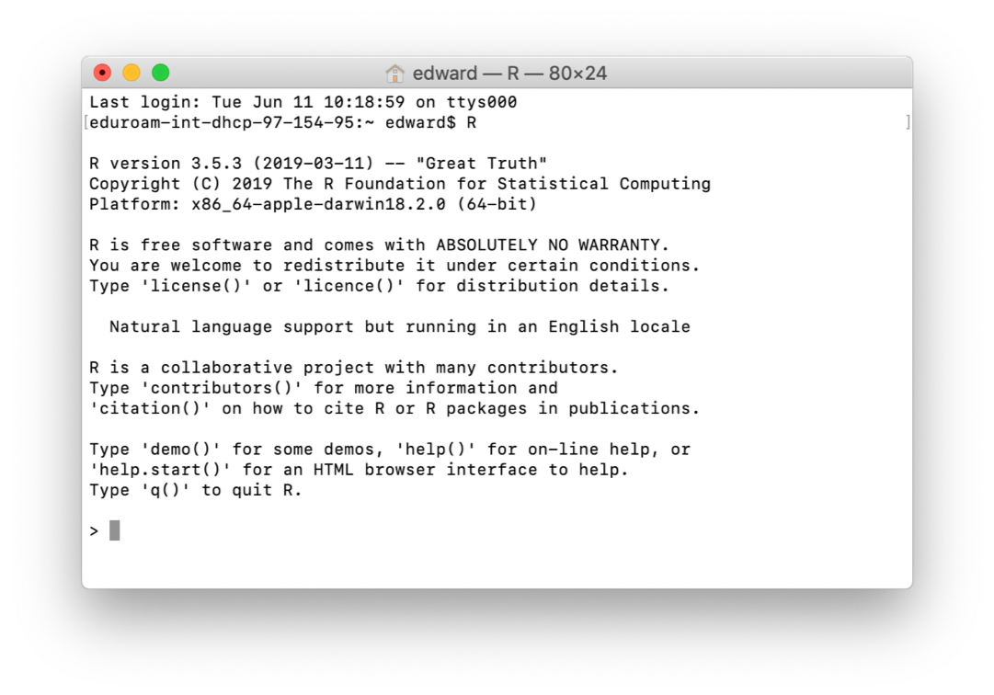
This is what R on it’s own looks like

Slide 11
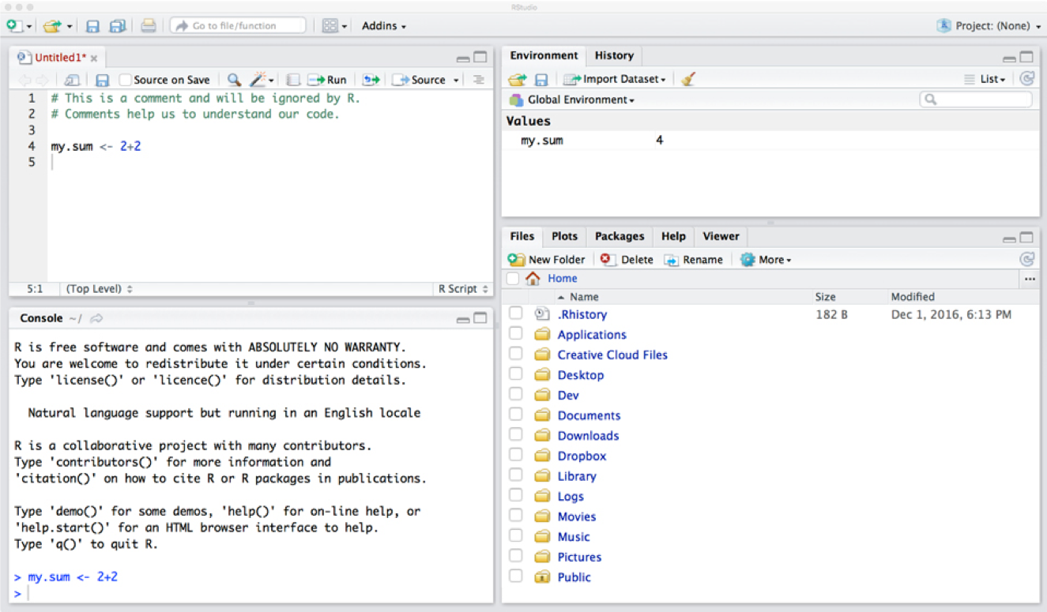
This is what RStudio looks like - much easier to work with
Notes:
Ask learners to open RStudio, but don’t get them to type anything in yet.

Slide 12
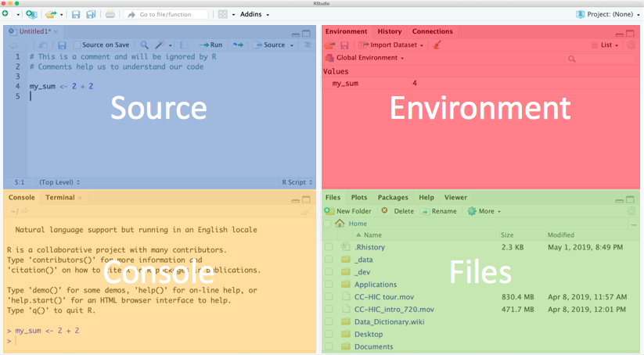
RStudio is made up of windows
Notes:
Explain each window.
Console - this is where R is run. Commands executed but not saved.
Source - text files that contain commands.
Environment - tells you which R objects you are working with.
Files - actually a helper window. Gives you files, help, plots. Warn people not to delete files from their computer.

Slide 13
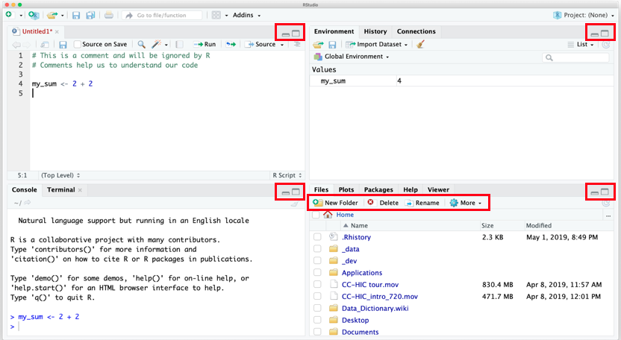
Adjusting your view of RStudio
Notes:
Explain what each button does.

Slide 14
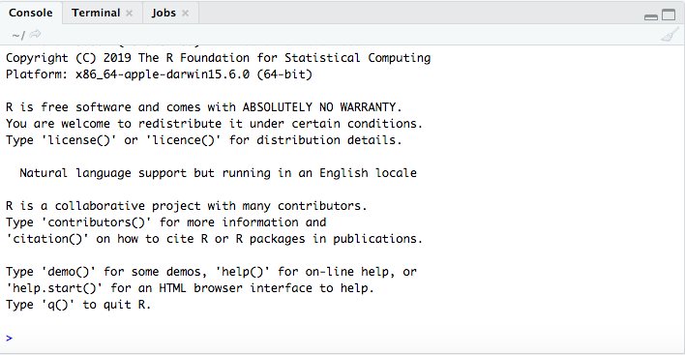
Using the Console window

Slide 15
Using the console
Bottom left window.
This is R!
This is your prompt to type >.
Type 2 + 2 then hit Enter.

Slide 16
Console output
You should see:
2 + 2
## [1] 4
> is the command prompt
2 + 2 is the command
4 is the output from R.
[1] is telling you that 4 is the first value in a sequence returned by R.
Notes:
Say that the ## sign is just printed on the slide as an indicator that we are seeing output rather than code entered. They shouldn’t see the symbol on their consoles.

Slide 17
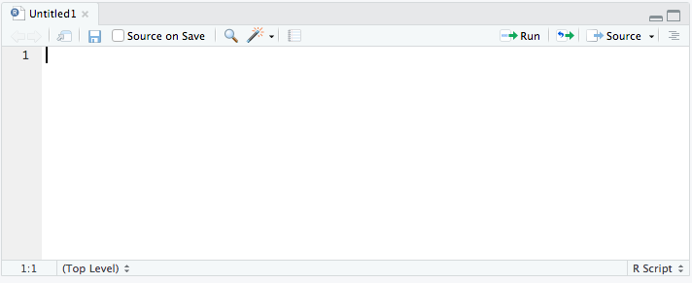
Using the Source

Slide 18
Using the Source
Type 2 + 2, then Enter.
What happens?
To ask R to run code
Highlight the code and:
MacOS: Cmd + Enter
Windows: Ctrl + Enter
Notice the output in the console.

Slide 19
Saving your work
Click the save icon
Save the file under a meaningful name.
Save it somewhere you can find it again.
.R is the file extension for R scripts.
Close the Source window.
Close R Studio.
Restart R Studio and click the open icon.
Find your file and open.
Your code should still be there.
You can run it again.
Notes:
Get them to do this. ?Use this to introduce the labbook idea? Every scientist is expected to maintain a labbook and this should be no different for a data scientist; so each time you sit down to work create a new file; I do this by creating a directory in each project called labbooks and then files named according as CCYY-MM-DD.R See - https://www.training.nih.gov/assets/Lab_Notebook_508_(new).pdf - http://www3.imperial.ac.uk/pls/portallive/docs/1/7289716.PDF - https://en.wikipedia.org/wiki/Lab_notebook

Slide 20
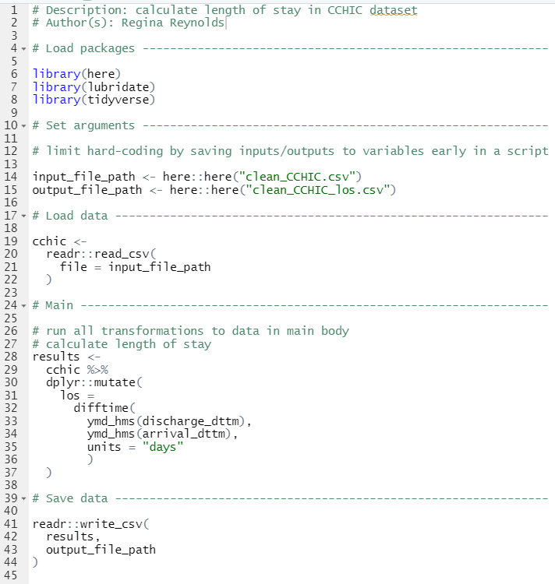
Good practices for writing R scripts
Well-written scripts should be:
Clear in their intended purpose
Explicit about requirements/dependencies
Sequential
Consistent in their style
As an example, see: Workshop1.R.
See also:
The tidyverse style guide
Tips from the US Geological Survey
A blog post on best practices
Notes:
Use this section to introduce the idea of organising code in a sequential, organised manner that eases reproducibility.

Slide 21
R building blocks
Object names
Data
Vectors
Data frames
Matrices
Lists
Functions
Stored in packages
Notes:
In this course, we will primarily be using vectors and data frames.

Slide 22
3 main building blocks
Object names
Everything needs a name in R: tables, plots, data files, functions
Data
Data comes in different classes:
Real numbers - numeric
Discrete numbers - integer
Characters - character
Data can be stored in vectors
Vectors can be stored in data frames
Functions
Little factories
Take an input (raw material) use function (factory) get an output (product)
Functions are collated into packages

Slide 23
Object names
You assign names to objects in R.
This is the assignment operator <-(=)
Shortcut:
Mac OSX: Option + -
Windows: Alt + -
Return the stored value by typing the name.
practice <- 2 + 2 + 6 practice
## [1] 10
Notes:
Get them to do this.

Slide 24
Object names
You can store any object under a name.
This example stores a character variable. You need to use quote marks to assign it.
say_hello <- "hello" say_hello
## [1] "hello"
Note that R does not like spaces in names.
say hello <- "hello"
## Error: <text>:1:5: unexpected symbol ## 1: say hello ## ^

Slide 25
Data
R is a statistical computing language
It is built around an understanding of data
Statistics uses:
Vectors
Data frames

Slide 26
Vectors
A vector contains elements of the same data type.
A vector of integers - an example would be age
## [1] 50 25 32 67 46 19 48
- A vector of real numbers - an example would be temperature.
## [1] 37.5 37.1 37.3 38.3 37.4 38.9
- A vector of characters/strings - an example would be name.
## [1] "Adam" "Sally" "Eve" "John" "James"
- A vector of logicals - an example would be 'are the blood results avaiblable?'
## [1] TRUE FALSE FALSE TRUE TRUE
You can always check the data type in a vector using the function class().
logical_vector <- c(TRUE, FALSE, FALSE, TRUE, TRUE) class(logical_vector)
## [1] "logical"

Slide 27
Naming vectors
The c() function combines individual values into a single vector.
# Storing several ages in one vector. age <- c(50, 25, 32, 67, 46, 19) age
## [1] 50 25 32 67 46 19
# Storing several peoples' names in one vector. name <- c("Adam", "Sally", "Eve", "John", "James", "Jennifer") name
## [1] "Adam" "Sally" "Eve" "John" "James" "Jennifer"

Slide 28
Recalling elements of a vector
R creates an index for each element of the vector.
It allocates a number to each element within the vector from left to right, starting with 1.
# The age of the second person. age[2]
## [1] 25
# The age of the fourth person. age[4]
## [1] 67
# The name of the fifth person. name[5]
## [1] "James"

Slide 29
Exercise: Vectors - other properties
Remember, vectors contain elements of the same data type.
Thus, what would happen if we were to add a value of TRUE to a vector of integers?
Use class() to examine the class of the vector. What has happened?
# Add a value of TRUE to a vector of integers test <- c(1, 2, 3, 4, TRUE)

Slide 30
Solution: Vectors - other properties
# Recall the vector test
## [1] 1 2 3 4 1
# Examine the class of the vector class(test)
## [1] "numeric"
The value of TRUE has been changed to 1.
The vector is still a numeric vector.
This is because logical vectors (i.e. TRUE/FALSE) can be coded in a binary format (1/0).

Slide 31
Exercise: Vectors - other properties
Add a character variable to a vector of integers.
test2 <- c(1, 2, 3, 4, "hi")
Recall the vector and use class() to examine the class of the vector. What has happened?

Slide 32
Solution: Vectors - other properties
# Recall the vector test2
## [1] "1" "2" "3" "4" "hi"
# Examine the class of the vector class(test2)
## [1] "character"
The character variable has been added on to the end of the vector.
The vector is now a character vector.

Slide 33
Data frames
You are already familiar with data frames
## name age gender ## 1 Adam 50 male ## 2 Sally 25 female ## 3 Eve 32 female ## 4 John 67 male ## 5 James 46 male ## 6 Jennifer 19 female
A data frame is a series of vectors aligned to form a table
Each vector becomes a column in the table
A properly formatted excel spreadsheet is essentially a data frame

Slide 34
Exercise: Creating a data frame
Create and name vectors containing information about these 6 patients.
Name: "Adam", "Sally", "Eve", "John", "James", "Jennifer"
Age: 50, 25, 32, 67, 46, 19
Gender: "male", "female", "female", "male", "male", "female"
Quotation marks are not needed for object names in R, but are when your data is made up of characters e.g. “male”, “female”.
As a rule:
Characters on the left side of the assignment operator. No quote marks.
Characters on the right side of the assignment operator. Use quote marks if storing letters.

Slide 35
Exercise: Creating a data frame
Combine these vectors into a data frame using data.frame().
Hint, the vector names need to go inside the ().
Save the data frame under the name patients.
Print the data frame called patients to your console.

Slide 36
Solution: Creating a data frame
# Creating individual vectors. name <- c("Adam", "Sally", "Eve", "John", "James", "Jennifer") age <- c(50, 25, 32, 67, 46, 19) gender <- c("male", "female", "female", "male", "male", "female") # Combining into a data frame. patients <- data.frame(name, age, gender)

Slide 37
Solution: Creating a data frame
patients
## name age gender ## 1 Adam 50 male ## 2 Sally 25 female ## 3 Eve 32 female ## 4 John 67 male ## 5 James 46 male ## 6 Jennifer 19 female
R arranges the vectors as columns in the data frame.
R names the columns of the data frame after the names of the vectors.
R numbers each row of the data frame, creating an index for each row within the data frame.

Slide 38
Recalling a vector in a data frame
Data frame columns are vectors.
$ can be used to extract a vector from a data frame.
We can get the age column from the data frame patients.
patients$age
## [1] 50 25 32 67 46 19

Slide 39
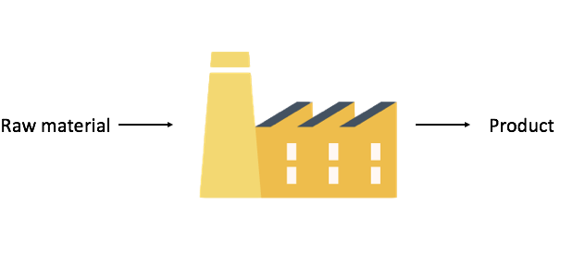
Functions as factories

Slide 40
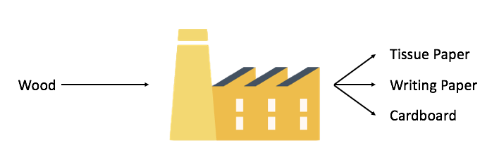
Functions as factories

Slide 41
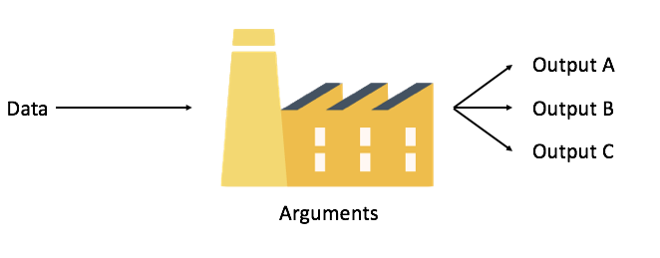
Functions as factories

Slide 42
Functions
Sometimes taught as a “black box”.
You can think of them as a factory.
Usually labelled as a verb (they are “doing” something).
Many come built into R.
Sys.time()
mean(1:100)
You can also install ‘packages’ containing bundles of functions.
View each function as a separate factory in a production line.

Slide 43
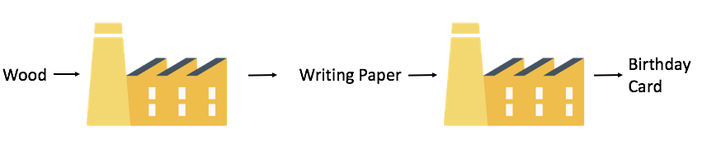
Functions in a line

Slide 44
Functions
You have been using functions already!
data.frame() is a function.
name, age, gender are the input arguments.
data.frame(name, age, gender)
## name age gender ## 1 Adam 50 male ## 2 Sally 25 female ## 3 Eve 32 female ## 4 John 67 male ## 5 James 46 male ## 6 Jennifer 19 female
The data frame is the output.

Slide 45
Try these functions yourself. What do they do?
Use the patients data frame as the argument.
head()
tail()
summary()

Slide 46
Try these functions yourself.
head() Gives you the first 6 rows
tail() Gives you the last 6 rows
summary() Gives an overview of the object
summary(patients)
## name age gender ## Length:6 Min. :19.00 Length:6 ## Class :character 1st Qu.:26.75 Class :character ## Mode :character Median :39.00 Mode :character ## Mean :39.83 ## 3rd Qu.:49.00 ## Max. :67.00

Slide 47
Warning note
Functions are carrying out pre-written instructions.
They will fail if they are supplied with the wrong kind of data - they will return an error message instead.
Try mean(patients$gender)
There are other constraints, which are dependent on the function itself.
HINT: some functions will not work with missing values. You will then need to specify the argument to remove these missing values.

Slide 48
Help with functions
How do you find out how to use a particular function?
Three ways:
Select the help tab in bottom right of RStudio, then type the function name into the search box, and read the help page.
Type ?function_name into the console.
If you can’t remember the exact function name try typing ??whatever_you_want_to_do into the console. It searches the whole database for matching terms.
Notes:
Get them to look up the help page for mean

Slide 49
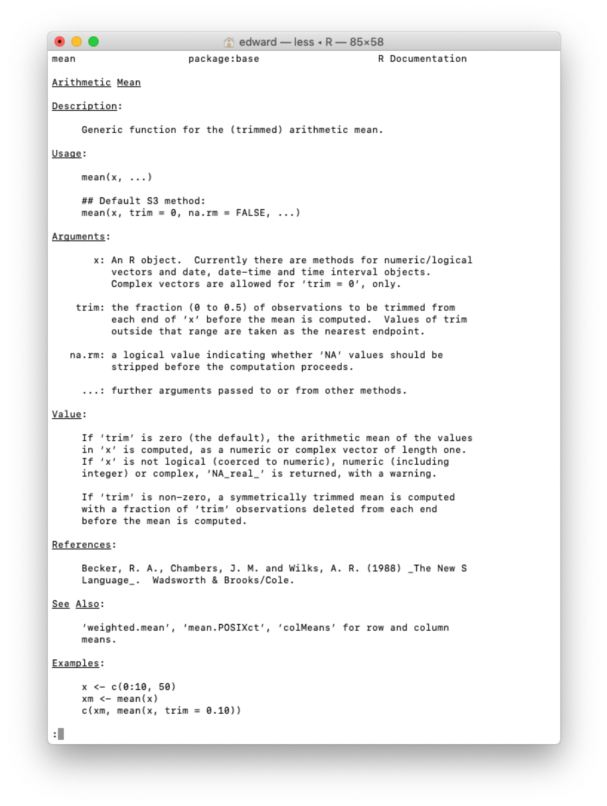
This is what a help page looks like.

Slide 50
Reading the help page
It’s quite complicated.
But the information is usually displayed in a standard format:
Brief description
An example of use
The argument(s) that can be passed to the function - along with any default value it takes if there is no value provided.
Breakdown of these arguments. Gives you more information about what you need to put in.
Tells you how the function works and what to expect to see in the output.
A reproducible example of use, that you can normally use verbatim.
Notes:
reference this back to the factory idea argument = names of the inputs function = machine/factory value = output

Slide 51
Explore functions yourself
Look up the function ls
What are the arguments you can give the function?
How do you specify the argument for ‘pattern’? Try it.
When might this be useful?
How do you specify the argument for ‘sorted’? Try it.
When might this be useful?
Notes:
Work through this with them.

Slide 52
Packages - collections of functions
There are bunch of functions that come with R. They are ‘base R’ functions.
Thousands of open access functions in other packages.
To access these: install the packages, then load them.
Let’s install and load the ‘tidyverse’ package
install.packages("tidyverse") library(tidyverse)
You can now use all of the functions that come with ‘tidyverse’.
You need to load the package using library each time you open R. But you will not need to install it again.
Notes:
Get them to load tidyverse. Emphasise that this is a process we will keep repeating throughout the course.

Slide 53
Other useful packages
These are some packages we will be user later in the course.
ggplot2 - plots graphs in R
readr - imports data into R
stringr - helps you manipulate strings
lubridate - helps you manipulate dates
Notes:
Maybe mention that a few of these packages are loaded with tidyverse.

