Slide 1
Importing data into R

Slide 2


Slide 3
What will this workshop teach you?
Getting .csv files into R.
Initial exploration of your data set.
The handout also includes some tips on importing data from Google Sheets.

Slide 4
Introduction
You have now learnt to input data into R manually.
But what happens if you are given an Excel spreadsheet and told to analyse it?
How can you look at and work with that data in R?

Slide 5
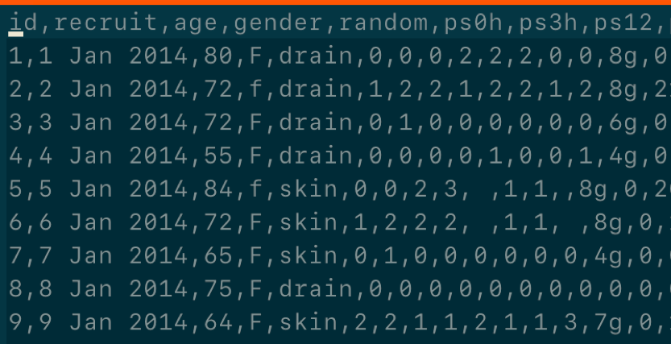
What is a CSV file?
Comma separated values file:
You still have columns and rows.
However, data values on a single row are separated by commas instead of walls of a cell.
Excel spreadsheets are easily converted into this format.

Slide 6
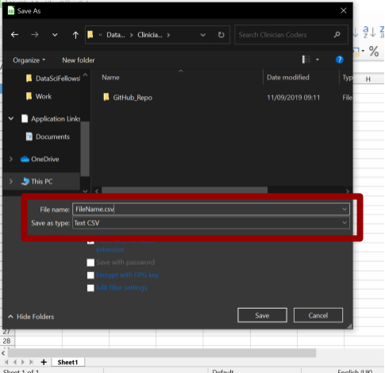
Time Out
Take a moment to download the practice data set.
Available in .csv format:
clean_CCHIC
Open and Save As a .csv file
Notes:
Upload file to MS Teams/Slack.

Slide 7
Files, directories and file paths
R can not read your data if it does not know where it is stored.
Your computer has a system for storing files within directories.
Directories are also known as folders.
The language used to instruct on the location of the file in known as the file path.

Slide 8
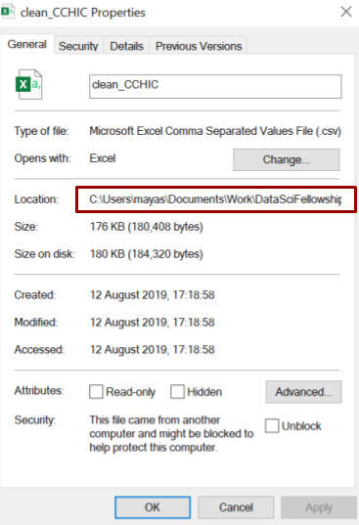
File paths
Starts with a Root directory and then Branches are specified.
You can find out the file path name by right clicking on any file:
Properties in Windows
Get Info in Mac
Folders within directories are specified with:
/ in Mac
\\ in Windows
However, the correct notation in R for both is /

Slide 9
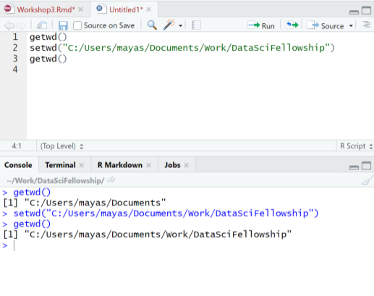
Finding and setting your Working Directory
R will have chosen a working directory for you.
getwd()
Will display your working directory in your console.
You can then reset it to your desired working directory using.
setwd()
Remember. You need quotation marks ("") around your file path name
Notes:
Candidates don’t necessarily need to do this at the moment.

Slide 10
Brief interlude…
Common file path problems:
You want to run the same script on a different platform (e.g. Windows –> UNIX), but the path to the data is now different.
You want to be able to easily switch between projects, which live in different directories, without having to change your working directory every time.

Slide 11
Brief interlude…
The answer to this: “Project-oriented workflows”
What They Forgot to Teach You About R – see Chapter 2 on Project-oriented workflows.
The package here is an excellent package for making the most of project-oriented workflows.
And for the You-Tubers among you, check out: Improve your workflow for reproducible science

Slide 12
Getting your work into R
Point and click
Less fiddly as no need to write code
But not reproducible
Using commands
Better for reproducibility
Someone else would just have to replace the source code to run the code on their own computer
Connecting to an online database or google spreadsheet
This will only be mentioned in the handout
Notes:
Three main methods

Slide 13
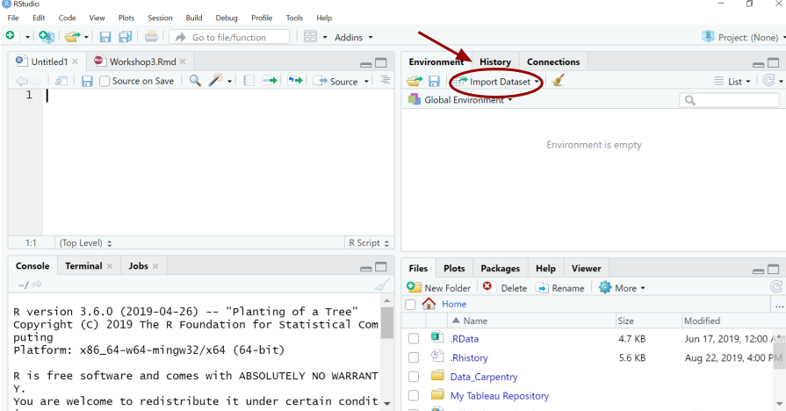
Method 1: Point and click
Click Import Dataset tab in the Environment pane

Slide 14
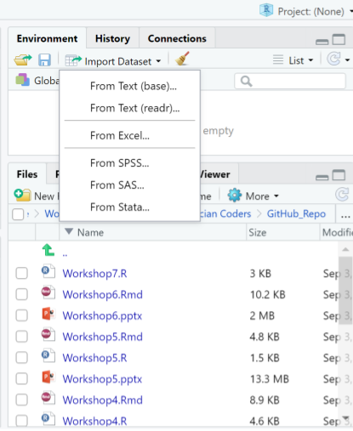
Choose From text (readr)

Slide 15
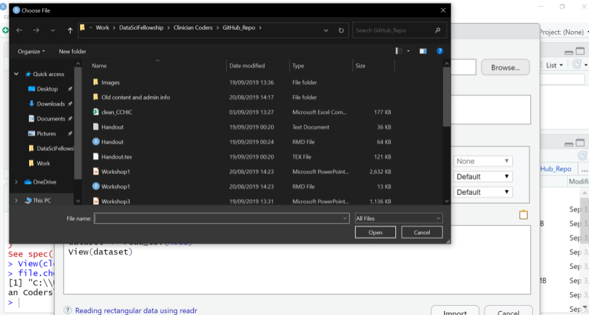
Browse files
Now browse for your file
Click on the file you wish to select
Then select Import
IF you try this you will notice there is no text in the source pane. This method is not reproducible.

Slide 16
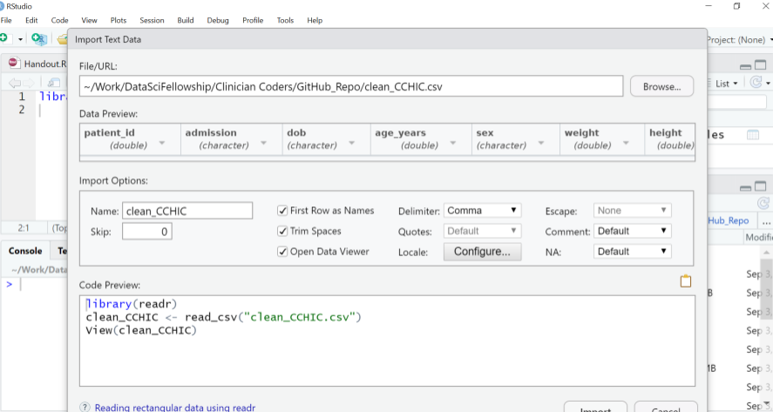
How can I make this reproducible?
Look for the code in the Code Preview
You can copy and paste this code into your source pane to make this step reproducible

Slide 17
Method 2: Commands
readr is a package containing functions to help R read your external files
It is automatically installed with tidyverse
Install and load the package as follows
install.packages("tidyverse") library(tidyverse)

Slide 18
Read your file
You can then tell R to read a CSV file by writing the full file path name. This is an example file path, but what you need to type depends on where you stored the data on your computer.
# You are saving your data in an object called "cchic" cchic <- read_csv("C:/Users/rhrey/OneDrive - University College London/ClinicianCoders_wd/ClinicianCoders/clean_CCHIC.csv")
Display the contents of the data frame cchic.
cchic
Notes:
Get them to do this

Slide 19
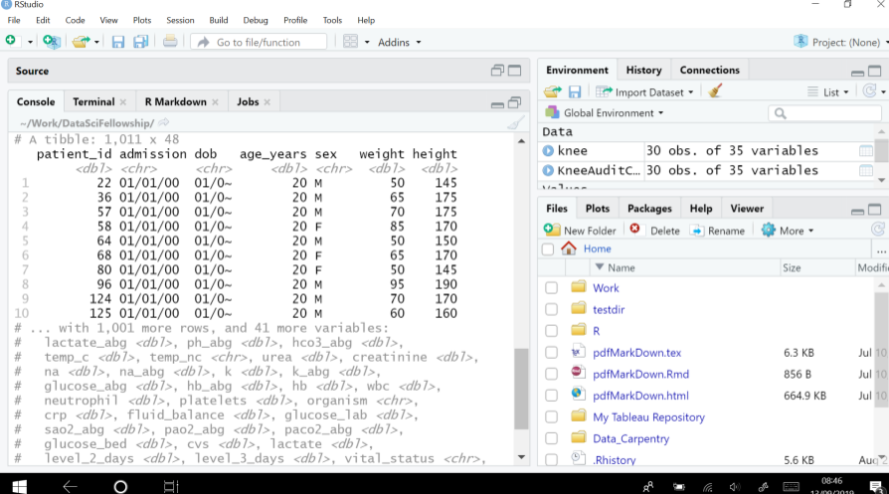
Tibble
Your data has been imported as a tibble, a specially formatted data frame. Notice how it reports the data type of each column under their name, similar to str() on a vector.

Slide 20
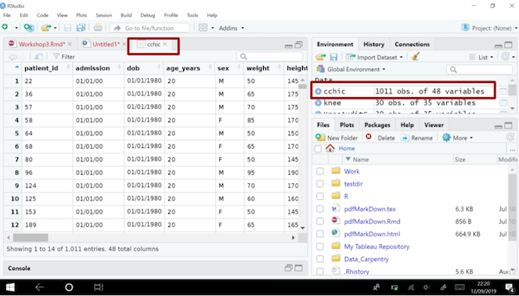
Viewing your data in R
You have imported your data into R.
You need a neat way of looking at it.
View(cchic)
The data is displayed in a familiar spreadsheet format.
This is a more human-legible table.
You can also view the data via the environment pane.

Slide 21
Shortcuts
There are notations to shorten the code for the file path.
Use single dot for a file within current working directory.
Use double dot .. for a file in the directory above the current working directory.
read_csv("../clean_CCHIC.csv")

Slide 22
Reviewing your data in R
Spreadsheets in R are called data frames
You can use these functions to investigate your data frame:
head(cchic)
tail(cchic)
names(cchic)
class(cchic)
str(cchic)

Slide 23
head()
head(cchic)
Prints the first 6 rows of the data frame.

Slide 24
tail()
tail(cchic)
Prints the last 6 rows of the data frame.

Slide 25
names()
names(cchic)
Prints the names of the variables.

Slide 26
class()
class(cchic)
Prints the class of the object cchic.

Slide 27
str()
str(cchic)
Prints the data type of each variable in cchic.

Slide 28
Look at specific items
You can look at specific data points.
cchic[21, 5]
## # A tibble: 1 × 1 ## temp_nc ## <dbl> ## 1 36.1
This displays the the piece of data in the 21st row and 5th column.

Slide 29
Selecting variables using $ sign
You can also use the $ function.
Enter data_frame_name$variable_name
cchic$weight
This will list all of the data in the weight column.

Slide 30
Other tools to review data
Specific functions from special packages help you describe the whole data set.
The function will look at each variable and will give you basic measures about the data, for example range and mean.
The data will also be described in a number of plots.
Desc() from DescTools package
describe() from Hmisc package
To use these you have to install the appropriate packages.
Notes:
Let them explore these if you have time.

Slide 31
Exercise
What types of variables do you have in cchic?
Display the discharge_dttm vector from in cchic.
How many men and women are in the database?
How many survived and how many died?
What does the function ls() do?
Use it to see how many vectors contain information about “temp”.

Slide 32
Answer 1.
What types of variables do you have in cchic?
str(cchic)

Slide 33
Answer 2
Display the discharge_dttm vector in cchic.
cchic$discharge_dttm

Slide 34
Answer 3
How many men and women are in the database?
table(cchic$sex)
## ## F M ## 2246 2754

Slide 35
Answer 4
How many survived and how many died?
table(cchic$vital_status)
## ## A D ## 4444 556

Slide 36
Answer 5
What does the function ls() do?
ls(cchic, pattern = "temp")
## [1] "temp_c" "temp_nc"
This lists all of the variables in cchic containing the word “temp”.

