Slide 1
Data wrangling

Slide 2


Slide 3
Content
Using the dplyr package.
Standard methods for selecting data.
Recipes to perform common operations, such as:
Manipulating strings
Manipulating dates
Changing data structure

Slide 4
What is data wrangling?
The process of transforming raw data into a form you can use for analysis.
Steps include:
Cleaning the data (Workshop 2) - as tempting as it might be to do this in Excel, for reproducibility, always try to do this in R.
Organising it into a structure that allows you to analyse it.
Creating derived variables from raw data.
Validating the data.

Slide 5
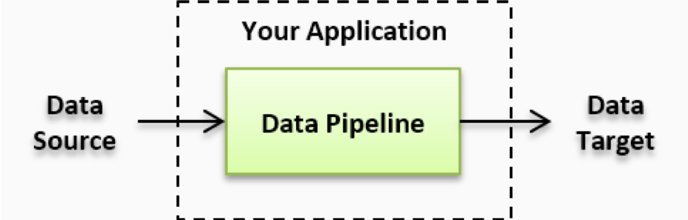
Another way to think of it…
Taking raw data
Subjecting it to processes along a data pipeline
Using the processed data for analysis

Slide 6
Load dplyr
dplyr is a package containing functions to help manipulate data.
It is automatically installed with tidyverse.
As we have already installed tidyverse, we simply need to load the package.
# You need to load the package each time you open R. library(tidyverse)

Slide 7
Load data
From the previous workshop, you should still have a data frame named cchic in your environment. If not, please load it again.

Slide 8
Two concepts you need to know before using dplyr
The pipe
Logical operators

Slide 9

The pipe
Takes whatever you did before, and passes it on to the next function.
Whenever you see it, think of the word ‘then’.
data_frame_name %>% dplyr::select(column_name) %>% mean()
Shortcut - Cmd + Shift + M (Mac) Ctrl + Shift + M (Windows)
Notes:
Tell them that there are a couple of things we need to cover about dplyr before we start working with it. This is the first one.

Slide 10
Logical operators
You use them to compare values
== (equal to)
!= (not equal to)
> (greater than)
< (less than)
>= (greater than or equal to)
<= (less than or equal to)
is.na() (is the value missing)
More than one condition?
& (and)
| (or)
Notes:
This is the second thing we need to learn. It applies to most parts of R.

Slide 11
Example of using logical operators
Try running:
test_age <- c(50, 25, 32, 67, 46, 19) # What elements in the vector are >= 65? test_age >= 65
## [1] FALSE FALSE FALSE TRUE FALSE FALSE
It should return a logical vector. This can then be used to filter your vector.
# Extract elements of vector which are >= 65 test_age[test_age >= 65]
## [1] 67

Slide 12
filter()
Choose rows based on the conditions you specify.
cchic %>% dplyr::filter(age_years >= 65)
The output is a data frame where all patients are 65 years or older.
Notes:
Dplyr works using ‘verbs’. The first one is filter.

Slide 13
select()
Allows you to choose specific variables from your dataset.
cchic %>% dplyr::select(sex)
Output is a data frame with the gender of all patients.
Notes:
The second verb is select.

Slide 14
Using filter() and select() together
cchic %>% dplyr::filter(age_years >= 65) %>% dplyr::select(sex)
Output is the gender of patients who are 65 years or older.
Question:What happens if you do select() and then filter()?

Slide 15
Using filter() and select() together
Question:What happens if you do select() and then filter()?
You have removed the age variable from the dataset, so you can’t filter based on age.

Slide 16
Piped data with functions
Piped data can be passed on to almost any function in R
cchic %>% dplyr::filter(age_years >= 65) %>% dplyr::select(sex) %>% summary()
Gives information on gender for patients older than 65.

Slide 17
Other dplyr wrangling verbs
group_by()
summarise()

Slide 18
Exercise: Using group_by() and summarise()
Try this.
cchic %>% dplyr::group_by(sex) %>% dplyr::summarise(mean_urea = mean(urea))
What is the output?
Hint – check for missing values in cchic$urea. You made need to add an additional argument in the function mean, which removes missing values.

Slide 19
Solution: Using group_by() and summarise()
cchic %>% dplyr::group_by(sex) %>% dplyr::summarise(mean_urea = mean(urea, na.rm = TRUE))
## # A tibble: 2 × 2 ## sex mean_urea ## <chr> <dbl> ## 1 F 7.49 ## 2 M 8.82
An alternative is to filter out the missing values of urea.

Slide 20
Take a break. Any questions?
Make sure you are happy running
filter()
select()
group_by()
summarise()

Slide 21
Favourite data tidying ‘recipes’
Rename a variable
Create a new variable
Extract numbers
Extract strings
Parse dates
Convert columns to rows and back again
Delete columns

Slide 22
1. Rename a variable
names(cchic)
The variable called na is very confusing
cchic <- cchic %>% dplyr::rename(sodium = na)

Slide 23
2. Create a new variable
Use the mutate() function
cchic <- cchic %>% dplyr::mutate(bmi = (weight / (height^2)))

Slide 24
3. Extract numbers
Parse numbers from text using the readr package.
library(readr)
Create a vector where the unit has been included as part of the value. You can’t do maths on this vector.
weight <- c("70kg", "80 kg", "82 kg", "74", "39") weight <- readr::parse_number(weight) str(weight)
## num [1:5] 70 80 82 74 39

Slide 25
4. Manipulate strings
library(stringr) test_gender <- c("f", "F", "M", "f")
Notice that female is coded in 2 different ways
We can change all of the letters to uppercase.
test_gender <- stringr::str_to_upper(test_gender) test_gender
## [1] "F" "F" "M" "F"
Look at the manipulate strings cheat sheet (https://resources.rstudio.com/rstudio-developed/strings) for other functions you can use.

Slide 26
5. Working with dates
R treats dates as characters unless you tell it not to.
library(lubridate) test_dates <- c("02-01-12", "03-04-15", "15-06-02")
Convert these characters to dates.
test_dates <- lubridate::dmy(test_dates) test_dates
## [1] "2012-01-02" "2015-04-03" "2002-06-15"

Slide 27
5. Working with dates - parsing dates
We can extract components of dates.
Extracting years
cchic <- cchic %>% dplyr::mutate(year_born = year(ymd(dob))) str(cchic$year_born)
Extracting days
cchic <- cchic %>% dplyr::mutate(discharge_day = day(ymd_hms(discharge_dttm))) str(cchic$discharge_day)

Slide 28
5. Working with dates - date intervals
We often want to calculate the difference between two dates or times. Let’s calculate the length of stay of patients admitted to the ICU.
cchic <- cchic %>% dplyr::mutate(los = difftime(ymd_hms(discharge_dttm), ymd_hms(arrival_dttm), units = "days"))

Slide 29
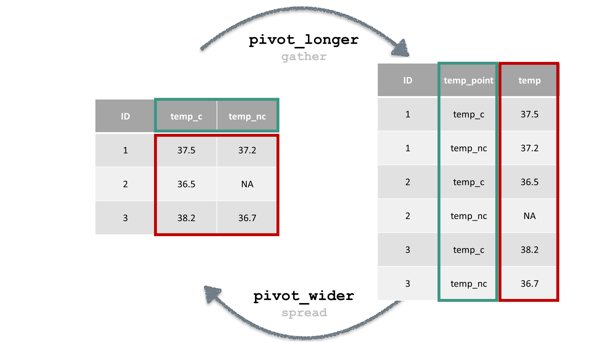
6. Columns to rows and back again
A dataframe can pivoted in two ways: longer or wider.
Notes:
Warn them that this concept takes a while to grasp. Also, warn participants that gather/spread have been superseded by pivot_longer/pivot_wider.

Slide 30
Why do this?
You may want to calculate the mean and standard deviation of all temperatures, and don’t care about the source.
You may want to plot all temperatures on a graph.
Instead of temperature area, you may have temperature on day 1, 2 etc.

Slide 31
Converting the data
Try this.
cchic_long <- cchic %>% tidyr::pivot_longer( cols = temp_c:temp_nc, names_to = "temp_point", values_to = "temperature" ) %>% dplyr::select(nhs_number, contains("temp")) names(cchic_long)
## [1] "nhs_number" "temp_point" "temperature"

Slide 32
Plotting the “longer” data
cchic_long %>% ggplot(aes( x = temp_point, y = as.numeric(temperature) )) + geom_boxplot()

Slide 33
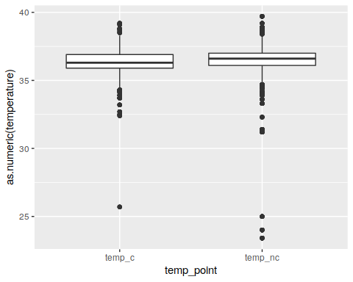

Slide 34
What if we want to convert it back?
We can use the tidyr function, pivot_wider().
cchic_reverted <- cchic_long %>% tidyr::pivot_wider( names_from = temp_point, values_from = temperature ) names(cchic_reverted)
## [1] "nhs_number" "temp_c" "temp_nc"
Notice that the variables “temp_c” and “temp_nc” are seperate again.

Slide 35
7. Deleting columns
What if we wanted to remove the temp_nc variable?
cchic %>% dplyr::select(-temp_nc)
The - sign means deselect here.
Don’t forget to assign the above code to something, otherwise the output won’t be saved.

Slide 36
Excercise
How many patients weigh more than 70kg?
Hint - look at the n() function.
Outcome of patients who were 60 years or older?
What is the mean length of stay of patients who are 60 years or older?
How many of these patients were discharged alive?
Hint - the variable vital_status indicates if the patient was alive or dead on discharge.

Slide 37
How many patients weigh more than 70kg?
cchic %>% dplyr::filter(weight > 70) %>% dplyr::summarise(number = n())
## # A tibble: 1 × 1 ## number ## <int> ## 1 2508

Slide 38
Outcome of patients who were 60 years or older.
# Mean length of stay cchic %>% dplyr::filter(age_years >= 60) %>% dplyr::summarise(los = mean(los, na.rm = TRUE))
# Number of people alive at discharge. cchic %>% dplyr::filter(age_years >= 60) %>% dplyr::select(vital_status) %>% table()
## . ## A D ## 2936 391

