Slide 1
Scene+: Scotia Decoupling of Realtime transaction to backend processing
Purpose, Implementation, Challenges

Slide 2
Purpose
Performance enhancement and reduce timeout error for Scotia transaction
Mitigate the issue where we have missing transaction from scotia bank
Get highest level of transparency and visibility internally in terms of what is happening to BNS transaction APIs

Slide 3
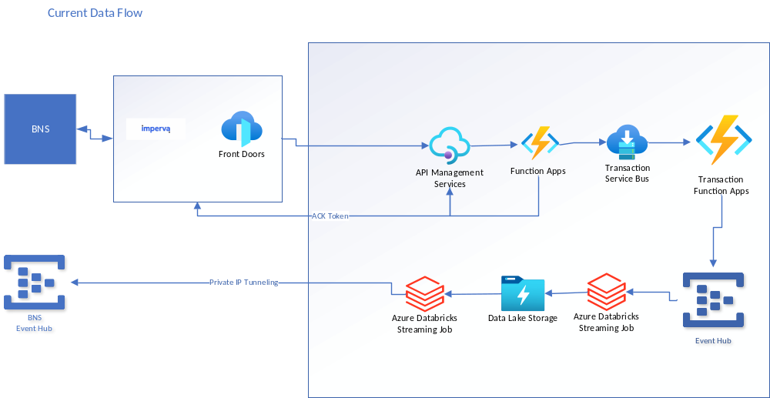
Current Setup

Slide 4
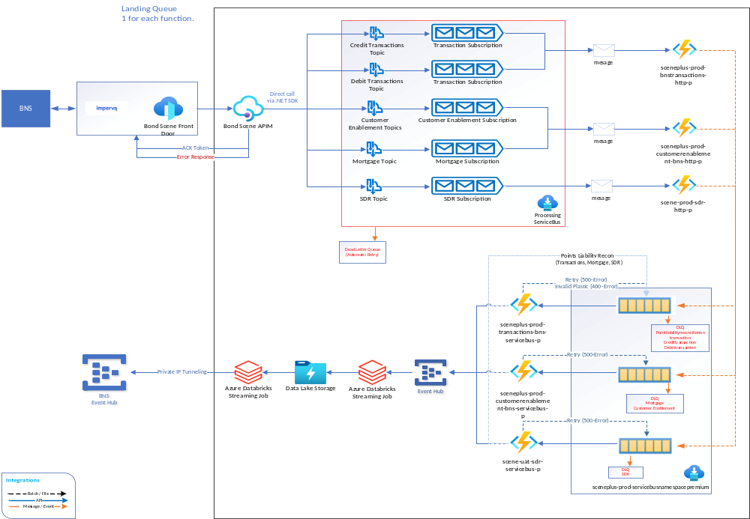

Slide 5
Challenges
Implementation at APIM without effecting other partners and API product catalog.
DLQ and processing for errored requests.

