Slide 1
Campaign Management Automation
Delivery Roadmap

Slide 2
Agenda
Introduction
Objective of project
High Level Requirements
Delivery Roadmap
High Level - Current State E2E Architecture
High Level – Phase 1 Future State E2E Architecture
Next steps

Slide 3
Objective
Create a new Scene+ Campaign Management Automation platform that is more efficient, personalized, scalable, robust and easily configurable compared to LE in current state
Handle diverse campaign and offer flows for faster turn-around
Implement omni-channel marketing campaigns by using an integrated platform with ready access to data segments
Deepen member engagement through program comprehension, optimized onboarding and lifecycle programs
Deliver real time, digital offers by connecting the offer platform to the CRM platform

Slide 4
High Level Requirements
Implement and manage various promotional offers including:
  Cross-Shop Offers
  Redemption Offers
  Engagement Offers
Ability to provide point issuance and redemption in real-time meeting current SLA for POS
Ability to provide BNS PIN Promotions & Coupon code redemption
Ability to provide point issuance and redemption through Batch file process for partners
Automate current manual Back-End Bonus (BEP) issuance process
CSM – Ability to view member level and program level offers to provide customer service support and backend issuances
CSM/Digital Web & Mobile – Ability to view issuance and redemption history at member level
* Refer to project BRD for more details

Slide 5
Delivery Roadmap
Change Management and Support
Phase 1
Phase 2 and beyond
Configure Salesforce Loyalty Management (LM) and other modules to build following offers:
Personalized offers:
Cross shop Offers
Location based transactions with minimum spend e.g. "Use your card at X locations to get Y points".
Redemption Offers
Promote loyalty rewards spending e.g. "Redeem X points and get Y back".
Engagement Offers
Survey/Polls rewards, Gaming activities, Mobile app engagement rewards, Digital enrolment rewards etc.
Offer to Channel experience:
Offers that can be directly streamed to various CRM channels including Mobile, Web, Email & Push Notifications.
Offers that can be pushed to members via automated journeys, Trigger campaigns or ad-hoc campaigns.
System Integration
Will implement point to point system integration. No Middleware.
Build system integration between Salesforce and other system
Snowflake to LM – Transaction Journal data
Interconnect between Loyalty Cloud, Data Cloud, Marketing Cloud and Marketing Cloud Personalization
MCP to Digital Web
MCP to Digital Mobile App
LM and Synapze LX
Update Digital Web and Mobile App to allow members to view Personalized offers.
CSM – Ability to view member level and program level offers to provide customer service support and backend issuances
Automate current manual Back-end bonus(BEB) issuance process leveraging MCP
Keep Bond's Loyalty Engine for real-time offers, base offers, BNS and Recipe offers (among others)
Provide PIN Promotions & Promo code redemption
Provide point issuance and redemption through Batch file process for partners
CSM – Ability to view member level and program level offers to provide customer service support and backend issuances
CSM/Digital Web & Mobile – Ability to view issuance and redemption history at member level
Additional capabilities like Stamp based promotions and multi-currency support
Provide point issuance and redemption in real-time meeting current SLA for POS
Allow all partners except BNS to create their offers that will then be visible in Scene website and Mobile App. (Assumption: BNS will keep using LE and fund LE)
Any reporting that is leveraging LE
Decommission Scene from using LE

Slide 6
Phase 1 – Impacted Systems
Systems | Deliverables | Stakeholders
Salesforce Loyalty Management (SF-LM), Marketing Cloud Personalization (SF-MCP), Data Cloud | Implementation of in-scope offer type in Loyalty Cloud Support segmentation from Marketing Cloud/Data Cloud to Loyalty Cloud Campaigns Configure Phase 1 offers and calculations in Loyalty Cloud, to support points accruals Configure Data Processing Engine to support bulk updates to members and points. Connect Loyalty Management, Marketing Cloud Personalization, Marketing Cloud and Data Cloud
Scene Website and Mobile App | Retrieve eligible offers for members from Salesforce Marketing Cloud Personalization (SF-MCP) Display eligible offers on website and Mobile App
Data Integration | Interconnect between Loyalty Cloud, Data Cloud, Marketing Cloud and Marketing Cloud Personalization Snowflake to LM – Transaction Journal data MCP to Digital Web MCP to Digital Mobile App LM and Synapze LX

Slide 7
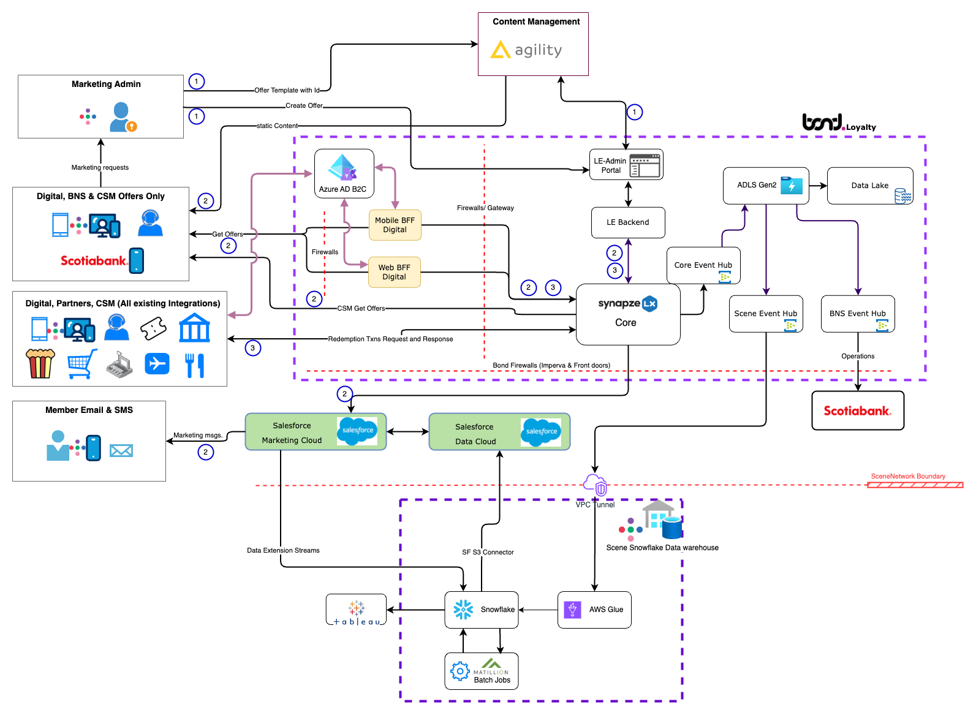
High Level - Current State E2E Architecture
Offers are created by Marketing Admin. LE Admin portal and Agility CMS are leveraged for offer creation and templates, respectively.
1
Offers are displayed on Digital channels (Mobile and web) and delivered to Member's inbox (Email & SMS)
Digital offers are retrieved through API calls and merged with Agility CMS static templates based on offerId and type.
API is exposed through LX Core and interacts with LE backend to pull offer information.
2
Redemption can happen at Partner sites (BAKKT, BlackHawk, Digital Channels (Promo code) and at Partner point of sale.
Redemption can be batch process or real-time for specific use-cases.
Loyalty Engine does offer evaluation based on campaign criteria and awards the Bonus points depending upon business rules.
3

Slide 8
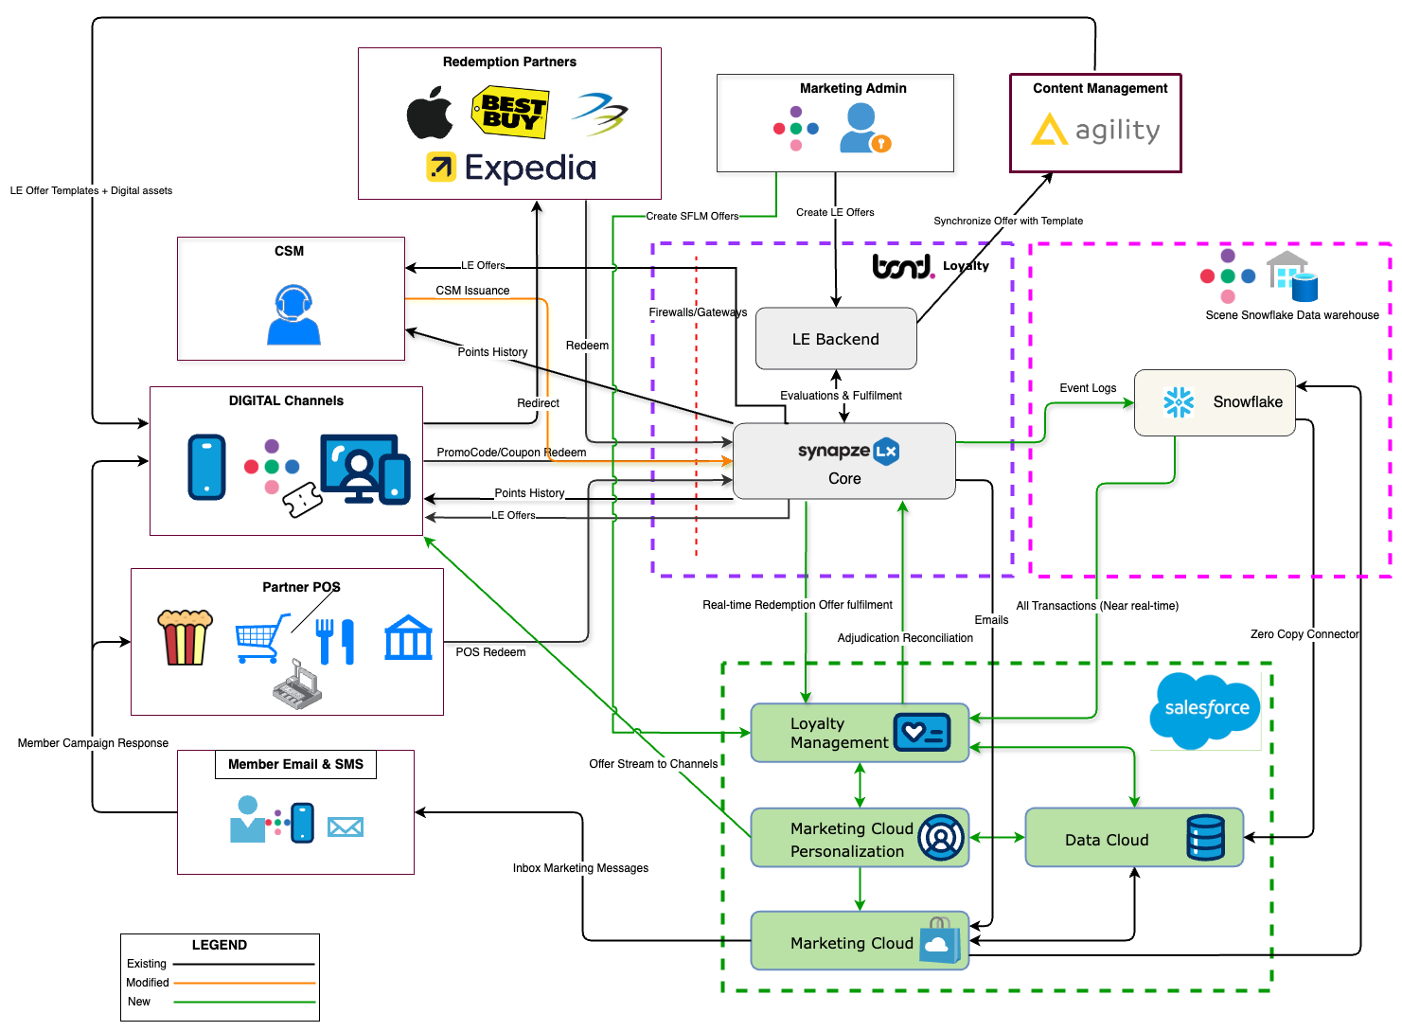
High-Level Phase 1 State E2E Architecture
Key highlights:
Salesforce Loyalty Management and other Salesforce Marketing cloud tools to co-exist with LE
Only program level offers to be configured in SFLM
Mutually exclusive campaigns
BNS/Recipe to continue using LE in Phase 1

Slide 9
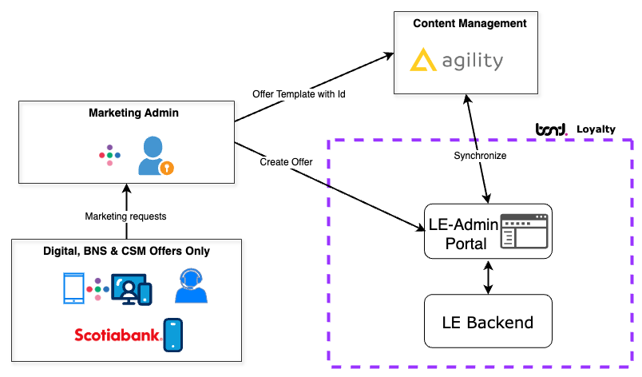
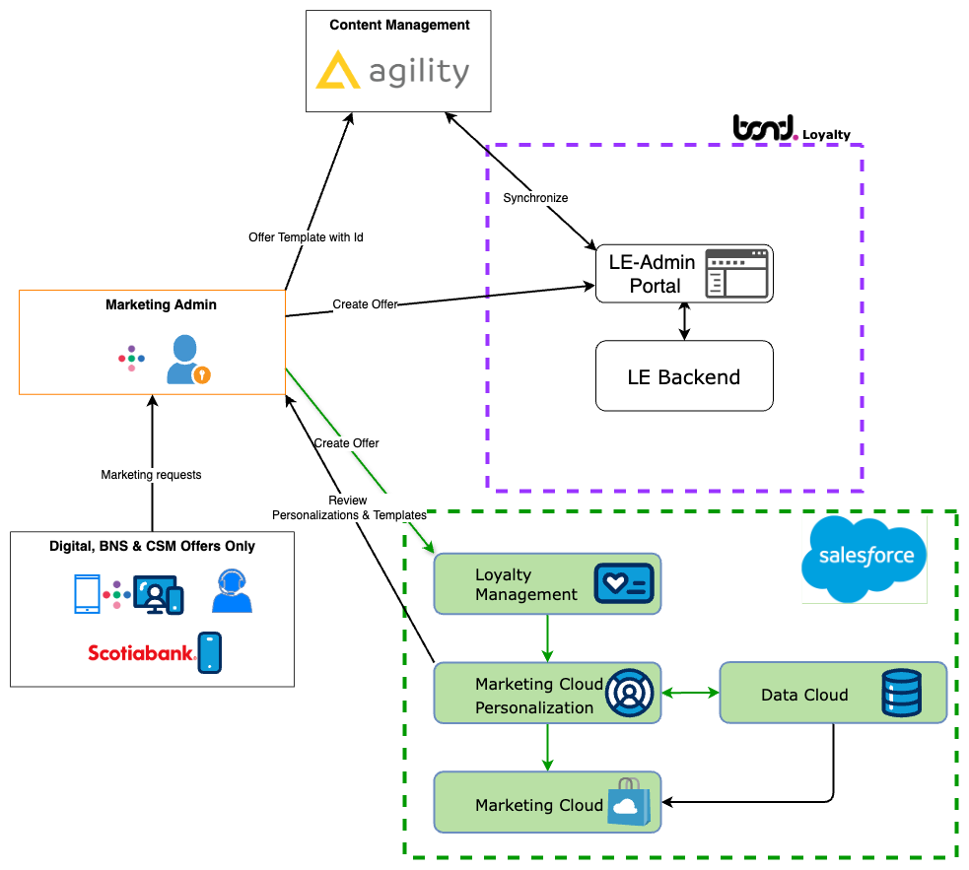
Create Offer Current State vs Phase 1 with SFLM
Create Program level Offers in SFLM
A
A
Current State
Phase 1 - Future State
Highlights:
Includes Salesforce Loyalty Management Software for Campaign management
Includes Marketing Cloud Personalization software for Segment based event propagation to digital channels
Mutually Exclusive Offers & Campaigns
Different Content Zones for offers (Offer prioritization is manual coordination)

Slide 10
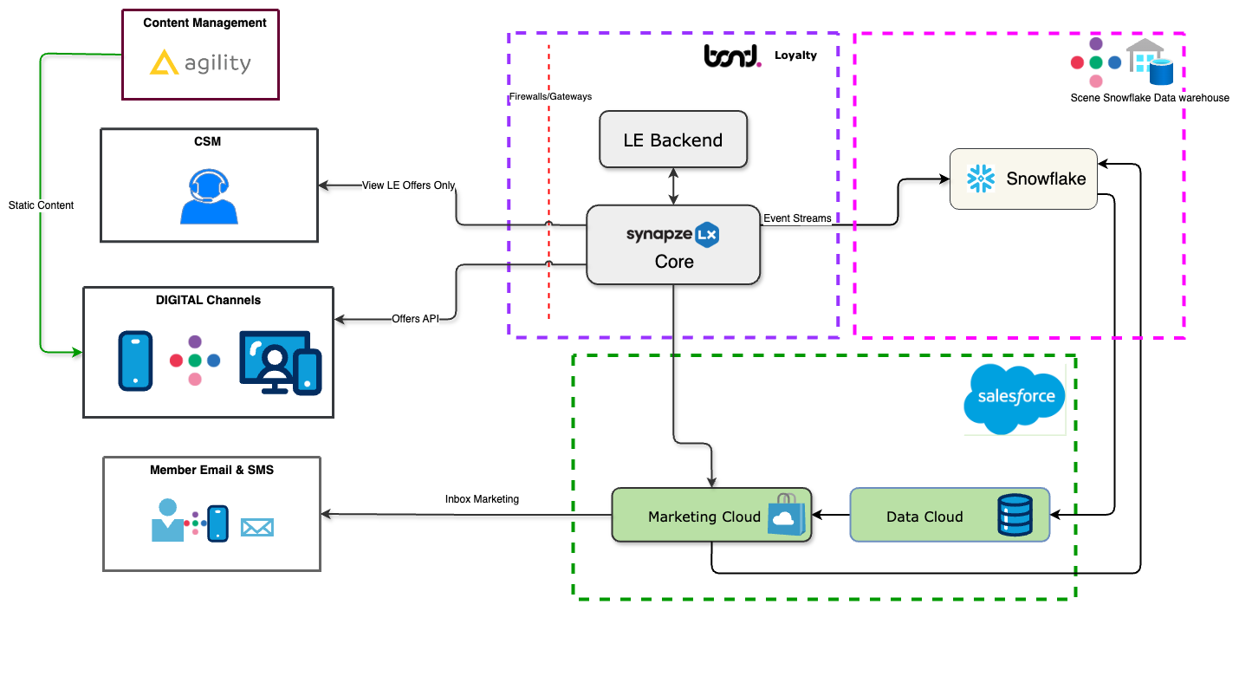
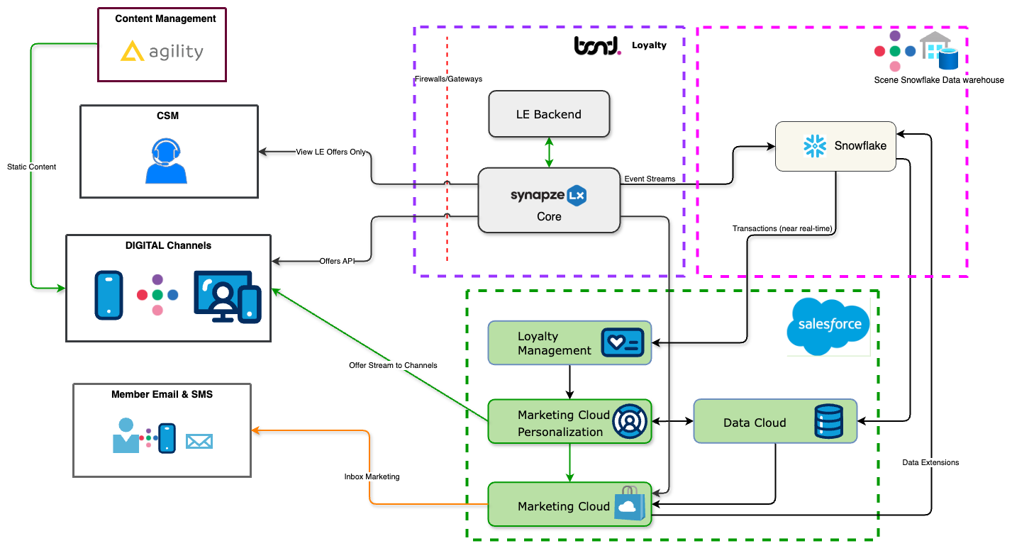
Offer Promotion Current Vs Option 1-Phase 1 with SFLM
A
Current State
Option 1-Phase 1 - Future State
JavaScript beacon and SDK integration with Channels to dynamically stream personalized offers
A
Note:
CSM doesn't have any ability to view the offers delivered to member due to lack of direct integration with MCP. Requires further assessment.

Slide 11
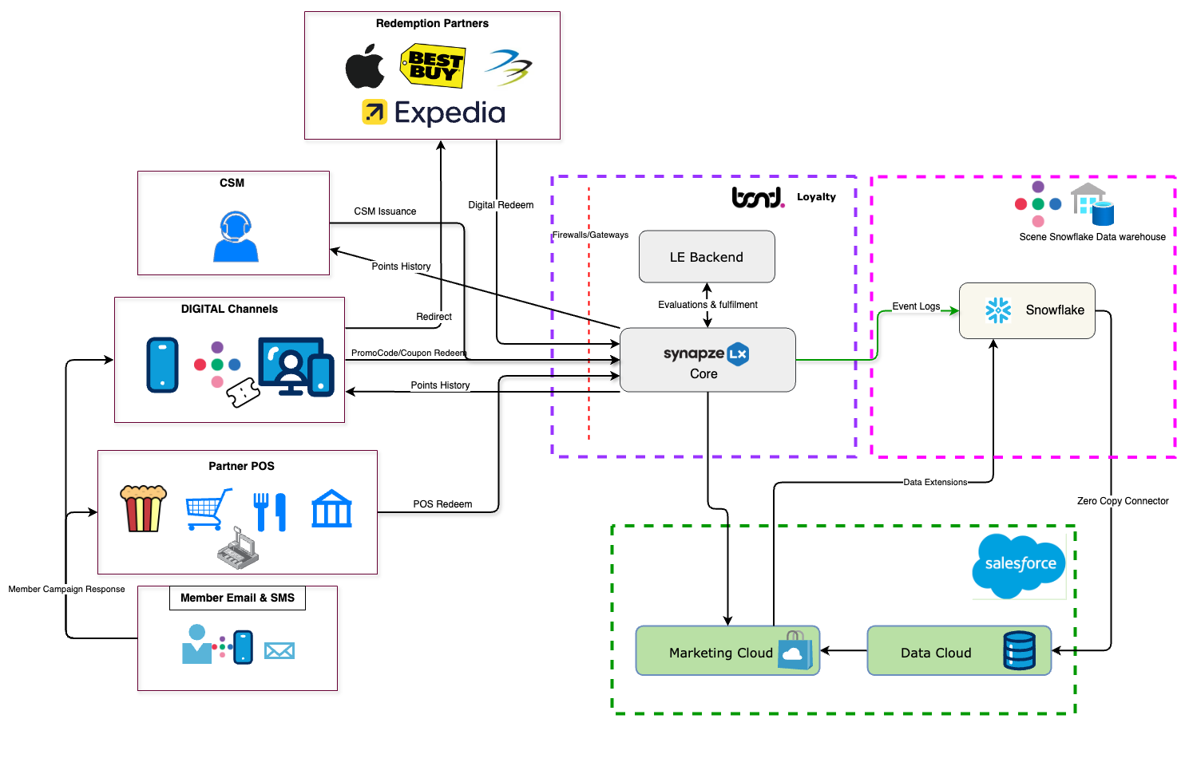
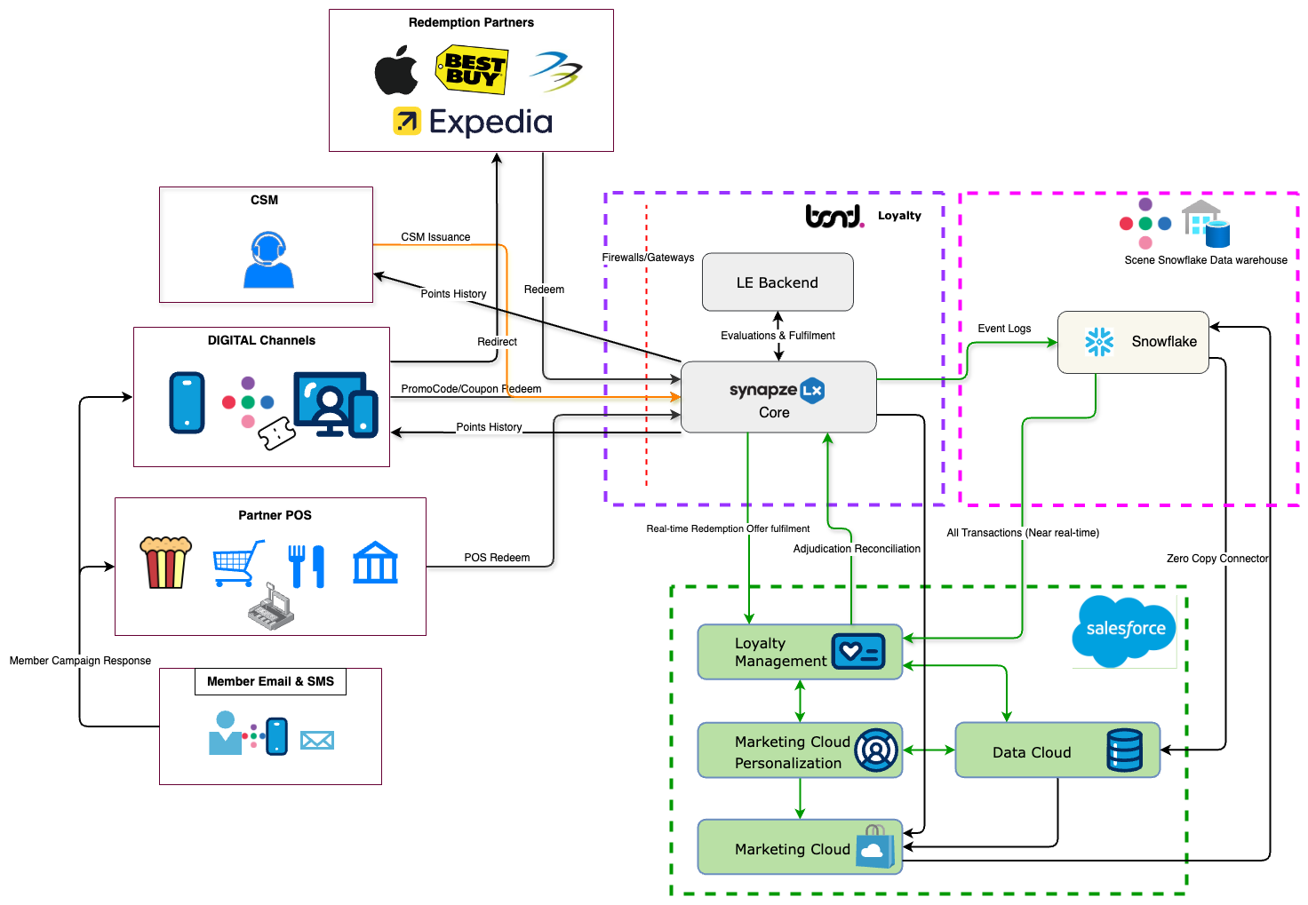
Offer Redemption Current Vs Option 1 – Phase 1 Operation with SFLM
C
B
A
Current State
Option 1 - Phase 1 - Future State
A
Copy all transactions from Snowflake to SFLM Transaction Journal
B
Point Adjudication and reconciliation in Synapze LX via API Integration
To be confirmed:
Point history and bonus audit logs may be retrieved from LE (Bond).
Need to ensure that response format from SFLM is consistent with existing experience for CSM and member's digital experience (Bond)
New reconciliation API to connect SFLM with Synapze Core (Bond)
Additional mapping efforts to conform to SFLM transaction journal sourcing data from Scene+ DW (FCB/Six)
C
Real-time redemption of offers from Synapze LX core to LM

Slide 12
Next Steps
Obtain assessment of cost and delivery timeline for Phase 1
Obtain high level assessment of high-level cost and duration for Phase 2 and beyond

