Slide 1
Scene+: SEON Fraud tool Integration

Slide 2
Purpose

Slide 3
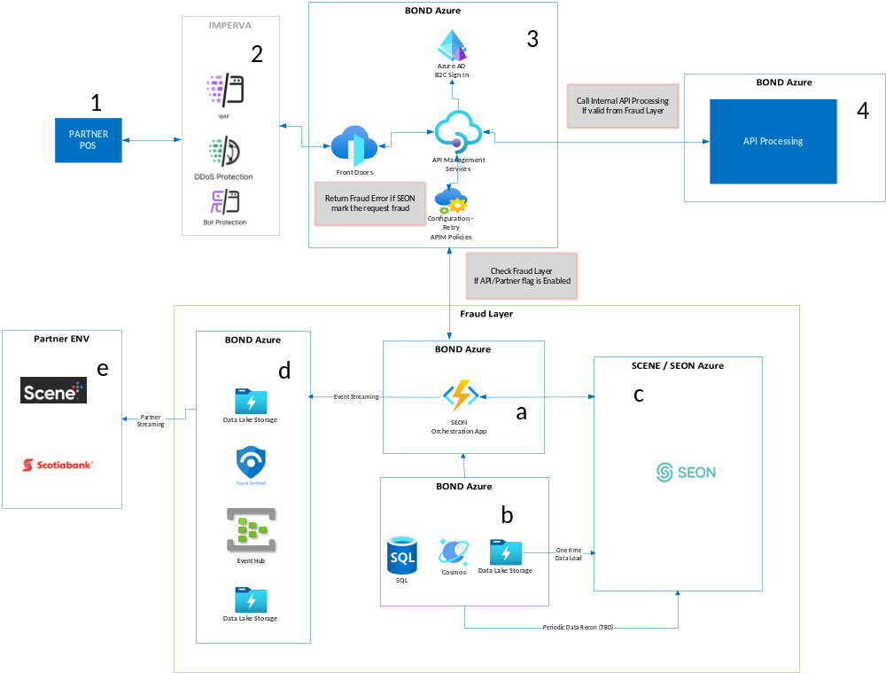

Slide 4
Challenges

