Slide 1
Scene+ usage of slots:
Purpose, Implementation, Challenges

Slide 2
Purpose
Multiple projects running at the same time and having different release date
Partner’s preference was to test only their projects changes and not to merge their features with other projects
Partner asking for separate environment where only their changes are hosted
Project release date is never fixed so that makes it harder to manage the lower environment and client’s approval on testing

Slide 3
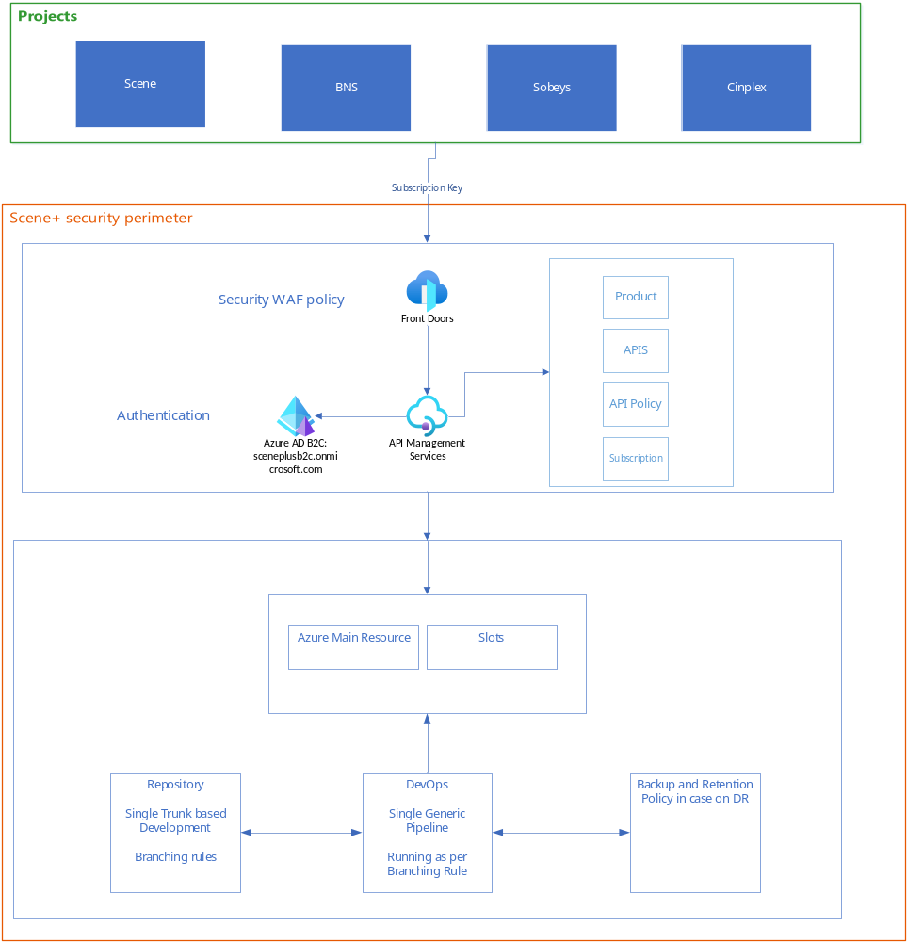
Solution

Slide 4
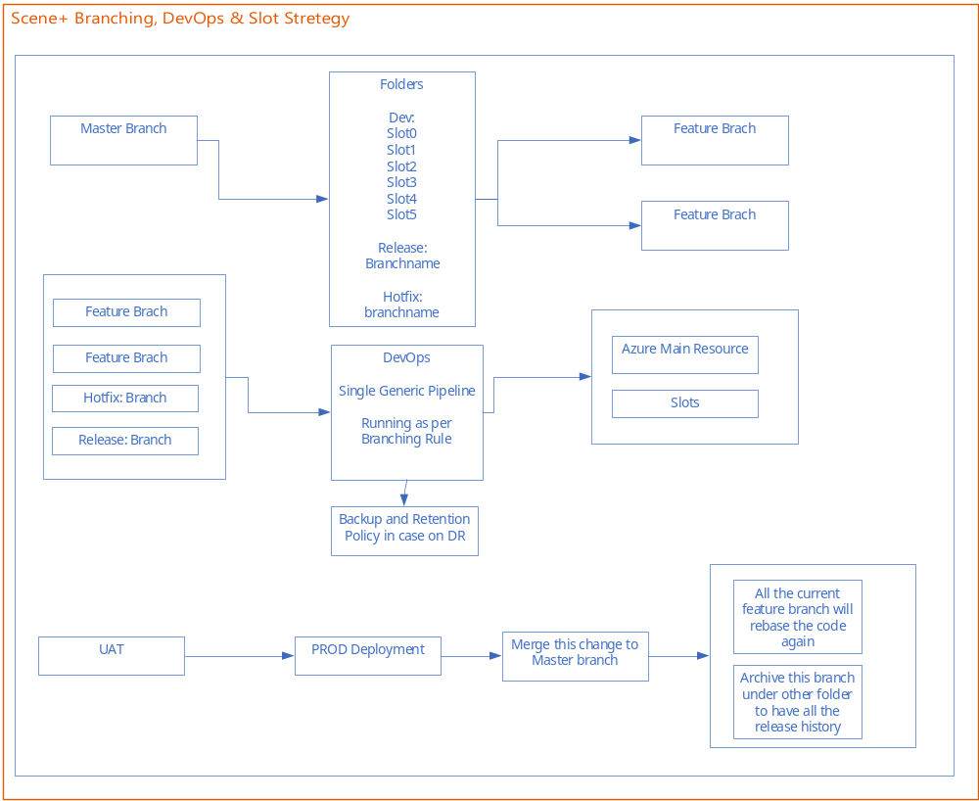

Slide 5
Challenges
Implementation
Manage the current projects that are in pipeline
And close coordination with other team to make required changes at the same time
  DevOps
  BTS
  Engineering Team

