Slide 1
Scene+: Windmill API and Initial Architecture Review

Slide 2
Point Issuance will be async Requests
Redemption, Account Inquiry, Account Link-Delink will be real-time call
All those point bank information will stream to Scene and BNS as it is
Volume is still need to be finalized but this might be like BNS
Data sync extension yet need to define with the windmill

Slide 3
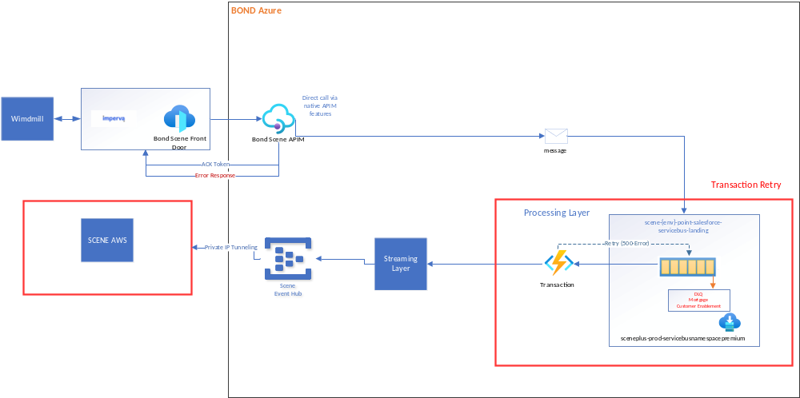

Slide 4
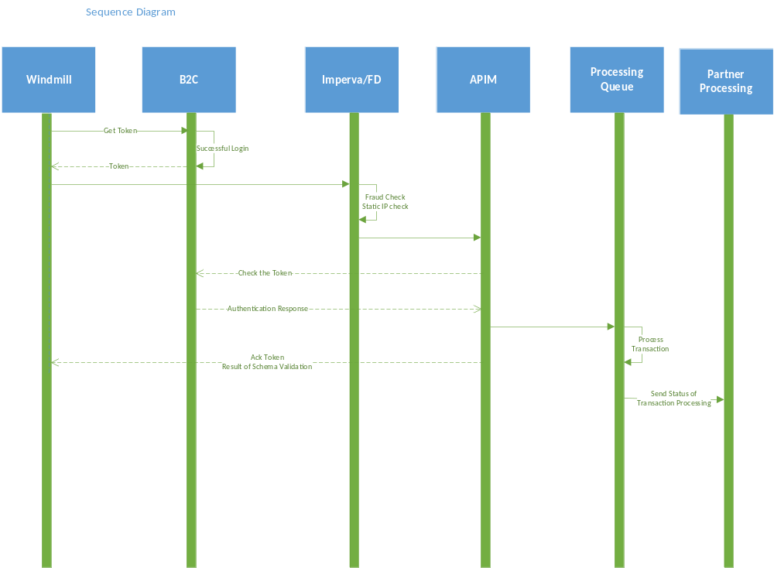

Slide 5
