Slide 1


Everything local.
One platform.
The marketplace, the free business toolkit, and the AI receptionist
for the businesses that keep every neighbourhood running.
Partner overview · July 2026 · Private & confidential
Notes:
Open with the Uber Eats line: they solved this for restaurants — nobody has solved it for the other 95% of local services.

Slide 2

THE PROBLEM
A huge industry still runs on missed calls
69%
$509B
$37,230
of US consumer spending is services — the last big offline category
a year spent on US home improvement & repair alone
median cost of one receptionist — the help small businesses can't afford
US BEA / FRED
Harvard JCHS, 2025
US BLS, May 2024
Even the market leader admits it: Angi's own annual report names its biggest competitor as “word of mouth and referrals.” The customers are there. The providers are there. The platform that connects them properly isn't — yet.
Clinket
2
Notes:
Land the three numbers, then the Angi quote — the strongest proof the market is still offline.

Slide 3
THE PROBLEM
What providers are stuck with today
The missed call
The wrong platforms
The lead-sellers
One-person businesses can't answer while doing the job
Nearly 1 in 5 medical appointments are no-shows — about $196 lost each time (peer-reviewed)
Hiring front-desk help costs $37K+ a year
Facebook Marketplace: 1B+ monthly shoppers but no booking, payments or reminders — and contact details get blocked
A UK bank study flagged ~1/3 of Marketplace listings as likely scams
28% of US small businesses have no website at all
Angi sells leads — providers pay whether or not they win the job
Fined $7.2M by the FTC for misleading pros about lead quality
Revenue down ~24% and service requests down ~30% in two years
Every missed call is lost income.
Demand exists. The workflow doesn't.
The old model taxes providers.
Clinket
3
Notes:
Sources: BMC Health Services Research; Capital One Shopping / TSB; Clutch; Angi 10-K; FTC April 2023.

Slide 4
THE ANSWER
Clinket — one platform, three ways to win
1
Marketplace + e-commerce
2
Free tools to run the business
3
AI assistant + receptionist
Search any service like Google — everything on one screen
Chat, call, WhatsApp — privacy stays in the customer's hands
Book & pay online; money held until the job is done
Refunds and support built in, Amazon-style
Bookings, quotes, invoices with payment links — $0
Their own customer book, built automatically
A ready-made website with booking + QR code
The on-ramp: every business can start today
Answers every missed call 24/7, like a trained employee
Books appointments, takes orders, creates quotes — live
Owner watches the transcript, takes over anytime
Every call summarized with the actions it took
One shared engine underneath: AI matching · smart search · customer insights · payments · messaging · notifications
Clinket
4
Notes:
A provider can adopt one pillar or all three — each one feeds the same data and network.

Slide 5
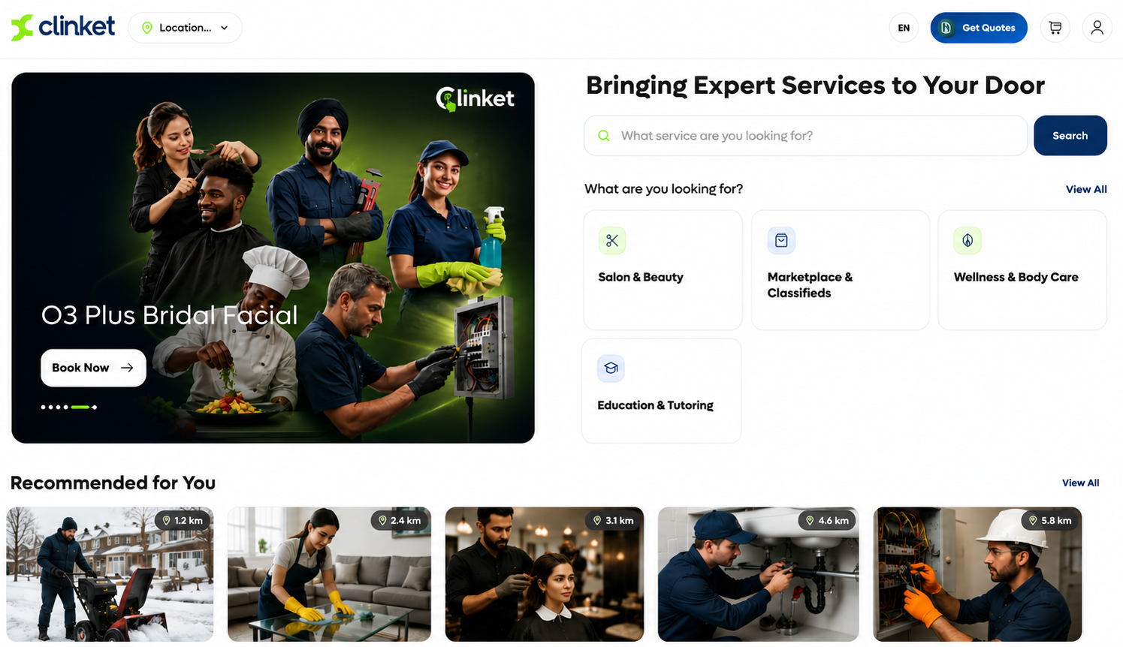
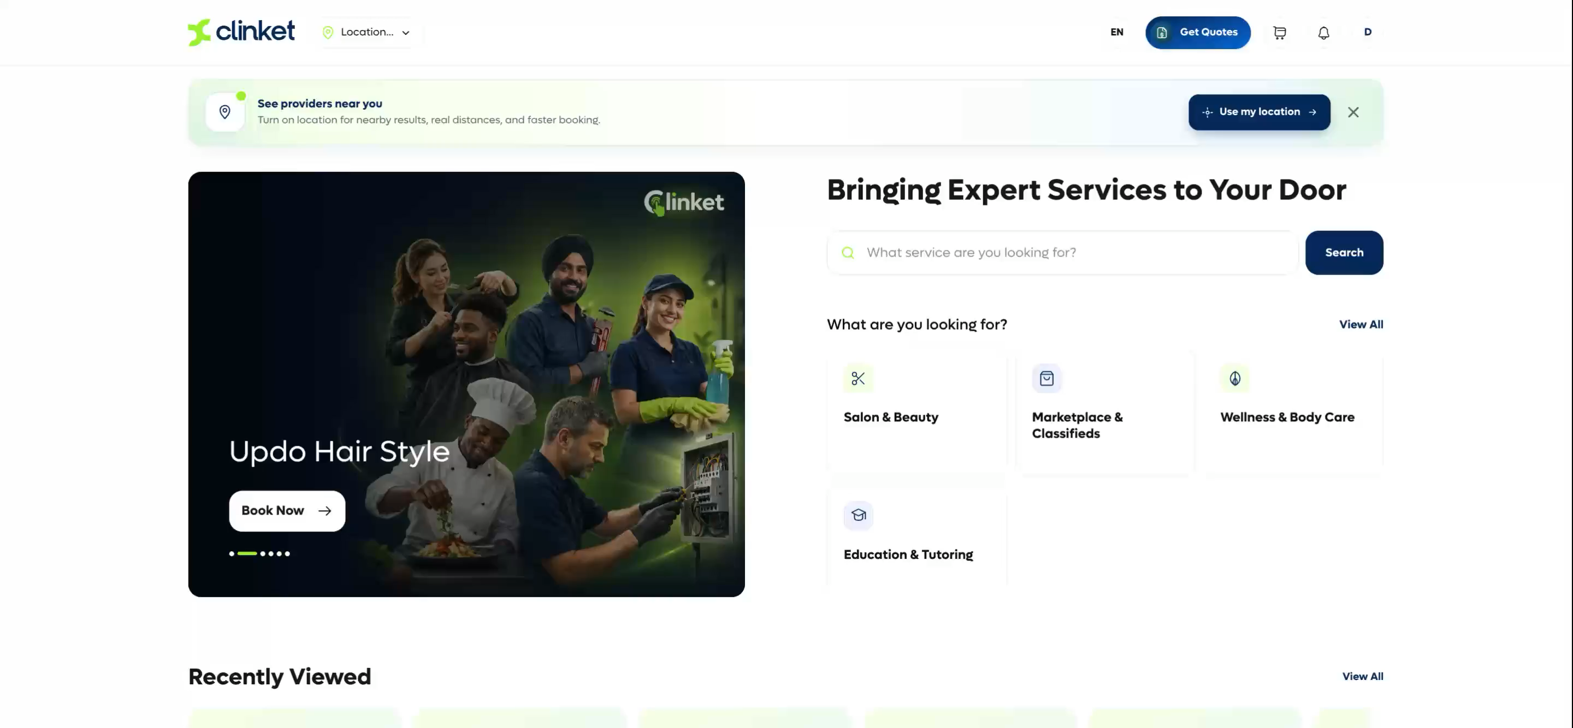
PILLAR 1 · LIVE TODAY
The marketplace — every service, one front door
As simple as a Google search — providers, honest ratings, photos of past work and clear tax-included pricing on the first screen
Talk your way: chat, call, voice notes, attachments — mirrored to WhatsApp if both sides prefer it, and encrypted
The customer decides when to share their phone or email — privacy is a feature
Pay online, with money held until the job is done; free cancellation until then; refunds if it goes wrong
Everything Amazon taught customers to expect — finally for services
Clinket
5
Notes:
Demo flow: search 'keratin' → provider profile → book → pay. Under 60 seconds.

Slide 6
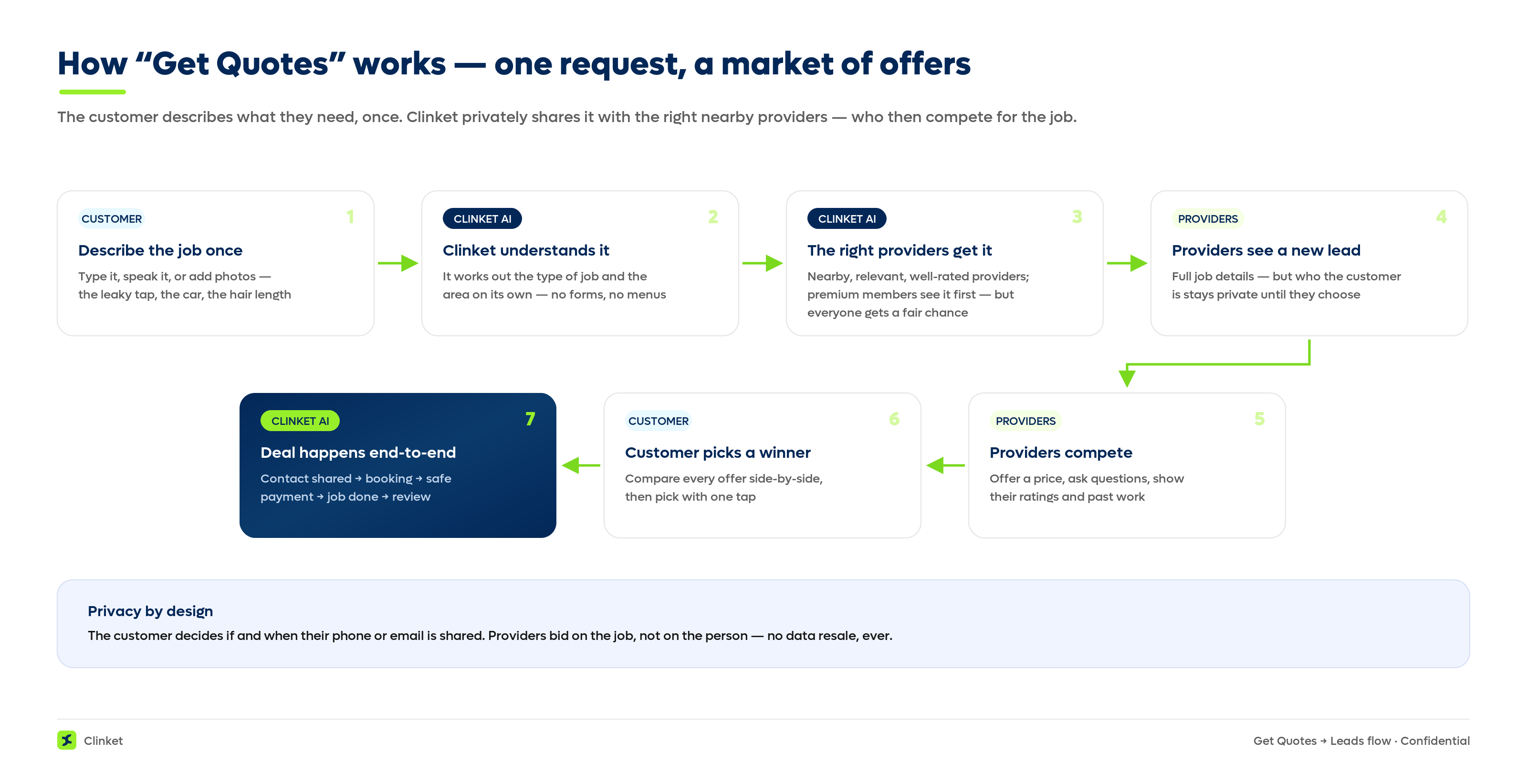
PILLAR 1 · THE LEAD ENGINE, DONE FAIRLY
How “Get Quotes” works
Clinket
6
Notes:
Key line: providers compete on merit — ratings and price — not on who paid most for a stranger's phone number. Premium tiers see leads earlier; nobody is starved.

Slide 7
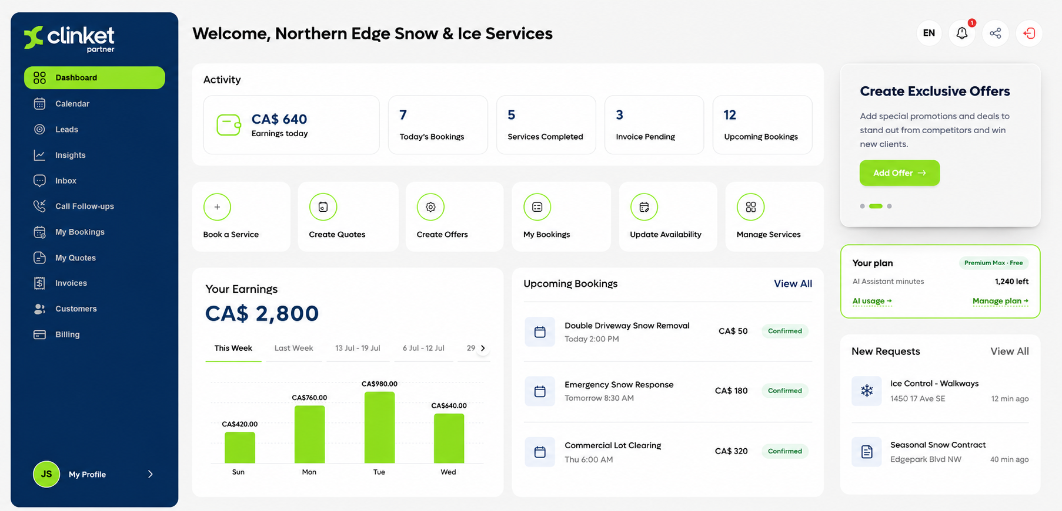
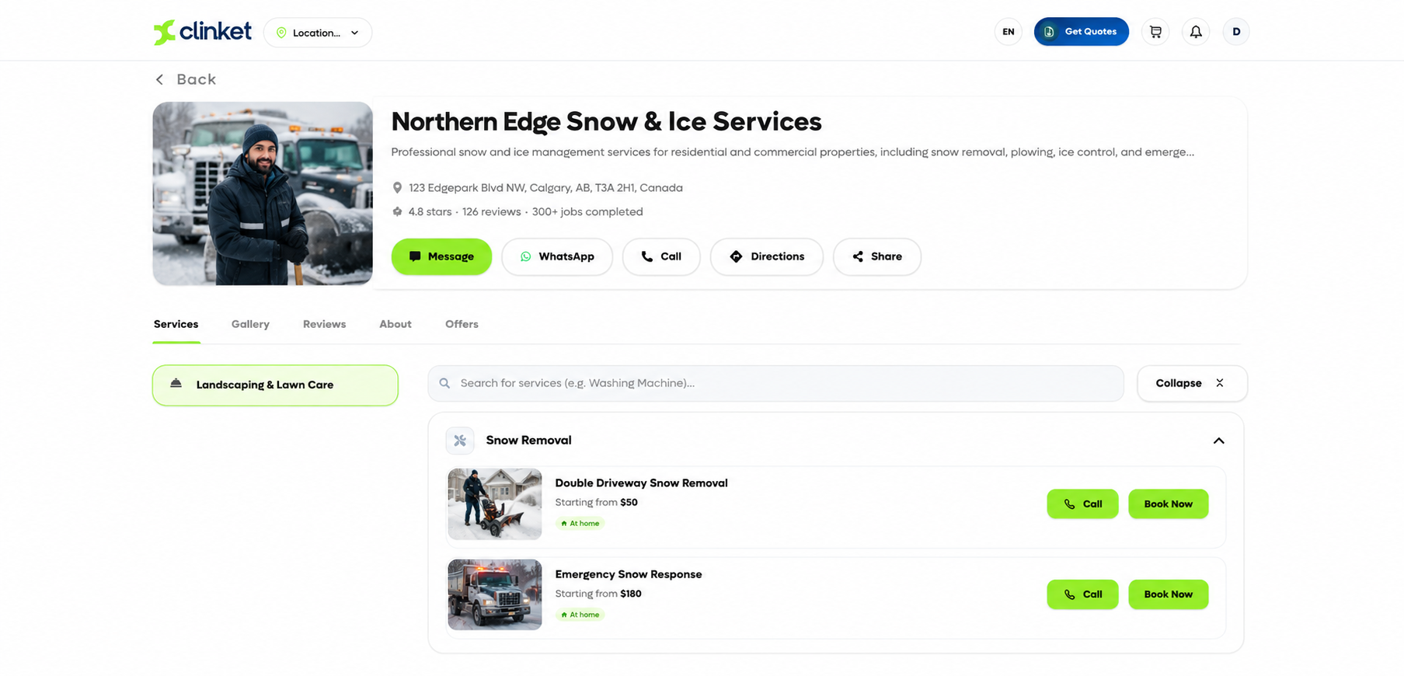
PILLAR 2 · LIVE TODAY
The free toolkit — a $0 back office for every business
Bookings and calendar, quotations, invoices with pay-online links — everything a small business never had
A customer book that builds itself — their customers, on or off Clinket
A ready-made personal website with online booking and a QR code — live on day one
Offers and campaigns to their own customer base
Free of charge. It's the on-ramp: businesses that run their day on Clinket grow into the marketplace, analytics and AI.
Clinket
7
Notes:
28% of US small businesses have no website (Clutch). We hand them one, free, with payments.

Slide 8
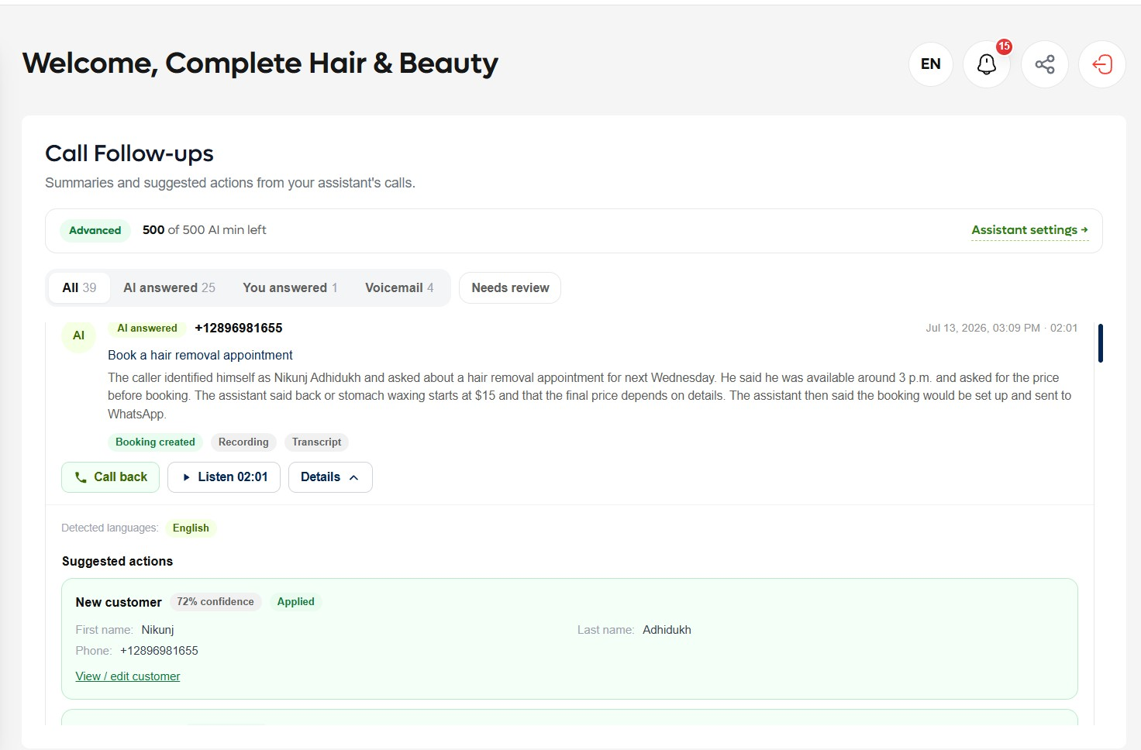
PILLAR 3 · LIVE TODAY, THE GAME CHANGER
The AI receptionist — never miss a call again
A dedicated business line: rings the owner first, AI takes over on missed calls, after hours, or always — the owner chooses
Knows the whole business and follows plain-language instructions — “no pepperoni today”
Actually, does the work: books and reschedules (one-time code protected), takes orders, creates quotes, sends WhatsApp/text/email confirmations
Owner watches the live transcript and can take over mid-call
After every call: a two-line summary and exactly what the AI did — booking created, customer added, quote sent.
https://assets-ca.dev.clinket.com/voice-recordings/DLGDU/6c9e83de-7fde-11f1-a61b-02420aef8ba1.mp3
Fits any business: pizza line · dental desk · one-person mechanic · equipment dealership (live demo built)
Clinket
8
Notes:
Setup is minutes: upload a flyer or menu and the AI builds the business profile itself.

Slide 9
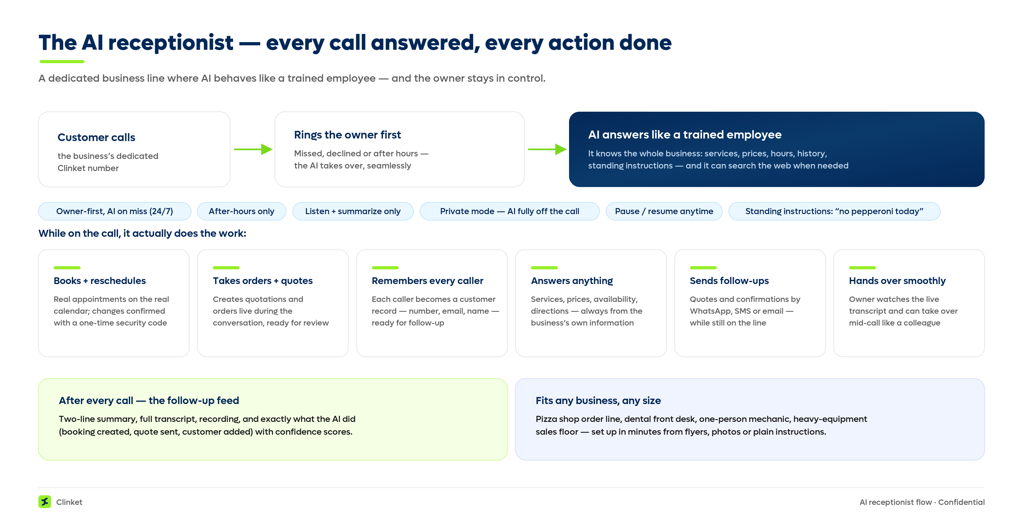
PILLAR 3 · UNDER THE HOOD, IN PLAIN ENGLISH
How the AI receptionist handles a call
Clinket
9
Notes:
Walk the flow left to right: rings owner → AI answers → does real work → owner reviews the follow-up feed.

Slide 10
THE COMPOUNDING ADVANTAGE
The data engine — insight that compounds
Customers feel it as magic
Providers feel it as answers
A homepage that learns what they like within minutes — recommendations like YouTube, but for services. Works with full privacy protection, approved by Apple and Google, built with legal guidance.
Who viewed my profile? What is my area searching for? Is my price high or low for my neighbourhood? Deep insight sold with Premium tiers — insight they could never buy alone.
50+ signals per interaction — what people search, click, book and pay across every category and neighbourhood. This is the asset that powers personalization today and precision B2B advertising tomorrow — and it compounds with every user.
Clinket
10
Notes:
Analytics is both a product feature (Premium tiers) and the moat for the future ad business.

Slide 11
THE MARKET · EVERY NUMBER SOURCED
A market that's huge, shifting online, and unowned
$509B
17–24%
39%/yr
US home improvement & repair spend alone (2025 proj.) — before beauty, cleaning, food, wellness…
yearly growth of online on-demand home-services platforms through 2030–32
AI voice agents: $2.5B (2025) → $35.2B (2033); North America leads
Harvard JCHS
Grand View Research; VMR
Grand View Research
34.8M small businesses in the US + 1.1M employer businesses in Canada (SBA 2024; ISED 2025) — and every household around them. Clinket is live in Canada/US and India, and a new country can be live in hours. Full sources: Appendix + the Partner overview document.
Clinket
11
Notes:
Be explicit that total spend vs platform revenue are different layers — we cite both honestly.

Slide 12
BUSINESS MODEL
How we make money — live in the product today
Free
Basic
Premium
Premium Max
Full toolkit + listing. Acts on 5 leads/mo — sees every lead, so upgrading tempts, never forces.
More leads (25/mo), earlier lead delivery, more WhatsApp.
100 leads/mo with an earlier look, deep analytics + a featured banner on the customer app — a digital billboard shown to nearby customers.
Unlimited leads, first look at every one, full analytics, top banner placement — the best billboard spot in their area.
+ AI receptionist plans
Standard & Advanced levels + AI minutes that work like a phone plan: allowance, top-ups, auto-recharge.
+ Promotions & loyalty engine
Free trials, personalized promo codes and targeted offers, in-app and by email — how users try it, love it, and convert to paid.
Clinket
12
Notes:
Every limit is an upgrade moment; every upgrade is self-serve — the ChatGPT-subscription mechanic. Billing approved by Apple & Google WITHOUT the usual store cut.

Slide 13
BUSINESS MODEL · FUTURE
What the same data unlocks next
Precision B2B advertising
Clinket-branded services
Selective transaction fees
A salon-supply wholesaler reaches exactly the salons in Hamilton — and our analytics knows which pages and placements each provider engages with most, so every ad lands where it's seen. Win-win-win.
The Kirkland / Amazon Basics play: where demand data proves a market, launch or lease out own-brand services and earn the operator margin.
A small fee only on categories we choose — e.g. buy-and-sell or delivery — deliberately never a tax on every service booking.
Any of these can outgrow subscriptions — and at scale could make the core platform free, widening the moat further.
Clinket
13
Notes:
Ad model: we know provider categories and behaviour — wholesale advertisers can't get this targeting anywhere else.

Slide 14
BUSINESS MODEL · WHERE NOBODY CAN FOLLOW
The financial layer — a different league
Pay over time, for customers
Insurance at the point of service
We help providers get financing
A finished basement or new driveway runs $1,000–$5,000+ — and the deal often dies on the price. Furniture stores fixed this long ago: pay-over-time at checkout (often 0%), with a financing partner and its lenders carrying the funding and credit risk (think Wisetack, Financeit, Affirm). We bring it into services — and can share the financing revenue.
Just renovated? Bought equipment? We offer the right coverage at exactly that moment — underwritten entirely by insurance partners. Zero risk on our books; commission on every policy.
We see what no bank sees: verified earnings, month after month. Shared with the provider's consent, lending partners offer credit at far lower risk. We connect and earn a commission — partners lend. Square & Shopify proved it for shops; nobody has for services.
We take none of the lending risk — partners underwrite and fund; we can share the revenue. And it only works with our bookings, payments and history already in place: competitors would have to rebuild Clinket first.
Clinket
14
Notes:
This is the attract-anyone slide: embedded finance built on verified platform data. None of the marketplaces or lead-sellers can copy it without becoming us first.

Slide 15
COMPETITION
Nobody holds more than one corner of the triangle
Angi / HomeAdvisor
Sells leads; pros pay win or lose. Revenue $1.36B → $1.03B in 2 yrs; requests −30%; $7.2M FTC fine over lead quality.
We align with providers instead of taxing them
Thumbtack / TaskRabbit
Growing ($400M, +27%) — proof the shift is real. Still lead-selling; no toolkit, no AI receptionist, no service checkout.
We monetize success, not attempts
Facebook Marketplace
Where providers actually are (1B+ monthly shoppers). No booking, payments, reminders; scam-prone; contact info blocked.
We give that demand a real workflow
Uber Eats / DoorDash
Solved this exact problem — for restaurants only.
We run the proven playbook for the other 95%
Vertical booking software
Single-industry tools with monthly fees; no marketplace bringing demand.
Our toolkit is free — and works for every industry
And the future moat: the financial layer only works on top of our bookings, payments and verified history — a rival would have to rebuild Clinket before they could even start.
Sources: Angi FY2025 10-K (SEC) · FTC Apr 2023 · Fast Company Apr 2025 · Capital One Shopping / TSB 2024
Clinket
15
Notes:
The triangle: marketplace + free tools + AI receptionist. Each rival holds one corner; the combination is the moat — and the financial layer they just saw is uncopyable without our data.

Slide 16
TRACTION & PROOF
Not a deck. A finished, approved product.
4 apps live: customer + provider, web + mobile — approved by Apple and Google
Admin console with full oversight — we know before users do
Complete billing & subscriptions — approved without the usual 15–30% app-store cut
AI receptionist live on real phone numbers in North America and India
Multi-region: Canada/US + India running; a new country live in hours
Try it yourself (dev environment)
Customer app
dev.clinket.com
Provider app
partner.dev.clinket.com
Admin console
admin.clinket.com
Mobile apps
Invite-only
Demo audio
https://assets-ca.dev.clinket.com/voice-recordings/DLGDU/6c9e83de-7fde-11f1-a61b-02420aef8ba1.mp3
Demo credentials shared privately on request.
Clinket
16
Notes:
Everything in this deck exists and runs today. The raise funds distribution, not construction.

Slide 17
TECHNOLOGY (PLAIN ENGLISH)
Built to scale — without the usual bills
0 → millions
New country in hours
Every layer scales itself. No growth cliff, no re-platforming, no 2 a.m. heroics.
One automated run deploys the whole platform to a new region — data kept in-country, local payments, local rules.
Hundreds, not millions
Nothing to steal
Monthly infrastructure cost stays tiny as we grow — margins improve with scale.
No usernames or passwords exist inside the platform — every internal connection uses managed identity. One guarded front door.
Designed and built end to end by the founder — one person, on Azure, with experience from 20M-customer systems to regulated medical data.
Clinket
17
Notes:
For technical reviewers, point to the appendix architecture slide and offer the full docs under NDA.

Slide 18
ROADMAP
Where we're heading
NOW
NEXT
THEN
Win the neighbourhood
Switch on the bigger engines
One place for everything
Everything is live and earning — all three pillars incl. the AI receptionist, with trials and promos converting users to paid. The push: all-in marketing & sales, city → province → country.
Precision B2B advertising on our analytics; Clinket-branded services where data proves demand; the financial layer — job financing, insurance, data-backed provider loans.
Book the plumber — and pay the mortgage, the utility bill, the transit pass. The WeChat (1.43B) / Paytm playbook, with AI at the centre — North America's seat is empty.
Clinket
18
Notes:
NOW: nothing left to build — reach is the constraint. THEN examples: mortgage, credit card, utilities, transit pass — one app, and the AI itself is monetizable at every step. Precedents: Tencent Q1 2026 (1.43B MAU); Paytm Q4 FY26 (77M MTU, 49M merchants); WhatsApp 2B+ daily actives (Meta).

Slide 19
What we're looking for
Expertise, networks — and fuel. This is not a build-the-product raise: the product is built, approved and paid for.
We're looking for partners who know how to make a platform pop — city, province, country.
Capital as the accelerant. Any investment goes purely into marketing and sales — nothing else. The engineering is done and the platform runs itself.
Notes:
Tone: we're not asking for a favour — we're offering a seat. Expertise and introductions often matter more than the cheque. The same push that wins services positions Clinket for the one-place-for-everything future — partners now are partners in that.

Slide 20
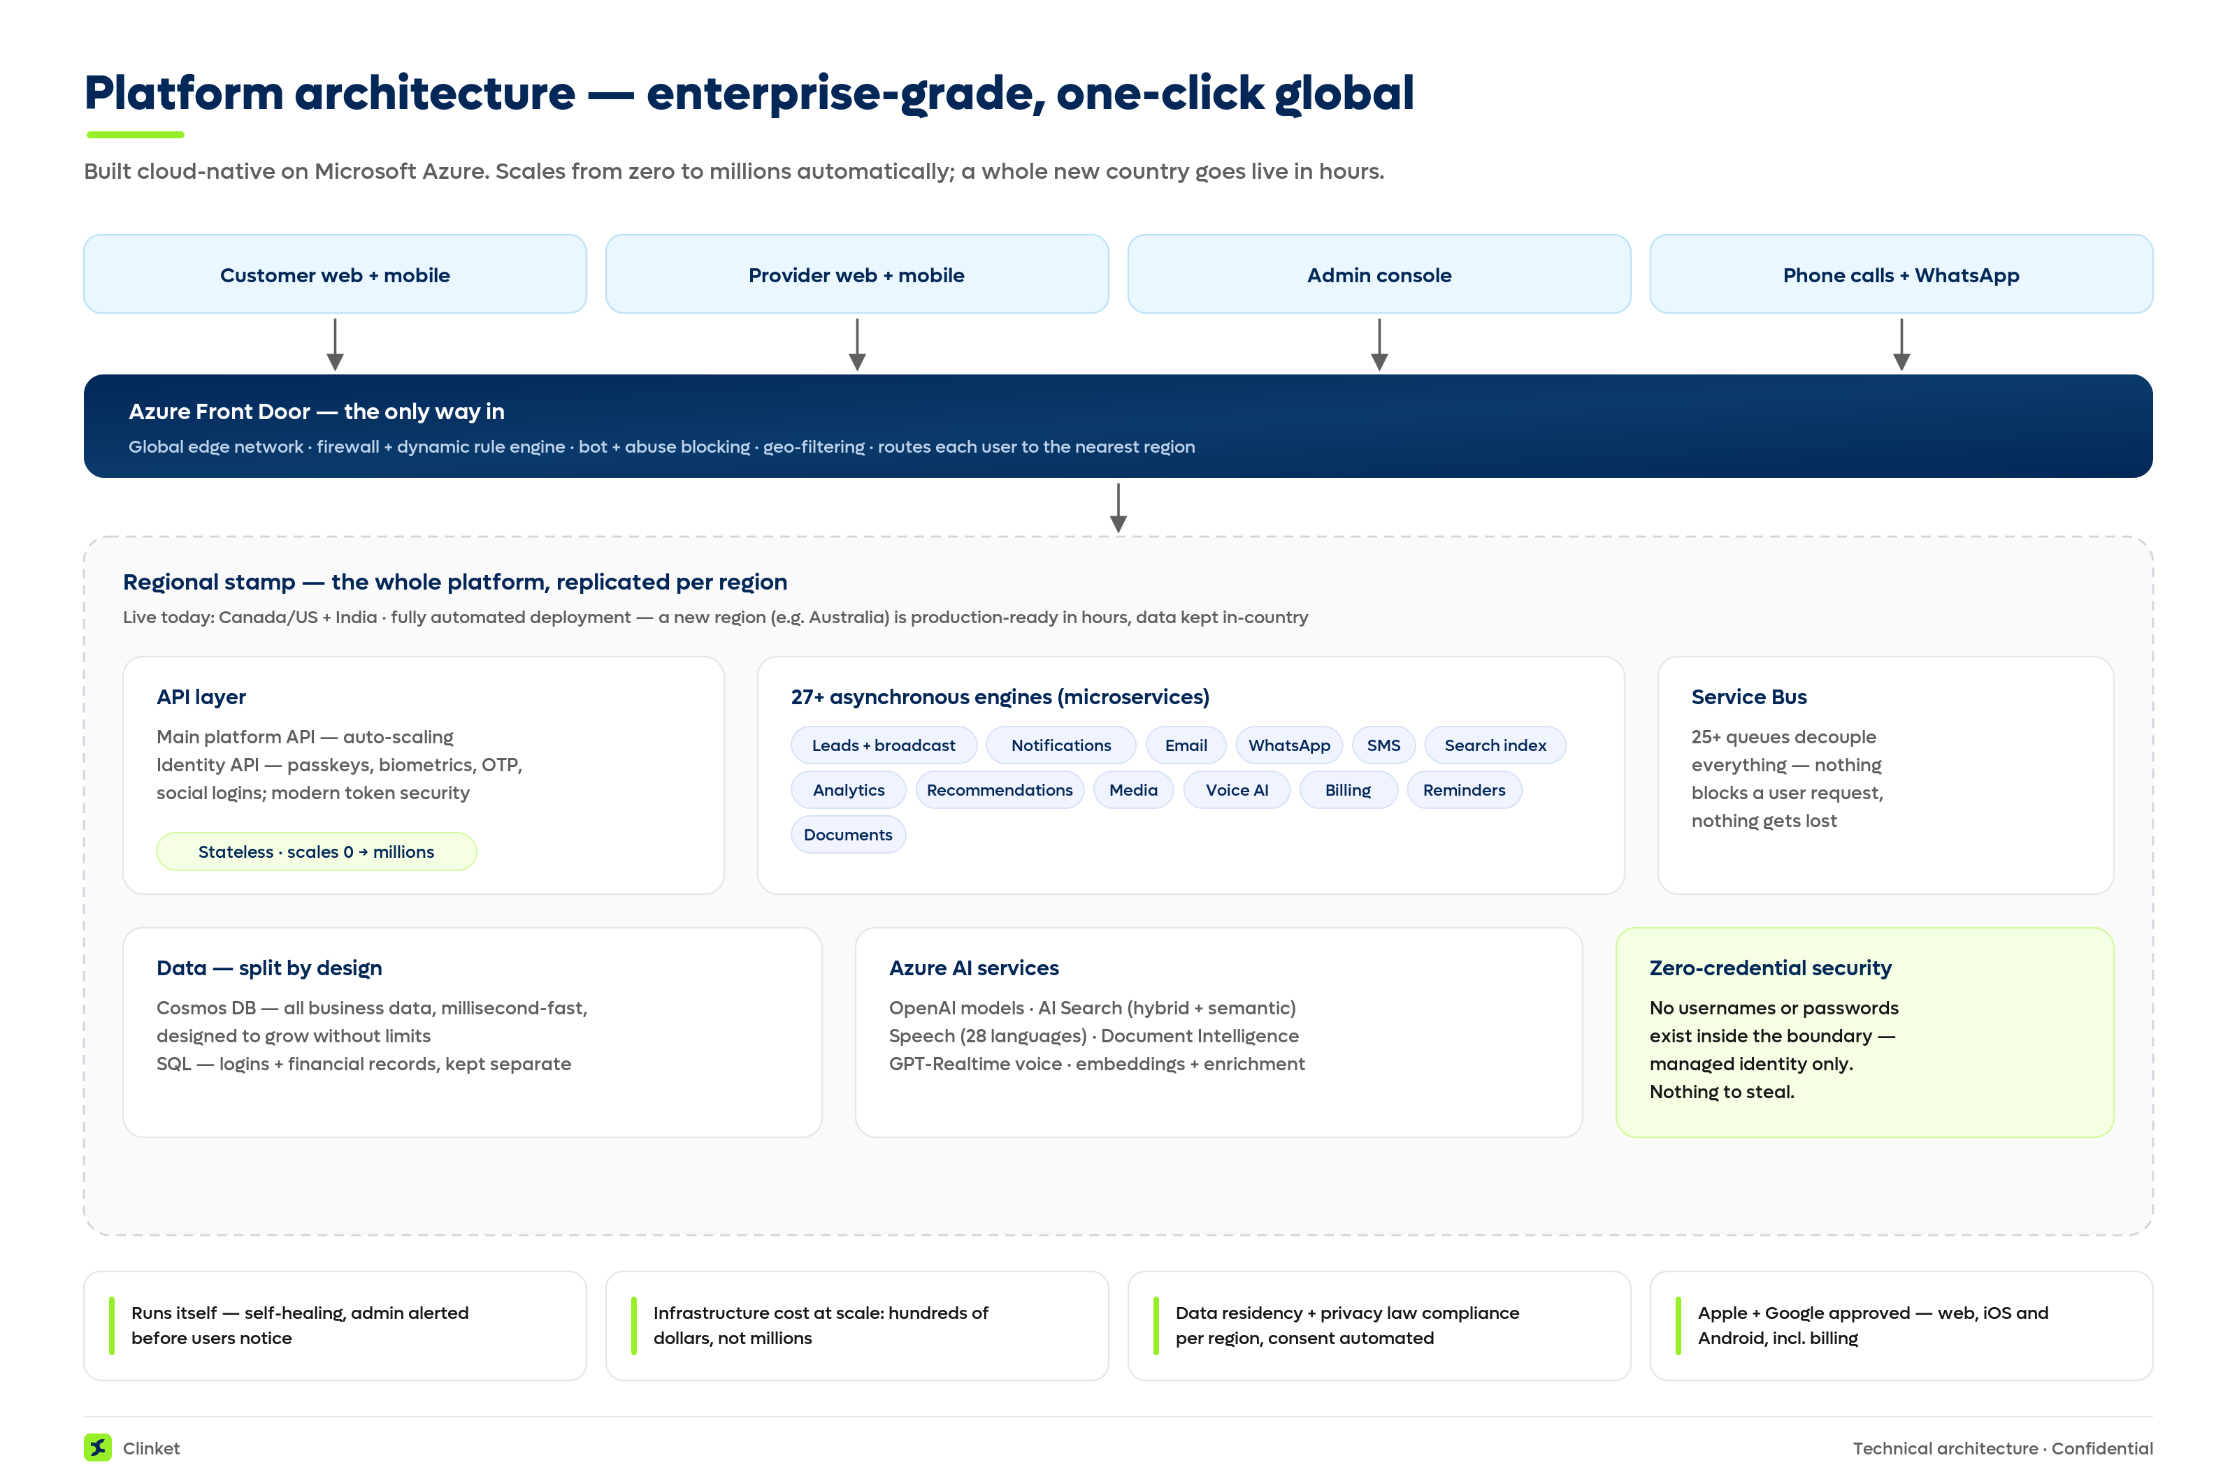
FOR TECHNICAL REVIEWERS
Appendix — platform architecture
Clinket
20
Notes:
Full technical documentation, data model and security review available under NDA.

Slide 21
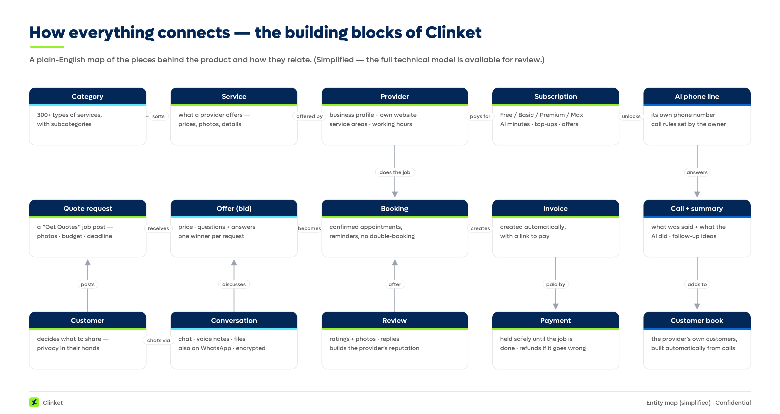
FOR TECHNICAL REVIEWERS
Appendix — how everything connects
Clinket
21
Notes:
Plain-English map of the product's building blocks; the production model is fully partitioned and indexed.

Slide 22
EVERY NUMBER IN THIS DECK IS VERIFIABLE
Appendix — sources
1. Harvard JCHS — US remodeling ~$509B (2025 proj.) · jchs.harvard.edu
2. US BEA via FRED — services ≈69% of consumer spending · fred.stlouisfed.org/series/PCES
3. CHBA — CA$213.7B; 57% of residential-construction jobs from renovation & repair · chba.ca/economic-impacts
4. Grand View Research — online home services 16.7% CAGR; Verified Market Research — 23.7% CAGR · grandviewresearch.com · verifiedmarketresearch.com
5. Angi Inc. FY2025 Form 10-K (SEC) — revenue & request declines; 500+ categories; lead model · sec.gov
6. FTC (Apr 2023) — HomeAdvisor order, up to $7.2M · ftc.gov
7. Fast Company (Apr 2025) — Thumbtack $400M, +27% · fastcompany.com
8. Capital One Shopping — Facebook Marketplace 1B+ monthly shoppers · capitaloneshopping.com/research
9. TSB Bank (2024) — ~34% of Marketplace ads show scam patterns · tsb.co.uk
10. Grand View Research (2026) — AI voice agents $2.5B → $35.2B, 39% CAGR · grandviewresearch.com
11. MarketsandMarkets — conversational AI $17.05B (2025) → $49.8B (2031), 19.6% CAGR · marketsandmarkets.com
12. SBA (2024) — 34.75M US small businesses · advocacy.sba.gov
13. ISED (2025) — 1.1M Canadian employer businesses, 98.2% small · ised-isde.canada.ca
14. US BLS (May 2024) — receptionists median $37,230/yr · bls.gov
15. Kheirkhah et al., BMC Health Services Research — 18.8% no-shows, ~$196 each · bmchealthservres.biomedcentral.com
16. Clutch (2021) — 28% of US small businesses have no website · clutch.co
17. Tencent Q1 2026 — WeChat 1,432M MAU · tencent.com · 18. Paytm Q4 FY26 — 77M MTU, 49M merchants · paytm.com
19. Meta (Jan 2026) — WhatsApp 2B+ daily actives · Meta Q4 2025 earnings call
Clickable links for every source: Appendix A of the Clinket Partner Overview (Word document).
Clinket
22

