Slide 1
Technology and Philosophy
of Artificial Intelligence
Dr. Clint Staley
Dean of STEM, UATX
CSC Professor Emeritus, Cal Poly SLO

Slide 2
“AI” Universe
Artificial Intelligence – stuff we thought only humans could do
  Symbolic AI – Old-school approach to AI, hand crafted
  Machine Learning – Modern approach; machines learn from examples
    Classic ML – random forests, linear/logistic regression
    Deep learning – what used to be “neural networks”, but much deeper with added elements
      Large Language Models (LLMs) – ChatGPT, Claude, Gemini, etc.
      Other Deep Learning – Diffusion models, ViTs, CNNs
      Generative AI – AI to create, not just analyze

Slide 3
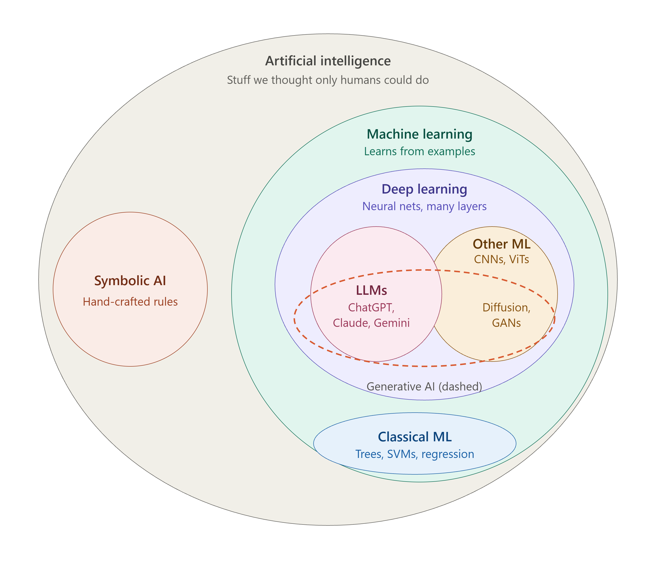

Slide 4
Common Large Language Model (LLM) Uses
Comprehensive web search
Summarizing and analyzing documents
Generating or editing prose
Tutorial discussions
Brainstorming and recommendations

Slide 5
LLM Use Basics
It’s all about the prompt(s)
  More than a question. Can include information, like documents, photos, etc.
  LLM “knows” info only at the time of training. Prompt gives current details.
  Not just one prompt – engage in conversation. Entire conversation is “input” for each chat
  Depth of remembered conversation varies by LLM – 2,000 words to 1 million
LLM’s “hallucinate”, often very confidently
  Check critical facts
  Any serious LLM session includes successfully correcting the LLM

Slide 6
Deeper Capabilities
More than a glorified Wikipedia. Examples:
Write and Revise a Story
  Understands the context of the story
  Summarizes; changes style
Analyzing humorous images
  Multimodal: understands images
  Understands subtle context
Help with AI Diagram
Discussion on Bayesian Analysis and Markov Chain Monte Carlo (MCMC)
Example: Theory of Mind

Slide 7
Other (non LLM) DL
Same principles of training and numerical patterns, but different designs and purposes.
Computer Vision: face recognition, object tracking
“Physical” or “Embedded” AI: robots, automated drones, self-driving cars
Reinforcement Learning (RL)
  Self-instructing. Requires automatically generable feedback.
  Examples: Alpha Go, code-writing agents, physical AI (via simulation)
Graph Neural Networks:
  AlphaFold – analyzes connection patterns, e.g. chemical compounds, protein fold

Slide 8
Example Uses – Other DL
Artistic creativity – funny image
  “Diffusion model”, e.g. DALL-E, Sora
  Photos, short movie clips
  May need feedback and adjustment, and may hallucinate
  Term “hallucination” originates with this type of AI
Generate audio
  Voice or music
  Note that this means voices are not representative e.g. on phone calls

Slide 9
An LLM Is Not
An improved search engine
  Is able to web-search when useful, but…
  … can work unplugged from the internet
Hand-crafted code
  No programming specific to the questions/answers
  Could be written in one page of code – 12 equations
The whole modern AI story
  Important other areas are making major advances too, e.g. reinforcement learning, computer vision

Slide 10
An LLM Is
A sophisticated mathematical engine
  12 equations, but on “matrices” – huge grids of numbers
  From 10 billion to over 1 trillion numbers
  The “intelligence” is in those numbers (aka weights or parameters)
Self-organizing!
  The weights are “trained” by incremental adjustment
        First, to match known texts
        Then to adjust to human feedback given by RLHF
Humans design the training process and the equations, but not the weights

Slide 11

Word/Idea “Embedding”
This is how an LLM represents words, phrases and ideas
Dimensions represent meaning, and also word position
But, with 12,800 numbers per word – many conceptual dimensions

Slide 12
How An LLM “Thinks”
Starts with word embeddings representing words in your prompt and the current conversation.
Combines words via “attention blocks” into higher embeddings representing phrases, then sentences, etc.
Predicts next “thought” as an embedding and chooses closest next word.
Repeat, word by word...

Slide 13
The Weights are the “Intelligence”
All “reasoning” is by word/concept embeddings.
And we (mostly) don’t know what each weight does.
Could learn to converse in a language none of its programmers understand.
Are world-models, theory of mind, etc. spontaneously emerging from the training? Latest research clearly says “yes”.

Slide 14
Is an LLM Intelligent?
“Yes” arguments
  Vast possibilities in 1 trillion weights. Printed out they’d be 4 million large books.
  Research in “mechanistic interpretability” shows conceptual models spontaneously arise from training
  (But, we still know only some of what those weights are doing, and “intelligent” doesn’t necessarily mean “conscious”)
“No” arguments
  Just mindless numbers and 12 equations
  Just predicting the next word.
  (But, it’s improving fast, a human brain is just “mindless” neurons and synapses, and how is it picking that next word so intelligently?)

Slide 15

AI History 1950s - 1960s
(1956) “Artificial Intelligence” first used as a term
(1956) First good “theorem prover” – symbolic AI
(1965) ELIZA basic “chatbot” in 200 lines of code
(1960s) Hopfield, Minsky and others do early work in “neural networks”
(1967) Minsky: “Within a generation … the problem of creating artificial intelligence will substantially be solved.”
(1969) Minsky and Papert publish “Perceptrons”
  Proves one-layer (all they knew how to train) neural networks very limited and triggers first “AI winter”

Slide 16
AI History 1970s-1990s
(1970) Seppo Linnainmaa quietly publishes “backpropagation” algorithm, solving the multilayer training problem. No one notices.
(1970s and 80s): Direct coding of logic in symbolic “expert systems”
  Turns out to be limited and fragile
  Vaunted “5th generation” computing fizzles
(1986) Backpropagation algorithm (re)discovered.
  Neural nets are back.
  But training networks > 3 layers proves very hard. (Modern AI takes hundreds.)
After brief burst of progress, a second “AI Winter”

Slide 17
AI History 2012-2023
Four important advances lay ground for new neural network growth
  More available training data via internet
  Computing power via GPUs
  Better neural network design
    activation functions
    residual connections, normalization layers
    better gradient descent algorithms
  Vibrant and very intensive research community
(2012) Neural networks, now “deep learning networks” are back, again!
(2017) “Attention is all you Need” paper describes Transformers
(2020-2023) Steady LLM improvement arrives at GPT-3.5/GPT-4, and world attention

Slide 18
AI History – Taking Stock
Early investigation of major ideas
  Neural networks since 1960s
Alternating optimism and AI winters
Symbolic logic vs neural networks
  The “bitter” (to some) lesson – can’t program AI directly
Need better theory – too much cut-and-try innovation

Slide 19
Recent AI Events
Nobel Prizes 2024
    Physics to John Hopfield and Geoffrey Hinton
    Chemistry to the developers of AlphaFold
Improved LLM Architectures
    MoE – “Mixture of Experts”
    CoT – “Chain of Thought” – LLMs that reason
Agentic AI
AI coding and math research
Research on “interpretability”

Slide 20
AI Events: late 2020s (?)
Automation of routine white collar work
  Writing, coding, art, music, law, healthcare, customer service, translation, entertainment, etc.
  Claude Code is like a competent, knowledgeable, very fast junior engineer.
  May increase productivity of experienced professionals by 5x
Physical AI
  AI with vision, movement, hearing
  Robotics, drones, self-driving cars, manufacturing, construction, etc.
  Much investment going into this; blue-collar labor is not necessarily safe from AI.
Scientific advances using AI

Slide 21
Near Term Issues to Consider
Legal questions of copyright and liability
“Alignment” of AI with human values
AI replaces professional beginners creating “apprentice gap”
Technological unemployment
  Not like going from farm to factory to simple white-collar work
  UBI might provide subsistence, but doesn’t provide purpose
“Manhattan Project” of the 2020s. Who will lead? US or China?
Possible threats to digital security
  Hugging Face incident, and PHP exploit
  Amodei and others: “We Must Pace the Frontier”

Slide 22
Advice to Students
Learn to create without AI first
  Can’t be in charge if you are dependent
  Gets you closer to content. Do your own code/calculations
Then, create using AI
  Leverage AI to create more than you can alone
  Use AI as “cointelligence” partner from whom you can learn as well
Always question/challenge the AI; don’t take output at face value
  “Any good LLM session includes you correcting the LLM”

Slide 23
AI Future – Limits on Prediction
“.. [no] faith in aerial navigation other than ballooning”
  Lord Kelvin, 1896
Alchemistic Empiricism
  Analogy of Chemistry in 1825
  Results in fits and starts as we try things out by guess-and-by-golly
Better theory is desperately needed
Start with Nature, End with Design
  Planes vs birds
  Deep Learning vs brains : Geoff Hinton’s warning

Slide 24
AI in 2030s (?)
S-curves
    Aerospace example, and two prior “winters” in neural networks
Option A: current S-curve plateaus in 1-2 years
    Some experts expect this (Ilya Sutskever)
Option B: plateau later, reaching AGI
    Unprecedented investment and research community; improvements continue
Option C: advances to self-improving loop – “singularity”
Which one – depends on who you listen to. No Theory
    Two years ago A:70% B:20%; C:10%
    Now A:30% B:50%; C:20% (and I just changed this, downward, two days ago!)
Even with a “third plateau”, underlying math has huge potential for fourth S-curve

Slide 25
Long Term Questions
What can AI teach us about the nature of thought and intelligence?
What if it becomes more intelligent than us?
Hard Problem of Consciousness
AI as “moral patient”?
Use of AI to extend human intelligence

