Slide 1
AI For Everyone
Dr. Clint Staley (C’80)
CSCI Professor, Principia College
CSC Professor Emeritus, Cal Poly SLO

Slide 2
“Large Language Model” (LLM) Demo
Write and Revise a Story (Claude Sonnet)
  Understands the context of the story
  Summarizes; changes style
Multimodal: ChatGPT cat photo
Many LLMs available, steadily improving
  ChatGPT (OpenAI), Claude (Anthropic), R1 (DeepSeek)

Slide 3
Using an LLM
Typical uses
  Comprehensive web search
  Summarizing and analyzing documents (Emancipation Proclamation example)
  Generating or editing prose (passive voice change)
  Tutorial discussions
  Brainstorming and recommendations (AZ cities visit)
  Language translation
Learning to Prompt
  More than a question. Note how ChatGPT rephrases
  Prompt and entire conversation are “input” for further conversation

Slide 4
An LLM Is Not
An improved search engine
  Is able to web-search when useful, but…
  … can work unplugged from the internet
Hand-crafted code
  No programming specific to the questions/answers
  Could be written in one page of code – 12 equations
The whole modern AI story
  Important other areas are making major advances too, e.g. “reinforcement learning”, computer vision

Slide 5
An LLM Is
A sophisticated mathematical engine
  12 equations, but on “matrices” – huge grids of numbers
  From 10 billion to over 1 trillion numbers
  The “intelligence” is in those numbers (aka weights or parameters)
Self-organizing!
  The weights are “trained” by incremental adjustment to match known texts and human feedback.
  Humans design the training process and the equations, but not the weights

Slide 6

Word/Idea “Embedding”
This is how an LLM represents words, phrases and ideas
Each word has a number sequence – an “embedding”
But, with 12,800 numbers per word – many conceptual dimensions

Slide 7
How An LLM “Thinks”
Starts with word embeddings representing words in your prompt and the current conversation.
Combines words into higher 12,800-number patterns representing phrases, then sentences, etc.
Predicts next “thought” as a number pattern and chooses closest next word.
Repeat, word by word...

Slide 8
The Weights are the “Intelligence”
All “reasoning” is by word/concept embeddings.
And we (mostly) don’t know what each weight does.
Could learn to converse in a language none of its programmers understand.
Are world-models, theory of mind, etc. spontaneously emerging from the training?

Slide 9
Is an LLM Intelligent?
“Yes” arguments
  Vast possibilities in 1 trillion weights. Printed out they’d be 4 million large books.
  Behavior suggests world-models, theory of mind, etc.
  (But, we really don’t know since we’re not sure how the weights work in detail)
“No” arguments
  Just mindless numbers and 12 equations
  Just predicting the next word.
  (But, it’s improving fast, a human brain is just “mindless” neurons and synapses, and how is it picking that next word so intelligently?)

Slide 10
“Other” AI
Diffusion Models
  DALL-E example (Mammoths on the chapel green, Sora video)
Reinforcement Learning
  Self-instructing, based on automatically generable feedback
  Alpha Go example
Computer Vision
  CNNs and Vision Transformers
  Recognize and interpret images and visual data (Cat humor)

Slide 11

AI History 1950s - 1960s
(1956) “Artificial Intelligence” first used as a term
(1956) First good “theorem prover” – symbolic AI
(1965) ELIZA basic “chatbot” in 200 lines of code
(1960s) Hopfield, Minsky and others do early work in “neural networks”.
(1967) Minsky: “Within a generation … the problem of creating artificial intelligence will substantially be solved.”
(1969) Minsky and Papert publish “Perceptrons”
  Proves early neural networks very limited and triggers first “AI winter”

Slide 12
AI History 1970s-1990s
(1970) Seppo Linnainmaa quietly publishes “backpropagation” algorithm, solving the multilayer training problem Minsky cites in 1969. No one notices.
(1970s and 80s): Direct coding of logic in “expert systems”
  Turns out to be limited and fragile
  Vaunted “5th generation” computing fizzles
(1986) Backpropagation algorithm (re)discovered.
  Neural nets are back.
  But training networks > 3 layers proves very hard. (Modern AI takes dozens or more.)
After brief burst of progress, a second “AI Winter”

Slide 13
AI History 2012-2024
Four important advances lay ground for new neural network growth
  more available training data via internet
  computing power via GPUs
  better neural twork design: “activation functions” and architectures (neural net => deep learning)
  vibrant and very intensive research community
(2012) Neural networks, now “deep learning networks” are back, again!
(2017) “Attention is all you Need” paper describes Transformers
(2020-2023) Steady LLM improvement arrives at GPT-4

Slide 14
AI History – Taking Stock
Early investigation of major ideas
  Neural networks since 1960s
Alternating optimism and AI winters
Symbolic logic vs neural networks
  The “bitter lesson” – don’t program AI directly

Slide 15
AI Events 2025
Nobel Prizes
  Physics to John Hopfield and Geoffrey Hinton
  Chemistry to the developers of Alpha Fold
Improved LLM Architectures
  MoE – “Mixture of Experts”
  CoT – “Chain of Thought”
DeepSeek
  Chinese innovators
  Demonstrates much more efficient use of computation

Slide 16
AI Future – Where is it heading?
“… heavier than air flying machines are impossible”
  Lord Kelvin, 1895
Alchemistic Empiricism
  Analogy of Chemistry in 1825
  Results in fits and starts as we try things out by guess-and-by-golly
Start with Nature, End with Design
  Planes vs birds
  Deep Learning vs brains : Geoff Hinton’s warning

Slide 17
AI Events: late 2020s (?)
Ongoing automation of white collar work
  Writing, coding, art, music, law, healthcare, customer service, language translation, entertainment, etc.
  My own experience: It's like a competent, widely read, and blindingly fast junior engineer.
  May double or triple productivity of experienced professionals.
Physical AI
  AI with vision, movement, hearing
  Robotics, self-driving cars, manufacturing, construction, etc.
Scientific advances using AI, especially RL

Slide 18
AI Events: 2030s (??)
Option A: AI progress will “plateau”
  We are reaching limits on compute and on data
  It’s plateaued before
Option B: Continued progress reaching “AGI” or “superintelligence”
  Unprecedented research community and infrastructure
  Continued improvement in design and training procedures
  Hardware is rapidly improving
5 years ago, many experts thought “A”. Now many think “B”.

Slide 19
Near Term Issues to Consider
Legal questions of copyright and liability
“Alignment” of AI with human values
“Apprentice gap”: How will entry level professionals learn their trade?
Technological unemployment
  Not like going from farm to factory to simple white-collar work
  UBI might provide subsistence, but doesn’t provide purpose
Which nation will lead? – Manhattan project of the 2020s

Slide 20
Advice to Students
Learn to create without AI first
  Can’t be “in charge” if you are dependent
  Gets you closer to content, like doing your own calculations
Then, create using AI
  Leverage AI to create more than you can alone
  Use AI as “cointelligence” partner from whom you can learn as well
  This is the workflow of the future

Slide 21
Long Term Questions
What can AI teach us about the nature of thought and intelligence?
What if it becomes more intelligent than us?
Hard Problem of Consciousness
“Who is my neighbor?”

Slide 22
Future Predictions – Dystopian SF
Premise: Technology is a power unto itself
(1984) Blade Runner
  LA is stygian hellscape in 2020s
(1984) Terminator
  LA is nuclear-blasted wreck with robots killing humans in 2020s
(1970) Colossus
  AI computer becomes world dictator in late 1970s

Slide 23
Future Predictions – CS Perspective
Premise: Technology is Mind’s creativity unfolding.
“The mariner will have dominion over the atmosphere and the great deep .. the astronomer will no longer look up to the stars, – he will look out from them..” Science and Health p125: 25-29

Slide 24
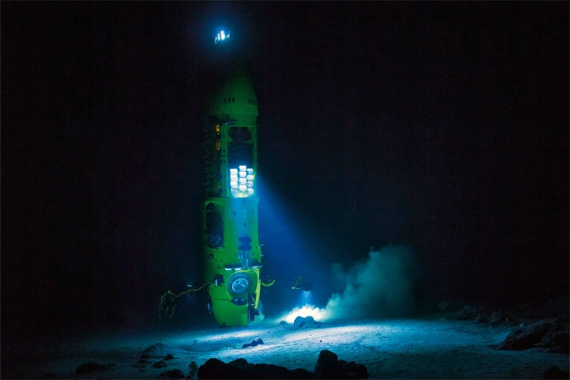
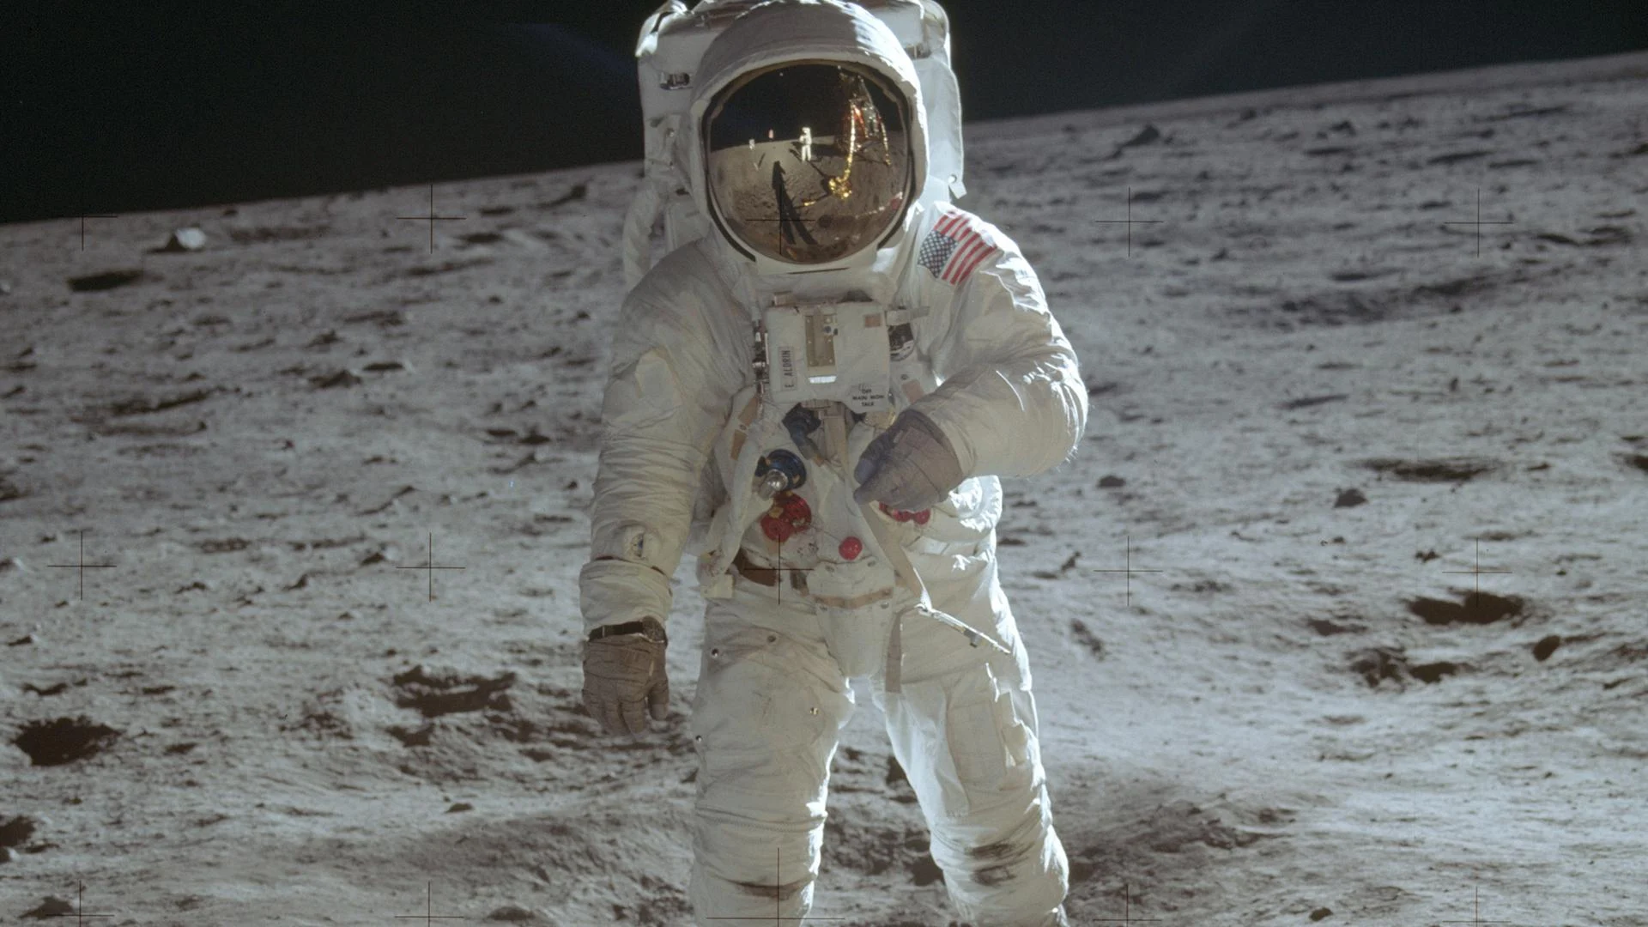
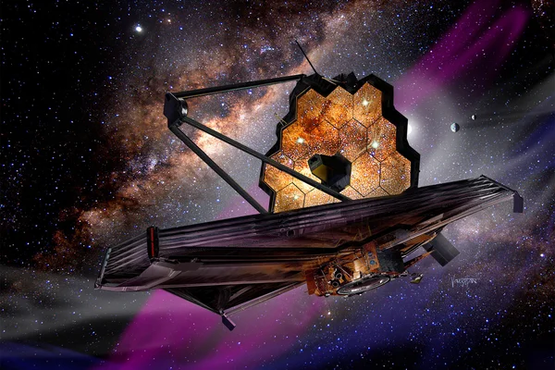

Slide 25
Christian Science Perspective
“There is no life, truth, intelligence, nor substance in matter. All is infinite Mind and its infinite manifestation…” S&H p 468
“Intelligence is omniscience, omnipresence, and omnipotence. It is the primal and eternal quality of infinite Mind...” S&H p 469

