Slide 1
AI Technical Concepts

Slide 2
How an LLM (e.g.GPT) Works
“Thinks” in patterns of 12,800 numbers each.
Combines words into phrases, phrases into sentences, sentences into concepts.
Predicts next “thought” and chooses best next word.
12 “matrix” equations, one page of code, describes the essential mechanism

Slide 3

Word/Idea “Embedding”

Slide 4
“Patterns”
AI identifies concepts by number sequences
  Word embedding
  Photo by pixel “grayscale” values
  Sound by frequencies at each time point
  Color by red/green/blue values

Slide 5
High-Dimensional Spaces
Patterns are points in high-dimensional space
  Two-number pattern is a position in 2-D space, e.g. latitude/longitude, or x/y
  Three-number pattern is a point in 3-D space, e.g. latitude/longitude/altitude
“Hypercube” sequence
  Line, square, cube, …
  Number of corners as dimension d rises?
High-dimensional space is big
  Largest distance corner-to-corner
  Proportion of inscribed “hypersphere”

Slide 6
Concept/Word Space
Consider 3-d cube of “meaning”
  e.g. small/big, cold/hot, light/heavy
  (0, 1, 1) => small hot heavy thing
  (.5, 0, 0) => midsized cold light thing
Words, phrases, even “ideas” are 3-D points
Number of corners (words) for dimension:
  20?
  265?
GPT uses 12,800 dimensions. Lots of “meaning” possible.

Slide 7
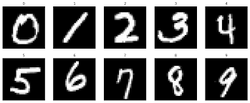
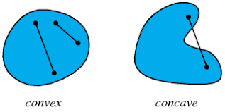
Pattern Space Regions
2-number pattern of size/weight.
  Categories are ping-pong balls, bowling balls, balloons
Grayscale images
  Each pixel a dimension
  20x20 → 400 dimensions
  Each digit is a region in 400-D
Convex vs nonconvex regions
  Is region of all 6-s convex?

Slide 8
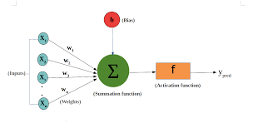
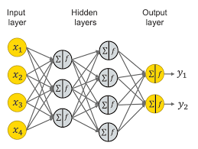
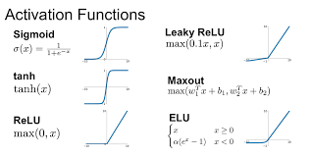
Neural Networks and Spaces
Neuron
  Numerical inputs from other neurons
  Weights on the inputs
  “Activation” or triggering function
Neural network
  Input pattern => Layers of neurons => Output pattern
What does it do?
  Weighted sums are affine transforms in pattern space
    Scale, rotate, translate, skew
  Activation functions “uncrumple” the folded regions
  Activation functions are essential to the “intelligence”

Slide 9


Slide 10
How GPT Learns
A neural network has many number-weights (“parameters”)
175 billion parameters for GPT-3. 1.7 trillion for GPT-4.
How do we get numbers that work? By adjusting parameters to imitate examples… Lots of examples.. 100 million sentences.
Further refinement and “socialization” by RLHF

Slide 11
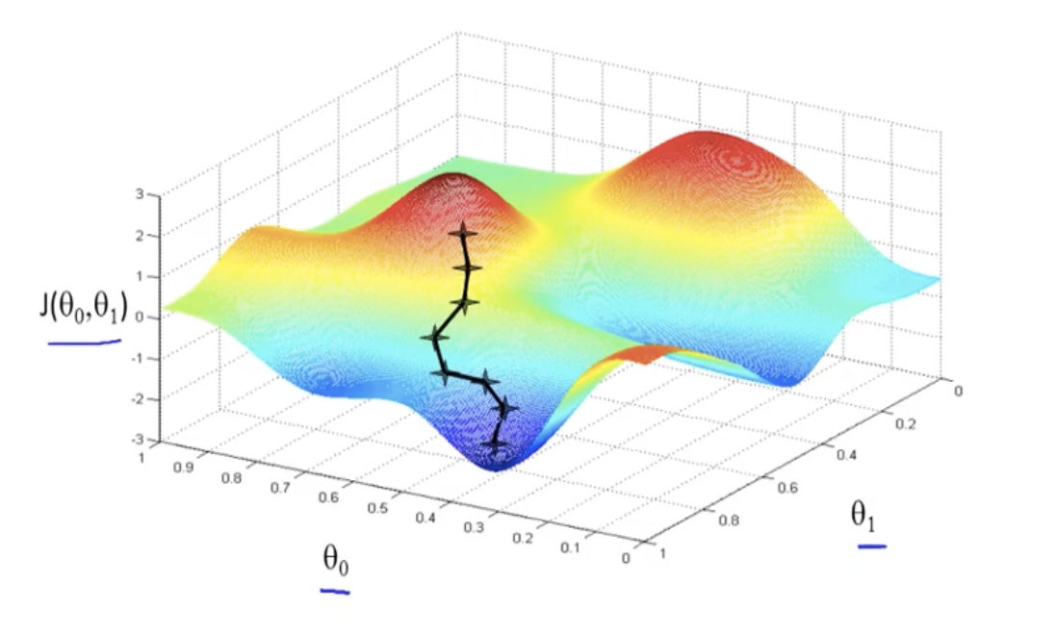
“Gradient Descent” Training
Example of 2 weights
Red mountains have high error; blue valleys have low error.
Start with random weights, then tweak weights to move toward low error. Rinse and repeat…
“Learning” is just rolling a ball down a hill, in high dimensions. No plan, no higher reasoning...
The network is thus self-taught, automatically adjusted
But, with 1+ trillion dimensions, and 100 million sentences.

Slide 12
The Weights are the “Intelligence”
Doesn’t need to do web hunts. Could run on a disconnected computer.
Trained weights are “long term memory”. Current conversation is “short term memory”. All internal logic is by word/concept embeddings.
And we don’t know what each weight does. It’s self-organized to follow examples.
Could learn to converse in a language none of its programmers understand.
Are world-models, theory of mind, etc. spontaneously emerging from the training?

Slide 13
An LLM
Is Not just an improved search engine
Is Not hand-crafted code
Is Not the whole modern AI story
Is a sophisticated mathematical engine
Is self-organizing
Is a partial mystery even to its creators

Slide 14
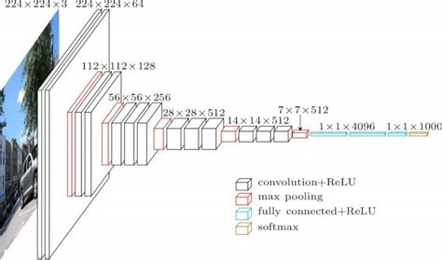
Other AI – CNNs
Convolutional Neural Networks

Slide 15
CNN Concepts
Deep Learning, but designed for images
Modeled after human visual system
Trained on huge image collections
Faces, objects, self-driving cars, etc.
Related work in neural radiance fields (“NeRF”s) reconstructs 3-D scenes.

Slide 16
Other AI – Reinforcement Learning
Automatic generation of training data
Example of playing games against yourself to learn.
Problem config => best move
But, when you win, how do you know which moves helped?
And, as you play, do you try new approaches or refine existing ones?

Slide 17
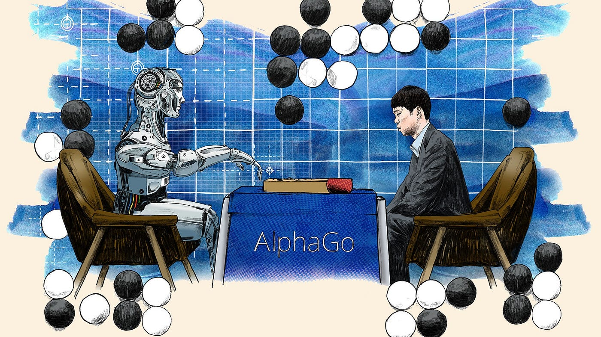
RL and Games
Game of Go is notoriously hard. Many moves, much lookahead needed.
Alpha-Go beats best human players using RL. And finds new strategies.

Slide 18
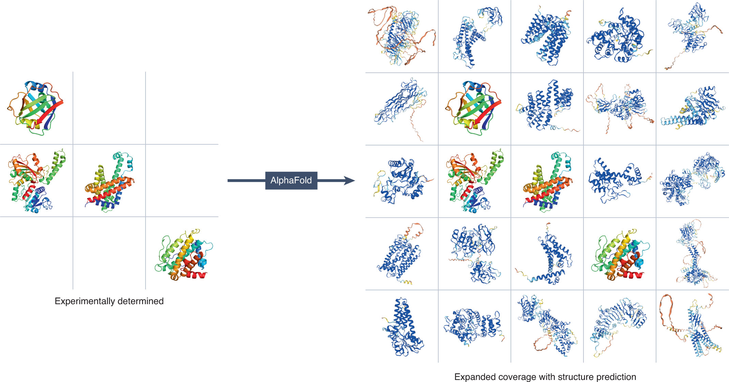
RL and Protein Folding
GATACAGA…. => shape of protein
Very hard, and critical to biomed research. One protein might take years of research
Alpha-fold learns to fold via RL, and folds 100,000 proteins.

Slide 19
Diffusion Models
DALL-E examples
Form of deep learning trained on labelled images
Translates text to image
Can also fill in missing parts of images

Slide 20
AI Technical Concepts
Word Embedding
Pattern Space
Gradient Descent
Attention
Transformer
RLHF: Reinforcement Learning by Human Feedback
Convolutional Neural Network (CNN)
Reinforcement Learning

Slide 21
How Far Will It Advance?
"Heavier-than-air flying machines are impossible" Lord Kelvin 1895
It will “plateau”
  Reaching limits on compute and on data
  It’s plateaued before
It will reach human intelligence or more
  Unprecedented research community and infrastructure
  Hardware is rapidly improving
  Could do self-instruction via reinforcement learning

Slide 22
So, which is it?
5 years ago, most researchers would guess “plateau”. Now most would guess major improvements
Hinton’s insight on deep learning vs. brains
  Example of early steam power, electricity, chemistry
  Birds vs planes
  GPT-4 is a mouse brain
Desperate need for mathematical theory
  Slow but worthwhile progress on this
  Some of the most important math of the 21st century

