Slide 1
AI Technical Concepts
Word Embedding
Pattern Space
Gradient Descent
Attention
Transformer
RLHF: Reinforcement Learning by Human Feedback
Convolutional Neural Network (CNN)
Reinforcement Learning

Slide 2
How an LLM (e.g.GPT) Works
“Thinks” in patterns of 12,000 numbers each.
Combines words into phrases, phrases into sentences, sentences into concepts.
Predicts next “thought” and chooses best next word.
12 “matrix” equations, one page of code, describes the essential mechanism

Slide 3
How GPT Learns
Those 12 equations have many number-weights (“parameters”)
Parameters for the 12,000-number “idea” for each word.
Parameters for combination into higher abstractions
175 billion parameters for GPT-3. 1.7 trillion for GPT-4.
How do we come up with them? By adjusting parameters to imitate examples… Lots of examples.. 100 million sentences.
Further refinement and “socialization” by RLHF

Slide 4

Word/Idea “Embedding”

Slide 5
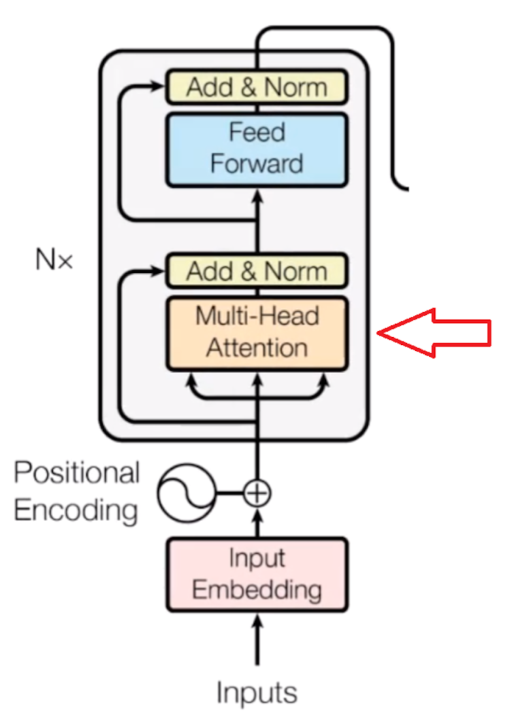

Slide 6
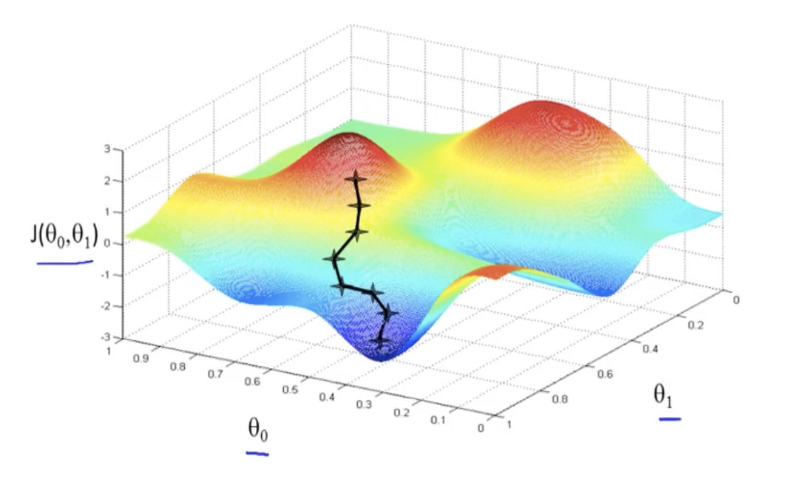
“Gradient Descent” Training
Example of 2 weights
Red mountains have high error; blue valleys have low error.
Start with random weights, then tweak weights to move toward low error. Rinse and repeat…
“Learning” is just rolling a ball down a hill, in high dimensions. No plan, no higher reasoning...
The network is thus self-taught, automatically adjusted
But, with 1+ trillion dimensions, and 100 million sentences.

Slide 7
The Weights are the “Intelligence”
Doesn’t need to do web hunts. Could run on a disconnected computer.
Trained weights are “long term memory”. Current conversation is “short term memory”. All internal logic is by word/concept embeddings.
And we don’t know what each weight does. It’s self-organized to follow examples.
Could learn to converse in a language none of its programmers understand.
Are world-models, theory of mind, etc. spontaneously emerging from the training?

Slide 8
An LLM
Is Not just an improved search engine
Is Not hand-crafted code
Is Not the whole modern AI story
Is a sophisticated mathematical engine
Is self-organizing
Is a partial mystery even to its creators

Slide 9
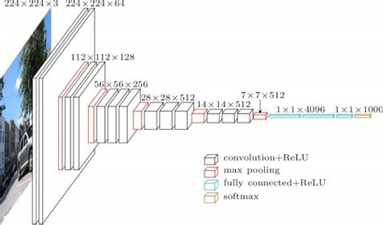
Other AI – CNNs
Convolutional Neural Networks

Slide 10
CNN Concepts
Deep Learning, but designed for images
Modeled after human visual system
Trained on huge image collections
Faces, objects, self-driving cars, etc.
Related work in neural radiance fields (“NeRF”s) reconstructs 3-D scenes.

Slide 11
Other AI – Reinforcement Learning
Automatic generation of training data
Example of playing games against yourself to learn.
Problem config => best move
But, when you win, how do you know which moves helped?
And, as you play, do you try new approaches or refine existing ones?

Slide 12
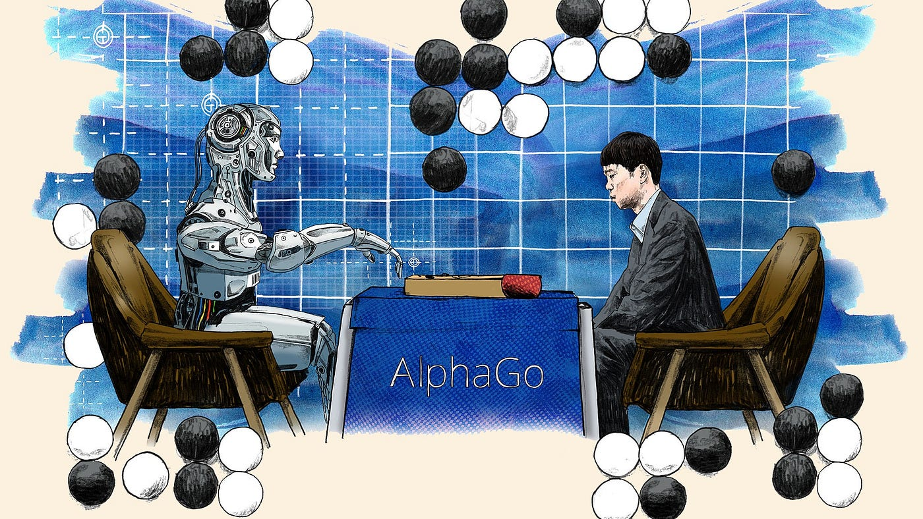
RL and Games
Game of Go is notoriously hard. Many moves, much lookahead needed.
Alpha-Go beats best human players using RL. And finds new strategies.

Slide 13
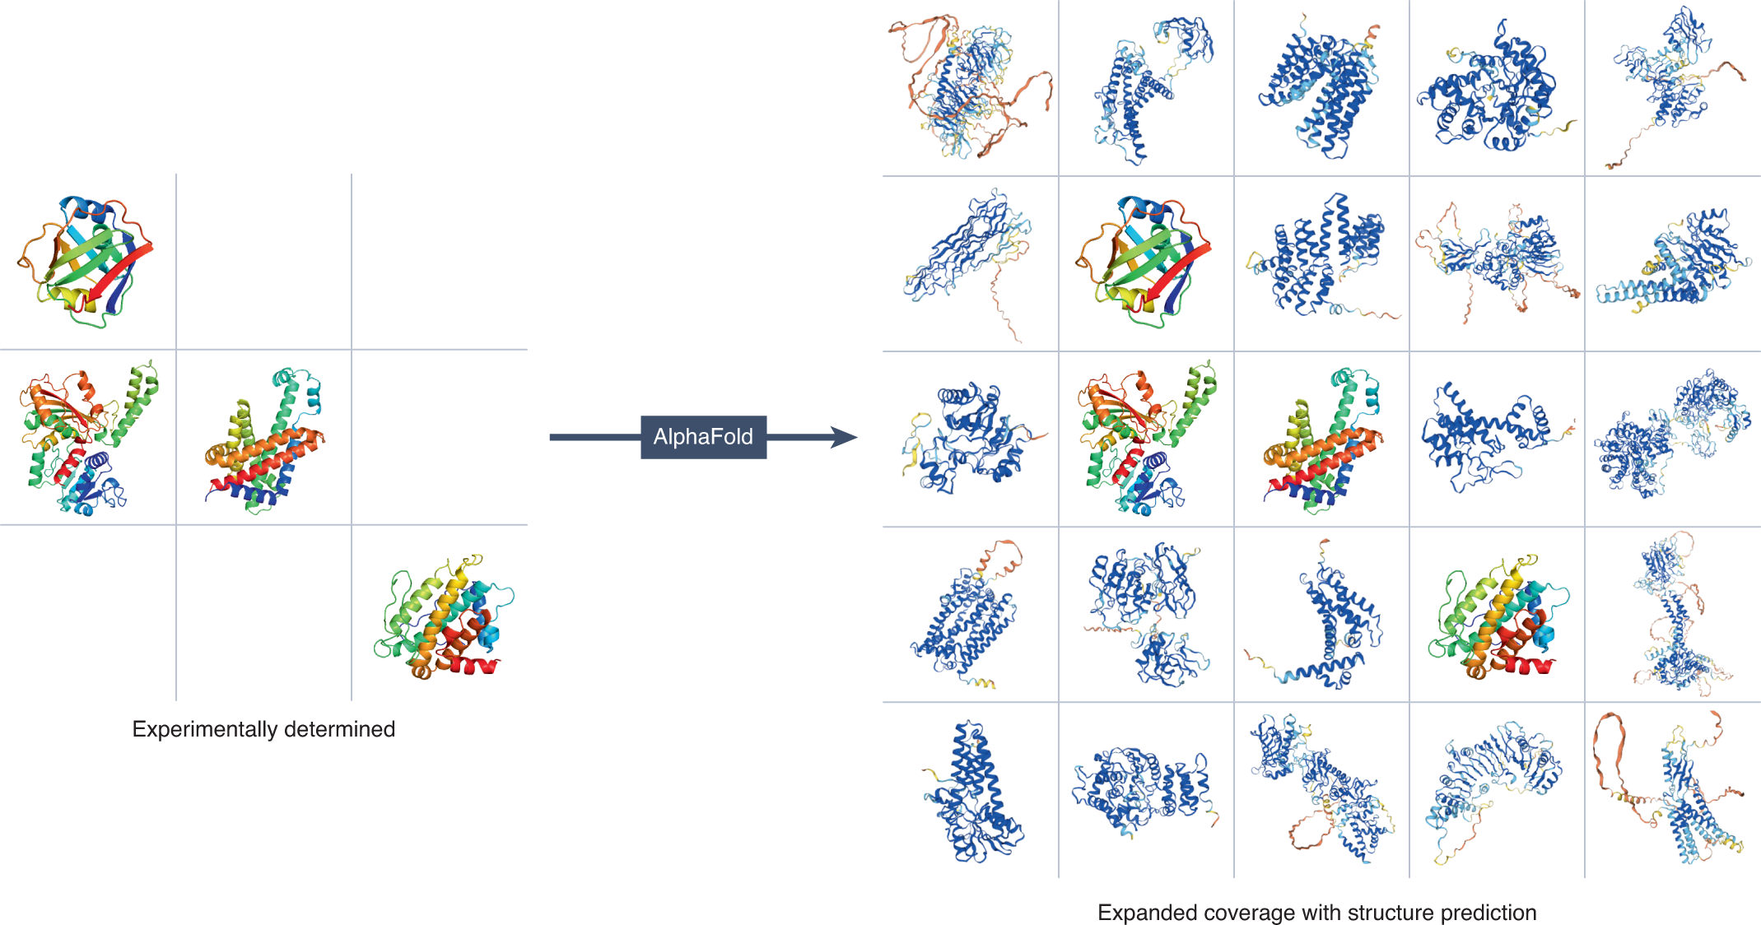
RL and Protein Folding
GATACAGA…. => shape of protein
Very hard, and critical to biomed research. One protein might take years of research
Alpha-fold learns to fold via RL, and folds 100,000 proteins.

Slide 14
Diffusion Models
DALL-E examples
Form of deep learning trained on labelled images
Translates text to image
Can also fill in missing parts of images

Slide 15
How Far Will It Advance?
"Heavier-than-air flying machines are impossible" Lord Kelvin 1895
It will “plateau”
  Reaching limits on compute and on data
  It’s plateaued before
It will reach human intelligence or more
  Unprecedented research community and infrastructure
  Hardware is rapidly improving
  Could do self-instruction via reinforcement learning

Slide 16
So, which is it?
5 years ago, most researchers would guess “plateau”. Now most would guess major improvements
Desperate need for theory. Like chemistry in 1824
Hinton’s insight on deep learning vs. brains
  Example of early steam power, electricity, chemistry
  Birds vs planes
  GPT-4 is a mouse brain

