Slide 1
How an LLM (e.g.GPT) Works
“Thinks” in patterns of 12,000 numbers each.
Combines words into phrases, phrases into sentences, sentences into concepts.
Predicts next “thought” and chooses best next word.
12 “matrix” equations, one page of code, describes the essential mechanism

Slide 2
How GPT Learns
Those 12 equations have many number-weights (“parameters”)
Parameters for the 12,000-number “idea” for each word.
Parameters for combination into higher abstractions
175 billion parameters for GPT-3. A trillion (?) for GPT-4.
How do we come up with them? By adjusting parameters to imitate examples… Lots of examples.. 100 million sentences.
Further refinement and “socialization” by RLHF

Slide 3
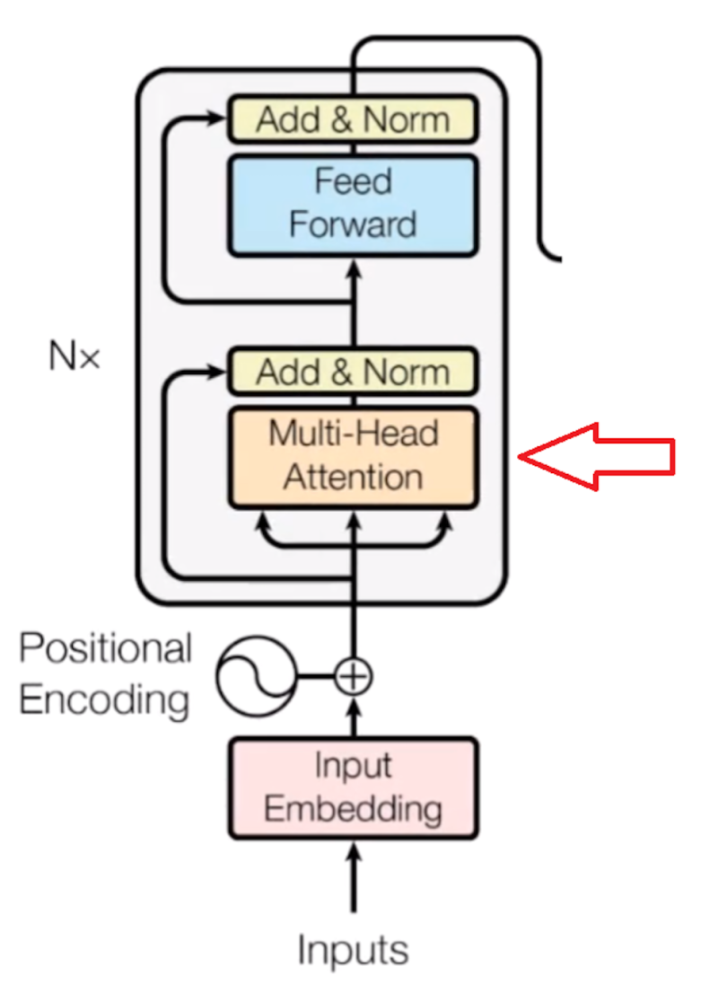

Slide 4

Word/Idea “Embedding”

Slide 5
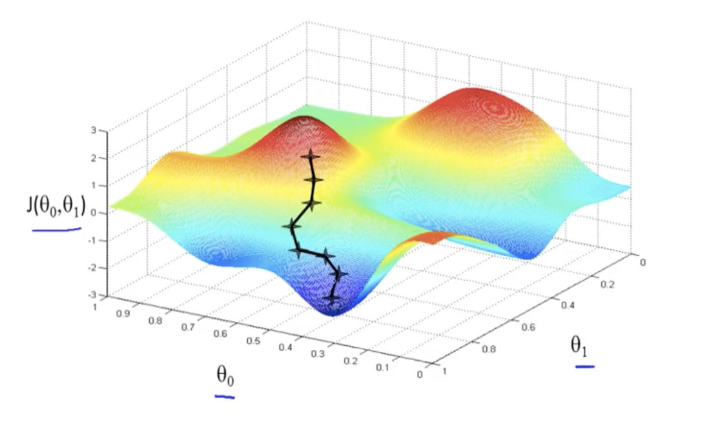
Network Training
Example of 2 weights
Red mountains have high error; blue valleys have low error.
Start with random weights, then tweak weights to move toward low error. Rinse and repeat…
“Learning” is just rolling a ball down a hill, in high dimensions. No plan, no higher reasoning...
The network is thus self-taught, automatically adjusted
But, with 1 trillion dimensions, and 100 million sentences.

Slide 6
The Weights are the “Intelligence”
Doesn’t do web hunts. Could run on a disconnected computer.
Trained weights are “long term memory”. Current conversation is “short term memory”. All internal logic is by word/concept embeddings.
And we don’t know what each weight does. It’s self-organized to follow examples.
Could learn to converse in a language none of its programmers understand.
Are world-models, theory of mind, etc. spontaneously emerging from the training?

Slide 7
An LLM
Is Not just an improved search engine
Is Not hand-crafted code
Is Not the whole modern AI story
Is a sophisticated mathematical engine
Is self-organizing
Is a mystery even to its creators

Slide 8
Some Useful Philosophy Terms
Turing Test: Does it act fully human? If so, it is…
Artificial General Intelligence or AGI
Weak AI: AGI behavior, but no actual awareness
  Modern usage sometimes has “narrow” meaning
Strong AI: AGI behavior, and is aware
Hard Problem of Consciousness: How can we tell if other people are aware/conscious?

Slide 9
Is It Intelligent?
“Yes” arguments
  Vast possibilities in 1 trillion weights. Printed out they’d be 4 million large books.
  Behavior suggests world-models, theory of mind, etc.
  (But, we really don’t know since we’re not sure how the weights work in detail, and it’s not AGI (yet).)
“No” arguments
  Just mindless numbers and 12 equations
  “Hallucinations”
  Just predicting the next word.
  (But, it’s improving fast, a human brain is just “mindless” neurons and synapses, we also make silly errors, and how is it picking that next word so intelligently?)

Slide 10
How Far Will It Advance?
"Heavier-than-air flying machines are impossible" Lord Kelvin 1895
It will “plateau”
  Reaching limits on compute and on data
  It’s plateaued before
It will reach human intelligence or more
  Unprecedented research community and infrastructure
  Hardware is rapidly improving
  Could do self-instruction via reinforcement learning

Slide 11
So, which is it?
5 years ago, most researchers would guess “plateau”. Now most would guess major improvements
Desperate need for theory. Like chemistry in 1824
Hinton’s insight on deep learning vs. brains
  Example of early steam power, electricity, chemistry
  Birds vs planes
  GPT-4 is a mouse brain

Slide 12
Questions to Ponder
How do we teach it to behave constructively and ethically?
How will it affect future employment?
What can it teach us about the nature of thought and intelligence?
Does AGI deserve rights?
What if it becomes more intelligent than us?

