Slide 1
Technology and Philosophy
of Artificial Intelligence
Dr. Clint Staley (C’80)
Dean of STEM, UATX
CSCI Professor, Principia College
CSC Professor Emeritus, Cal Poly SLO

Slide 2
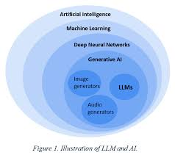
Types of AI
AI: software with “human-like” intelligence
Machine Learning: AI that trains itself
Deep Learning: ML that models neurons
Generative AI: Deep Learning that generates text, music, art rather than just analyzing.
  LLM Large Language Model: ChatGPT, Gemini, Claude, Grok
  Art and Music generators: Suno, Sora, DALL-E, etc

Slide 3
LLM Demo
Like a text conversation, but with highly sophisticated program
Much more than a search engine:
Write and Revise a Story (Claude Sonnet)
  Understands the context of the story, summarizes; changes style
Explain funny images
  Gets the humorous intent, understands images
Engage in “theory of mind” exercise
  Intuitive, self-reflective

Slide 4
Example Uses
Document summary/analysis – IP agreement
  Prompt includes entire document
  Summarizes, points out issues, correctly evaluates
  (But check for accuracy!)
Editing prose – remove passive voice
  Understands grammar, style
  Example revision for PV is correct, succinct

Slide 5
Example Uses, cont..
Write standard documents – reference letter
  Prompt should include particular details, and general instructions
  Can reuse prompt over and over w/ adjustments
  Good at first drafts, but needs final polish (3rd paragraph, for instance)
Tutorial Study – hierarchical Bayes’ analysis
  Gives good “textbook” summaries and explanations
  Also response intuitively to questions
  Wide ranging knowledge – like talking with universal graduate TA

Slide 6
LLM Use “How To”
Prompting is Essential
More than a question. Can include information, like documents, photos, etc.
LLM “knows” info from training, sometimes years earlier. Prompt gives current details.
Task examples – “no shot”, “one shot”, …
Not just one prompt – entire conversation is “input” for each exchange
Depth of remembered conversation “context window” varies by LLM
  10,000 words to 1,000,000

Slide 7
LLM “How To” – continued
LLM’s “hallucinate”, often very confidently – check critical facts
Many LLMs available
  ChatGPT (OpenAI), Claude (Anthropic), Grok (X), R1 (DeepSeek)
Steadily Improving. You can choose a level of intelligence
Usage measured by “tokens”
  Certain amount free. More with subscriptions
Likely to be in short supply for a few years. Use efficiently
  Simpler tools when they are enough
  Ask for brief responses

Slide 8
An LLM Is Not
An improved search engine
  Is able to web-search when useful, but…
  … can work unplugged from the internet
Hand-crafted code
  No programming specific to the questions/answers
  Could be written in one page of code – 12 equations
The whole modern AI story
  Important other areas are making major advances too, e.g. “reinforcement learning”, computer vision (will review later)

Slide 9
An LLM Is
A sophisticated mathematical engine
  12 equations, but on “matrices” – huge grids of numbers
  From 10 billion to over 1 trillion numbers
  The “intelligence” is in those numbers (aka weights or parameters)
Self-organizing!
  The weights are “trained” by incremental adjustment
        First, to match known texts
        Then to adjust to human feedback given by “RLHF”
Humans design the training process and the equations, but not the weights

Slide 10
Other AI
“Diffusion Model”
  Deep Learning and generative, but not LLM
  Same principles and training, but different design and purposes.
  Generate photos, short movie clips, music
  (Term “hallucination” originates with this type of AI)
Can generate audio of text in your own voice
  Note that this means voices are not representative e.g. on phone calls

Slide 11
Other AI - cont
Computer Vision: face recognition, object tracking
“Physical” or “Embedded” AI: robots, automated drones
Reinforcement Learning (RL)
    Self-instructing. Requires automatically generable feedback.
    Examples: Alpha Go, code-writing agents, physical AI (via simulation)
Graph Neural Networks:
    Analyze connection patterns, e.g. chemical compounds
    AlphaFold, which solves protein folding problems

Slide 12

Word/Idea “Embedding”
This is how an LLM represents words, phrases and ideas
Dimensions represent meaning, and also word position
But, with 12,800 numbers per word – many conceptual dimensions

Slide 13
How An LLM “Thinks”
Starts with word embeddings representing words in your prompt and the current conversation.
Combines words via “attention blocks” into higher embeddings representing phrases, then sentences, etc.
Predicts next “thought” as an embedding and chooses closest next word.
Repeat, word by word...

Slide 14
The Weights are the “Intelligence”
All “reasoning” is by word/concept embeddings.
And we (mostly) don’t know what each weight does.
Could learn to converse in a language none of its programmers understand.
Are world-models, theory of mind, etc. spontaneously emerging from the training? Latest research clearly says “yes”.

Slide 15
Is an LLM Intelligent?
“Yes” arguments
  Vast possibilities in 1 trillion weights. Printed out they’d be 4 million large books.
  Research in “mechanistic interpretability” shows conceptual models spontaneously arise from training
  (But, we still know only some of what those weights are doing, and “intelligent” doesn’t necessarily mean “conscious”)
“No” arguments
  Just mindless numbers and 12 equations
  Just predicting the next word.
  (But, it’s improving fast, a human brain is just “mindless” neurons and synapses, and how is it picking that next word so intelligently?)

Slide 16
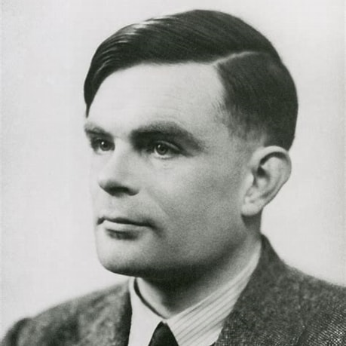
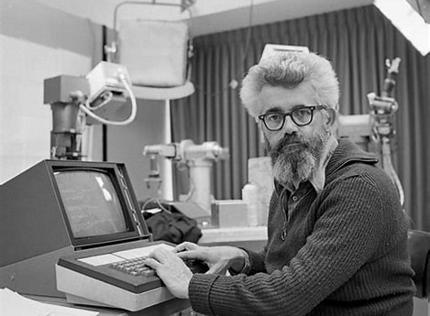
AI Events and People 1950s
(1912-1954) Alan Turing
  Theoretical father of CS. “Turing Test”
  Early thoughts on “connectionist” AI – forerunner to neural nets/deep learning
(1956) “Dartmouth conference”
  John McCarthy coins “Artificial Intelligence”
(1956) Logic Theorist
  First good “theorem prover” – symbolic AI

Slide 17

AI History 1960s
(1965) ELIZA basic “chatbot” in 200 lines of code
(1960s) Hopfield, Minsky and others do early work in “neural networks”
(1967) Minsky: “Within a generation … the problem of creating artificial intelligence will substantially be solved.”
(1969) Minsky and Papert publish “Perceptrons”
  Proves one-layer (all they knew how to train) neural networks very limited and triggers first “AI winter”

Slide 18
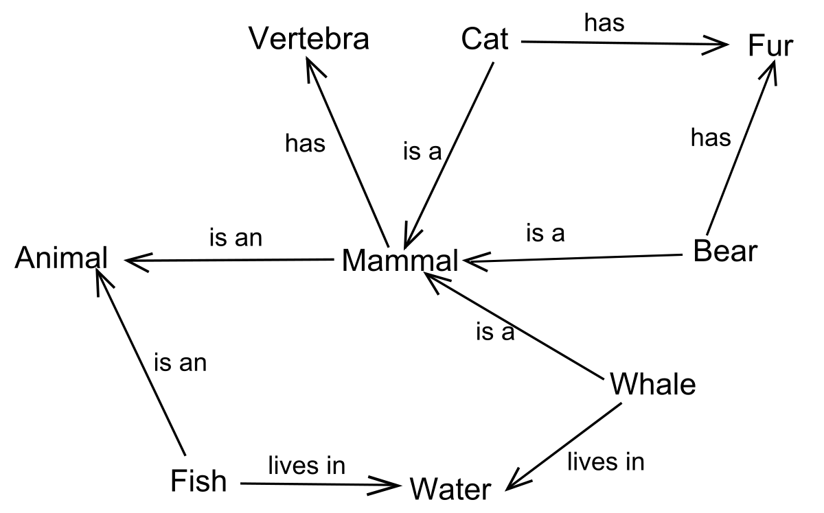
First AI Winter 1970-1985
(1970) S Linnainmaa quietly publishes “backpropagation” algorithm,
(1974) P Werbos does the same. No one notices.
Gradual development of symbol/logic based AI
(1982) Japan announces “5th generation computing” project – hardware devoted to expert systems or symbolic reasoning
Various limited successes with expert systems

Slide 19
AI History 1986- early1990s
(1986) Backpropagation algorithm (re)discovered.
  Neural nets are back.
  But training networks > 3 layers proves very hard. (Modern deep learning uses hundreds.)
  Advances inhibited by persistent effort to imitate neurons, which don’t train by backpropagation.
After brief burst of progress, a second “AI Winter”

Slide 20
Second AI Winter 1990-2012
Expert systems and symbolic AI prove too limited/fragile
Gradual improvements in neural networks, by Geoff Hinton, Ilya Sutskever, Yan LeCunn, Yoshua Bengio and many others.
Other machine-learning methods, e.g. SVMs, explored.
Various limited neural net successes e.g. character recognition for written digits.

Slide 21
AI History 2012-2024
Four important advances lay ground for new neural network growth
  more available training data via internet
  computing power via GPUs (video games fund the AI revolution :))
  better neural network design: stop imitating neurons
  vibrant and very intensive research community
(2012) Surprise success of neural networks in image recognition
(2017) “Attention is all you Need” paper describes Transformers
(2020-2023) Steady LLM improvement arrives at GPT-4

Slide 22
AI History – Taking Stock
Early investigation of major ideas
  Neural networks and symbol systems since 1950s
Alternating optimism and AI winters
Neural networks and ML beat symbolic logic
  The “bitter lesson” – can’t program AI directly
Focus on imitating nature (neurons) was a distraction
Needed confluence of factors – the “adjacent possible”

Slide 23
2024 AI Events
Nobel Prizes 2024
  Physics to John Hopfield and Geoffrey Hinton
  Chemistry to the developers of Alpha Fold
Improved LLM Architectures
  MoE – “Mixture of Experts”
  CoT – “Chain of Thought” – LLMs that reason
Early Coding Tools, e.g. Cursor

Slide 24
2025 Events
Huge buildout of data centers
      Electrical and (sometimes) water concerns
      Shortage of computer memory
But, ongoing efficiency advances
      E.g. Distillation, “Turboquant”
Mid-year talk of a plateau in LLM progress...
But by year end, models, especially Anthropic, advancing
  Claude Code revolutionizes software dev (!)

Slide 25
2026 Events
AI Agents
  LLM that does computer/online tasks for you
Ongoing relentless improvement of LLMs
Anthropic Mythos release
  So serious a cyber security threat that it’s being withheld

Slide 26
AI Events: late 2026-> (?)
Ongoing automation of white collar work
  Writing, coding, art, music, law, healthcare, customer service, language translation, entertainment, etc.
  Claude Code is like a competent, knowledgeable, very fast junior engineer.
  May increase productivity of experienced professionals by 5x,
Physical AI
  AI with vision, movement, hearing
  Robotics, drones, self-driving cars, manufacturing, construction, etc.
Scientific advances using AI

Slide 27
Near Term Issues to Consider
Legal questions of copyright and liability
“Alignment” of AI with human values
Economic and environmental impact of data center buildout
      Demand pressure on memory, electricity
      Encouraging efficient use of “tokens”
Employment Impacts
      Not like going from farm to factory to simple white-collar work
      “UBI” can provide subsistence, but doesn’t provide purpose
Which nation will lead, US or China? – Manhattan project of the 2020s

Slide 28
Near Term Issues – Education
How does education adapt to AI?
Starship vs Cloister
  Be able to do everything *without* AI.
  Can’t be “in charge” if you are dependent
But, do use AI
  Leverage AI as “cointelligence” to create more than you can alone
  Always question/challenge the AI; don’t take output at face value
  “Any good LLM session includes you correcting the LLM”
Students must jump the “apprentice gap”

Slide 29
AI Future – Limits on Prediction
“… heavier than air flying machines are impossible”
  Lord Kelvin, 1895
Alchemistic Empiricism
  Analogy of Chemistry in 1825
  Results in fits and starts as we try things out by guess-and-by-golly
Start with Nature, End with Design
  Planes vs birds
  Deep Learning vs brains : Geoff Hinton’s warning

Slide 30
AI Future – Ideas to Consider
Pair of essays worth reading by Dario Amodei (darioamodei.com)
      (2024) “Machines of Loving Grace”
      (2026) “The Adolescence of Technology”
Technological History Lessons
      S curve pattern in innovation – aerospace example
      AI winters of past
      Effect of missing theory

Slide 31
AI Future – 3 Tracks
Option A: Progress will plateau near term (in a year or two)
  We are reaching limits on compute and on data
  Example of aerospace after 1970
Option B: Progress will plateau mid-term (2030s)
  Continued improvement in hardware and “frontier models”
  Likely to reach “AGI” or “superintelligence”
Option C: Progress explodes with AI refining its own design
  “Singularity” concept

Slide 32
3 Tracks – Which?
Estimates vary, of course, and shift over time.
  My own vague impressions (not data supported!)
  2023: A: 70%, B 25%, C 5%
  2025 midyear A: 75%, B 15%, C 10%
  2026 present: A: 45%, B 45%, C 10%
Long term, regardless of A/B/C possibilities
  We have uncovered something fundamental about intelligent behavior
  Future, near or long term, shows no clear limits on this

Slide 33
Long Term Questions
What can AI teach us about the nature of thought and intelligence?
What if it becomes more intelligent than us?
Hard Problem of Consciousness
AI as “moral patient”?
Use of AI to extend human intelligence

Slide 34
Future Predictions – Dystopian SF
Premise: Technology is a power unto itself
(1984) Blade Runner
  LA is stygian hellscape in 2020s
(1984) Terminator
  LA is nuclear-blasted wreck with robots killing humans in 2020s
(1970) Colossus
  AI computer becomes world dictator in late 1970s

Slide 35
Future Predictions – CS Perspective
Premise: Technology is Mind’s creativity unfolding.
“The mariner will have dominion over the atmosphere and the great deep .. the astronomer will no longer look up to the stars, – he will look out from them..” Science and Health p125: 25-29

Slide 36
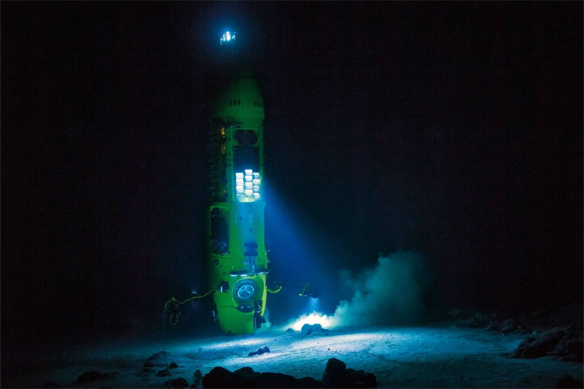
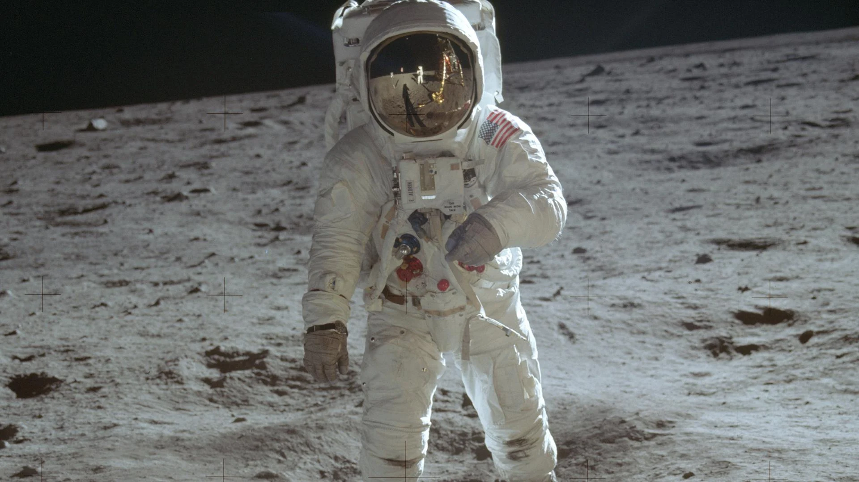


Slide 37
Christian Science Perspective
“There is no life, truth, intelligence, nor substance in matter. All is infinite Mind and its infinite manifestation…” S&H p 468
“Intelligence is omniscience, omnipresence, and omnipotence. It is the primal and eternal quality of infinite Mind...” S&H p 469

