Slide 1
AI Technical Concepts

Slide 2
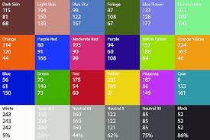

Numerical Input/Output
AI identifies inputs and outputs by numbers
  Words => word embedding
  Photos => pixel values: three numbers each
  Sound => wave height values, 65000/second

Slide 3
Pattern Spaces
Patterns are points in high-dimensional space
  Two-number pattern is a position in 2-D space, e.g. latitude/longitude, or x/y
  Three-number pattern is a point in 3-D space, e.g. latitude/longitude/altitude
  But real patterns are thousands or millions of numbers...
High-dimensional pattern space
  Line, square, cube, … hypercube
  Number of corners as dimension d rises
  High-dimensional space is big
  Example: largest distance corner-to-corner a hypercube

Slide 4
Example Pattern Space
Three concept world: small/big, cold/hot, light/heavy
  (0, 1, 1) => small hot heavy thing
  (.5, 0, 0) => midsized cold light thing
  Words, phrases, “ideas” are 3-D points
Number of concepts (words) grows rapidly with more dimensions
  20?
  265?
GPT uses 12,800 dimensions. Lots of “meaning” possible.
Similar words/concepts are near each other in a “region”

Slide 5
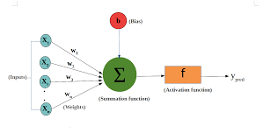
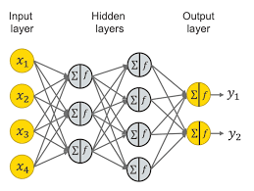
Neural Networks and Spaces
Neuron
  Weights on numerical inputs from other neurons
  Weighted-sum output (for now)
Neural network
  Input pattern => Layers of neurons => Output pattern
What does it do?
  Weighted sums do rotations, scaling etc. in pattern space
Activation function
  Each neuron “makes a decision” via activation function
  Activation functions are essential to the “intelligence”
  Design of better activation functions was an important advance

Slide 6
How GPT Learns
A neural network has many number-weights (“parameters”)
175 billion parameters for GPT-3. 1.7 trillion for GPT-4.
How do we get numbers that work? By adjusting parameters to imitate examples… Lots of examples.. 100 million sentences.
Further refinement and “socialization” by RLHF

Slide 7
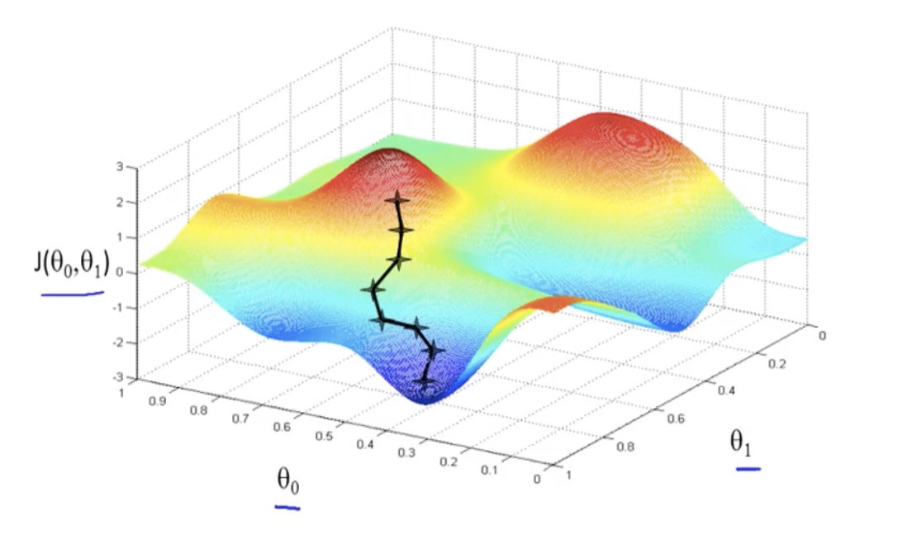
Neural Network Training
Weights themselves are a “pattern” and have a space!
Example of 2 weights and error value
Gradient Descent
  Start with random weights – random location
  Mathematically find uphill direction – “gradient”
  Step in the opposite direction to reduce error.
  Basically rolling downhill, in high dimensions. No plan, no higher reasoning...
The network is thus self-taught, automatically adjusted
Biggest challenge is not reducing the error. Problem is “overfitting”

Slide 8
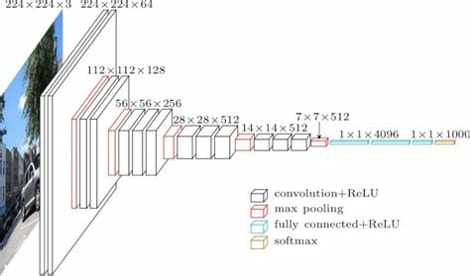
Deep Learning Architectures
CNN architecture
  Gridlike layers to analyze image patterns
  Each layer combines visual features
  “Pooling” layers (not NN) concentrate pixels
  “Deep learning” is neural nets with non-NN layers

Slide 9

Deep Learning Architectures...
Transformer architecture
  How ChatGPT works
  Blocks of roughly 4 layers, many deep
  Each layer combines words/phrases
  One layer (a “softmax”) in each block is not neural net

Slide 10
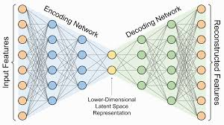
Deep Learning Architectures…
Diffusion Networks
  A form of “autoencoder”
  Train network to compress to “latent space”
  Encoder network and decoder network
  Draw samples from latent space and use just decoder

Slide 11
Reinforcement Learning (RL)
Getting enough training data is important, and hard.
Sometimes we can automatically generate it via “unsupervised learning”
  Example of playing games against yourself to learn.
Tricky to get it working
  When you win, how do you know which moves helped?
  Do you try new approaches or refine existing ones?
But, when it works…
  Alpha Go beat all human players and found new strategies
  Same system learned chess better than all human players – in a few hours

Slide 12
Technical Ideas to Know
Numerical representation of input and output
Patterns and pattern spaces
Intuitive nature of high-dimensional space
Training by “gradient descent”
Supervised vs unsupervised learning
Architecturs: CNN, Transformer, Diffusion network
Reinforcement learning (RL)

Slide 13
Current Research – Optimization
Make using the AI – “inference” – less expensive
  Reduce power consumption
  Allow LLMs to run on edge devices like phones
Compressing/removing weights
  “low-rank factorization” reduces transformation dimensionality and cost, preserving function
  Lottery Ticket Hypothesis: Any large network has much smaller network within that works as well
“Quantization” – reducing precision of the weights for speed
“Speculative Decoding”
  Small “draft” LLM model does initial cut, confirmed by stronger model
Knowledge Distillation (KD)
  Train small LLM from “smart” larger one that offers nuance

Slide 14
Current Research – Ability
Longer context windows
  Squared complexity – requires creative selectivity in pairwise comparisons
Physical and multimodal AI
  Computer vision
  Robotics
Improved generalization
  Training Data vs General Case
  More data examples
  Understanding the deep math of gradient descent: “Grokking” and double descent
  RL-based training, especially in physical AI, coding, etc.

Slide 15
Current Research – Architectures
“Architecture” is organization and design of the layers, activation functions, etc.
  History: RNN → LSTM → Transformer
  Each addresses weaknesses in former
  Activations: sigmoid -> relu -> GeGLU
  Progress is ad-hoc, empirical, and often surprising
Mixture of Experts (MoE)
  DeepSeek story...
Transformer research focuses on context windows
  RoPE, sparse attention, etc.
Transformer → State Space Models (SSMs) ?

Slide 16
Current Research – Alignment
Curation of data
Reduction of hallucinations
  Self-checking, chain-of-reasoning
  Informed prompts (RAG)
Mechanistic Interpretability (MI) and “explainability”
  Sparse autoencoders, and “golden gate Claude”
  Reverse engineering weight subnets “circuits”Explainability (see theory)

Slide 17
Current Research – Theory
High Math Approaches
    Information Bottleneck Theory
    Neural Tangent Kernels
    Sheaf Theory
    Analysis of high-dimensional optimization surfaces, e.g. singular learning theory (SLT)
  Behavior of high-dimensional gradient descent
    Double descent pattern and “grokking”

