Slide 1
Technology and Philosophy of AI
Dr. Clint Staley
Professor of STEM, UATX
CSC Professor Emeritus, Cal Poly SLO

Slide 2
“Large Language Model” (LLM) Demo
Write and Revise a Story (Claude Sonnet)
  Understands the context of the story
  Summarizes; changes style
Multimodal: Analyzing humorous images
Many LLMs available, steadily improving
  ChatGPT (OpenAI), Claude (Anthropic), Grok (X), R1 (DeepSeek)

Slide 3
Typical LLM Uses
Comprehensive web search
Summarizing and analyzing documents (Emancipation Proclamation example)
Generating or editing prose
Tutorial discussions
Brainstorming and recommendations

Slide 4
LLM Use “How To”
It’s all about the prompt(s)
  More than a question. Can include information, like documents, photos, etc.
  LLM “knows” info only at the time of training, sometimes years earlier. Prompt gives current details.
  Not just one prompt – engage in conversation. Entire conversation is “input” for each chat
  Depth of remembered conversation varies by LLM – 1,000 words to 100,000
LLM’s “hallucinate”, often very confidently
  Check critical facts
  Scan generated material for oddities

Slide 5
Example Uses
Better web hunt – advice on furniture problem
  Gives full description, various solutions, etc. (and it worked!)
Document summary/analysis – IP agreement
  Prompt includes entire document
  Summarizes, points out issues, correctly evaluates
  (But check for accuracy!)

Slide 6
Example Uses, cont..
Editing prose – remove passive voice
  Understands grammar, style
  Example revision for PV is correct, succinct
Brainstorming – name a cat
  Sometimes offers silly suggestions with good ones
  Will often come up with ideas you didn’t think of

Slide 7
Example Uses, cont..
Write standard documents – reference letter
  Prompt should include particular details, and general instructions
  Can reuse prompt over and over w/ adjustments
  Good at first drafts, but needs final polish (3rd paragraph, for instance)
Tutorial Study – hierarchical Bayes’ analysis
  Gives good “textbook” summaries and explanations
  Also response intuitively to questions
  Wide ranging knowledge – like talking with universal graduate TA

Slide 8
Example Uses – Other AI
Artistic creativity – funny image
  “Diffusion model”, e.g. DALL-E, Sora
  Photos, short movie clips
  May need feedback and adjustment, and may hallucinate
  (Term “hallucination” originates with this type of AI)
Generate audio of text in your own voice
  Very convincing
  Note that this means voices are not representative e.g. on phone calls

Slide 9
An LLM Is Not
An improved search engine
  Is able to web-search when useful, but…
  … can work unplugged from the internet
Hand-crafted code
  No programming specific to the questions/answers
  Could be written in one page of code – 12 equations
The whole modern AI story
  Important other areas are making major advances too, e.g. “reinforcement learning”, computer vision

Slide 10
An LLM Is
A sophisticated mathematical engine
  12 equations, but on “matrices” – huge grids of numbers
  From 10 billion to over 1 trillion numbers
  The “intelligence” is in those numbers (aka weights or parameters)
Self-organizing!
  The weights are “trained” by incremental adjustment
        First, to match known texts
        Then to adjust to human feedback given by RLHF
Humans design the training process and the equations, but not the weights

Slide 11

Word/Idea “Embedding”
This is how an LLM represents words, phrases and ideas
Each word has a number sequence – an “embedding”
But, with 12,800 numbers per word – many conceptual dimensions

Slide 12
How An LLM “Thinks”
Starts with word embeddings representing words in your prompt and the current conversation.
Combines words into higher 12,800-number patterns representing phrases, then sentences, etc.
Predicts next “thought” as a number pattern and chooses closest next word.
Repeat, word by word...

Slide 13
The Weights are the “Intelligence”
All “reasoning” is by word/concept embeddings.
And we (mostly) don’t know what each weight does.
Could learn to converse in a language none of its programmers understand.
Are world-models, theory of mind, etc. spontaneously emerging from the training?

Slide 14
Is an LLM Intelligent?
“Yes” arguments
  Vast possibilities in 1 trillion weights. Printed out they’d be 4 million large books.
  Behavior suggests world-models, theory of mind, etc.
  (But, we really don’t know since we’re not sure how the weights work in detail)
“No” arguments
  Just mindless numbers and 12 equations
  Just predicting the next word.
  (But, it’s improving fast, a human brain is just “mindless” neurons and synapses, and how is it picking that next word so intelligently?)

Slide 15
Other AI
Same principles of training and numerical patterns, but different designs and purposes.
Diffusion Models (saw earlier)
Reinforcement Learning (RL)
  Self-instructing. Requires automatically generable feedback.
  Alpha Go example
Computer Vision and Physical AI
  CNNs and Vision Transformers
Graph Neural Networks
  Analyze connection patterns, e.g. chemical compounds

Slide 16

AI History 1950s - 1960s
(1956) “Artificial Intelligence” first used as a term
(1956) First good “theorem prover” – symbolic AI
(1965) ELIZA basic “chatbot” in 200 lines of code
(1960s) Hopfield, Minsky and others do early work in “neural networks”
(1967) Minsky: “Within a generation … the problem of creating artificial intelligence will substantially be solved.”
(1969) Minsky and Papert publish “Perceptrons”
  Proves one-layer (all they knew how to train) neural networks very limited and triggers first “AI winter”

Slide 17
AI History 1970s-1990s
(1970) Seppo Linnainmaa quietly publishes “backpropagation” algorithm, solving the multilayer training problem. No one notices.
(1970s and 80s): Direct coding of logic in “expert systems”
  Turns out to be limited and fragile
  Vaunted “5th generation” computing fizzles
(1986) Backpropagation algorithm (re)discovered.
  Neural nets are back.
  But training networks > 3 layers proves very hard. (Modern AI takes hundreds.)
After brief burst of progress, a second “AI Winter”

Slide 18
AI History 2012-2024
Four important advances lay ground for new neural network growth
  more available training data via internet
  computing power via GPUs
  better neural network design: “activation functions” and architectures (neural net => deep learning)
  vibrant and very intensive research community
(2012) Neural networks, now “deep learning networks” are back, again!
(2017) “Attention is all you Need” paper describes Transformers
(2020-2023) Steady LLM improvement arrives at GPT-4

Slide 19
AI History – Taking Stock
Early investigation of major ideas
  Neural networks since 1960s
Alternating optimism and AI winters
Symbolic logic vs neural networks
  The “bitter” (to some researchers) lesson – can’t program AI directly

Slide 20
Recent AI Events
Nobel Prizes
  Physics to John Hopfield and Geoffrey Hinton
  Chemistry to the developers of Alpha Fold
Improved LLM Architectures
  MoE – “Mixture of Experts”
  CoT – “Chain of Thought” – LLMs that reason
DeepSeek
  Chinese innovators
  Demonstrates much more efficient use of computation

Slide 21
AI Events: late 2020s (?)
Ongoing automation of white collar work
  Writing, coding, art, music, law, healthcare, customer service, language translation, entertainment, etc.
  My own experience: It's like a competent, widely read, and blindingly fast junior engineer.
  May double or triple productivity of experienced professionals.
Physical AI
  AI with vision, movement, hearing
  Robotics, self-driving cars, manufacturing, construction, etc.
Scientific advances using AI, especially RL

Slide 22
Near Term Issues to Consider
Legal questions of copyright and liability
“Alignment” of AI with human values
AI enables experienced professionals but replaces beginners creating “apprentice gap”
Technological unemployment
  Not like going from farm to factory to simple white-collar work
  UBI might provide subsistence, but doesn’t provide purpose
Which nation will lead? – Manhattan project of the 2020s

Slide 23
AI Future – Where is it heading?
“… heavier than air flying machines are impossible”
  Lord Kelvin, 1895
Alchemistic Empiricism
  Analogy of Chemistry in 1825
  Results in fits and starts as we try things out by guess-and-by-golly
Start with Nature, End with Design
  Planes vs birds
  Deep Learning vs brains : Geoff Hinton’s warning

Slide 24
AI Events: 2030s (??)
Option A: AI progress will “plateau”
  We are reaching limits on compute and on data
  It’s plateaued before
Option B: Continued progress reaching “AGI” or “superintelligence”
  Unprecedented research community and infrastructure
  Continued improvement in design and training procedures
  Hardware is rapidly improving
5 years ago, many experts thought “A”. Now many think “B”.

Slide 25
Long Term Questions
What can AI teach us about the nature of thought and intelligence?
What if it becomes more intelligent than us?
How do we deal with technological unemployment?
Hard Problem of Consciousness

Slide 26
Advice to Students
Learn to create without AI first
  Can’t be “in charge” if you are dependent
  Gets you closer to content, like doing your own calculations
Then, create using AI
  Leverage AI to create more than you can alone
  Use AI as “cointelligence” partner from whom you can learn as well
  This is the workflow of the future

Slide 27
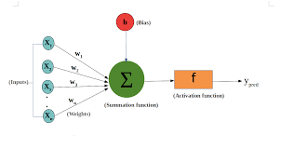
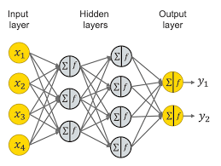
Neural Networks
Basic “neuron”
  Weights on inputs
  “Activation function”
  Banks of these in “layers”
“Train” by adjusting weights
  Many sample input/outputs

Slide 28
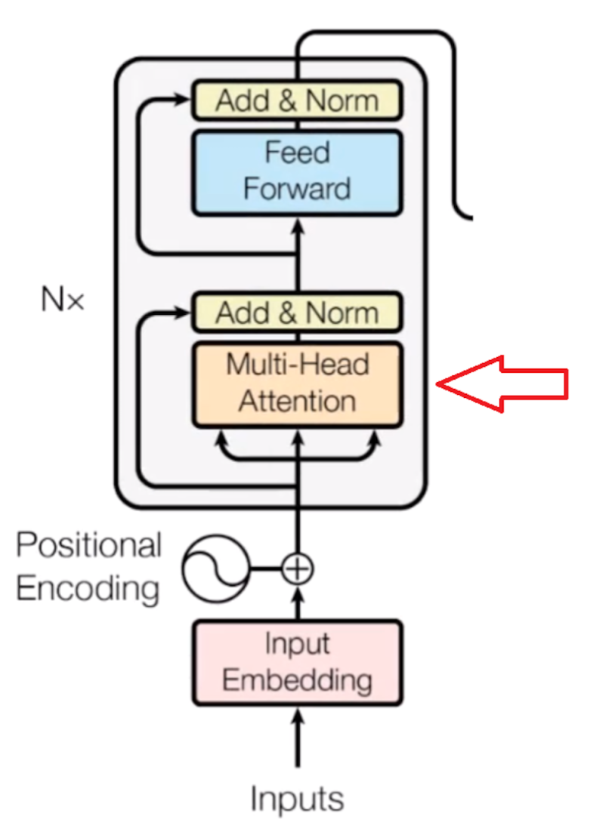
Transformer Architecture
Tokens to embeddings
Positional Embedding
Neural networks for Attention
Neural networks for analysis
Many layers deep
Final output is next token

Slide 29
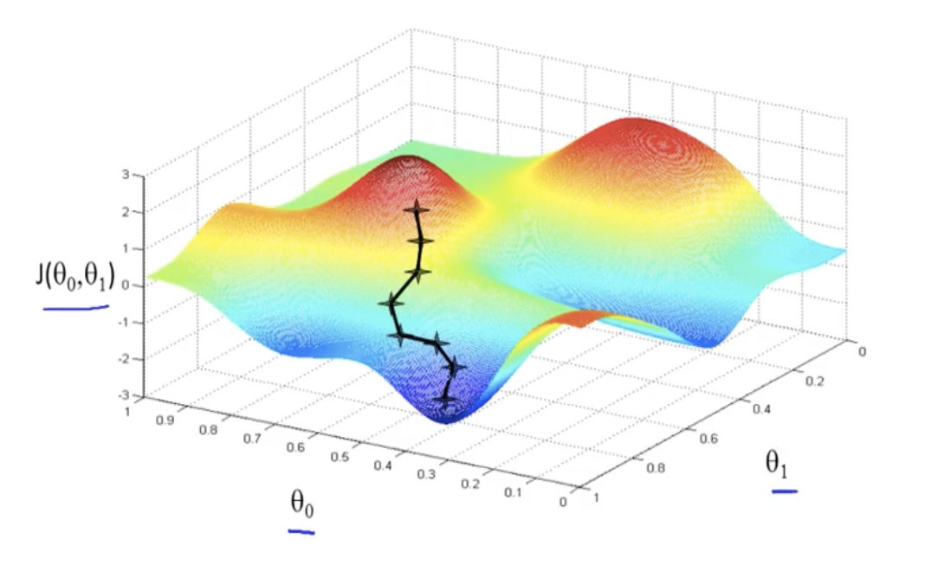
Training Process
“Gradient Descent”
  Compute “error” in output based on examples
  Adjust all weights a bit to reduce that error
  Repeat
Two-weight example
  Compute “downhill” direction
  Adjust weights

Slide 30
Current Research – Optimization
Make using AI less expensive after training
  Reduce power consumption
  Allow LLMs to run on edge devices like phones
Not all weights are equally valuable; groups of weights can be compressed
Precision of the weights can be looser, even down to one bit
“Speculative Decoding”
  Small “draft” LLM model does initial cut, confirmed by stronger model
Knowledge Distillation (KD)
  Train small LLM from “smart” larger one that offers nuance

Slide 31
Current Research – Intelligence
Longer context windows
  Squared complexity – requires creative selectivity in pairwise comparisons
  Reasoning models
  Architecture improvements: RoPE, better activation functions
  Improved generalization
    More data examples
    RL-based training, especially in physical AI, coding, etc.
    Double descent pattern and “grokking”

Slide 32
Current Research – Explainability
Analyzing embeddings for concept patterns
  Sparse autoencoders, and “golden gate bridge”
Mechanistic Interpretability (MI)
  Reverse engineering weight subnets “circuits”
High Math Approaches
  Mutual Information Theory
  Sheaf Theory
  Analysis of high-dimensional optimization surfaces, e.g. singular learning theory (SLT)

