Slide 1
AI Research Universe
Dr. Clint Staley (C’80)
Professor of STEM, UATX
Former CSCI Professor, Principia College
CSC Professor Emeritus, Cal Poly SLO

Slide 2
“Large Language Model” (LLM) Demo
Write and Revise a Story (Claude Sonnet)
  Understands the context of the story
  Summarizes; changes style
Multimodal: Analyzing humorous images
Many LLMs available, steadily improving
  ChatGPT (OpenAI), Claude (Anthropic), Grok (X), R1 (DeepSeek)

Slide 3
An LLM Is Not
An improved search engine
  Is able to web-search when useful, but…
  … can work unplugged from the internet
Hand-crafted code
  No programming specific to the questions/answers
  Could be written in one page of code – 12 equations
The whole modern AI story
  Important other areas are making major advances too, e.g. “reinforcement learning”, computer vision

Slide 4
An LLM Is
A sophisticated mathematical engine
  12 equations, but on “matrices” – huge grids of numbers
  From 10 billion to over 1 trillion numbers
  The “intelligence” is in those numbers (aka weights or parameters)
Self-organizing!
  The weights are “trained” by incremental adjustment
        First, to match known texts
        Then to adjust to human feedback given by RLHF
Humans design the training process and the equations, but not the weights

Slide 5

Word/Idea “Embedding”
This is how an LLM represents words, phrases and ideas
Dimensions represent meaning, and also word position
But, with 12,800 numbers per word – many conceptual dimensions

Slide 6
How An LLM “Thinks”
Starts with word embeddings representing words in your prompt and the current conversation.
Combines words via “attention blocks” into higher embeddings representing phrases, then sentences, etc.
Predicts next “thought” as an embedding and chooses closest next word.
Repeat, word by word...

Slide 7
The Weights are the “Intelligence”
All “reasoning” is by word/concept embeddings.
And we (mostly) don’t know what each weight does.
Could learn to converse in a language none of its programmers understand.
Are world-models, theory of mind, etc. spontaneously emerging from the training?

Slide 8
Other AI
Same principles of training and numerical patterns, but different designs and purposes.
Diffusion Models (saw earlier)
Reinforcement Learning (RL)
  Self-instructing. Requires automatically generable feedback.
  Alpha Go example
Computer Vision and Physical AI
  CNNs and Vision Transformers
Graph Neural Networks
  Analyze connection patterns, e.g. chemical compounds

Slide 9
All the world’s a number
Words/concepts => embeddings
Images => pixels
Colors => 3-value vectors
Sounds => frequency intensities or wave amplitudes
Categorizations => probability distributions

Slide 10
High Dimensions
All modern AI centers on high-dimensional spaces
Example of dimensional progression – hypercubes
  Square, cube, tesseract…
  Number of corners grows exponentially
Concept embedding example
  small/big, cold/hot, sad/happy…
  “vocabulary” for 10, 20, 265 dimensions…
“Pattern space” and pattern regions
Neural layers do “affine transforms” in high dimensions

Slide 11
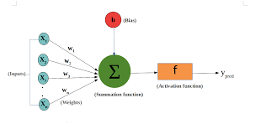
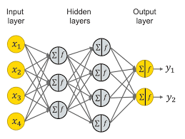
The Computations
Basic “neuron”
  Weights on inputs
  “Activation function”
  Layers do pattern-space “affine transforms”
  Banks of layers form “neural networks”
Other types of mathematical layers
  “softmax”, 2-d max
  Thus “deep learning” not just “neural nets”

Slide 12
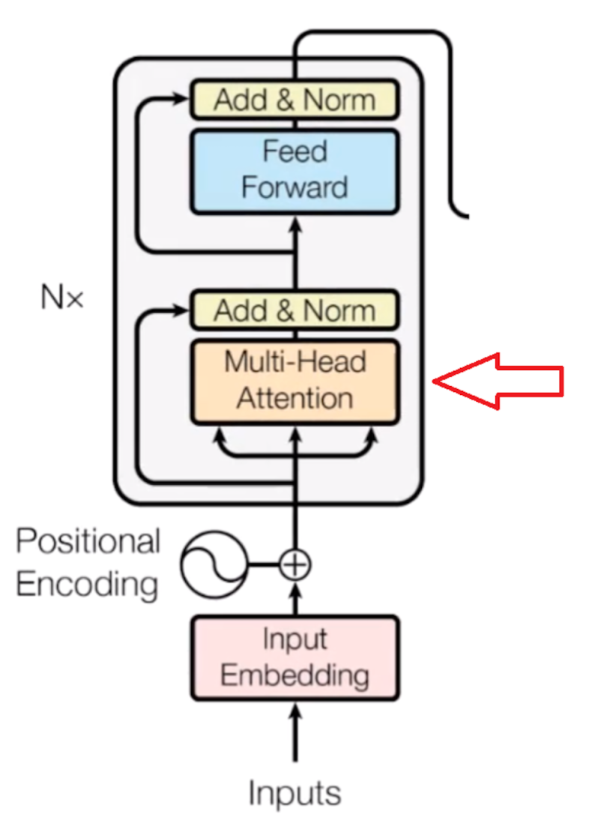
Transformer Architecture
Tokens to embeddings
Positional Embedding
Neural networks for Attention
Neural networks for analysis
Many layers deep
Final output is next token

Slide 13
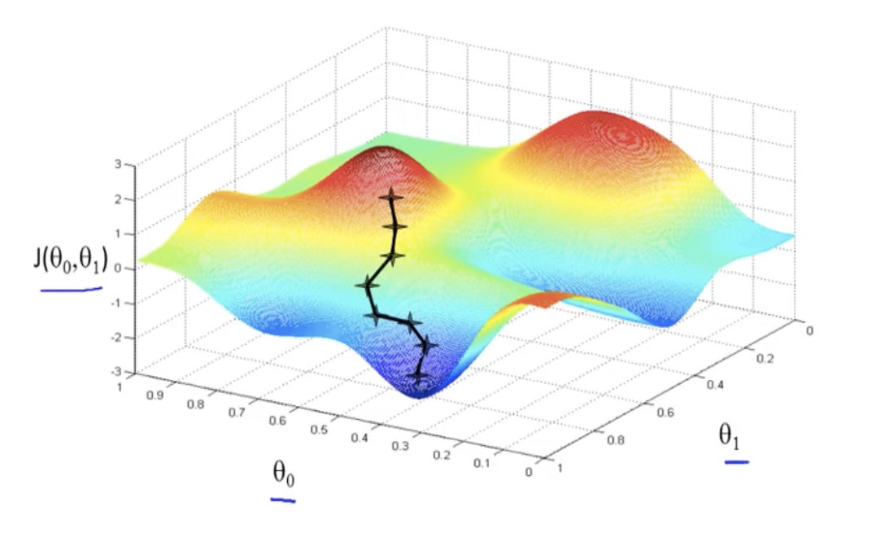
Training Process
“Gradient Descent” PreTraining
  Compute “error” in output based on examples
  Compute “downhill” direction of error (aka negative gradient)
  Adjust all weights a bit to reduce that error
  Repeat
  And… one trillion dimensions
Post-training via RLHF
  Adjust weights to satisfy human trainers
  “Alignment” happens here

Slide 14
Current Research – Optimization
Make using the AI – “inference” – less expensive
  Reduce power consumption
  Allow LLMs to run on edge devices like phones
Compressing/removing weights
  “low-rank factorization” reduces transformation dimensionality and cost, preserving function
  Lottery Ticket Hypothesis: Any large network has much smaller network within that works as well
“Quantization” – reducing precision of the weights for speed
“Speculative Decoding”
  Small “draft” LLM model does initial cut, confirmed by stronger model
Knowledge Distillation (KD)
  Train small LLM from “smart” larger one that offers nuance

Slide 15
Current Research – Ability
Longer context windows
  Squared complexity – requires creative selectivity in pairwise comparisons
Reasoning models
Physical and multimodal AI
  Computer vision
  Robotics
Improved generalization
  More data examples
  RL-based training, especially in physical AI, coding, etc.

Slide 16
Current Research – Architectures
“Architecture” is organization and design of the layers, activation functions, etc.
  History: RNN → LSTM → Transformer
  Each addresses weaknesses in former
  Activations: sigmoid -> relu -> GeGLU
  Progress is ad-hoc, empirical, and often surprising
Mixture of Experts (MoE)
  DeepSeek story...
Transformer research focuses on context windows
  RoPE, sparse attention, etc.
Transformer → State Space Models (SSMs) ?

Slide 17
Current Research – Alignment
Curation of data
Reduction of hallucinations
  Self-checking, chain-of-reasoning
  Informed prompts (RAG)
Mechanistic Interpretability (MI) and “explainability”
  Sparse autoencoders, and “golden gate Claude”
  Reverse engineering weight subnets “circuits”Explainability (see theory)

Slide 18
Current Research – Theory
High Math Approaches
  Information Bottleneck Theory
  Neural Tangent Kernels
  Sheaf Theory
  Analysis of high-dimensional optimization surfaces, e.g. singular learning theory (SLT)
Behavior of high-dimensional gradient descent
  Double descent pattern and “grokking

