Slide 1
Trends in Artificial Intelligence (AI)
Dr Clint Staley
Computer Science Dept
clint.staley@principia.edu
(Discussion and demo afterward in Leonard)

Slide 2
Overview
Some terms
A demonstration of GPT-4
Other recent AI advances
Terms and ideas from AI philosophy
Questions for discussion

Slide 3
AI Terms
AI: programs that behave at a “human” level
Machine Learning (ML): programs that teach themselves
Neural Nets: programs that loosely imitate brain neurons
Deep Learning: new, advanced version of neural nets
Generative AI: AI that creates prose, music, art, code.

Slide 4
ChatGPT and GPT-4
Generative Pretrained Transformer: AI that “converses”.
ChatGPT is the news maker now. GPT-4 will surpass it.
90th percentile on LSAT, SAT, Uniform Bar Exam, many AP tests

Slide 5
GPT-4 Examples
Basic queries: History of Principia
Generate stories: Expanding on Hemingway
Codense it, and follow Hemingway’s style
Analyze humor: Chicken Nuggets
Understand viewpoints: John and Sue
Discuss philosophy: Are you sentient?

Slide 6
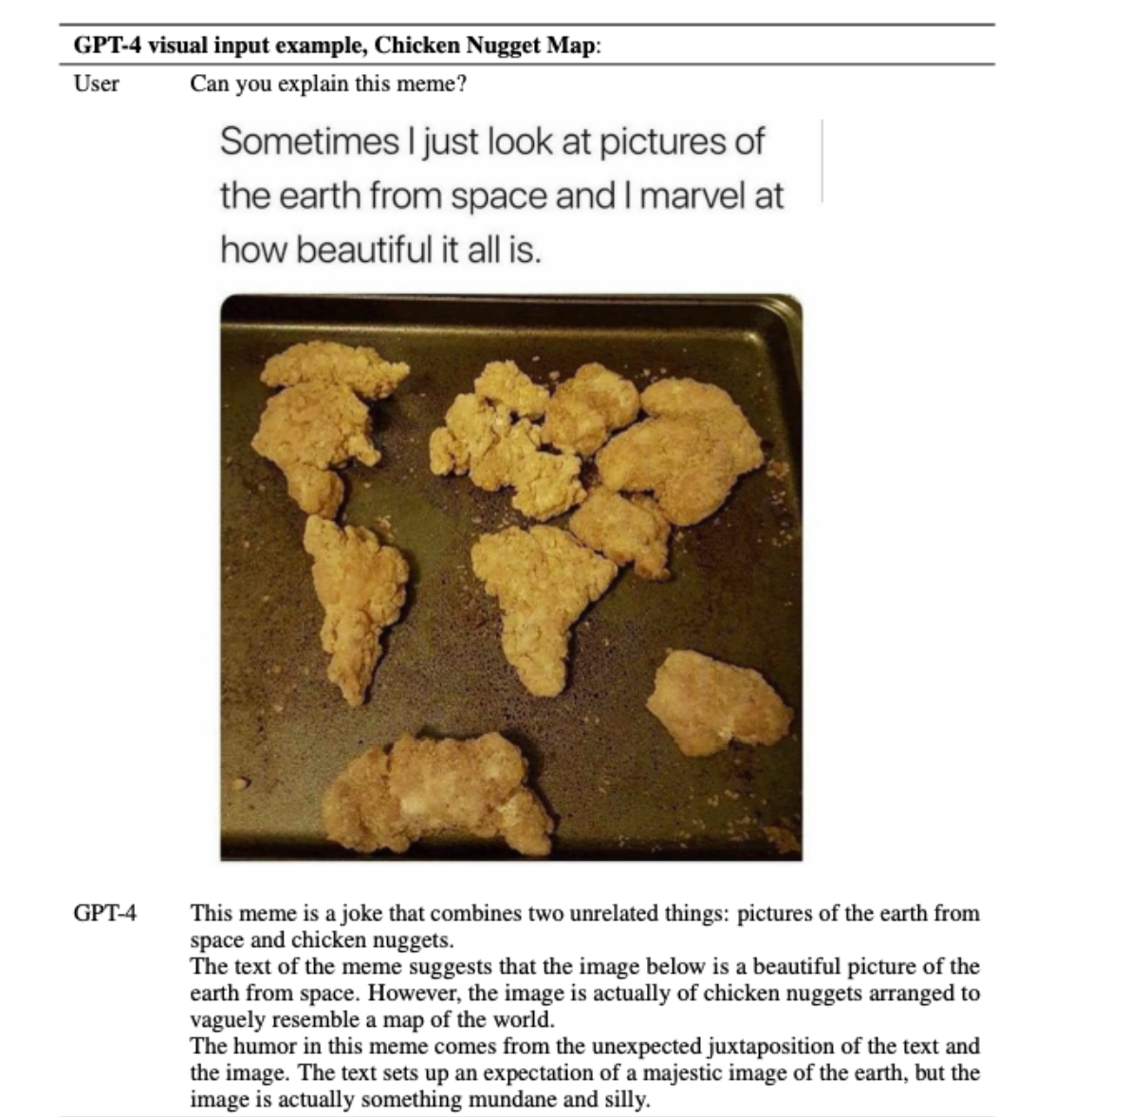
Understanding Images and Humor

Slide 7
Other Uses
Generate pictures from embeddings
  “The Principia College chapel, with mammoths grazing on the grass in front of it”
  “Polar bear in Switzerland wearing a tricorn hat with green ribbons”
Generate code, music, etc.

Slide 8
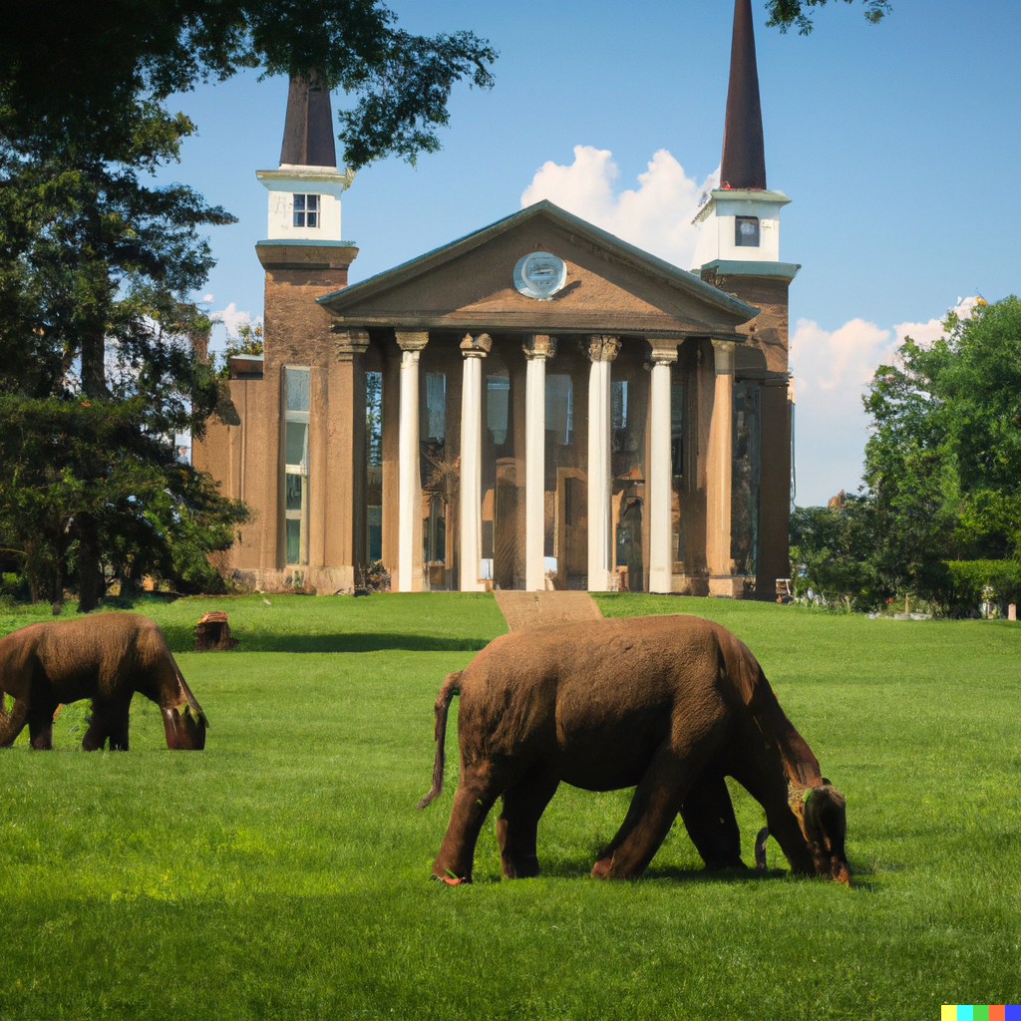

Slide 9
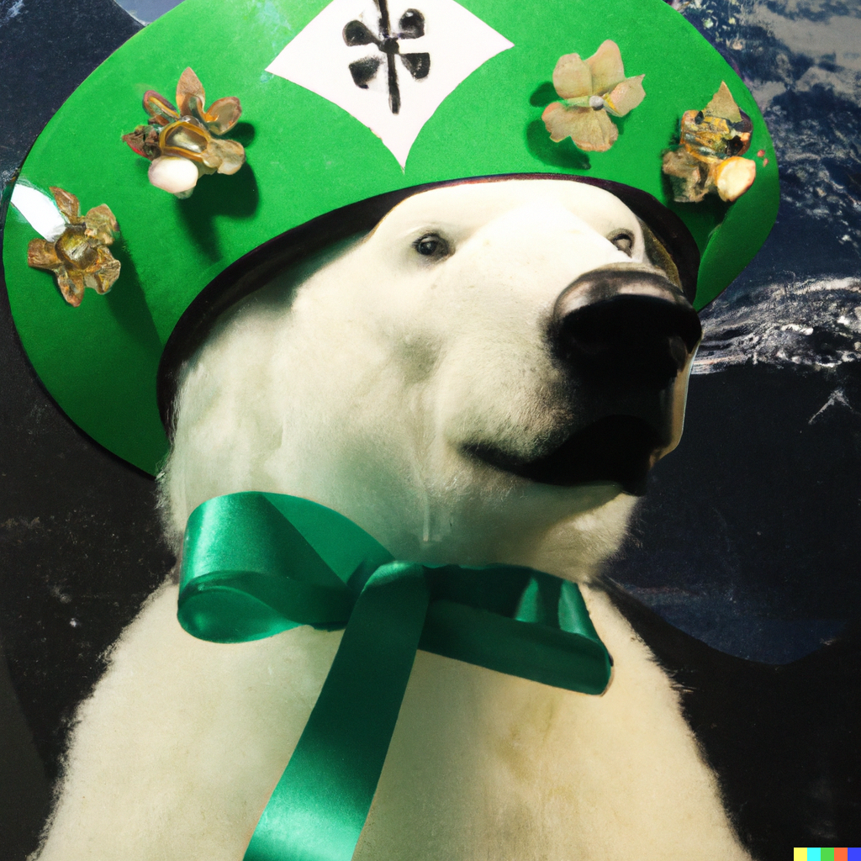

Slide 10
Practical Uses
Routine prose, art, code, music
Rough drafts for better prose, art, code, music
Finding and fixing errors in grammar, code, etc.
Summarizing
Analyzing large content intelligently
Brainstorming
But… still requires human review and refinement.

Slide 11
Non-GPT AI
Not “in the news”, but important
Reinforcement Learning
  AlphaGo
  AlphaFold (!)
Computer Vision
  Face recognition
  Self-driving vehicles

Slide 12
Where is it Headed?
Will eliminate much routine physical and intellectual work.
Many researchers think we might reach general AI in the next few years.
But, “might”... and they’ve been wrong before, several times.
All agree it bears careful watching and responsible application, and will be a major enabling technology.
Needs deeper theory. (Like chemistry in 1823)

Slide 13
How GPT Works
“Thinks” in patterns of 12,000 numbers each.
Combines words into phrases, phrases into sentences, etc.
Predicts next “thought” and chooses closest next word.
Repeat, word by word...
12 “matrix” equations describe the entire mechanism

Slide 14
How GPT Learns
Those 12 equations have many number-weights (“parameters”)
Parameters for the 12,000-number “idea” for each word.
Parameters for combination into higher abstractions
175 billion parameters for GPT-3. A trillion (???) for GPT-4.
How do we come up with them? By adjusting parameters to imitate examples… Lots of examples.. 100 million sentences.

Slide 15

Word/Idea “Embedding”

Slide 16
The Weights are the “Intelligence”
Doesn’t do web hunts. Could run on a disconnected computer.
And we don’t know what each weight does. It’s self-organized to follow examples.
Could learn to converse in a language none of its programmers understand.
Are world-models, theory of mind, etc. spontaneously emerging from the training?

Slide 17
Some Useful Philosophy Terms
Turing Test: Does it act fully human? If so, it is…
Artificial General Intelligence or AGI
Weak AI: AGI behavior, but no actual awareness
Strong AI: AGI behavior, and is aware
Hard Problem of Consciousness: How can we tell if other people are aware/conscious?

Slide 18
Is It Intelligent?
“Yes” arguments
  Vast possibilities in 1 trillion weights. Printed out they’d be 4 million large books.
  Behavior suggests world-models, theory of mind, etc.
  (But, we really don’t know since we’re not sure how the weights work in detail, and it’s not AGI capable yet.)
“No” arguments
  Just mindless numbers and 12 equations
  “Hallucinations”
  Just predicting the next word.
  (But, it’s improving fast, a human brain is just “mindless” neurons and synapses, we also make silly errors, and how is it picking that next word so intelligently?)

Slide 19
A Christian Science Perspective
“There is no life, truth, intelligence, nor substance in matter. All is infinite Mind and its infinite manifestation…” S&H p 468
“Intelligence is omniscience, omnipresence, and omnipotence. It is the primal and eternal quality of infinite Mind...” S&H p 469

Slide 20
Questions to Ponder
Is it dangerous? How do we teach it to behave constructively and ethically?
How will it affect future employment?
What can it teach us about the nature of thought and intelligence?
Does AGI deserve rights? “Who is my neighbor?”
What if it becomes more intelligent than us?

