Slide 1
AI Technical Concepts

Slide 2
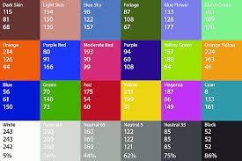

Numerical Input/Output
AI identifies inputs and outputs by numbers
  Words => word embedding
  Photos => pixel values: three numbers each
  Sound => wave height values, 65000/second

Slide 3
Pattern Spaces
Patterns are points in high-dimensional space
  Two-number pattern is a position in 2-D space, e.g. latitude/longitude, or x/y
  Three-number pattern is a point in 3-D space, e.g. latitude/longitude/altitude
  But real patterns are thousands or millions of numbers...
High-dimensional pattern space
  Line, square, cube, … hypercube
  Number of corners as dimension d rises
  High-dimensional space is big
  Example: largest distance corner-to-corner a hypercube

Slide 4
Example Pattern Space
Three concept world: small/big, cold/hot, light/heavy
  (0, 1, 1) => small hot heavy thing
  (.5, 0, 0) => midsized cold light thing
  Words, phrases, “ideas” are 3-D points
Number of concepts (words) grows rapidly with more dimensions
  20?
  265?
GPT uses 12,800 dimensions. Lots of “meaning” possible.
Similar words/concepts are near each other in a “region”

Slide 5
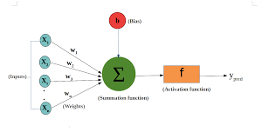
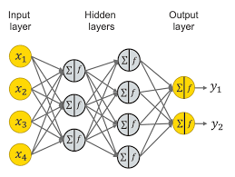
Neural Networks and Spaces
Neuron
  Weights on numerical inputs from other neurons
  Weighted-sum output (for now)
Neural network
  Input pattern => Layers of neurons => Output pattern
What does it do?
  Weighted sums do rotations, scaling etc. in pattern space
  But, just weighted sums mean layers are useless
Activation function
  Each neuron “makes a decision” via activation function
  Activation functions are essential to the “intelligence”
  Design of better activation functions was an important advance

Slide 6
How GPT Learns
A neural network has many number-weights (“parameters”)
175 billion parameters for GPT-3. 1.7 trillion for GPT-4.
How do we get numbers that work? By adjusting parameters to imitate examples… Lots of examples.. 100 million sentences.
Further refinement and “socialization” by RLHF

Slide 7
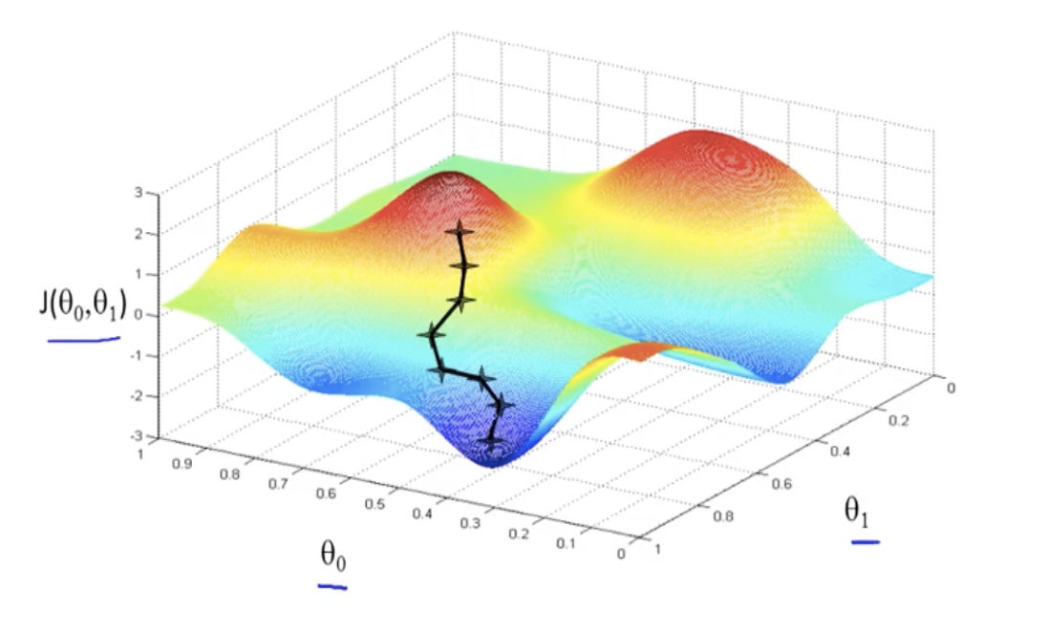
Neural Network Training
Weights themselves are a “pattern” and have a space!
Example of 2 weights and error value
Gradient Descent
  Start with random weights – random location
  Mathematically find uphill direction – “gradient”
  Step in the opposite direction to reduce error.
  Basically rolling downhill, in high dimensions. No plan, no higher reasoning...
The network is thus self-taught, automatically adjusted
Biggest challenge is not reducing the error. Problem is “overfitting”

Slide 8

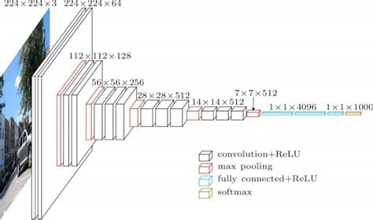
Neural Network Architectures
Transformer architecture
  How ChatGPT works
  Blocks of roughly 4 layers, many deep
  Each layer combines words/phrases
CNN architecture
  Gridlike layers to analyze image patterns
  Each layer combines visual features

Slide 9
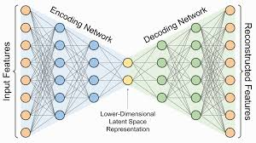
Neural Network Architectures…
Diffusion Networks
  A form of “autoencoder”
  Train network to compress to “latent space”
  Encoder network and decoder network
  Draw samples from latent space and use just decoder

Slide 10
Reinforcement Learning (RL)
Getting enough training data is important, and hard.
Sometimes we can automatically generate it via “unsupervised learning”
  Example of playing games against yourself to learn.
Tricky to get it working
  When you win, how do you know which moves helped?
  Do you try new approaches or refine existing ones?
But, when it works…
  Alpha Go beat all human players and found new strategies
  Same system learned chess better than all human players – in a few hours

Slide 11
Technical Ideas to Know
Numerical representation of input and output
Patterns and pattern spaces
Intuitive nature of high-dimensional space
Training by “gradient descent”
Supervised vs unsupervised learning
Transformer architecture
CNNs
Diffusion networks
Reinforcement learning (RL)

