Slide 1
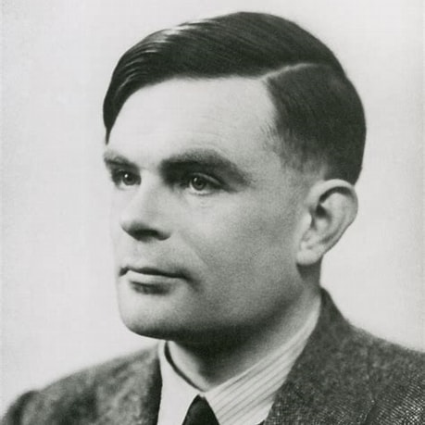
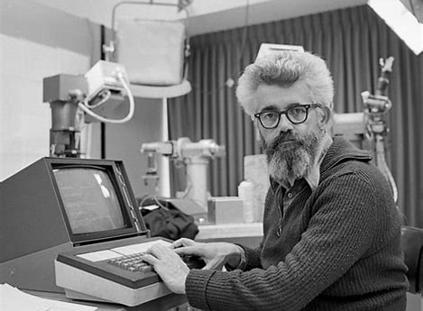
AI Events and People 1950s
(1912-1954) Alan Turing
  Theoretical father of CS. “Turing Test”
  Early thoughts on “connectionist” AI – forerunner to deep learning
(1956) “Dartmouth conference”
  John McCarthy coins “Artificial Intelligence”
(1956) Logic Theorist
  First good “theorem prover” – symbolic AI

Slide 2
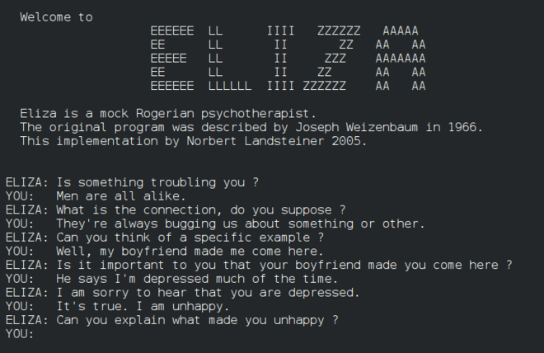
AI Events and People 1960s
(1965) ELIZA
  Very basic “chatbot” in 200 lines of code
(1967) Minsky: “Within a generation … the problem of creating artificial intelligence will substantially be solved.”
(1968) First chess-playing program able to beat a decent human player
(1969) Minsky and Papert publish “Perceptrons”
  Proves early neural networks very limited
  One of the triggers of 1970s “AI winter”

Slide 3
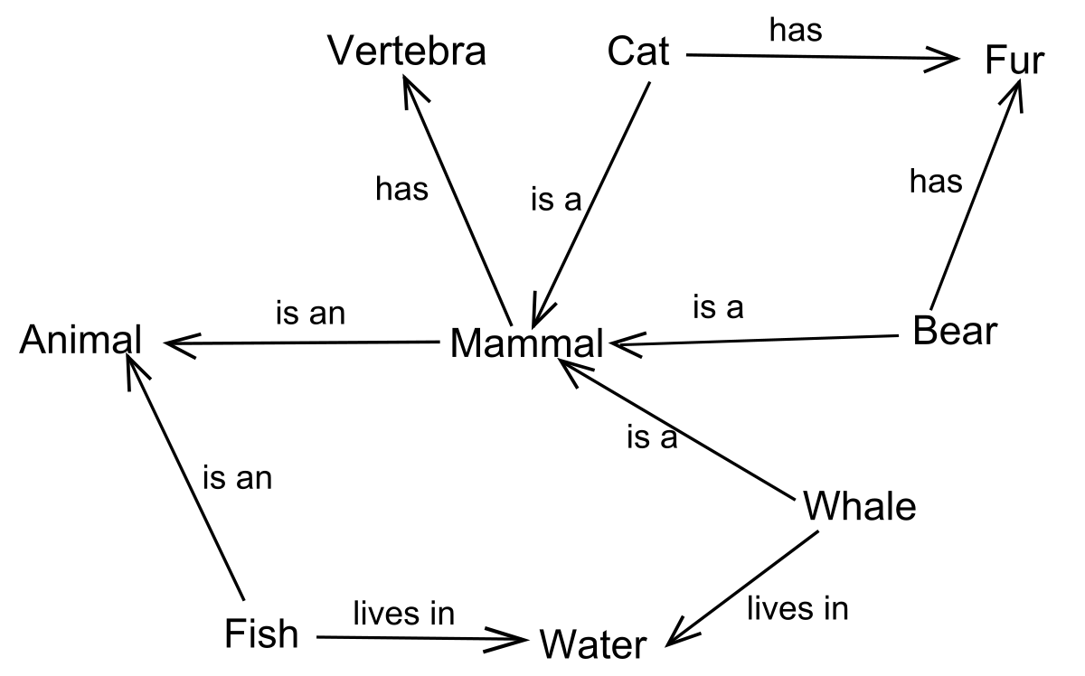
AI People and Events 1970-1985
First “AI Winter”
(1974) Paul Werbos PhD describes neural net backpropagation algorithm in detail. No one notices.
Gradual development of symbol/logic based AI
(1982) Japan announces “5th generation computing” project – hardware devoted to expert systems or symbolic reasoning
Various limited success with expert systems

Slide 4
AI People and Events 1985-1990
(1986) Backpropagation algorithm rediscovered. Neural nets are back, briefly.
  But training > 3 layers proves very hard.
Continued work on symbolic AI and expert systems.
  But, symbolic AI is limited..
  .. and fragile
  .. and 5th generation project peters out

Slide 5
AI People and Events 1990-2012
Second “AI winter”
Gradual improvements in neural networks, by Geoff Hinton, Ilya Sutskever, Yan LeCunn, Yoshua Bengio and many others.
Other pattern recognition methods, e.g. SVMs, explored.
Various limited neural net successes e.g. character recognition for written digits.

Slide 6
AI Events 2012-2017
Four important advances lay ground for new neural network growth
  more available training data via internet
  computing power via GPUs
  Better neural twork design: “activation functions” and architectures (neural net => deep learning)
  Vibrant research community
(2012) Surprise success of neural networks in image recognition
(2015) “LSTM” architecture improves language processing
(2017) Alpha Go beats world Go champion

Slide 7
Last 7 years
(2017) Vaswani et al publish “All you Need is Attention”
(2020, 2022, 2023) OpenAI releases GPT-3, GPT-3.5, GPT-4
(2020) Deep learning solves protein folding
(2020 – 2024) Diffusion models generate images and movies

Slide 8
AI Events 2025
Nobel Prizes
  Physics to John Hopfield and Geoffrey Hinton
  Chemistry to the developers of Alpha Fold
Improved LLM Architectures
  MoE – “Mixture of Experts”
  CoT – “Chain of Thought”
DeepSeek
  Chinese innovators
  Demonstrates much more efficient use of computation

Slide 9
AI History – Big Ideas
Early investigation of major ideas
  Neural networks since 1960s
  Early “chatbots” in 1960s
Alternating optimism and AI winters
  Easy to underestimate the challenge
  Repeated pattern of giving up on neural networks prematurely
Symbolic logic vs Pattern Recognition
  The former looked promising; the latter worked.
  “Bitter Lesson” – don’t program AI directly; let it self-organize

Slide 10
AI Future – Where is it heading?
“… heavier than air flying machines are impossible”
  Lord Kelvin, 1895
Alchemistic Empiricism
  Analogy of chemistry in 1825
  Results in fits and starts as we try things out by guess-and-by-golly
Start with Nature, End with Design
  Planes vs birds
  Deep Learning vs brains : Geoff Hinton’s warning

Slide 11
What Does History Tell Us Now?
LLMs are only part of the story
Expect some period of slowdown / disillusion
  Very often true for exciting new tech, e.g. internet in 1999
But, long term, expect continued progress
  Each “winter”, short or long, was followed by big jump forward
Big advances may result from:
  Better theoretical understanding
  Improvements on nature

