Slide 1
Introduction
A personal computer has a microprocessor that manages the computer's arithmetical, logical and control activities.
Each family of processors has its own set of instructions for handling various operations like getting input from keyboard, displaying information on screen and performing various other jobs. These set of instructions are called 'machine language instructions'.
Processor understands only machine language instructions which are strings of 1s and 0s. However machine language is too obscure and complex for using in software development. So the low level assembly language is designed for a specific family of processors that represents various instructions in symbolic code and a more understandable form.

Slide 2
Assembly language is a low-level programming language for a computer, or other programmable device.
It is specific to a particular computer architecture in contrast to most high level programming languages, which are generally portable across multiple systems.
Assembly language is converted into executable machine code by a utility program referred to as an assembler eg NASM, MASM etc.

Slide 3
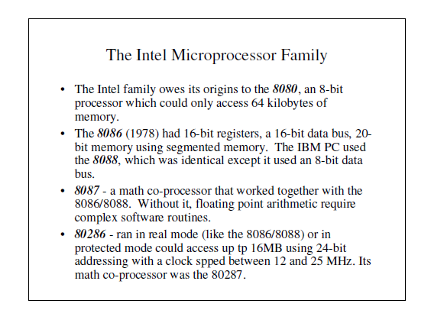
History of the Microprocessor Family

Slide 4
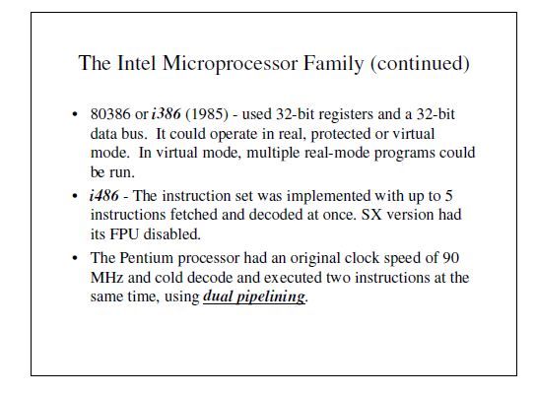

Slide 5
Advantages of assembly language programming
An understanding of assembly language provides knowledge of:
Interface of programs with OS, processor and BIOS;
Representation of data in memory and other external devices;
How processor accesses and executes instruction;
How instructions accesses and process data;
How a program access external devices.
Advantages of using assembly language are:
• It requires less memory and execution time;
• It allows hardware-specific complex jobs in an easier way;
• It is suitable for time-critical jobs;
• It is most suitable for writing interrupt service routines and other memory resident programs

Slide 6
Functional Organization of Computer Hardware

Slide 7
Central Processing Unit (CPU)
Also known as the Processor- most important component of the computer.
regarded as the brain of the computer. This is so because all data processing and control operations are coordinated here.
In micro computers, the CPU is housed inside the system unit. It is mounted on a circuit board known as, the motherboard or the system board.
The CPU has three different functional units called arithmetic and logic unit, control unit and the main memory.

Slide 8
Arithmetic and Logic Unit (ALU)
A unit of CPU where all arithmetic and logical operations are carried out.
The basic arithmetic operations include; addition, subtraction, multiplication and division.
Logic operations are based on the computers capacity to compare two or more values. For example, it may compare whether a piece of data is greater than or less than, equal to or not equal to.
In order for the ALU to be able to process data, it has special temporary storage locations called registers, which hold the data just before processing and hold the results after processing.

Slide 9
Control Unit
Coordinates all processing activities in the CPU as well as input, storage and output operations.
It determines which operation or instruction is to be executed next.
To coordinate these activities, the control unit uses a system clock. The system clock sends electric signals as its means of communication, just like the way the traffic is controlled.
The number of pulses per second determines the speed of a microprocessor. The faster the clock pulses, the faster the CPU hence the faster the computer can process data.

Slide 10
Main Memory(Primary memory/working storage)
Also known as primary storage it provides storage location for data and instructions accessed by the control unit.
Computer memory can be classified into read only memory (ROM) and random access memory (RAM).

Slide 11
Overall functional organization of the CPU
The arithmetic and logic unit, the control unit and the main memory use electrical pathways or links referred to as buses.
There are three types of buses namely;
Control bus: This is the pathway for all timing and controlling functions sent by the control unit to other parts of the system. Address bus: This is the pathway used to locate the storage position in memory where the next instruction data to be processed is to be found. Data bus: This is the pathway where the actual data transfer takes place.

Slide 12
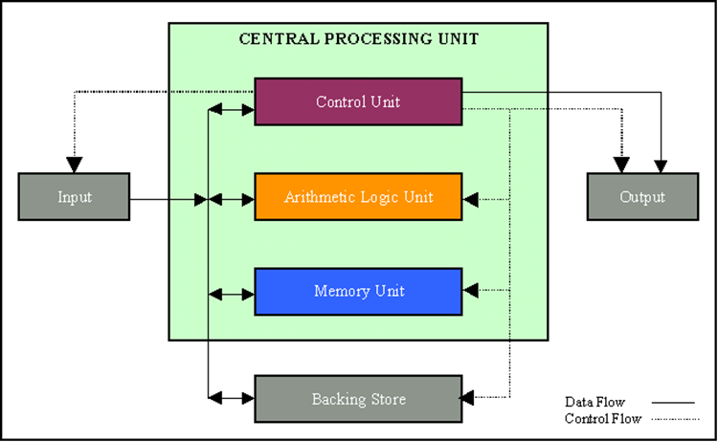

Slide 13
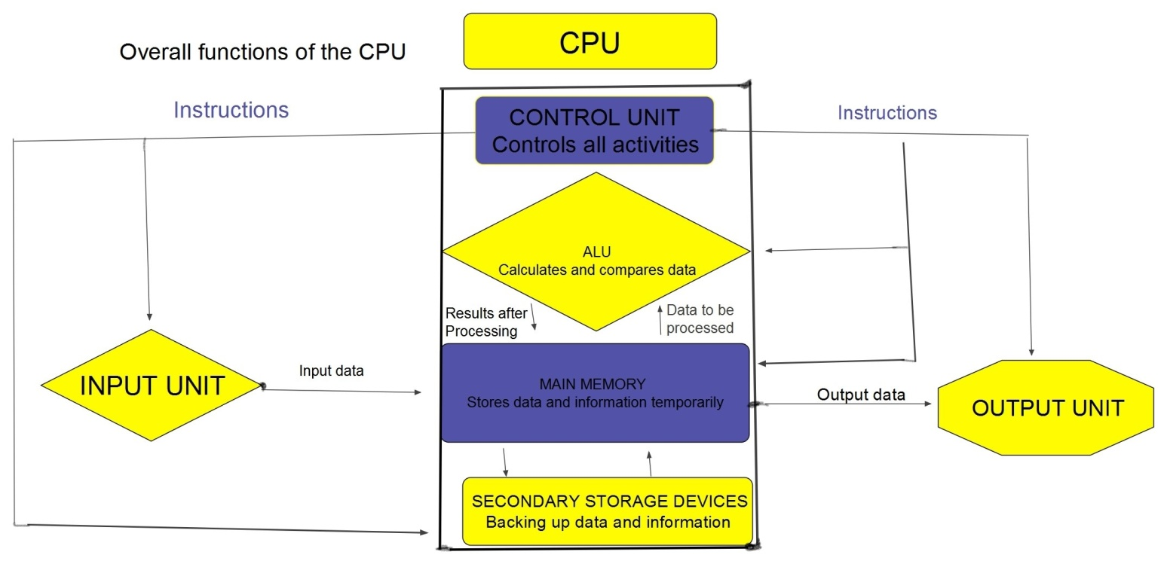
The figure below shows a summary of the overall organization of the CPU and how it controls other computer components.

Slide 14
Assemblers, Linkers and Loaders

Slide 15
Assembly is a low-level task- Need to assemble assembly language into machine code binary.
Requires - Assembly language instructions - pseudo-instructions - And Specified layout and data using assembler directives
Today, we use a modified Harvard Architecture (Von Neumann architecture) that mixes data and instructions in memory, but kept in separate segments, and has separate caches

Slide 16
Assembler
A program which converts assembly language into machine code.
A computer doesn’t understand human languages but it deals in a much simpler language called binary language, however a programmer can not write the whole program with its complexity in a binary language therefore we need a program that can convert the human written language (assembly language) into binary language, these softwares are called assemblers.
In assembler, a programmer can write a program into sequence of assembler instructions. The sequence of assembler instruction is known as source code and source program.

Slide 17
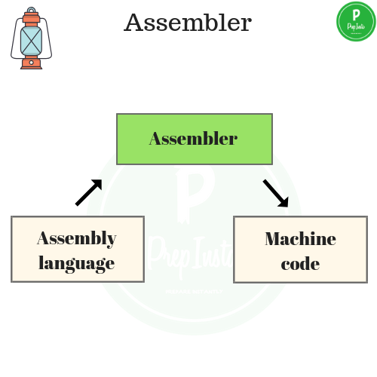

Slide 18
Compiler
A Compiler is a program that converts a number of statements of a program into binary language.
It is more intelligent than an interpreter because it goes through the entire code at once and can tell the possible errors, limits and ranges.
However, this makes it’s operating time a little slower.
It is platform-dependent, it helps to detect error and gets displayed after reading the entire code by compiler.
In other words we can say that; Compilers turns the high level language to binary language or machine code at once

Slide 19
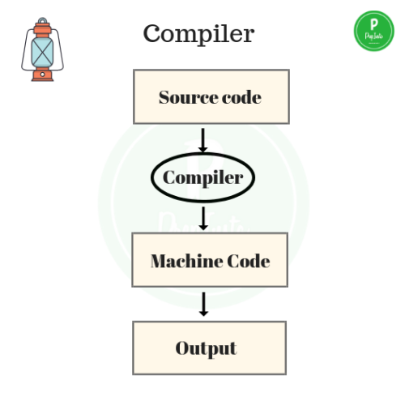

Slide 20
Linker
For a code to run we need to include a header file or a file saved from the library which are pre-defined.
If they are not included in the beginning of the program then after execution the compiler will generate errors, and the code will not work.
Linker is a program that holds one or more object files created by compiler, then combines them into one executable file.
Linking is implemented at both load time and compile time. Compile time is when high level language is turned to machine code and load time is when the code is loaded into the memory by loader.

Slide 21
Linker is of two types:
1.Dynamic Linker:-
It is implemented during run time.
It requires less memory.
In dynamic linking there are many chances of error and failure
Linking stores the program in virtual memory to save RAM, So we have need to shared library
2.Static Linker:-
It is implemented during compilation of source program.
It requires more memory.
Linking is implemented before execution
It is faster and portable.
There are less chances of error and No chances to failure.

Slide 22
Loader
A program that loads machine codes of a program into the system memory.
It is part of the O/S of the computer that is responsible for loading the program.
It is the bare beginning of the execution of a program.
Loading a program involves reading the contents of executable file into memory. Only after the program is loaded, the operating system starts the program by passing control to the loaded program code.
All operating systems that support loading have loaders and many have loaders permanently in their memory.

Slide 23
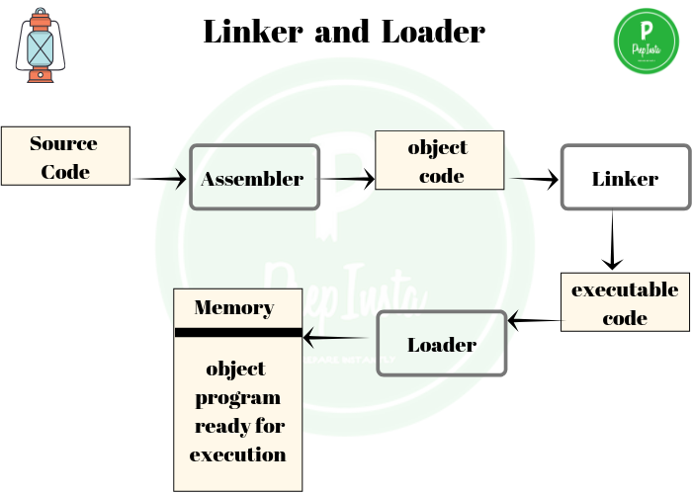

Slide 24
Conclusion
Compiler produces assembly files (contain RISC-V assembly, pseudo-instructions, directives, etc.)
Assembler produces object files (contain RISC-V machine code, missing symbols, some layout information, etc.)
Linker joins object files into one executable file (contains RISC-V machine code, no missing symbols, some layout information)
Loader puts program into memory, jumps to 1st instruction, and starts executing a process (machine code)

