Slide 1
Design, implementation and debug programs in an assembly language

Slide 2
ASSEMBLING LANGUAGE OVERVIEW
An assembly program is written using a simple text editor.
Each assembler has specific syntax rules regarding the structure of the source file and the names that are used to represent assembler directives , opcodes , and operands .
There are also syntax rules regarding comments in the file.

Slide 3
Getting Started
you will need some software, namely an assembler and an editor.
An Assembler takes the written assembly code and converts it into machine code. Often, it will come with a linker that links the assembled files and produces an executable from it.
Windows executables have the .exe extension. Here are some of the popular ones:
1. MASM –Originally by Microsoft, it's now included in the MASM32v8 package, which includes other tools as well. You can get it from http://www.masm32.com/
2. TASM – Another popular assembler. Made by Borland but is still a commercial product, so you can not get it for free.
3. NASM – A free, open source assembler, which is also available for other platforms. It is available at http://sourceforge.net/projects/nasm/
Note that NASM can't assemble most MASM programs and vice versa.

Slide 4
An editor is where you write your code before it is assembled. Editors are personal preferences; there are a LOT of editors around, so try them and pick the one you like.
1. Notepad – Comes with Windows; although it lacks many features, it's quick and simple to use.
2. Visual Studio – Although it's not a free editor, it has excellent syntax highlighting features to make your code much more readable.

Slide 5
Assembler process
Create source file using a text editor and save it (.ASM)
Execute commands from a DOS prompt to assembler your text file and create an output hex file with a .HEX extension (e.g ASM51) <filename> [options])
If errors occur during the assembly, edit the source file to correct the syntax error. A listing file (.LST) may be used to see what error the assembler encountered. (e.g, to create a .LST file, use: ASM51<filename>-F)
Once the assembler executes without error, load the .HEX file into a simulator, or into your target hardware (into EPROM , flash , or RAM)
Execute your code and continue the debugging process

Slide 6
USING DEBUGGER
A debugger displays the contents of memory and lets you view registers and variables as they change. You can step through a program one line at a time (called Tracing), making it easier to find logic errors.
Some of the most rudimentary functions that any debugger can perform are;
▪ Assemble short programs
▪ View a program’s source code along with its machine code
▪ View the CPU registers and flags
▪ Trace or execute a program, watching variables for changes
▪ Enter new values into memory
▪ Search for binary or ASCII values in memory
▪ Move a block of memory from one location to another
▪ Fill a block of memory
▪ Load and write disk files and sectors
Debug commands may be divided into four categories namely;

Slide 7
Program Creation and Debugging
i. A-Assemble a program using instruction mnemonics e.g. A 100 ; Assembles at CS:100h
When you press Enter at the end of each line, debug prompts you for the next line of input. Each input line starts with a segment-offset address. To terminate input, press the Enter key on a blank line.
ii. G-Execute the program currently in memory
iii. R-Display the contents of registers and flags
iv. P-Proceed past an instruction, procedure, or loop
v. T-Trace a single instruction
vi. U-Disassemble memory into assembler mnemonics

Slide 8
Memory Manipulation
i. C-Compare one memory range with another
ii. D-Dump (display) the contents of memory
iii. E-Enter bytes into memory
iv. F-Fill a memory range with a single value
v. M-Move bytes from one memory range to another
vi. S-Search a memory range for specific value(s)

Slide 9
Miscellaneous
i. H-Perform hexadecimal addition and subtraction
ii. Q-Quit Debug and return to DOS

Slide 10
Input-Output
I. I-input a byte from a port
II. L-load data from disk
iii. O-Send a byte to a port
iv. N-Create a filename for use by the L and W commands
v. W-Write data from memory to disk

Slide 11
Every program has 2 parts: data, logic
– Most program bugs occur in the logic
2 approaches to debbuging;
1st: synthesis– Try to fix the problem by changing the code somewhere
– Wrong!
2nd: analysis– Try to find out what your program is doing before any fixes
– Right!

Slide 12
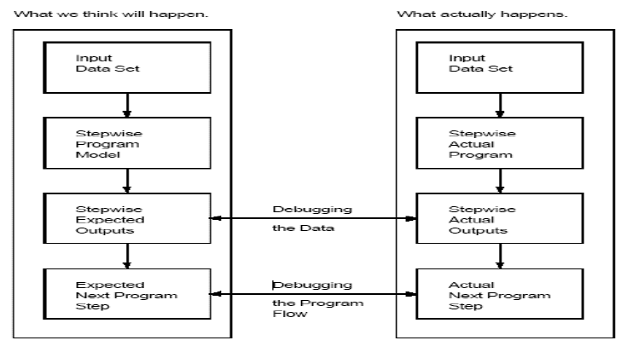
Actual process

Slide 13
Choose an input data set
Predict what the program will do with the input data set at each step of the program, and what the program will do next (the program model)
Now run the program, and look for data values and program steps that differ from the prediction
Once we find out where the program deviates from the prediction, we are on track to finding the bugs and fixes for the bugs

Slide 14
Debugging Program Flow/Logic
Program trace: stepping through the program one statement at a time. Values of registers are shown during each step. Data elements in memory have to be checked manually
Breakpoints: much like a high-level language debugger, e.g. Gdb. These cause program flow to be interrupted, and control transferred to the debugger (the user)
Breakpoints can be set at statements, as well as when certain conditions are met, e.g. data elements become some specific values

Slide 15
Debugging Data Elements
Registers: state of the registers must be known at each step. Debugger usually will display contents of all the registers, including the CCR. Watch for any deviating register content values
Memory: usually are displayed in hexadecimal
You will most likely need a source code listing generated by the assembler, not the original source code file. And you will need an up-to-date one!
Debugging plan: no universal solutions, but in general make your code “modularly”

