Slide 1
logic circuits

Slide 2
perform operations on digital signals
Implemented as electronic circuits where signal values are restricted to a few discrete values
In binary logic circuits there are only two values, 0 and 1
The general form of a logic circuit is a switching network

Slide 3
Boolean algebra
Direct application to switching networks
Work with 2-state devices i.e 2-valued Boolean algebra (switching algebra)
Use a Boolean variable (X, Y, etc.) to represent an input or output of a switching network
Variable may take on only two values (0, 1)
X=0, X=1
These symbols are not binary numbers, they simply represent the 2 states of a Boolean variable
They are not voltage levels, although they commonly refer to the low or high voltage input/output of some circuit element

Slide 4
Variables and functions
The simplest binary element is a switch that has two states
If the switch is controlled by x, we say the switch is open if x =0 and closed if x =1

Slide 5
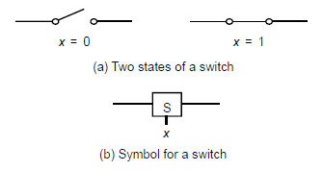
Variables and functions

Slide 6
Assume the switch controls a lightbulb as shown, The output is defined as the state of the light L
If the light is on -> L=1
If the light is off -> L=0
Refer to image on next slide
The state of L, as a function of x is
L(x)=x
L(x) is a logic function
x is an input variable

Slide 7
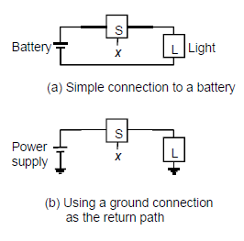
Variables and functions

Slide 8
Variables and functions (AND)
Consider the possibility of two switches controlling the state of the light
Using a series connection, the light will be on only if both switches are closed
L(x₁, x₂)= x₁· x₂
L=1 iff (if and only if) x₁ AND x₂ are 1
The circuit implements a logical AND function

Slide 9
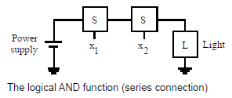
Variables and functions (AND)

Slide 10
Variables and functions (OR)
Using a parallel connection, the light will be on only if either or both switches are closed
L(x₁, x₂)= x₁+ x₂
L=1 if x₁ OR x₂ is 1 (or both)
The circuit implements a logical OR function

Slide 11
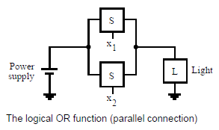
Variables and functions (OR)

Slide 12
Various series-parallel connections would realize various logic functions
Example;
L(x₁, x₂, x₃)= (x₁ + x₂) · x₃

Slide 13
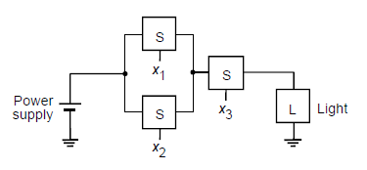
Series-parallel

Slide 14
Inversion
Before, actions occur when a switch is closed.
What about the possibility of an action occurring when a switch is opened?
L(x)= x’
Where L=1 if x=0 and L=0 if x=1
L(x) is the inverse (or complement) of x
The circuit implements a logical NOT function

Slide 15
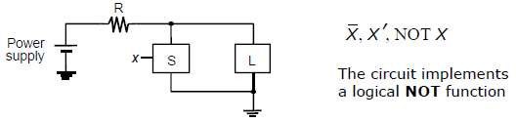
Inversion

Slide 16
Inversion of a function
If a function is defined as f(x₁, x₂)= x₁+ x₂
Then the complement of f is
f’(x₁, x₂)= x’₁+ x’₂ = (x₁+ x₂)’
Similarly, if f(x₁, x₂)= x₁ · x₂
Then the complement of f is
f’(x₁, x₂)= x₁’ · x₂’= (x₁ · x₂)’

Slide 17
Logic gates and networks
Each basic logic operation (AND, OR, NOT) can be implemented resulting in a circuit element called a logic gate
A logic gate has one or more inputs and one output that is a function of its inputs
A larger circuit is implemented by a network of gates– Called a logic network or logic circuit

Slide 18
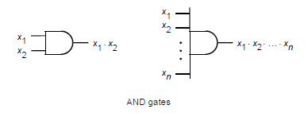
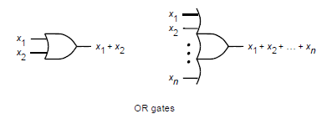
Logic gates and networks (AND, OR)

Slide 19

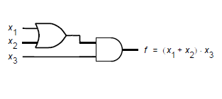
Logic gates and networks (NOT, LOGIC CIRCUIT)

