Slide 1
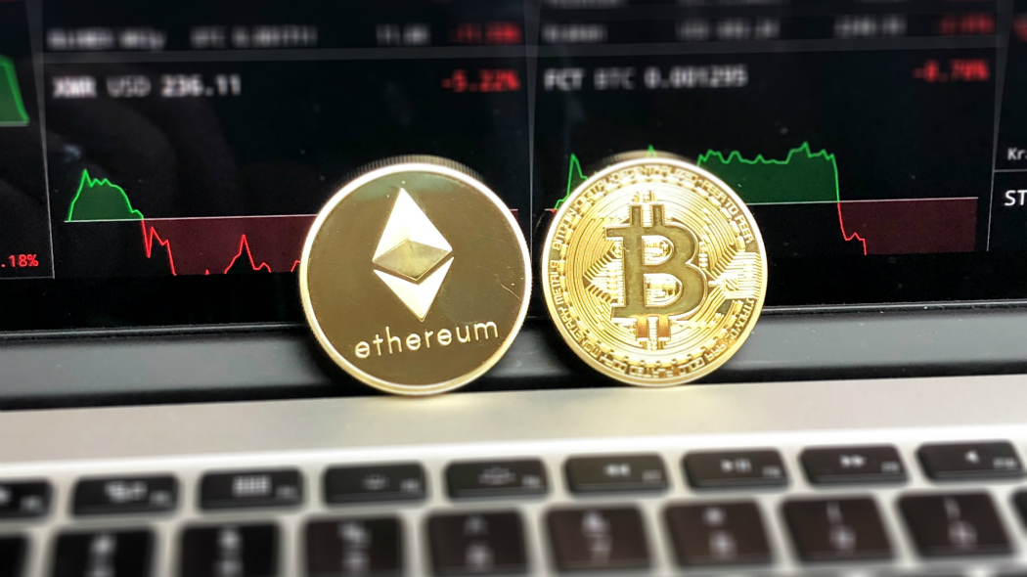
Blockchain overview
1. Introduction to Blockchain
2. How Blockchain works
3. Applications of Blockchain
4. Advantages of blockchain
5. Challenges of Blockchain
6. Future of blockchain
7. Support for/Against the statement
8. conclusion

Slide 2
Introduction to Blockchain
Definition:
A blockchain is a decentralized, distributed digital ledger that records transactions across multiple nodes in a way that ensures data is secure, transparent, and immutable. Each record (block) is linked to the previous one using cryptographic hashes, forming a "chain" of blocks.
It eliminates the need for a central authority or intermediary, relying instead on a consensus mechanism.
Key Characteristics:
Decentralization: Operates on a peer-to-peer network.
Transparency: All participants in the network can view transactions.
Immutability: Once a block is added to the chain, its data cannot be altered without consensus.
Security: Uses cryptography to protect data integrity and ensure trust.
Significance:
The foundational technology behind cryptocurrencies like Bitcoin and Ethereum.
Blockchain is also the backbone of various decentralized applications (DApps) and smart contracts.

Slide 3
How Blockchain Works
Data Storage in Blocks:
Each block contains a list of transactions, a timestamp, and a cryptographic hash of the previous block.
Blocks are added to the chain in a linear, chronological order.
Cryptography:
Transactions are secured using public and private keys.
Hashing algorithms ensure data integrity by creating unique digital fingerprints for each block.
Consensus Mechanisms:
Proof of Work (PoW): Miners solve complex mathematical puzzles to validate transactions (e.g., Bitcoin).
Proof of Stake (PoS): Validators are chosen based on their stake in the network (e.g., Ethereum post-Merge).
Other Mechanisms: Delegated Proof of Stake (DPoS), Practical Byzantine Fault Tolerance (PBFT).

Slide 4
Applications of Blockchain
Finance:
Facilitates cryptocurrency transactions, reducing costs and increasing speed.
Decentralized Finance (DeFi): Peer-to-peer lending, asset management, and tokenized stocks.
Cross-border payments and remittances (e.g., Ripple, Stellar).
Supply Chain:
Tracks products from origin to destination, improving transparency.
Reduces fraud and counterfeiting in industries like food and pharmaceuticals.
Healthcare:
Secures electronic health records, ensuring privacy and data integrity.
Tracks drug manufacturing and distribution to prevent counterfeit medications.
Other Emerging Areas:
Real estate (e.g., tokenized property).
Identity management (e.g., digital IDs like Estonia’s e-Residency).
Voting systems to enhance transparency and security.

Slide 5
Advantages of Blockchain
Immutability: Once recorded, data cannot be tampered with, ensuring trust and accountability.
Transparency: All participants in the network have access to the same version of the ledger.
Decentralization: Reduces reliance on intermediaries, lowering costs and increasing efficiency.
Enhanced Security: Cryptographic techniques ensure that data is secure and only accessible to authorized parties.

Slide 6
PoW-based blockchains (e.g., Bitcoin) consume significant energy, raising environmental concerns.
Challenges of Blockchain
Scalability: Current networks struggle to process large volumes of transactions, leading to delays and high fees.
Energy Consumption: PoW-based blockchains (e.g., Bitcoin) consume significant energy, raising environmental concerns.
Regulatory Uncertainty: Many governments lack clear policies, creating barriers to adoption.
Interoperability: Limited ability to interact across different blockchain networks.
Cost: Initial setup and maintenance costs can be high for organizations.

Slide 7
Future Potential
Digital Identity:
Programs like Estonia's e-Residency allow people to manage secure, digital identities on blockchain.
Blockchain Beyond Cryptocurrency:
Applications in governance, gaming (e.g., NFTs), and Internet of Things (IoT).
Adoption Trends:
Industries are moving from proof-of-concept stages to implementing blockchain for real-world solutions.
Improvements in Scalability:
Second-layer solutions like Lightning Network and blockchain 3.0 innovations promise faster and cheaper transactions.

Slide 8
Statement Analysis: Support For/Against
Support:
Blockchain implementations in 2017 (and beyond) have led to significant real-world applications:
Ethereum introduced smart contracts, enabling decentralized applications.
Financial institutions began using blockchain for cross-border payments (e.g., RippleNet).
Supply chain solutions (e.g., IBM’s Food Trust) gained traction, reducing fraud.
These successes demonstrate that blockchain can move beyond "hype" to practical, revenue-generating applications.
Criticism:
Many blockchain startups failed due to lack of viable business models and technical challenges.
Scalability and energy consumption remain significant hurdles.
Overhyped projects created unrealistic expectations, leading to skepticism.
Balanced View:
While blockchain has achieved significant milestones, it’s not a universal solution. Industries need to evaluate its use case suitability and address scalability and regulatory challenges.

Slide 9
Conclusion
Blockchain has immense potential to revolutionize industries, offering transparency, security, and efficiency. However, realizing this potential requires addressing challenges like scalability and regulatory uncertainty. As adoption grows, blockchain technology will likely transition from hype to a fundamental tool shaping the digital economy.

Slide 10
 | Names | Reg No
1. | CLINTON OMARI | EB3/56416/21
2. | YVONE WARUI | EB3/56405/21
3. | MORINE MAINA | EB3/56368/21
4. | KIPKIRUI BRIAN | EB3/56408/21
5. | STEPHEN MBURU | EB3/56409/21
6. | SAMUEL TAJEWUO | EB3/56414/21
7. | PHELIX OTIENO | EB3/56467/21
8. | RUTH NYANCHAMA | EB3/56449/21
9. | DANIEL MARPE | EB3/56427/21
10. | CLINTON SAGANA | EB3/56450/21

