Slide 1
Command Line Part II
More and better usage of the commands

Slide 2
Pipes and Redirection
The | (pipe) takes the output from the command on the left, and "pipes" it to the command on the right
The < will take and send the input from the file on the right to the program on the left. (I don’t use this
The > takes the output of the command on the left, then writes it to the command on the right.
The >> takes the output of the command on the left, then appends it to the command on the right.

Slide 3
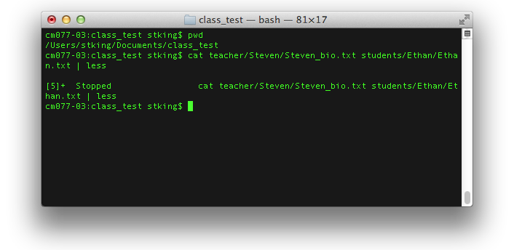
Pipe |
Output of command to another command

Slide 4
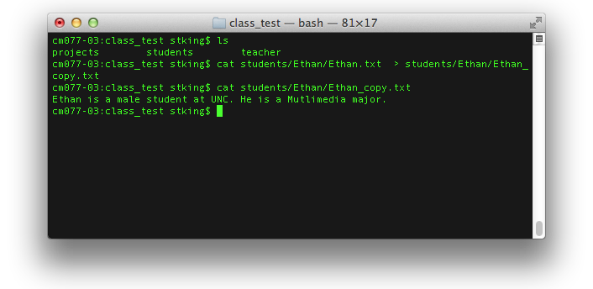
> Pass and Write
Takes output of command and write to file on the right.

Slide 5
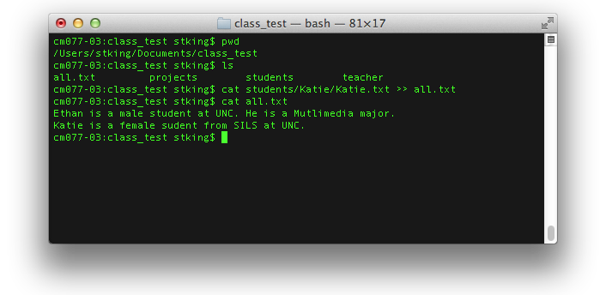
>> Pass and Append
Take command and add to bottom of existing file.

Slide 6
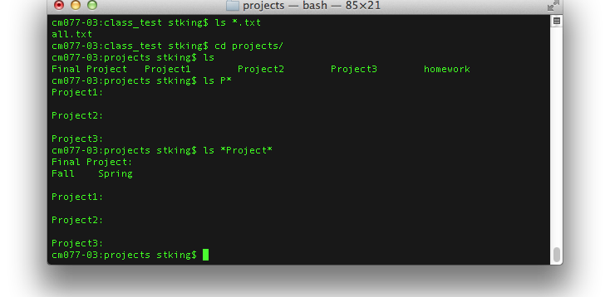
Wildcards *
Matching strings with *

Slide 7
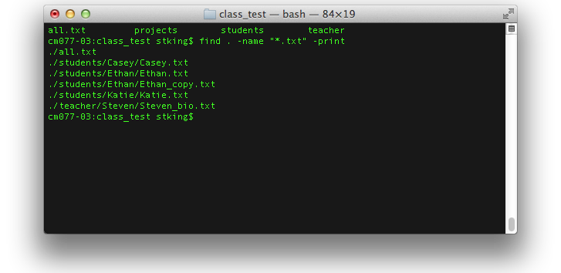
Finding Files
How to find anything!

Slide 8
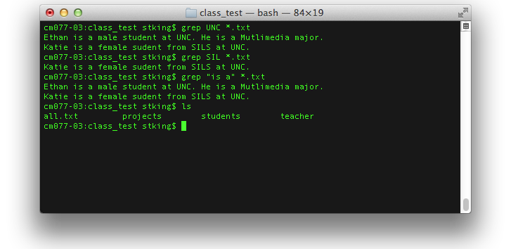
Finding more with grep
Looking Inside Files (grep, select-string)
Comand + string + type

Slide 9
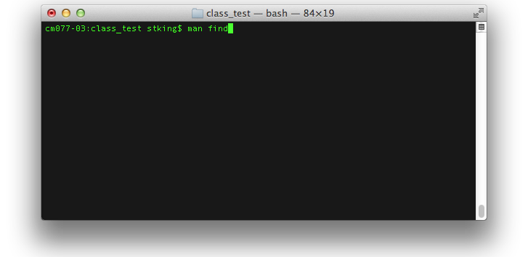
Need help, ask a man!
It’s a joke! Type man for manual.

Slide 10
Assignment 2
Follow the commands on today’s post and save the console log.

