Slide 1
Django Forms
Standard Django Form
Django ModelForm

Slide 2
Standard Form
Django form objects for use inside templates for common tasks such as data validation and HTML generation.

Slide 3
4 Steps
Create forms.py
Update urls.py
Update views.py
Add to template

Slide 4
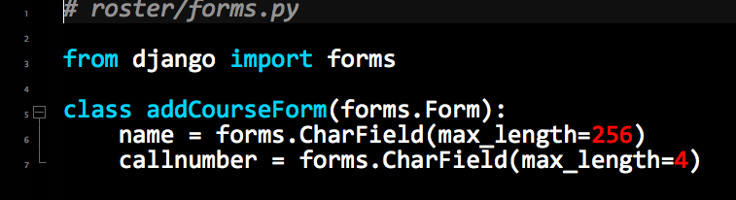
roster/forms.py
create forms.py in your app folder

Slide 5
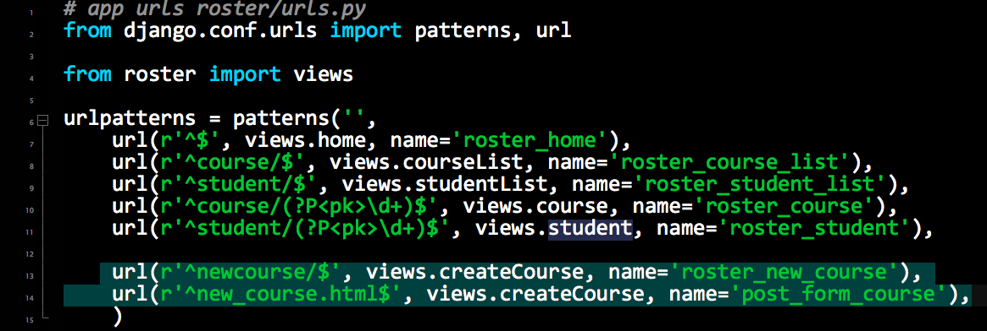
Update urls.py to include post/get url
Add last line

Slide 6
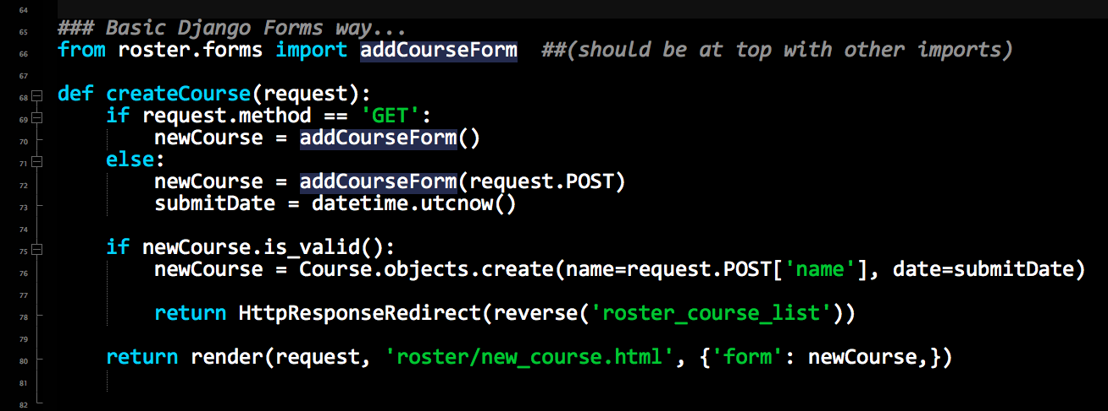
add to views.py

Slide 7
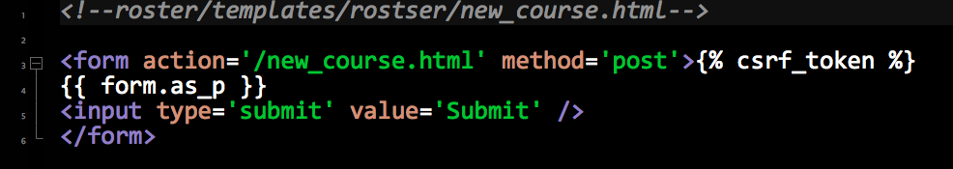
add form code to template.py

Slide 8
test form at /newcourse

Slide 9
Model Forms (A different way)
Similar to previous but it is tied to the model and best used when saving data in Django.

Slide 10
Same steps to setup
Edit forms.py
Update urls.py (same as previous example)
Update views.py
Add to template (same as previous example)

Slide 11
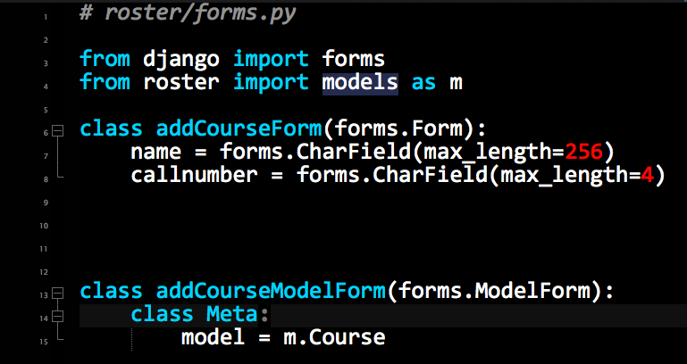
Edit Form

Slide 12
Edit urls.py (same as previous)

Slide 13
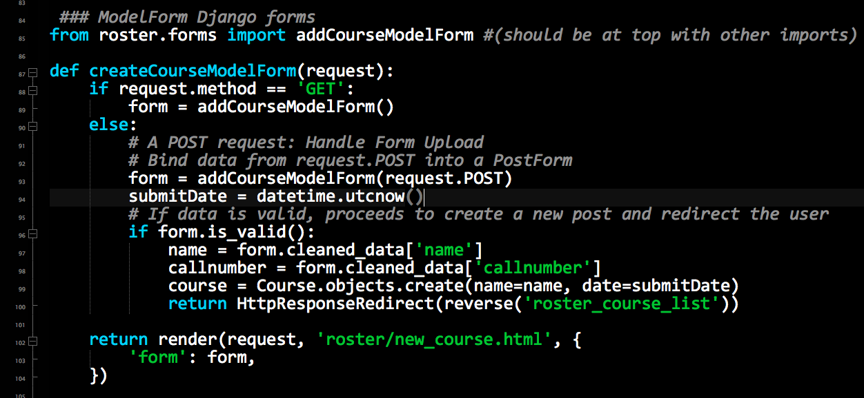
Edit views.py

Slide 14
Edit template (same as previous)

Slide 15
test form at /newcourse

Slide 16
Customization of Form
You can customize the HTML in the template file for the form.

