Slide 1

Intro to Python
Learning the basics, just enough for Django
More to come later as needed.

Slide 2
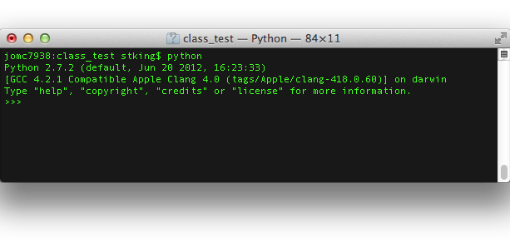
Start Python
Command: python
>>> is the prompt

Slide 3
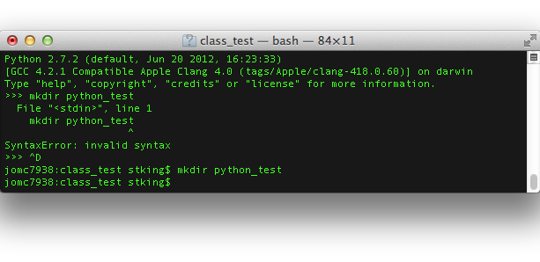
$ vs >>>
Python is a processing language

Slide 4
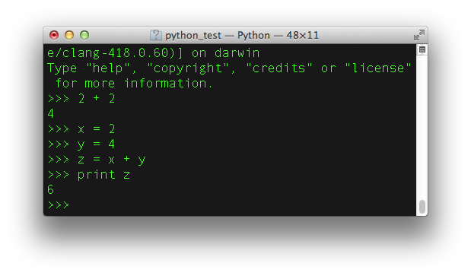
Python Interpreter
Shows how scripts will run.

Slide 5
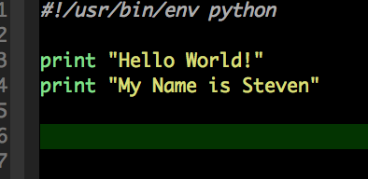
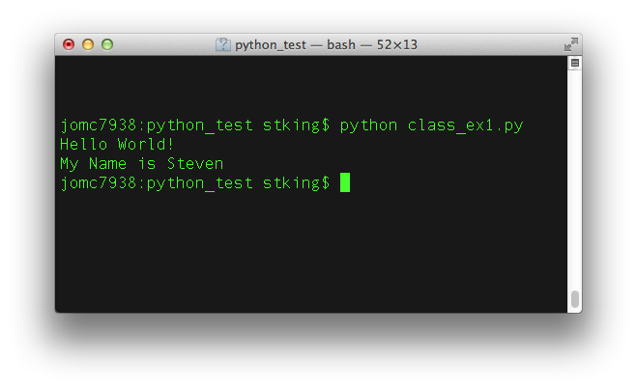
Hello World!
Write the .py
Execute the file

Slide 6
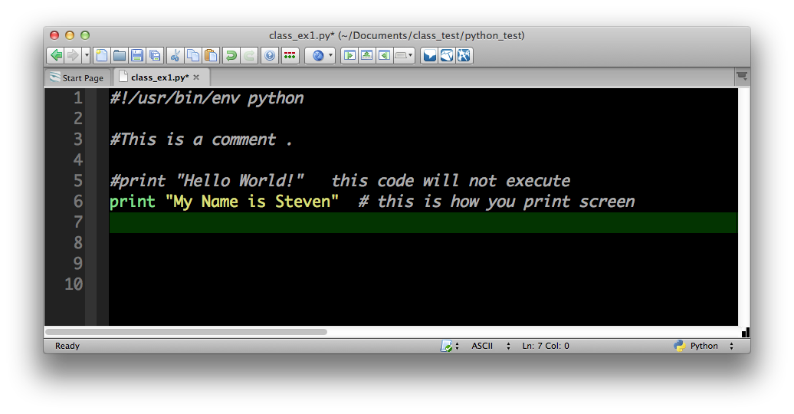
Comments #

Slide 7
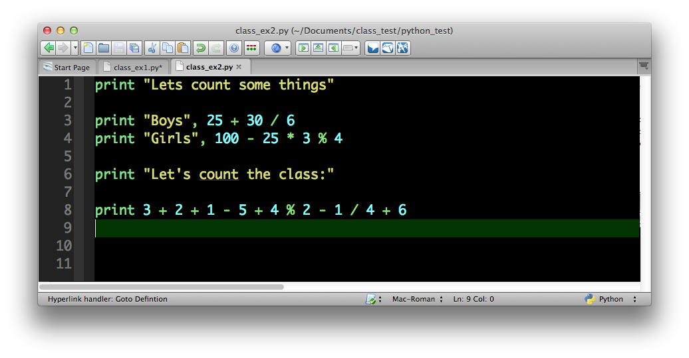
Basic Math
Order of Operations PEMDAS
% remainder of divison

Slide 8
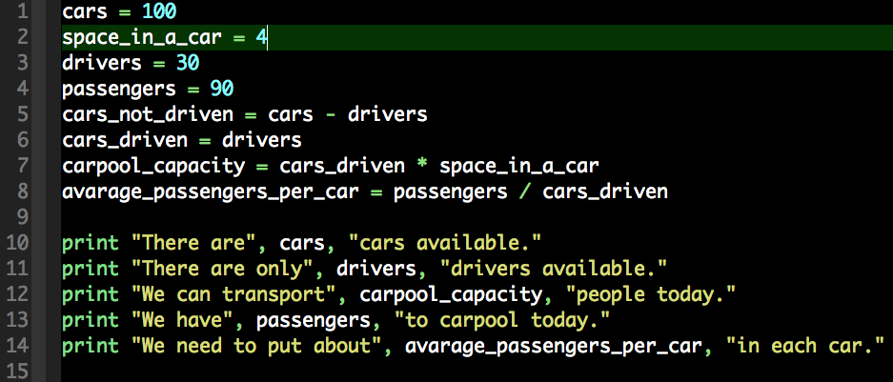
Variables
Substitution representation

Slide 9
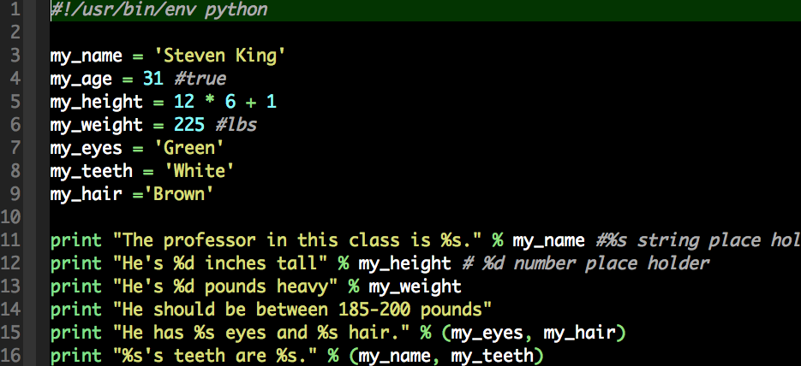
Another Way to do Variables
%s string
%d number

Slide 10
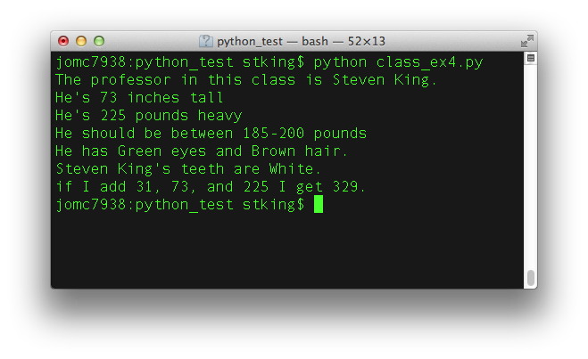
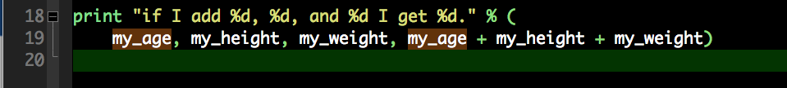
Lets get complicated.
More variables with math.

Slide 11
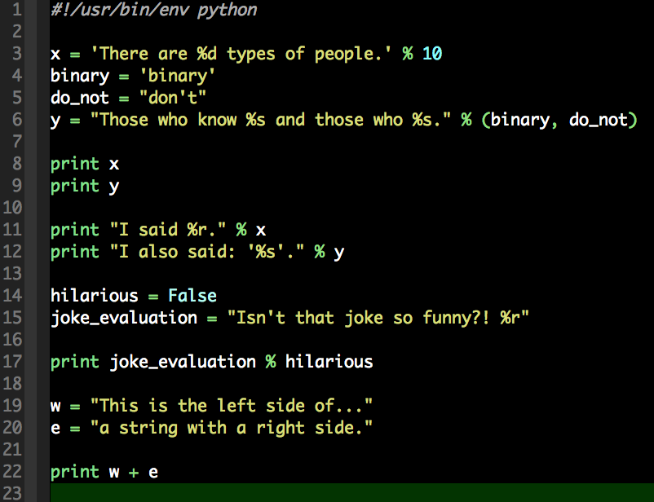
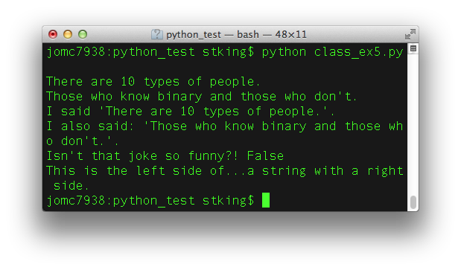
Strings

Slide 12
Assignment 3
Write a Python script that tells a story with names, numbers and math.
Requirements:
Use 5 different variables
Add, Subtract, Multiple and Divide
Display vars as string in both % and name form (, var,)
Bonus: Use the Python interpreter to calculate 5 to the 18th power

