Slide 1

Intro to Python Part II
Functions, Lists, Prompts, etc.

Slide 2
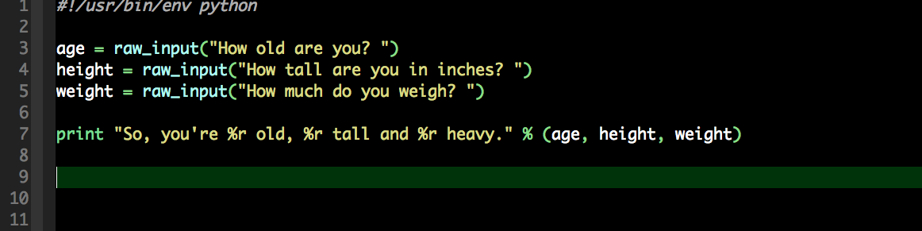
Prompt
Used to received dynamic data for the script.

Slide 3
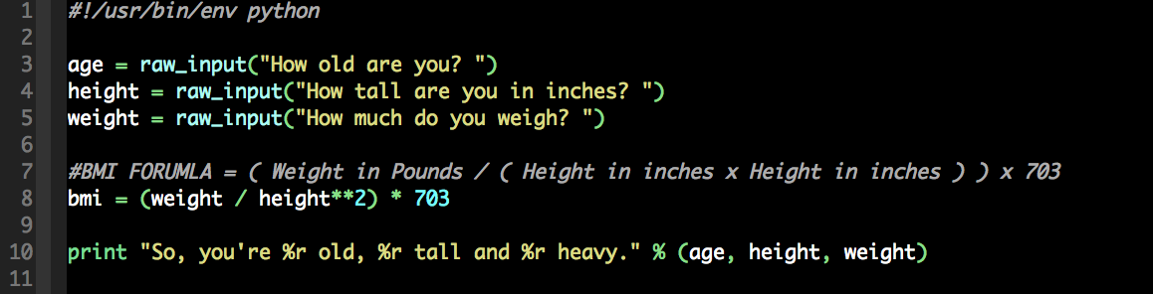
Add some math

Slide 4
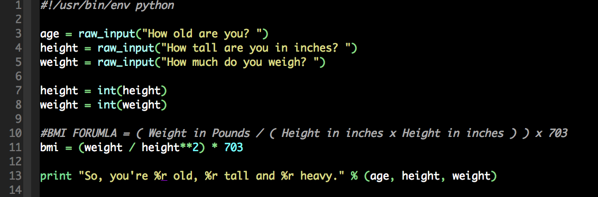
Better Math using int()
Built in integer function.

Slide 5
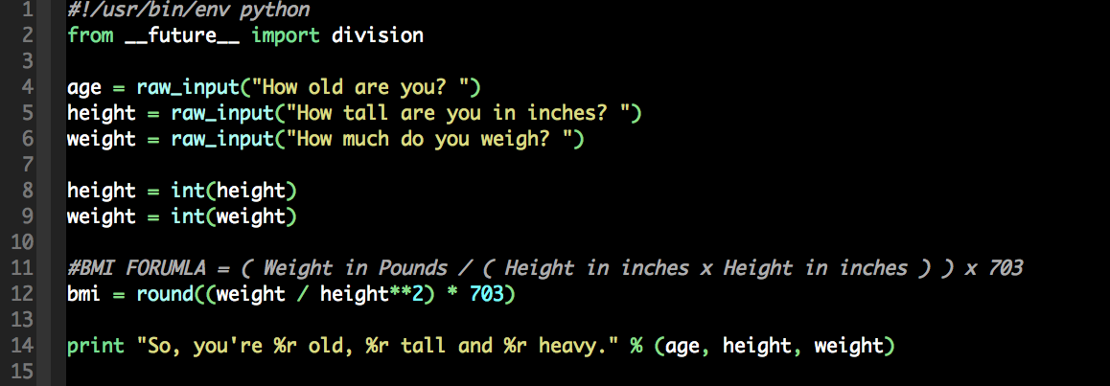
From the Future
Better way to divide.

Slide 6
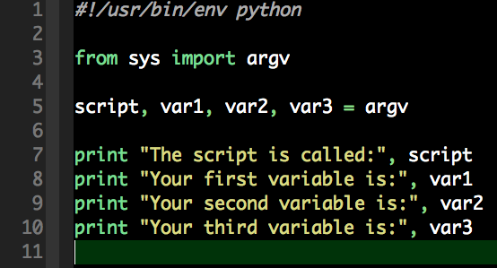
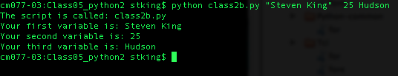
Parameters and Modules
Note: All parameters are strings

Slide 7
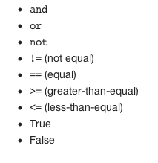
Learning Logic
Logical operators
http://learnpythonthehardway.org/book/ex27.html

Slide 8
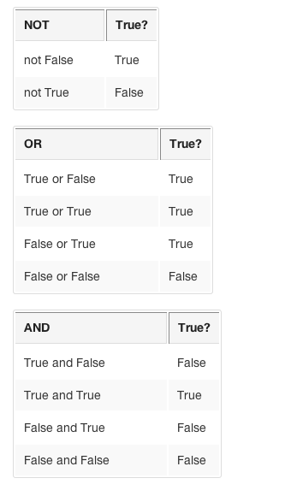
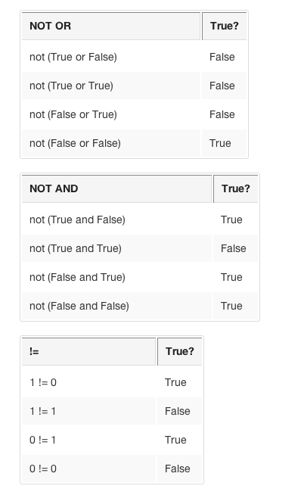
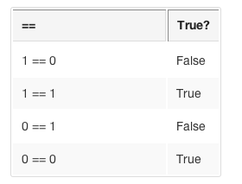
Truth Tables

Slide 9
If Statements
Basic Logic,
Test if something is true
If 5 <= 5:
Print “true”

Slide 10
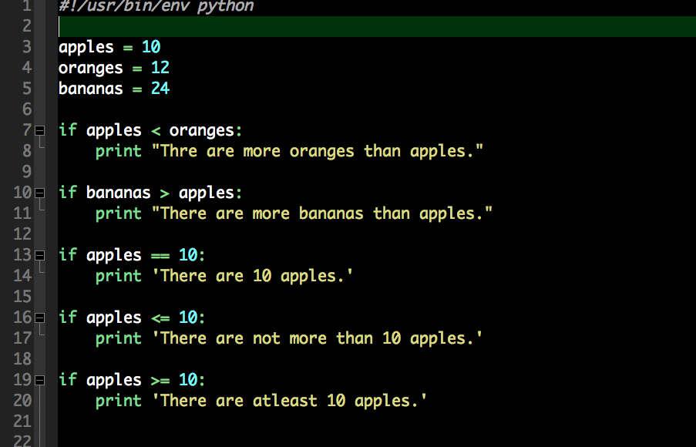

Slide 11
Populate your vars with Params
Use the parameters to populate your script.
Did it work?
Try these numbers:
5, 10 and 255

Slide 12
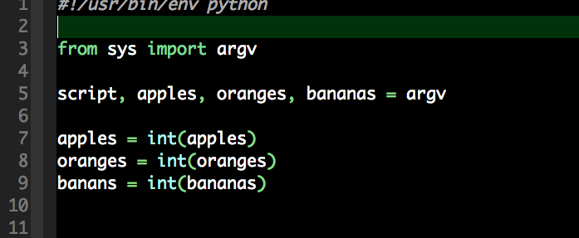
Populate your vars with Params
Use the parameters to populate your script.

Slide 13
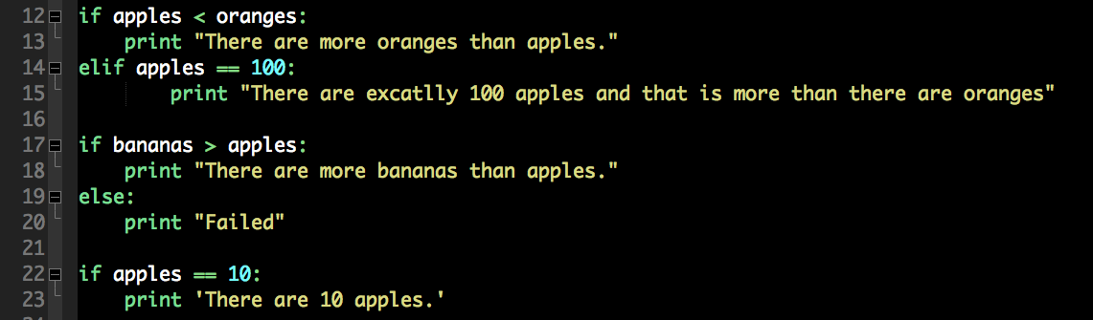
Else and Else if

Slide 14
Lists (Arrays)
In Python what you called an Array is a list.

Slide 15
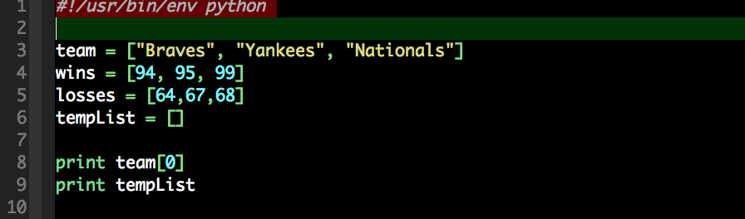
Lists

Slide 16
Loops and Lists
The best way to access lists are through loops
For loop is more complex than in JS.

Slide 17
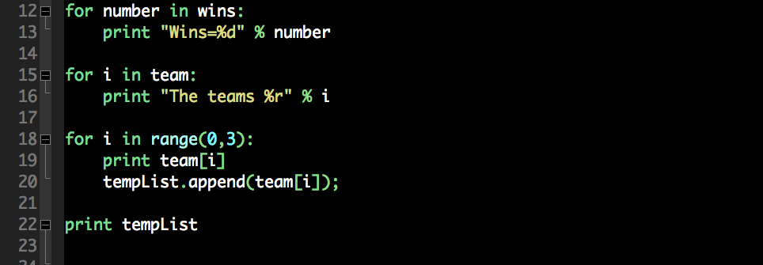
for Loop

Slide 18
Using Lists
.append()
.remove()
.pop() pop from the end
.pop(0) pop from the beginning
len(arrayName) for length

Slide 19
Assignment: Story Time
Write a Choose your own adventure story like the example.
Must have at least 2 decision points with at least two choices for each.
Provide human feedback along the way.

